Slide 1

Cache CoherencE Example
xxx
999

Slide 2
WHY does ıt occur?
In a shared memory multiprocessor with a separate cache memory for each processor, it is possible to have many copies of any one instruction operand: one copy in the main memory and one in each cache memory. When one copy of an operand is changed, the other copies of the operand must be changed also. If it is not changed cache coherence inconsistency occurs.

Slide 3
Levels of cache coherence
There are three distinct levels of cache coherence :
Every write operation appears to occur instantaneously.
All processors see the same sequence of changes of values for each separate operand.
Different processors may see an operation and assume different sequences of values; this is known as non-coherent behavior.

Slide 4
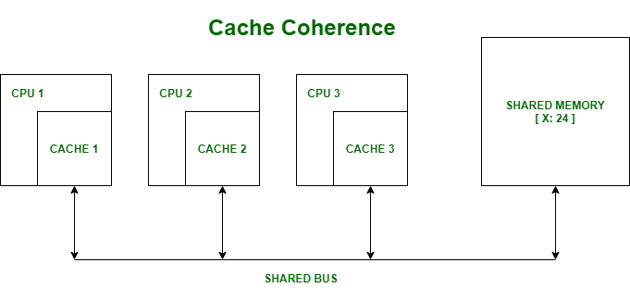
Cache coherence Example
Figure1-Cache Coherence[1]
Since there are multiple levels in a memory hierarchy, with some of these levels private to one or more processors(e.g cpu’s caches are private), some levels may contain copies of data objects that are inconsistent with others.

Slide 5
This problem is manifested most obviously when individual processors maintain cached copies of a unique shared-memory location, and then modify that copy. The inconsisten view of that object obtained from other processor’s caches.

Slide 6
Example 1
Let say in our shared memory, there is a variable named X and it is equal to 24.

Slide 7
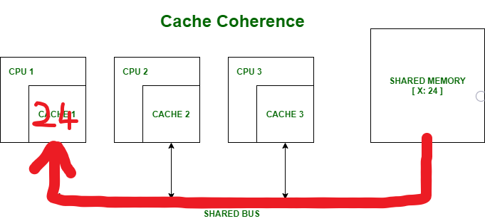
Processor 1 read X : obtains 24 from the memory and caches it.

Slide 8
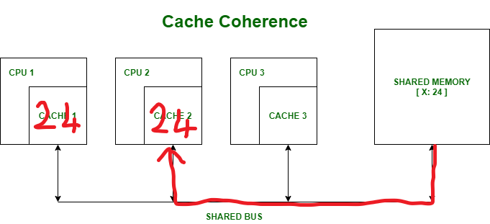
Processor 2 read X : obtains 24 from memory and caches it.

Slide 9
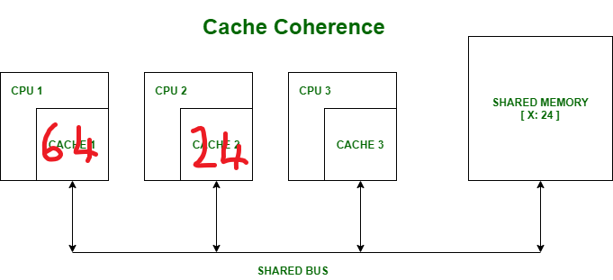
Processor 1 write X : 64 instead of 24. Its locally cached copy is updated.

Slide 10
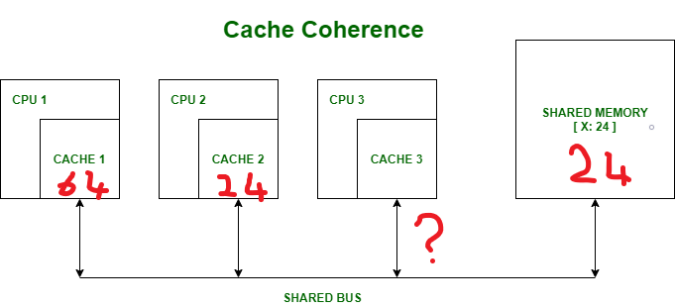
Processor 3 reads X. What value should it get?

Slide 11
Shared memory and processor 2 thinks it is 24 and processor 1 thinks it is 64. This is a data inconsistency and the cache coherence problem.

Slide 12
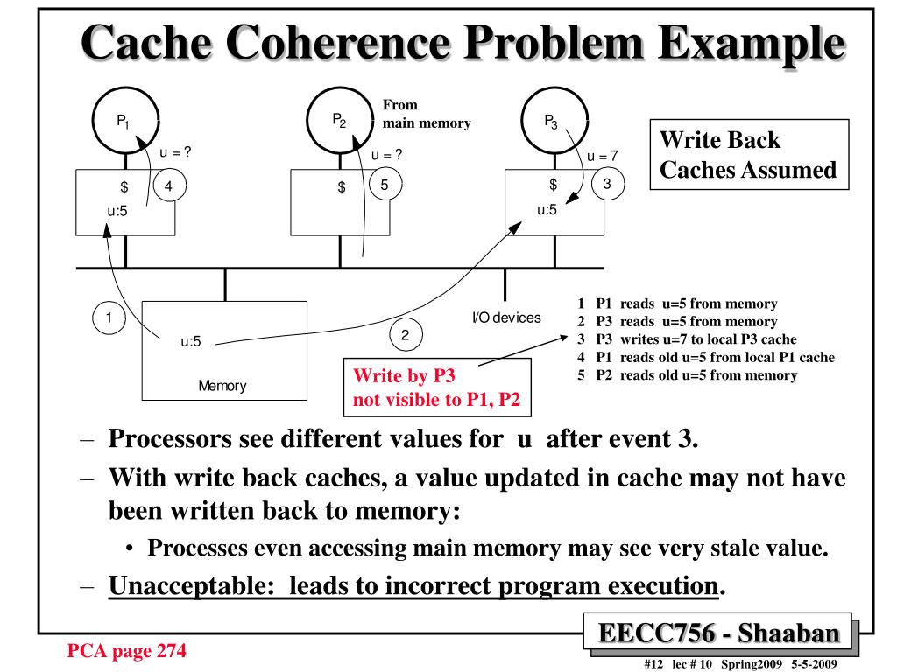
Cache coherence Example 2
Figure2-Cache Coherence Problem Example[3]

Slide 13
PreventIonS
There are software and hardware preventions of the cache coherence problem. As a software prevention, the system must implement a cache coherence protocol to regulate the actions of the cores.

Slide 14
Cache Coherence protocols
There are various Cache Coherence Protocols in multiprocessor system:
MSI protocol (Modified, Shared, Invalid)
MOSI protocol (Modified, Owned, Shared, Invalid)
MESI protocol (Modified, Exclusive, Shared, Invalid)
MOESI protocol (Modified, Owned, Exclusive, Shared, Invalid)

Slide 15
References
[1]cu16bsc3173(24-08-2020).Cache coherence:
https://www.geeksforgeeks.org/cache-coherence/
[2]Wood,Hill,Sorin.(2011).A primer on memory consistency and cache coherence:
https://course.ece.cmu.edu/~ece847c/S15/lib/exe/fetch.php?media=part2_2_sorin12.pdf
[3]Shaaban(spring 2009)EECC756:
https://image3.slideserve.com/6553848/cache-coherence-problem-example-l.jpg

