Slide 1
Random Access Protocols
Slotted Aloha
Pure(Unslotted) Aloha
Carrier Sense Multiple Access(CSMA)
CSMA with Collision Detection(CD)
Cahit Barkın Özer 2018556059

Slide 2
Random access protocols
when node has packet to send
transmit at full channel data rate R.
no a priori coordination among nodes
two or more transmitting nodes ➜ “collision”,
random access MAC protocol specifies:
how to detect collisions
how to recover from collisions (e.g., via delayed retransmissions)
examples of random access MAC protocols:
slotted ALOHA
ALOHA
CSMA, CSMA/CD, CSMA/CA

Slide 3
Slotted ALOHA
assumptions:
all frames same size
time divided into equal size slots (time to transmit 1 frame)
nodes start to transmit only slot beginning
nodes are synchronized
if 2 or more nodes transmit in slot, all nodes detect collision
operation:
when node obtains fresh frame, transmits in next slot
if no collision: node can send new frame in next slot
if collision: node retransmits frame in each subsequent slot with prob. p until success

Slide 4
Slotted ALOHA
node 1
1
1
1
1
C=collision slot
E=empty slot
S=successful slot
node 2
2
2
2
node 3
3
3
3
C
E
C
S
E
C
E
S
S
Pros:
single active node can continuously transmit at full rate of channel
highly decentralized: only slots in nodes need to be in sync
simple
Cons:
collisions, wasting slots
idle slots
nodes may be able to detect collision in less than time to transmit packet
clock synchronization

Slide 5
Slotted ALOHA: efficiency
efficiency: long-run fraction of successful slots (many nodes, all with many frames to send)
max efficiency: find p* that maximizes Np(1-p)^{N-1}
for many nodes, take limit of Np*(1-p*)^{N-1} as N goes to infinity, gives:
max efficiency = 1/e = 0.37
suppose: N nodes with many frames to send, each transmits in slot with probability p
probability that given node has success in a slot = p(1-p)^{N-1}
probability that any node has a success = Np(1-p)^{N-1}
at best: channel
used for useful
transmissions 37%
of time!
!

Slide 6
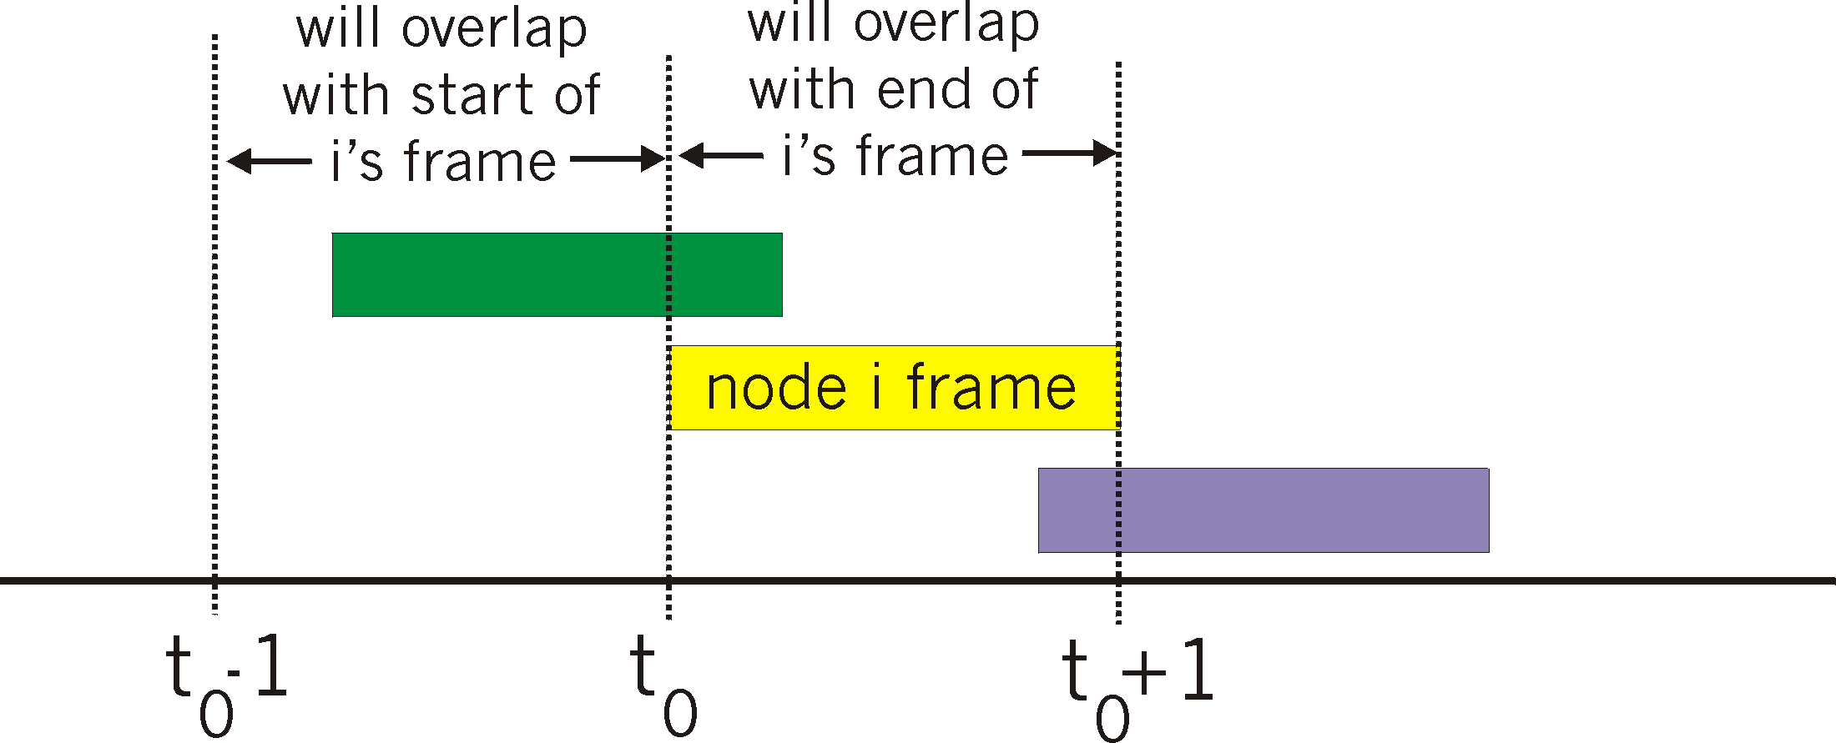
Pure (unslotted) ALOHA
unslotted Aloha: simpler, no synchronization
when frame first arrives
transmit immediately
collision probability increases:
frame sent at t₀ collides with other frames sent in [t₀-1,t₀+1]

Slide 7
Pure ALOHA efficiency
P(success by given node) = P(node transmits) .
P(no other node transmits in [t₀-1,t₀] .
P(no other node transmits in [t₀-1,t₀]
= p . (1-p)^{N-1 .} (1-p)^{N-1}
= p . (1-p)^{2(N-1)}
… choosing optimum p and then letting n
= 1/(2e) = .18
even worse than slotted Aloha!

Slide 8
CSMA (carrier sense multiple access)
CSMA: listen before transmit:
if channel sensed idle: transmit entire frame
if channel sensed busy, defer transmission
human analogy: don’t interrupt others!

Slide 9

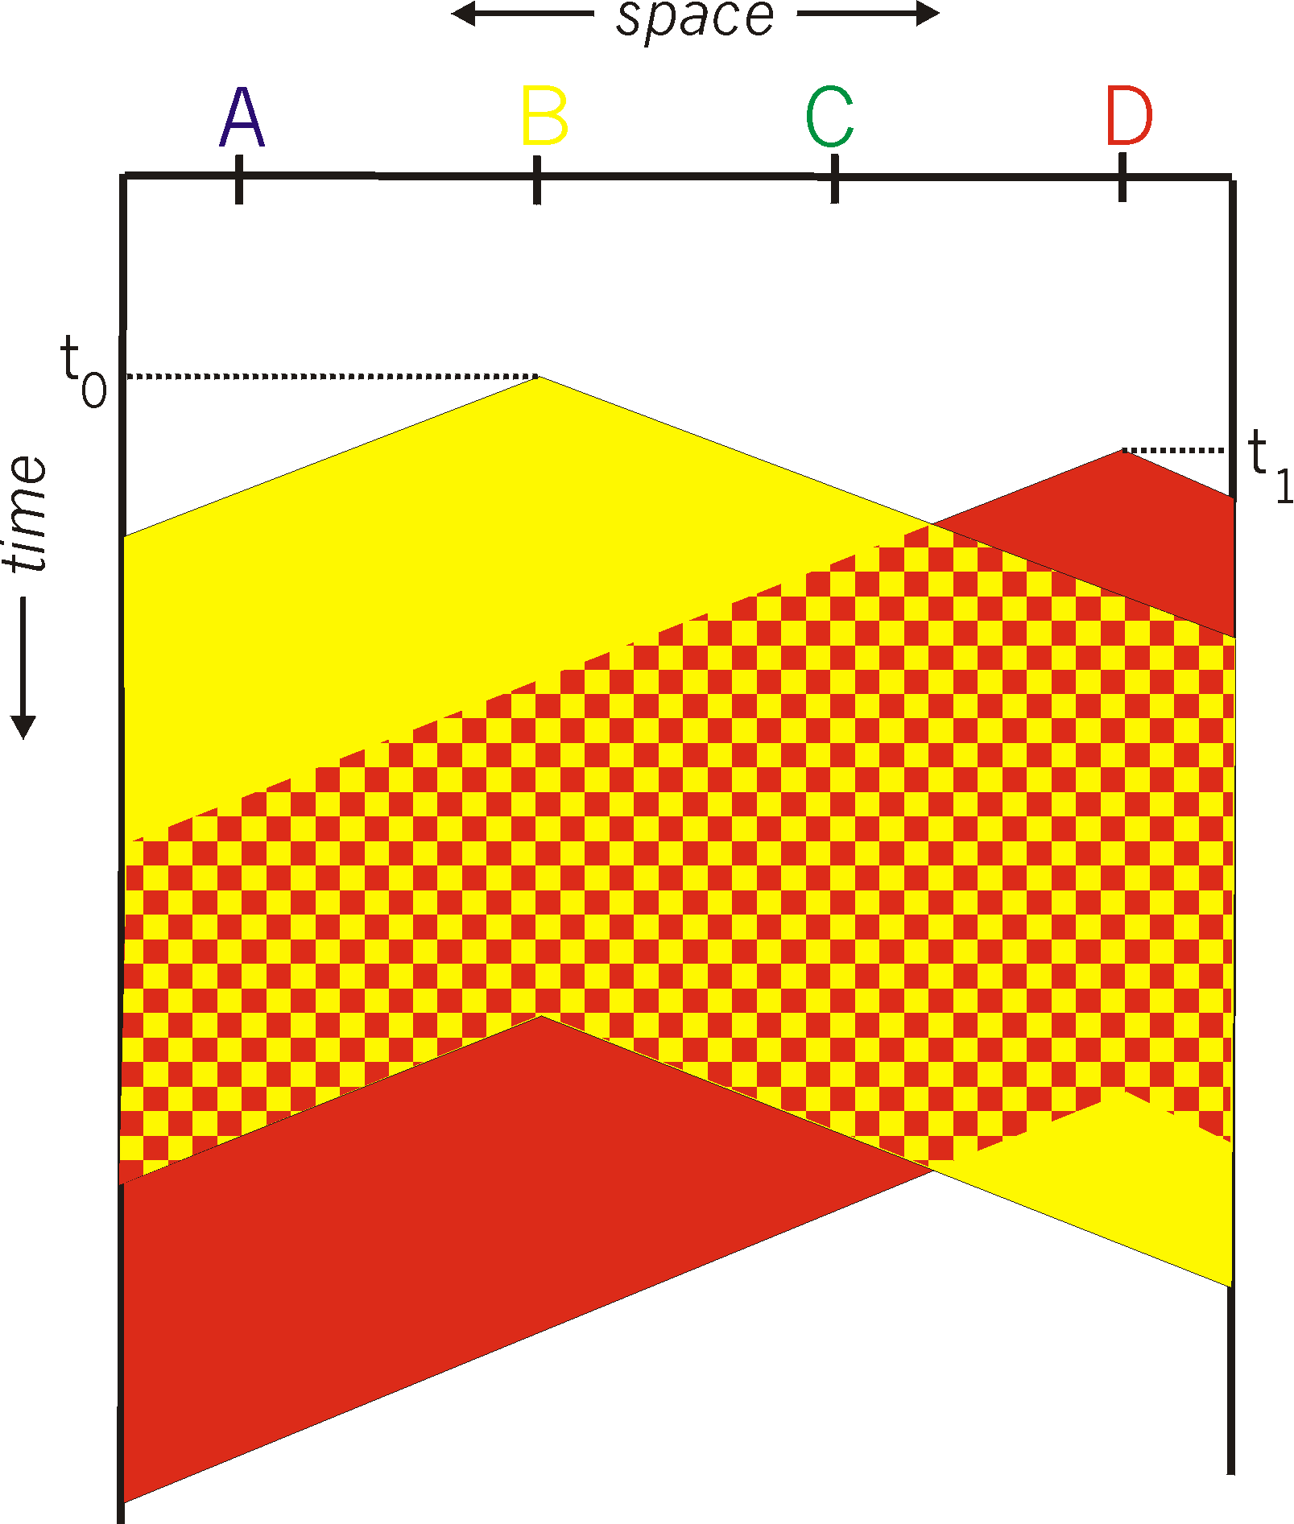
CSMA collisions
spatial layout of nodes
collisions can still occur: propagation delay means two nodes may not hear each other’s transmission
collision: entire packet transmission time wasted
distance & propagation delay play role in in determining collision probability

Slide 10
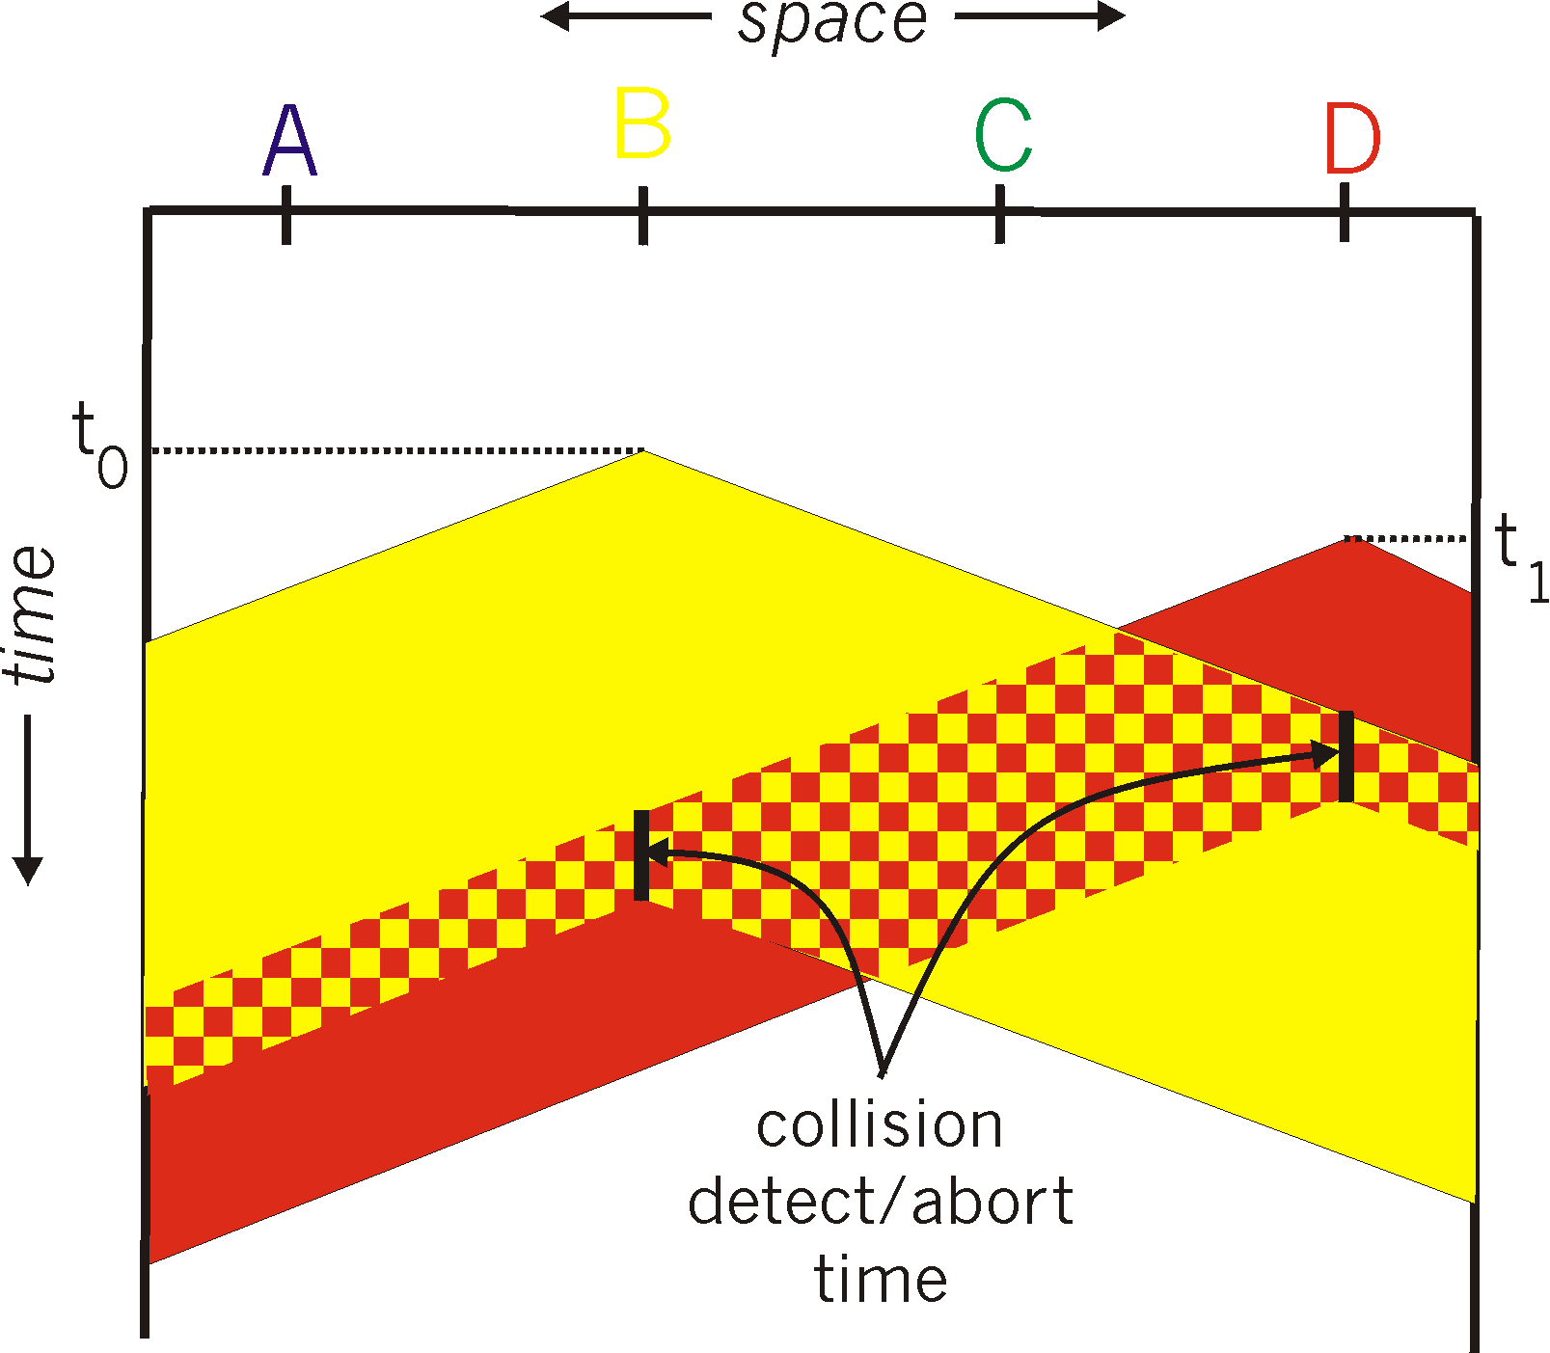
CSMA/CD (collision detection)
CSMA/CD: carrier sensing, deferral as in CSMA
collisions detected within short time
colliding transmissions aborted, reducing channel wastage
collision detection:
easy in wired LANs: measure signal strengths, compare transmitted, received signals
difficult in wireless LANs: received signal strength overwhelmed by local transmission strength
spatial layout of nodes

Slide 11
Ethernet CSMA/CD algorithm
1. NIC receives datagram from network layer, creates frame
2. If NIC senses channel idle, starts frame transmission. If NIC senses channel busy, waits until channel idle, then transmits.
3. If NIC transmits entire frame without detecting another transmission, NIC is done with frame !
4. If NIC detects another transmission while transmitting, aborts and sends jam signal
5. After aborting, NIC enters binary (exponential) backoff:
after mth collision, NIC chooses K at random from {0,1,2, …, 2^{m}-1}. NIC waits K·512 bit times, returns to Step 2
longer backoff interval with more collisions

Slide 12
CSMA/CD efficiency
T_{prop} = max prop delay between 2 nodes in LAN
t_{trans} = time to transmit max-size frame
efficiency goes to 1
as t_{prop} goes to 0
as t_{trans} goes to infinity
better performance than ALOHA: and simple, cheap, decentralized!

Slide 13
Thank you for listening
References:
Computer Networking: A Top Down Approach 6th edition book

