Slide 1
CEN 427 Python Programming
Serkan KARTAL
Department of Computer Engineering
Cukurova University

Slide 2
CEN 427- Python Fundamentals
What is Python?
An interpreted high-level programming language.
"scripting language"
Created by Guido van Rossum around 1990.
Named in honor of Monty Python

Slide 3
Where to Get Python?
http://www.python.org
Downloads
Documentation and tutorial
Community Links
Third party packages
Python Versions
Most users use "CPython"
• Version 2.X (most common)
• Version 3.X (bleeding edge, the future)

Slide 4
Running Python
Python programs run inside an interpreter
The interpreter is a simple "console-based« application that normally starts from a command shell (e.g., the Unix shell)
bash % python
Python 2.7.3 (r271:86832, Feb 27 2011, 11:47:28)
GCC 4.2.1 (Apple Inc. build 5664)] on darwin
Type "help", "copyright", "credits" or "license"
>>>
Expert programmers usually have no problem using the interpreter in this way, but it's not so user-friendly for beginners

Slide 5
Course Setup
You need nothing more than a basic Python 3.6 installation or newer.
Where to get Python (if not installed)
http://www.python.org
There is no dependency on any particular operating system, editor, IDE, or extra Python-related tooling.
Alternate Tools
PyCharm
Spyder
…..

Slide 6
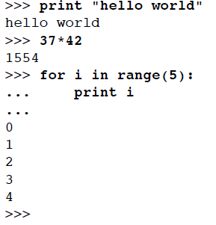
The Python Interpreter / Interactive Mode
When you start Python, you get an "interactive" mode where you can experiment
If you start typing statements, they will run immediately
No edit/compile/run/debug cycle
>>> is the interpreter prompt for starting a new statement
... is the interpreter prompt for continuing a statement (it may be blank in some tools)
Enter a blank line to finish typing and to run 12

Slide 7
Interactive Mode
Use underscore (_) for the last result
>>> 37*42
1554
>>>_*2
3108
Note: This only works in interactive mode (you never use _ in a program)
Getting Help
>>> help(range)
Help on built-in function range in module __builtin__:
range(...)
range([start,] stop[, step]) -> list of integers
Return a list containing an arithmetic progression of integers.
range(i, j) returns [i, i+1, i+2, ..., j-1]; start (!) defaults to 0.
...
>>>
Documentation at http://docs.python.org

Slide 8
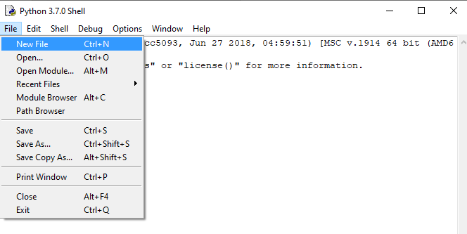
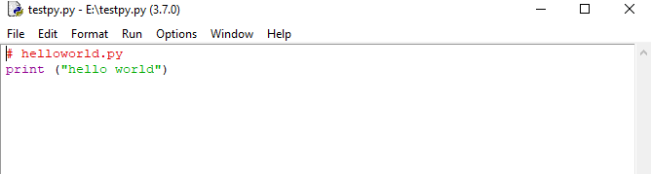
Creating Programs
Programs are put in .py files
# helloworld.py
print ("hello world")
Source files are simple text files
Saving a new Program in IDLE

Slide 9
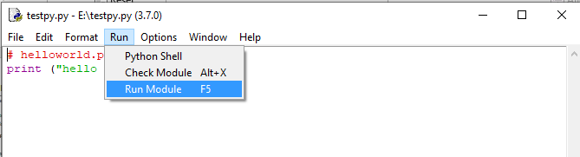

Running Programs (IDLE)
Select "Run Module" (F5)
Will see output in IDLE shell window
In production environments, Python may be run from command line or a script

Slide 10
Statements
A Python program is a sequence of statements
Each statement is terminated by a newline
Statements are executed one after the other until you reach the end of the file.
When there are no more statements, the program stops
Comments
Comments are denoted by #
# This is a comment
height = 442 # Meters
There are no block comments in Python
(e.g., /* ... */).

Slide 11
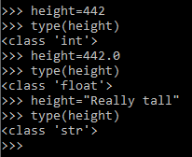
Variables
A variable is just a name for some value
Variable names follow same rules as C [A-Za-z_][A-Za-z0-9_]*
You do not declare types (int, float, etc.)
height = 442 # An integer
height = 442.0 # Floating point
height = "Really tall" # A string
Python is case sensitive
These are all different variables:
name = "Jake"
Name = "Elwood"
NAME = "Guido«
Language statements are always lower-case
print ("Hello World") # OK
PRINT ("Hello World") # ERROR
while x < 0: # OK
WHILE x < 0: # ERROR

Slide 12
Looping
The while statement executes a loop
while num_bills * bill_thickness < sears_height:
print (day, num_bills, num_bills * bill_thickness)
day = days + 1
num_bills = num_bills * 2
print('Number of days', day)
Executes the indented statements underneath while the condition is true
Indentation:
There is a preferred indentation style
Always use spaces
Use 4 spaces per level
Avoid tabs (convert to spaces)
Always use a Python-aware editor

Slide 13
Conditionals
Relations
If-else
if a < b:
print ("Computer says no")
else:
print ("Computer says yes")
If-elif-else
if a == '+’:
op = PLUS
elif a == '-’:
op = MINUS
elif a == '*’:
op = TIMES
else:
op = UNKNOWN
Relational operators
< > <= >= == !=
Boolean expressions (and, or, not)
if b >= a and b <= c:
print ("b is between a and c")
if not (b < a or b > c):
print ("b is still between a and c")

Slide 14

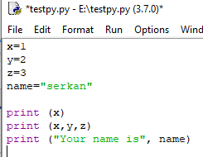
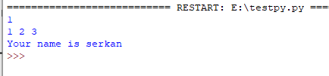
Truth Values
Printing
Evaluates as "True"
Non-zero numbers
Non-empty strings
Non-empty containers (lists, etc.)
Evaluates as "False"
0 (Zero)
Empty strings or containers
The print statement
print (x)
print (x,y,z)
print ("Your name is", name)
Produces a single line of text
Items are separated by spaces
Always prints a newline unless a trailing comma is added after last item

Slide 15
User input
To read a line of typed user-input
name = input('Enter your name:')
print('Your name is', name)
This is useful for small programs, learning exercises or simple debugging. It is not widely used for real programs.
pass statement
Sometimes you need to specify an empty code block. The keyword pass is used for it.
if a > b:
pass
else:
print('Computer says false’)
This is also called a "no-op" statement. It does nothing. It serves as a placeholder for statements, possibly to be added later

Slide 16
Long Lines
Sometimes you get long statements that you want to break across multiple lines
Use the line continuation character (\)
if product=="game" and type=="pirate memory" \
and age >= 4 and age <= 8:
print ("I'll take it!")

Slide 17
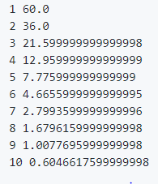
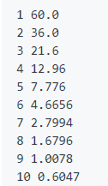
Exercise : The Bouncing Ball
A rubber ball is dropped from a height of 100 meters and each time it hits the ground, it bounces back up to 3/5 the height it fell. Write a program bounce.py that prints a table showing the height of the first 10 bounces.
Your program should make a table that looks something like this:
Note: You can clean up the output a bit if you use the round() function. Try using it to round the output to 4 digits

Slide 18
Basic Datatypes
Python only has a few primitive types of data
Numbers
Strings (character text)
Numbers:
Python has 4 types of numbers
• Booleans
• Integers
• Floating point
• Complex (imaginary numbers)

Slide 19
Booleans
Integers
Two values: True, False
a = True
b = False
Evaluated as integers with value 1,0
c = 4 + True # c = 5
d = False
if d == 0:
print ("d is False")
Signed values of arbitrary size
a = 37
b = -2993929937277166273771284818122412
Integer Division
Classic division (/) - truncates
>>> 5/4
1.25
Floor division (//) - truncates (same)
>>> 5//4
1

Slide 20
Floating point (float)
Use a decimal or exponential notation
a = 37.45
b = 4e5 # 4 x 10**5 or 400,000
c = -1.345e-10
Represented as double precision using the native CPU representation (IEEE 754)
17 digits of precision
Exponent from -308 to 308
Same as the C double type
Be aware that floating point numbers are inexact when representing decimal values.
>>> a = 2.1 + 4.2
>>> a == 6.3
????
>>> a
???
The result of a calculation may not be quite what you expect (emphasis, not a Python bug)

Slide 21
Floating Point Operators
+ Add
- Subtract
* Multiply
/ Divide
% Modulo (remainder)
** Power
pow(x,y [,z]) Power modulo (x**y)%z
abs(x) Absolute value
divmod(x,y) Division with remainder
Additional functions are in the math module
import math
a = math.sqrt(x)
b = math.sin(x)
c = math.cos(x)
d = math.tan(x)
e = math.log(x)

Slide 22
Converting Numbers
Type name can be used to convert
a = int(x) # Convert x to integer
b = float(x) # Convert x to float
Example:
>>> a = 3.14159
>>> int(a)
3
Also work with strings containing numbers
>>> a = "3.14159"
>>> float(a)
3.14159

Slide 23
Strings
Written in programs with quotes
a = "Yeah but no but yeah but..."
b = 'computer says no’
Standard escape characters work (e.g., '\n’)
An ordered sequence of bytes (characters)
Stores 8-bit data (ASCII)

Slide 24
String Representation
Strings work like an array : s[n]
a = "Hello world"
b = a[0] # b = 'H'
c = a[4] # c = 'o'
d = a[-1] # d = 'd' (Taken from end of string)
Slicing/substrings : s[start:end]
d = a[:5] # d = "Hello"
e = a[6:] # e = "world"
f = a[3:8] # f = "lo wo"
g = a[-5:] # g = "world«
Concatenation (+)
a = "Hello" + "World"
b = "Say " + a

Slide 25
String Methods
Length (len)
>>> s = "Hello"
>>> len(s)
5
Membership test (in, not in)
>>> 'e' in s
True
>>> 'x' in s
False
>>> "hi" not in s
True
Replication (s*n)
>>> s = "Hello"
>>> s*5
'HelloHelloHelloHelloHello'

Slide 26
String Mutability
Strings are "immutable" (read only). Once created, the value can't be changed
>>> s = "Hello World"
>>> s[1] = 'a'
Traceback (most recent call last):
File "<stdin>", line 1, in <module>
TypeError: 'str' object does not support item assignment
>>>
All operations and methods that manipulate string data always create new strings
String Conversions:
Use str() to convert a value to a string
>>> x = 42
>>> str(x)
'42'

Slide 27
Lists
A array of arbitrary values
names = [ 'Elwood', 'Jake', 'Curtis' ]
nums = [ 39, 38, 42, 65, 111]
Adding new items (append, insert)
names.append('Murphy’) # Adds at end
names.insert(2,'Aretha’) # Inserts in middle
Concatenation : s + t
s = [1, 2, 3]
t = ['a', 'b']
s + t #[1, 2, 3, 'a', 'b']

Slide 28
Lists (cont)
Lists are indexed by integers (starting at 0)
names = [ 'Elwood', 'Jake', 'Curtis' ]
names[0] #'Elwood'
names[1] #'Jake'
names[2] #'Curtis’
Changing one of the items
names[1] = 'Joliet Jake’
Length (len)
>>> names = ['Elwood','Jake','Curtis']
>>> len(names)
3
Membership test (in, not in)
>>> 'Elwood' in names
True
>>> 'Britney' not in names
True
Replication (s * n)
>>> s = [1, 2, 3]
>>> s * 3
[1, 2, 3, 1, 2, 3, 1, 2, 3]
>>>

Slide 29
List Searching
Finding the first position of an item
>>> names = ['Elwood','Jake','Curtis']
>>> names.index('Curtis')
2
>>> names[2]
'Curtis’
List Removal:
Removing an item
names.remove('Curtis')
Deleting an item by index
del names[2]
Removing an item does not create a hole. Other items will move down to fill the space vacated. If there are more than one occurrence of the element, remove() will remove only the first occurrence.

Slide 30
List Iteration / List Sorting
Iterating over the list contents
for name in names:
# use name
# e.g. print(name)
...
Similar to a 'foreach' statement from other programming languages
List Sorting
s = [10, 1, 7, 3]
s.sort() # s = [1, 3, 7, 10]
Sorting in reverse order
s = [10, 1, 7, 3]
s.sort(reverse=True) # s = [10, 7, 3, 1]

Slide 31
Lists and Math
Caution : Lists weren't designed for "math"
>>> nums = [1, 2, 3, 4, 5]
>>> nums * 2
[1, 2, 3, 4, 5, 1, 2, 3, 4, 5]
>>> nums + [10, 11, 12, 13, 14]
[1, 2, 3, 4, 5, 10, 11, 12, 13, 14]
>>>
They don't represent vectors/matrices
There are some add-ons for this (e.g., numpy)

Slide 32
File Input and Output
Opening a file
f = open('foo.txt','r') # Open for reading
g = open('bar.txt','w') # Open for writing
To read data
data = f.read([maxbytes]) # Read up to maxbytes bytes
To write text to a file
g.write('some text’)
To close when you're done
f.close()

Slide 33
Reading File Data
End-of-file indicated by an empty string
data = f.read(nbytes)
if data == '':
# No data read. EOF
...
Example: Reading a file in fixed-size chunks
f = open(filename,'r')
while True:
chunk = f.read(chunksize)
if chunk == '':
break
# Process the chunk
...
f.close()
Writing string data
f = open('outfile', 'w')
f.write('Hello World\n')
...
f.close()

Slide 34
File Management
Files should be properly closed when done
f = open(filename, 'r')
# Use the file f
...
f.close()
In modern Python (2.6 or newer), use "with"
with open(filename, 'r') as f:
# Use the file f
...
Statements
This automatically closes the file when control leaves the indented code block

Slide 35
Reading File Data
Read an entire file all at once as a string.
with open('foo.txt', 'rt') as file:
data = file.read()
# `data` is a string with all the text in `foo.txt`
Read a file line-by-line by iterating.
with open(filename, 'rt') as file:
for line in file:
# Process the line
Write string data.
with open('outfile', 'wt') as out:
out.write('Hello World\n')
...

Slide 36
Type Conversion
In Python, you must be careful about converting data to an appropriate type
x = '37' # Strings
y = '42'
z = x + y # z = '3742' (concatenation)
x = 37
y = 42
z = x + y # z = 79 (integer +)

Slide 37
Simple Functions
Use functions for code you want to reuse
def sumcount(n):
'''Returns the sum of the first n integers'''
total = 0
while n > 0:
total += n
n -= 1
return total
Calling a function
a = sumcount(100)
A function is just a series of statements that perform some task and return a result

Slide 38
Library Functions
Python comes with a large standard library
Library modules accessed using import
import math
x = math.sqrt(10)
import urllib
u = urllib.urlopen('http://www.python.org/index.html')
data = u.read()
Will cover in more detail later

Slide 39
Exception Handling
Errors are reported as exceptions
An exception causes the program to stop
>>> int('N/A')
Traceback (most recent call last):
File "<stdin>", line 1, in <module>
ValueError: invalid literal for int() with base 10: 'N/A'
For debugging, message describes what happened, where the error occurred, along with a traceback.

Slide 40
Exceptions
Exceptions can be caught and handled
To catch, use try-except statement
for line in f:
fields = line.split()
try:
shares = int(fields[1])
except ValueError:
print ("Couldn't parse", line)
...
Name must match the kind of error you're trying to catch
>>> int('N/A')
Traceback (most recent call last):
File "<stdin>", line 1, in <module>
ValueError:invalid literal for int() with base 10: 'N/A'

