Slide 1
CEN 427 Python Programming
Serkan KARTAL
Department of Computer Engineering
Cukurova University

Slide 2
Section 2-Working with Data
Overview
Most programs work with data
In this section, we look at how Python programmers represent and work with data
Common programming idioms

Slide 3
Primitive Datatypes
Python has a few primitive types of data
Integers
Floating point numbers
Strings (text)
Obviously, all programs use these
None type
Nothing, nil, null, nada
logfile = None
This is often used as a placeholder for optional or missing value
if logfile:
logfile.write('Some message’)
If you don't assign logfile to something, the above code would crash (undefined variable)

Slide 4
Data Structures
Real programs have more complex data
Example: information about a stock holding:
100 shares of GOOG at $490.10
This is an "object" with three parts
Name ("GOOG", a string)
Number of shares (100, an integer)
Price (490.10, a float)

Slide 5
Tuples
A collection of values grouped together
Example:
s = ('GOOG', 100, 490.1)
Sometimes the () are omitted in syntax
s = 'GOOG', 100, 490.1
Special cases (0-tuple, 1-tuple)
t = () # An empty tuple
w = ('GOOG’,) # A 1-item tuple

Slide 6
Tuple Use
Tuples are usually used to represent simple records and data structures
contact = ('David Beazley', 'dave@dabeaz.com')
stock = ('GOOG', 100, 490.1)
host = ('www.python.org', 80)
Basically, a single "object" of multiple parts. Analogy: A single row in a database table
Tuple contents are ordered (like an array).
s = ('GOOG', 100, 490.1)
name = s[0] # 'GOOG'
shares = s[1] # 100
price = s[2] # 490.1
However, the contents can't be modified.
>>> s[1] = 75
TypeError: object does not support item assignment
You can, however, make a new tuple based on a current tuple.
s = (s[0], 75, s[2])

Slide 7
Tuple Packing
Tuples are more about packing related items together into a single entity.
s = ('GOOG', 100, 490.1)
The tuple is then easy to pass around to other parts of a program as a single object.
Tuple Unpacking:
To use the tuple elsewhere, you can unpack its parts into variables.
name, shares, price = s
print('Cost', shares * price)
The number of variables on the left must match the tuple structure.
name, shares = s # ERROR
Traceback (most recent call last):
...
ValueError: too many values to unpack

Slide 8
Tuples vs. Lists
Are tuples just a read-only list? No.
Tuples are most often used for a single record consisting of multiple parts
record = ('GOOG', 100, 490.1)
Lists are usually a collection of distinct items (typically all of the same type)
names = ['Elwood', 'Jake', 'Curtis']

Slide 9
Dictionaries
A dictionary is mapping of keys to values.
A hash table or associative array.
The keys serve as indices for accessing values.
Example:
s = {
'name': 'GOOG',
'shares': 100,
'price': 490.1
}

Slide 10
Dictionaries
Getting values: Just use the key names
>>> print(s['name'], s['shares'])
GOOG 100
>>> s['price']
490.10
Adding/modifying values : Assign to key names
>>> s['shares'] = 75
>>> s['date'] = '6/6/2007'
Deleting a value
>>> del s['date']

Slide 11
dictionary operations
>>> for k in s:
print(k, '=‘, s[k])
…
name = GOOG
shares = 100
price = 490.1
>>> keys = s.keys()
>>> keys
dict_keys(['name', 'shares', 'price’])
>>>items = s.items()
>>>items
dict_items([('name', 'GOOG'), ('shares', 100), ('price', 490.1)])

Slide 12
Why dictionaries?
Dictionaries are useful when
there are many different values
those values might be modified or manipulated.
Dictionaries make your code more readable.
s['price']
# vs
s[2]

Slide 13
Containers
Programs often have to work with many objects.
A portfolio of stocks
A table of stock prices
There are three main choices to use.
Lists (Ordered data.)
Dictionaries ( Unordered data)
Sets ( Unordered collection of unique items)

Slide 14
Lists as a Container
Use a list when the order of the data matters
Lists can hold any kind of object
Example: A list of tuples
portfolio = [
('GOOG', 100, 490.1),
('IBM', 50, 91.3),
('CAT', 150, 83.44)
]
portfolio[0] # ('GOOG', 100, 490.1)
portfolio[2] # ('CAT', 150, 83.44)

Slide 15
List construction
Example of building a list from scratch
records = [] # Initial empty list
# Use .append() to add more items
records.append(('GOOG', 100, 490.10))
records.append(('IBM', 50, 91.3))
...
Example: Reading records from a file
records = [] # Initial empty list
with open('Data/portfolio.csv', 'rt') as f:
next(f) # Skip header
for line in f:
row = line.split(',')
records.append((row[0], int(row[1]), float(row[2])))

Slide 16
Dicts as a Container
Dictionaries are useful if you want fast random lookups (by key name)
Example: A dictionary of stock prices
prices = {
'GOOG': 513.25,
'CAT': 87.22,
'IBM': 93.37,
'MSFT': 44.12
}
>>> prices['IBM']
93.37
>>> prices['GOOG']
513.25
>>>

Slide 17
Dict Construction
Example of building a dict from scratch.
prices = {} # Initial empty dict
# Insert new items
prices['GOOG'] = 513.25
prices['CAT'] = 87.22
prices['IBM'] = 93.37
Example: Populating from a file
prices = {} # Initial empty dict
with open('Data/prices.csv', 'rt') as f:
for line in f:
row = line.split(',')
prices[row[0]] = float(row[1])

Slide 18
Dictionary Lookups
Test the existence of a key
if key in d:
# YES
else:
# NO
Looking up a value that might not exist
name = d.get(key, default)
Example:
>>> prices.get('IBM', 0.0)
93.37
>>> prices.get('SCOX', 0.0)
0.0

Slide 19
Sets
Sets are collection of unordered unique items.
tech_stocks = { 'IBM','AAPL','MSFT' }
# Alternative syntax
tech_stocks = set(['IBM', 'AAPL', 'MSFT’])
useful for duplicate elimination.
names = ['IBM', 'AAPL', 'GOOG', 'IBM', 'GOOG', 'YHOO']
unique = set(names)
# unique = set(['IBM', 'AAPL','GOOG','YHOO’])
Additional set operations:
unique.add('CAT') # Add an item
unique.remove('YHOO') # Remove an item
s1 = { 'a', 'b', 'c'}
s2 = { 'c', 'd' }
s1 | s2 # Set union { 'a', 'b', 'c', 'd' }
s1 & s2 # Set intersection { 'c' }
s1 - s2 # Set difference { 'a', 'b'

Slide 20
Formatted Output
When working with data, you often want to produce structured output (tables, etc.).
Name Shares Price
---------- ---------- -----------
AA 100 32.20
IBM 50 91.10
CAT 150 83.44
MSFT 200 51.23
GE 95 40.37
MSFT 50 65.10
IBM 100 70.44

Slide 21
Exercise
The file portfolio.csv contains a list of stocks in a portfolio. In Exercise:
Read a stock portfolio file into a list of dictionaries with keys name, shares, and price.
Read a stock portfolio file into a list of tuples with name, shares, and price.

Slide 22
String Formatting
One way to format string in Python 3.6+ is with f-strings.
>>> name = 'IBM'
>>> shares = 100
>>> price = 91.1
>>> f'{name:>10s} {shares:>10d} {price:>10.2f}'
' IBM 100 91.10'
Format codes
d Decimal integer
b Binary integer
x Hexadecimal integer
f Float as [-]m.dddddd
e Float as [-]m.dddddde+-xx
g Float, but selective use of E notation
s String
c Character (from integer
:>10d Int. right aligned in 10-character field
:<10d Int. left aligned in 10-character field
:^10d Int. centered in 10-character field
:0.2f Float with 2 digit precision

Slide 23
format() Function
format() that can apply formatting to arguments or keyword arguments.
>>> '{name:>10s} {shares:10d} {price:10.2f}'.format(name='IBM', shares=100, price=91.1)
' IBM 100 91.10'
>>> '{:10s} {:10d} {:10.2f}'.format('IBM', 100, 91.1)
' IBM 100 91.10’
C-Style Formatting
Formatting operator (%)
>>> 'The value is %d' % 3
'The value is 3'
>>> '%5d %-5d %10d' % (3,4,5)
' 3 4 5'
>>> '%0.2f' % (3.1415926,)
'3.14'

Slide 24
Working with Sequences
Python has three «sequence» datatypes.
a = 'Hello’ # String
b = [1, 4, 5] # List
c = ('GOOG', 100, 490.1) # Tuple
Sequences are ordered : s[n]
a[0] # 'H'
b[-1] # 5
c[1] # 100
Sequences have a length : len(s)
len(a) # 5
len(b) # 3
len(c) # 3

Slide 25
Working with Sequences
Sequences can be replicated: s * n.
>>> a = 'Hello'
>>> a * 3
'HelloHelloHello'
>>> b = [1, 2, 3]
>>> b * 2
[1, 2, 3, 1, 2, 3]
Sequences of the same type can be concatenated: s + t.
>>> a = (1, 2, 3)
>>> b = (4, 5)
>>> a + b
(1, 2, 3, 4, 5)
>>>
>>> c = [1, 5]
>>> a + c
Traceback (most recent call last):
File "<stdin>", line 1, in <module>
TypeError: can only concatenate tuple (not "list") to tuple

Slide 26
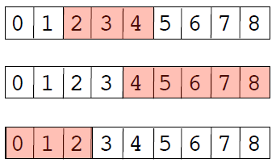
Sequence Slicing
Slicing operator : s[start:end]
a = [0,1,2,3,4,5,6,7,8]
a[2:5] # [2,3,4]
a[-5:] # [4,5,6,7,8]
a[:3] # [0,1,2]
Indices must be integers.
Slices do not include the end value
If indices are omitted, they default to the beginning or end of the list.
# Reassignment
a = [0,1,2,3,4,5,6,7,8]
a[2:4] = [10,11,12] # [0,1,10,11,12,4,5,6,7,8]
# Deletion
a = [0,1,2,3,4,5,6,7,8]
del a[2:4] # [0,1,4,5,6,7,8]

Slide 27
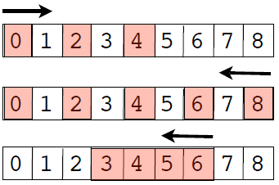
Extended Slices
Extended slicing: s[start:end:step]
a = [0,1,2,3,4,5,6,7,8]
a[0:5:2] # [0,2,4]
a[::-2] # [8,6,4,2,0]
a[6:2:-1] # [6,5,4,3]
step indicates stride and direction
end index is not included in result
Go easy on it for code clarity

Slide 28
Sequence Reductions
sum(s)
>>> s = [1, 2, 3, 4]
>>> sum(s)
10
>>>
min(s), max(s)
>>> min(s)
1
>>> max(s)
4
>>> max(t)
'World'
>>>

Slide 29
Iteration over a sequence
The for-loop iterates over sequence data.
>>> s = [1, 4, 9, 16]
>>> for i in s:
... print(i)
...
1
4
9
16
>>>
On each iteration of the loop, you get new item of data to work with.

Slide 30
break
continue
Breaking out of a loop (exiting)
for name in namelist:
if name == 'Jake':
break
...
...
Statements
Only applies to the inner-most loop
Skipping to the next iteration
for line in lines:
if line == '\n': # Skip blank lines
continue
# More statements
...
Useful if the current item isn't of interest or needs to be ignored in processing

Slide 31
Looping over integers
range() creates a list of integers
for i in range(100):
# i = 0,1,...,99
range([start,] end [,step])
x = range(100) # x = [0, 1,..., 99]
y = range(10, 20) # y = [10, 11,..., 19]
z = range(10, 50, 2) # z = [10, 12,..., 48]

Slide 32
enumerate() function
enumerate(sequence [, start = 0])
Provides a loop counter value
names = ['Elwood', 'Jake', 'Curtis']
for i, name in enumerate(names):
# Loops with i = 0, name = 'Elwood'
# i = 1, name = 'Jake'
# i = 2, name = 'Curtis’
Example: Keeping a line number
with open(filename) as f:
for lineno, line in enumerate(f, start=1):
...

Slide 33
enumerate() Function
enumerate() is a nice shortcut
for i,x in enumerate(names):
Statements
Compare to:
i = 0
for x in names:
statements
i += 1
Less typing and enumerate() runs slightly faster

Slide 34
for and tuples
Looping with multiple iteration variables
points = [
(1, 4),(10, 40),(23, 14),(5, 6),(7, 8)
]
for x, y in points:
# Loops with x = 1, y = 4
# x = 10, y = 40
# x = 23, y = 14
# ...
Here, each tuple is unpacked into a set of iteration variables.

Slide 35
zip() function
Combines multiple sequences into tuples
columns = ['name', 'shares', 'price']
values = ['GOOG', 100, 490.1 ]
pairs = zip(columns, values)
# ('name','GOOG'), ('shares',100), ('price',490.1)
One use, looping over two sequences
for column, value in pairs:
...
Another use: making dictionaries
d = dict(zip(columns, values))

Slide 36
List Comprehensions
A list comprehension creates a new list by applying an operation to each element of a sequence.
>>> a = [1, 2, 3, 4, 5]
>>> b = [2*x for x in a ]
>>> b
[2, 4, 6, 8, 10]
>>>
Another example:
>>> names = ['Elwood', 'Jake']
>>> a = [name.lower() for name in names]
>>> a
['elwood', 'jake']
>>>

Slide 37
List Comp: Examples
List comprehensions are hugely useful
Collecting the values of a specific field
stocknames = [s['name'] for s in stocks]
Performing database-like queries
a = [s for s in stocks if s['price'] > 100 and s['shares'] > 50 ]
Data reductions over sequences
cost = sum([s['shares']*s['price'] for s in stocks])

Slide 38
List Comprehensions
General syntax
[expression for names in sequence if condition]
What it means
result = []
for names in sequence:
if condition:
result.append(expression)

Slide 39
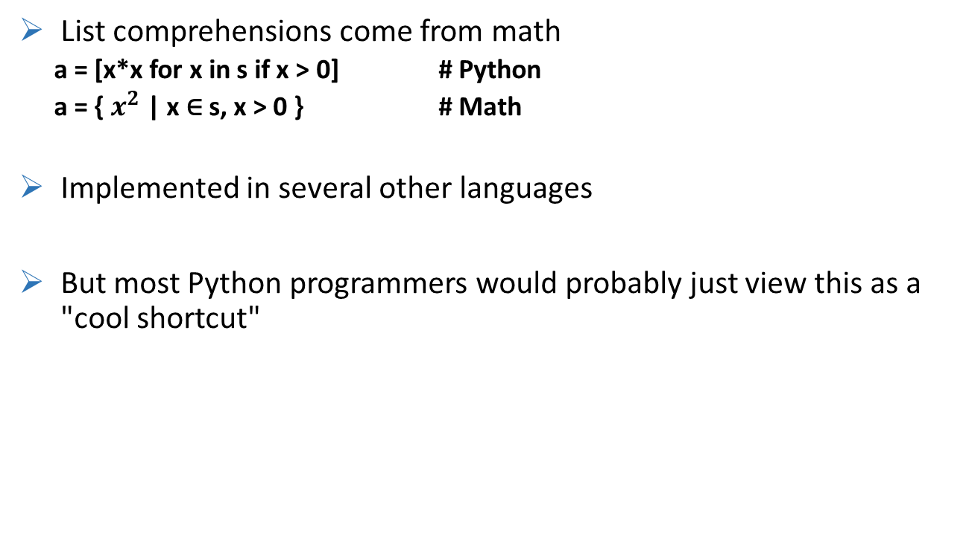
Historical Digression
List comprehensions come from math
a = [x*x for x in s if x > 0] # Python
a = { $x^{2}$ | x ∈ s, x > 0 } # Math
Implemented in several other languages
But most Python programmers would probably just view this as a "cool shortcut"

Slide 40
More details on objects
So far: a tour of the most common types
Have skipped some critical details
Memory management
Copying
Type checking

Slide 41
The Issue with Assignment
Many operations in Python are related to assigning or storing values.
a = value # Assignment to a variable
s[n] = value # Assignment to a list
s.append(value) # Appending to a list
d['key'] = value # Adding to a dictionary
A caution : assignment operations never make a copy of the value being assigned
All assignments are merely reference copies (or pointer copies if you prefer)

Slide 42
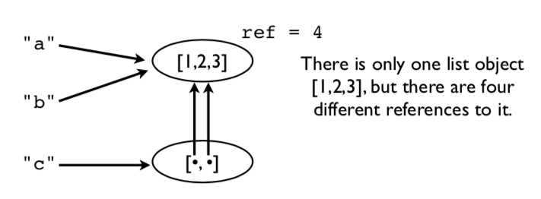
Assignment example
Consider this code fragment.
a = [1,2,3]
b = a
c = [a,b]
picture of the underlying memory

Slide 43
Assignment Example
Modifying a value affects all references
>>> a.append(999)
>>> a
[1,2,3,999]
>>> b
[1,2,3,999]
>>> c
[[1,2,3,999], [1,2,3,999]]
Notice how a change in the original list shows up everywhere else.
This is because no copies were ever made. Everything is pointing to the same thing.

Slide 44
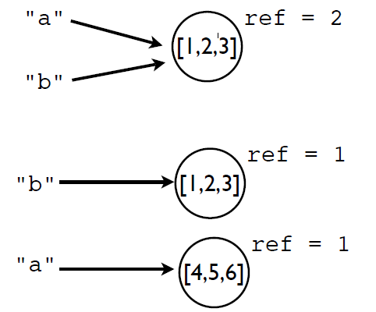
Reassigning values
Reassigning a value never overwrites the memory used by the previous value.
a = [1,2,3]
b = a
a = [4,5,6]
Remember: Variables are names, not memory locations.

Slide 45
Some Dangers
If you don't know about this sharing, you will shoot yourself in the foot at some point
Typical scenario : You modify some data thinking that it's your own private copy and it accidentally corrupts some data in some other part of the program
Comment: This is one of the reasons why the primitive data types (int, float, string) are immutable (read-only)

Slide 46
Identity and References
Use the is operator to check if two values are exactly the same object.
>>> a = [1,2,3]
>>> b = a
>>> a is b
True
is compares the object identity (an integer).
>>> id(a)
3588944
>>> id(b)
3588944
>>>

Slide 47
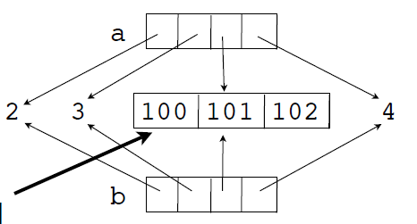
Shallow Copies
Lists and dicts have methods for copying.
>>> a = [2,3,[100,101],4]
>>> b = list(a) # Make a copy
>>> a is b
False
It's a new list, but the list items are shared.
>>> a[2].append(102)
>>> b[2]
[100,101,102]
>>>
>>> a[2] is b[2]
True
>>>
This inner list is
still being shared

Slide 48
Deep Copying
Sometimes you need to make a copy of an object and all the objects contained within it.
Use the copy module for this:
>>> a = [2,3,[100,101],4]
>>> import copy
>>> b = copy.deepcopy(a)
>>> a[2].append(102)
>>> b[2]
[100,101]
>>> a[2] is b[2]
False
This is the only safe way to copy something

Slide 49
Names, Values, Types
Variable names do not have a type. It's only a name.
However, values do have an underlying type.
>>> a = 42
>>> b = 'Hello World'
>>> type(a)
<type 'int'>
>>> type(b)
<type 'str'>
type() will tell you what it is.
The type name is usually used as a function that creates or converts a value to that type.

Slide 50
Type Checking
How to tell if an object is a specific type.
if isinstance(a, list):
print('a is a list’)
Checking for one of many possible types.
if isinstance(a, (list,tuple)):
print('a is a list or tuple’)
*Caution: Don't go overboard with type checking. It can lead to excessive code complexity.

Slide 51
Summary
Have looked at basic principles of working with data in Python programs
Brief look at part of the object-model
A big part of understanding most Python programs.

