Slide 1


How do I install the app on my phone?

Slide 2
IF THIS IS NOT A FIRST-TIME INSTALLATION
DELETE THE PREVIOUSLY INSTALLED APP BEFORE
TO MAKE A NEW INSTALLATION

Slide 3
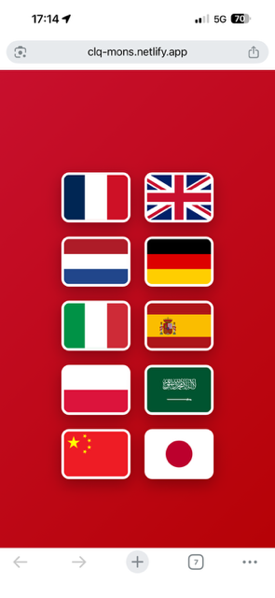
AFTER SELECTING THE DESIRED CITY
(CLICK OR SCAN THE QR CODE)
CHOOSE YOUR LANGUAGE

Slide 4
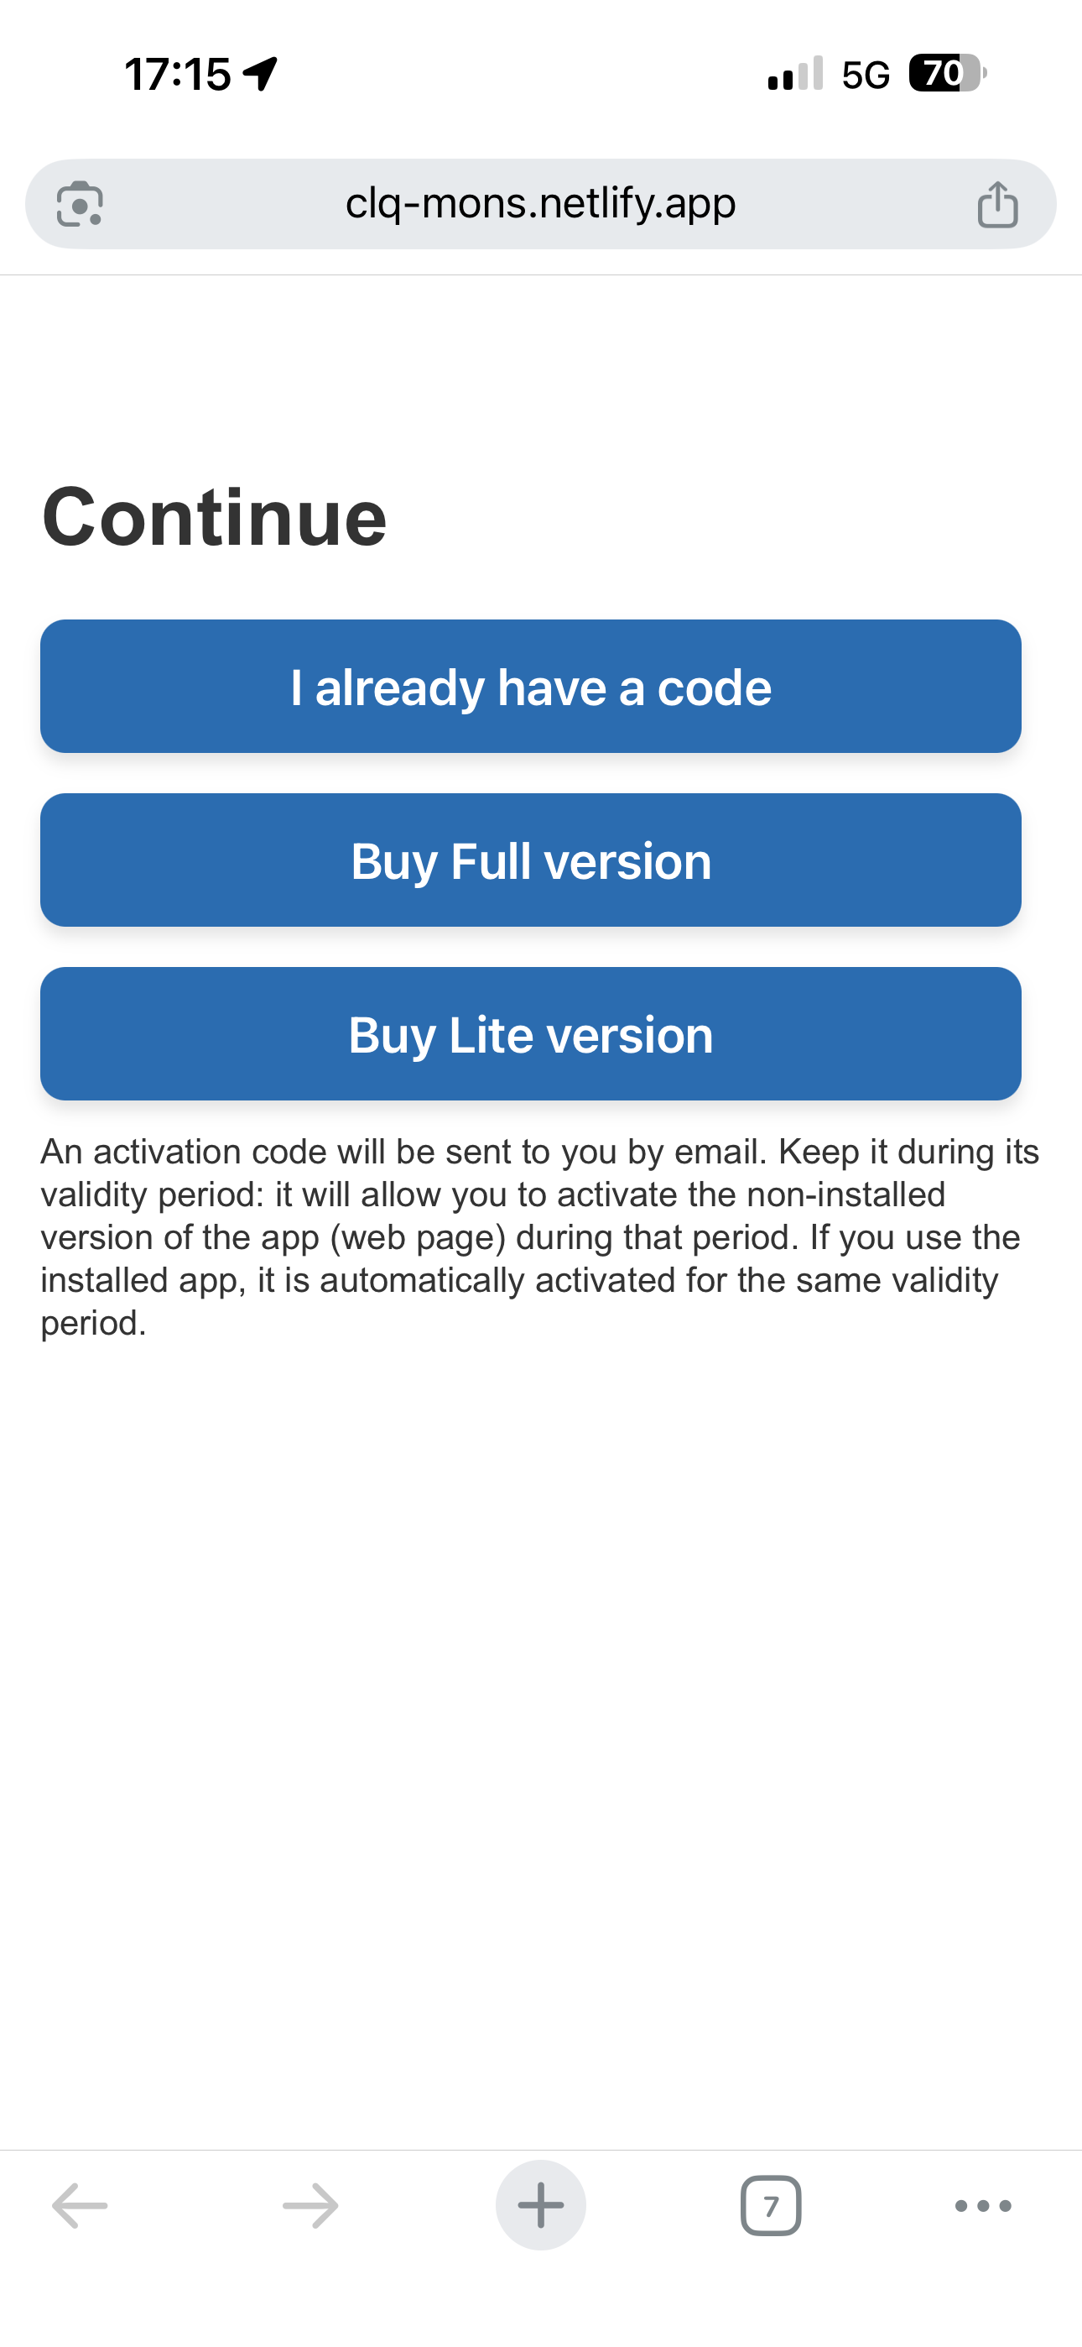
CHOOSE FROM THE PAYMENTS PAGE THE "FULL" VERSION OR THE "LITE" VERSION (LESS INFORMATION AND VERY LOW PRICE)
IF YOU HAVE ALREADY RECEIVED A CODE BY EMAIL YOU CAN ENTER IT VIA "I ALREADY HAVE A CODE" BUT ACTIVATION BY EMAIL IS MORE CONVENIENT

Slide 5
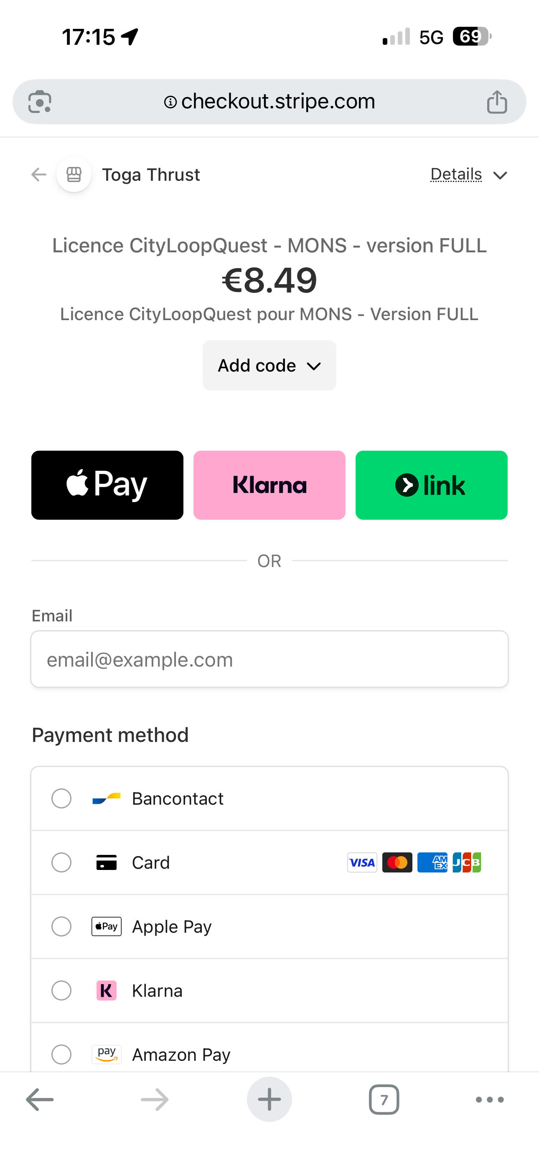
ON THE PAYMENTS PAGE, IF YOU HAVE A PROMO CODE, ENTER IT VIA "ADD PROMO CODE“
ENTER YOUR EMAIL (YOU WILL RECEIVE YOUR ACTIVATION CODE) CONFIRM YOUR PAYMENT METHOD
FINALIZE THE ORDER

Slide 6
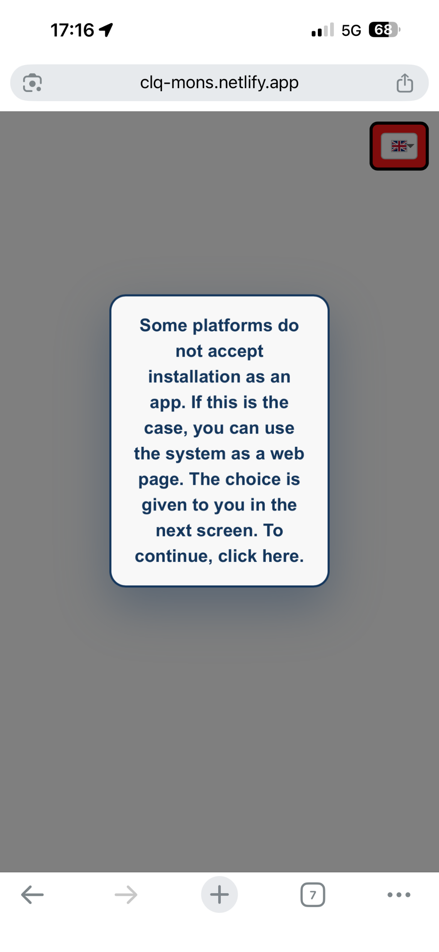
READ THE WARNING MESSAGE

Slide 7
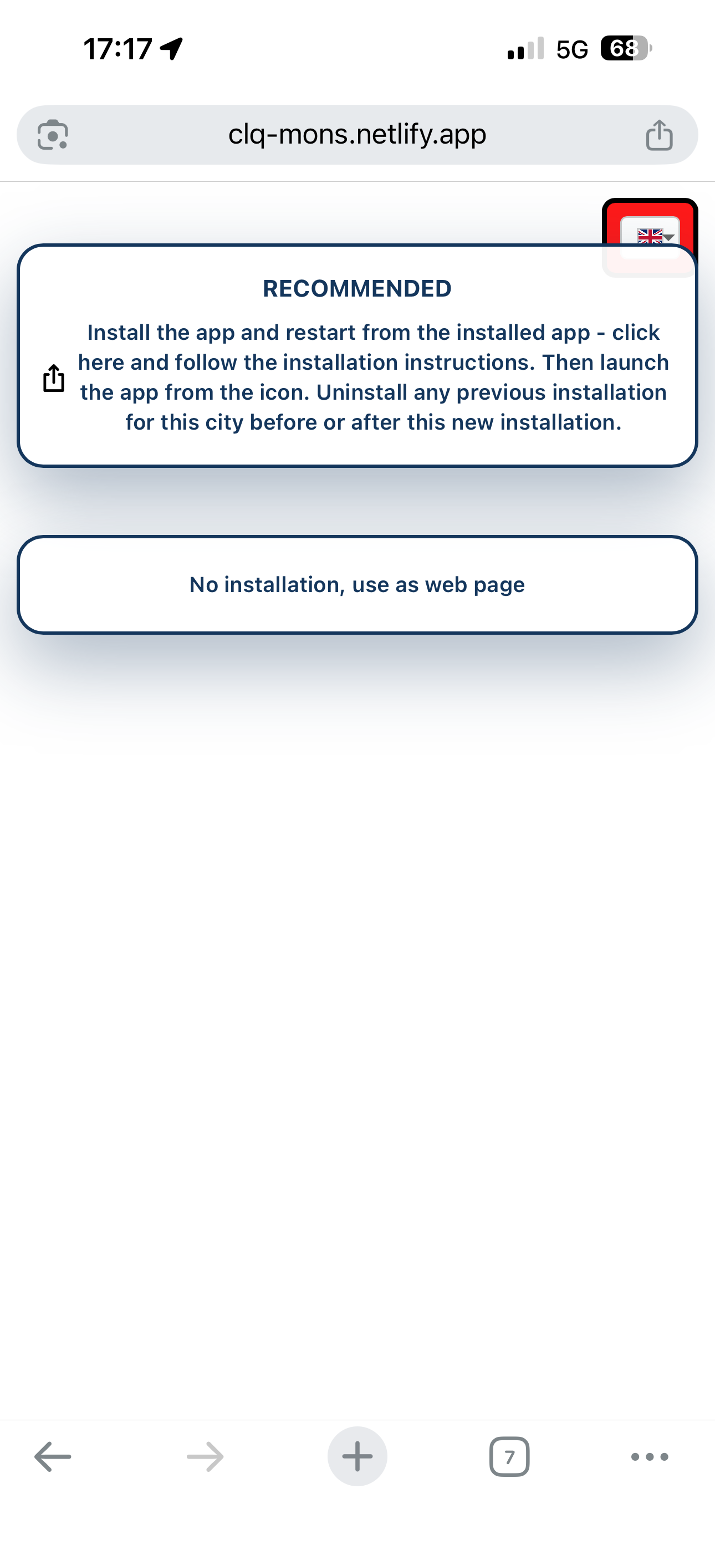
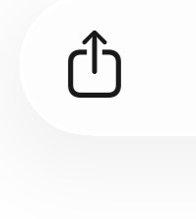
ON ANDROID, SIMPLY CHOOSE THE "RECOMMENDED – INSTALL THE APP ... » THE APP WILL INSTALL ITSELF
ON IPHONE, AFTER CHOOSING THE "RECOMMENDED – INSTALL THE APP ... »
FIND THE SHARE ICON ON THE SCREEN
AT THE VERY TOP OF THE SCREEN OR AT THE
VERY BOTTOM DEPENDING ON THE IOS VERSION
IF YOU CANNOT OR DO NOT WANT TO NO INSTALLATION CHOOSE "NO INSTALLATION, USE AS A WEB PAGE »

Slide 8
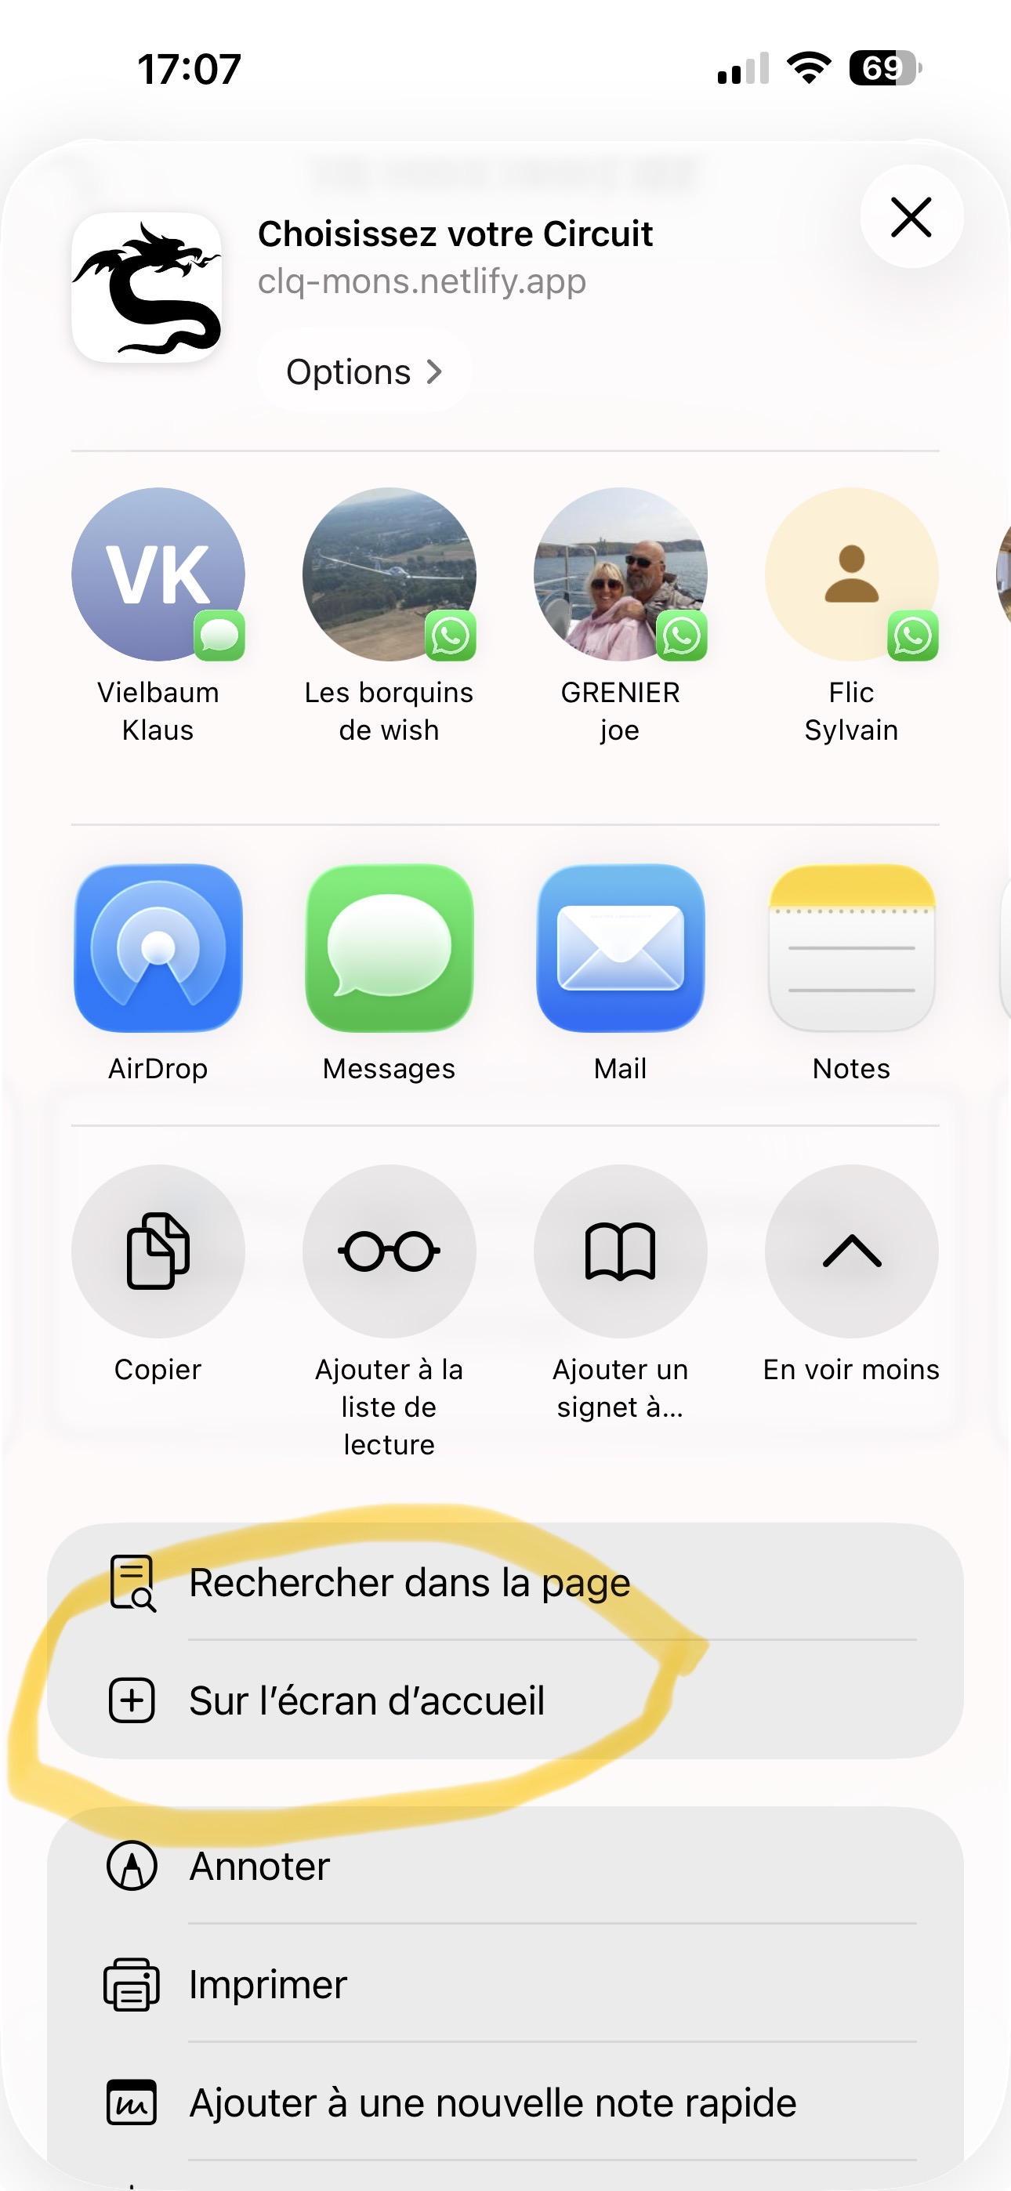








AFTER CLICKING "SHARE“
IF NECESSARY, CLICK ON "SEE MORE“
THEN SELECT "+ ON THE HOME SCREEN"

Slide 9
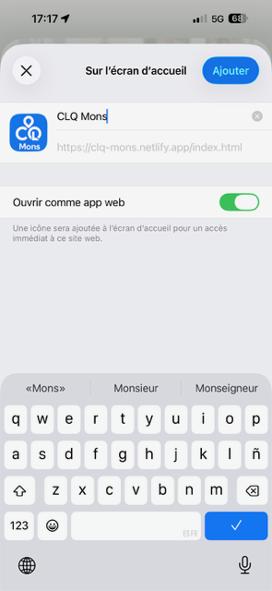


IF NOT AUTOMATICALLY SELECTED
CHOOSE "OPEN AS WEB APP“
CLICK ON "ADD"

Slide 10
THE APP IS NOW INSTALLED ON YOUR DEVICE
LOOK FOR THE CITYLOOP QUEST ICON AND OFF WE GO!
HAVE A GOOD WALK!

