Slide 1
QNLP Workflow on HPC+QC: Session 2
QCE23 Tutorial – 09/21/2023
In-Saeng Suh, Prasanna Date, Francisco Rios, Antonio Perez, Kathleen Hamilton, Mayanka Shekar, John Gounley and Georgia (Gina) Tourassi
Oak Ridge National Laboratory
Dong Jun Woun (UTK)
This research is supported by the Department of Energy Office of Science Advanced Scientific Computing Research program office.

Slide 2
QNN
Presenter: Kathleen E. Hamilton (ORNL)
Target:
Build and train classifier models on unstructured or structured datasets

Slide 3
Quantum Neural Networks: A Quick Introduction
The field of quantum machine learning has benefitted greatly by adapting models and methods from classical machine learning
This segment of the tutorial will dive into the design and training of quantum neural networks for binary and multiclass classifications
The training is done through supervised learning, partially executed in a quantum circuit model, and partially executed with classical methods
For this tutorial all training and circuit execution will be done in simulation

Slide 4
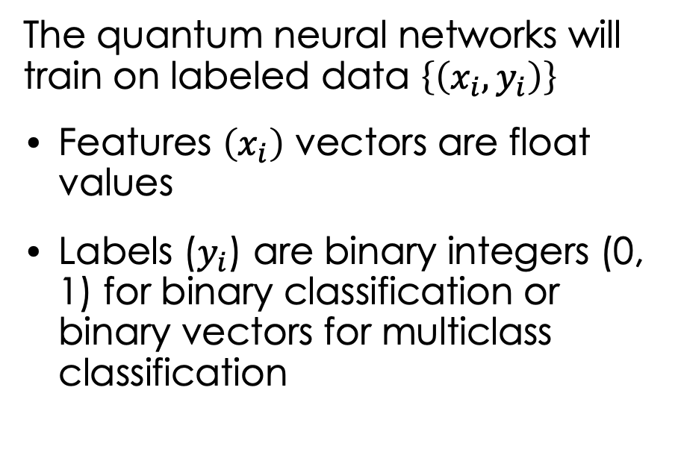
Quantum Neural Networks: A Design Overview
The quantum neural networks will train on labeled data $\left\{\left(x_{i}, y_{i}\right)\right\}$
Features $\left(x_{i}\right)$ vectors are float values
Labels ($y_{i}$) are binary integers (0, 1) for binary classification or binary vectors for multiclass classification
3 design elements needed
A sequence of gates to map the classical features into quantum states
A sequence of gates that implement trainable, parameterized unitaries
A set of measurements on the prepared state which extract a label prediction
Feature Encoding followed by trainable unitary layers
Feature Encoding interleaved with trainable unitary layers
Construction using overlapping 2 qubit unitaries (“bricklayer”)

Slide 5
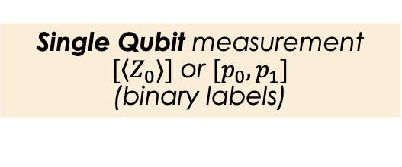
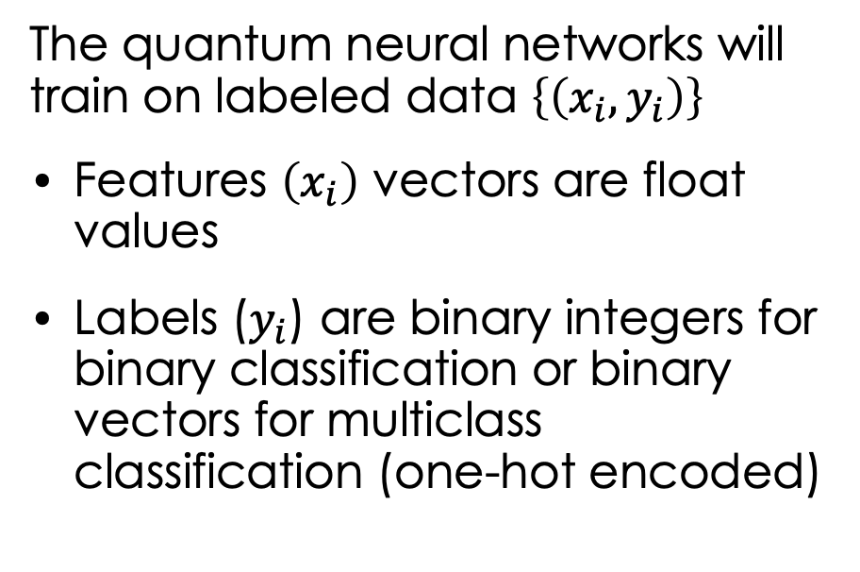
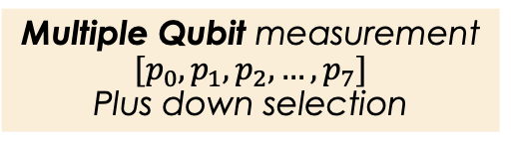
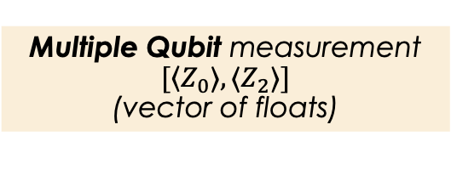
Quantum Neural Networks: A Design Overview
The quantum neural networks will train on labeled data $\left\{\left(x_{i}, y_{i}\right)\right\}$
Features $\left(x_{i}\right)$ vectors are float values
Labels ($y_{i}$) are binary integers for binary classification or binary vectors for multiclass classification (one-hot encoded)
3 design elements needed
A sequence of gates to map the classical features into quantum states
A sequence of gates that implement trainable, parameterized unitaries
A set of measurements on the prepared state which extract a label prediction
Single Qubit measurement $[\left\langle Z_{0}⟩]\right.$ or $[p_{0},p_{1}]$
(binary labels)
Multiple Qubit measurement $[\left\langle Z_{0}⟩, ⟨Z_{2}⟩]\right.$
(vector of floats)
Multiple Qubit measurement $[p_{0},p_{1},p_{2}, …,p_{7}]$
Plus down selection

Slide 6
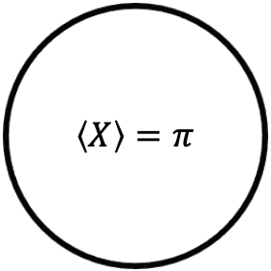
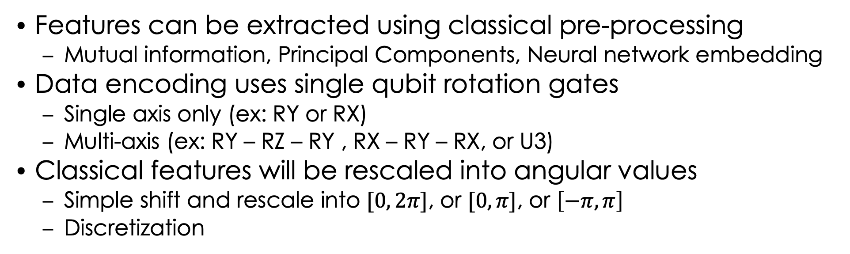

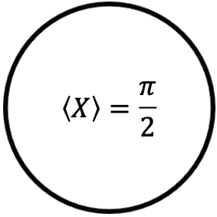
Quantum Neural Networks: Data Pre-processing
Features can be extracted using classical pre-processing
Mutual information, Principal Components, Neural network embedding
Data encoding uses single qubit rotation gates
Single axis only (ex: RY or RX)
Multi-axis (ex: RY – RZ – RY , RX – RY – RX, or U3)
Classical features will be rescaled into angular values
Simple shift and rescale into $[0, 2π]$, or $[0, π]$, or $\left[−π, π\right]$
Discretization
Shift and rescale
Discretization
4
2
5
$$\left\langle X\right\rangle =π$$
1
$$\left\langle X\right\rangle =\frac{π}{2}$$
N
0
$$\left\langle X\right\rangle =0$$

Slide 7
DisCoCat
Presenter: Antonio Coello Perez (ORNL)
Targets:
Build and train a DisCoCat model for binary classification

Slide 8
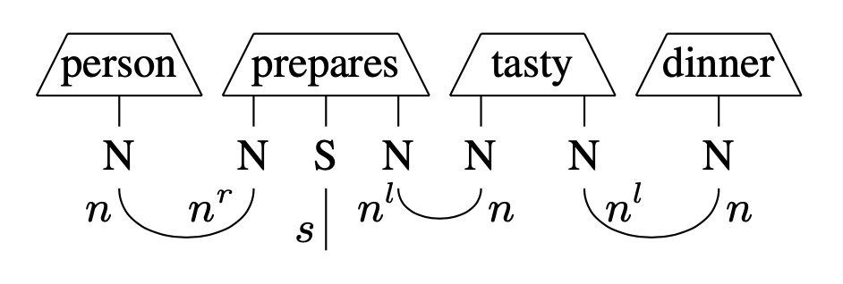
A DisCoCat model assigns vector spaces to word types
DisCoCat: Distributional Compositional Categorical model of meaning
Example:
The rules to extract the meaning of a sentence from the meaning of its words are tensor contractions
Can quantum computing be used to extract these features?

Slide 9
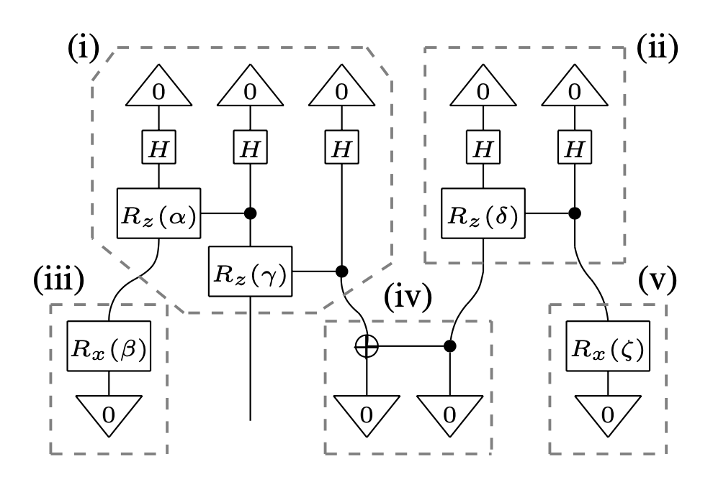
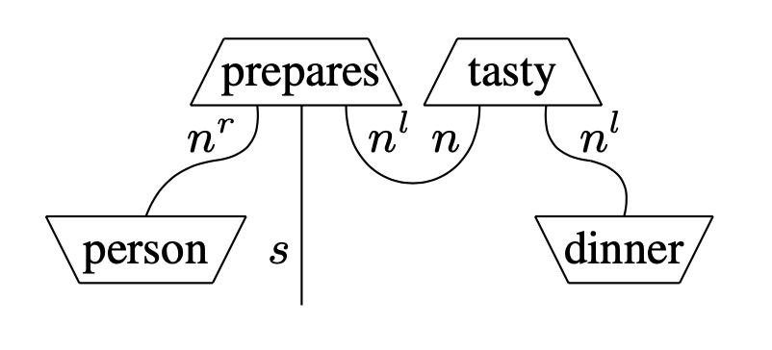
The tensor diagram of a sentence can be easily mapped into a quantum circuit,
and the angles defining the vector words can be trained to classify sentences
For example, if S has dimension 2
the sentence can belong to either
class 0: [1, 0]
or
class 1: [0, 1]
Wires translate to qubits
Word features become parametrized quantum gates
The gates depend on the chosen ansatz

Slide 10

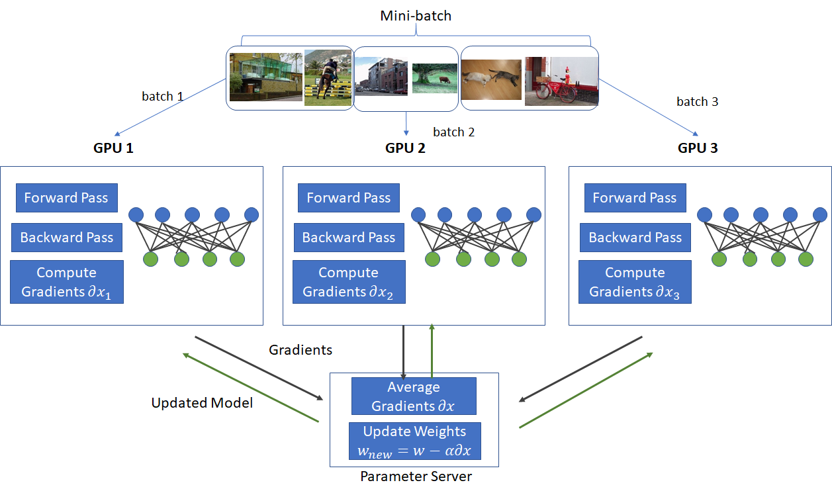
To simulate how the model trains, we use OLCF’s Frontier supercomputer
Training set
CPU 1 CPU 2 CPU3

Slide 11
Q-LSTM
Presenter: Antonio Coello Perez (ORNL)
Targets:
Build and train hybrid long short-term memory models for binary classification and part-of-speech tagging

Slide 12
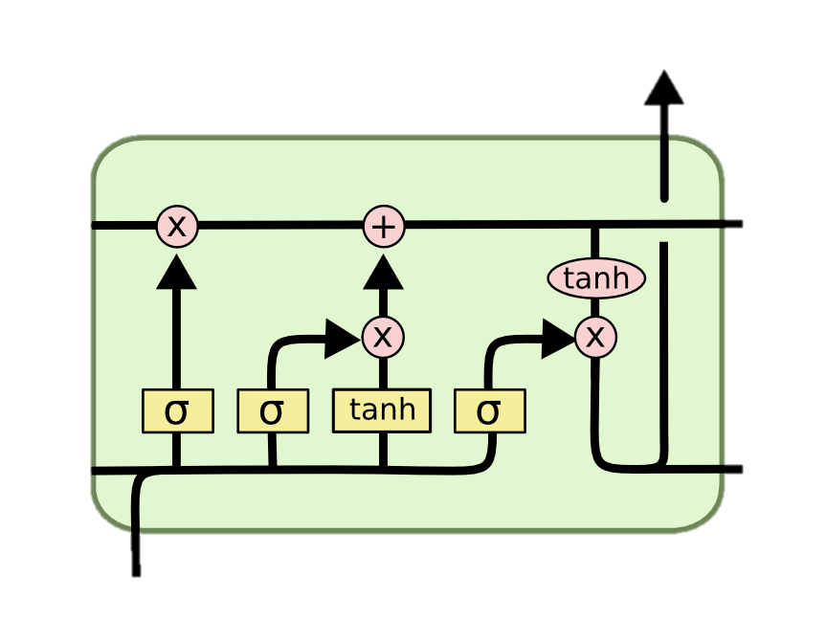
Long Short-Term Memory (LSTM) Neural Networks can be used to classify sequential data
A memory block consists of cell and hidden states
Gates in the block discern which information is forgotten, updated and returned as an output
x_{t} : Input data
h_{t} : Hidden state
c_{t} : Cell state
v_{t} = ( h_{t-1}, x_{t} )
f_{t} = σ( W_{f} v_{t} + b_{f} )
i_{t} = σ( W_{i} v_{t} + b_{i} )
ĉ_{t} = tanh( W_{c} v_{t} + b_{c} )
o_{t} = σ( W_{o} v_{t} + b_{o} )
c_{t} = f_{t} × c_{t-1} + i_{t} × ĉ_{t}
h_{t} = o_{t} × tanh( c_{t} )
c_{t-1}
c_{t}
h_{t-1}
LL
LL
LL
LL
h_{t}
x_{t}
Hochreiter, S., et al., Neural Comput. 9, 1735 (1997)

Slide 13
A label for a sentence can be extracted from the hidden state of the last memory block…
Skillful woman debugs complex program
IT related sentence
LL
LL

Slide 14
... or a label for each of its words can be extracted from the corresponding hidden states
Skillful woman debugs complex program
adjective noun verb adjective noun
LL
LL
LL
LL
LL
LL

Slide 15
Quantum LSTM replaces the linear layers of the gates with parametrized quantum circuits

Slide 16
QSVN
Presenters: Prasanna Date (ORNL), Dong Jun Woun (UTK)
Target:
Design and train support vector machines for high-dimensional feature spaces

