Slide 1
Quantum + HPC for Natural Language Processing
QCE23 Tutorial – 09/21/2023
In-Saeng Suh, Prasanna Date, Francisco Rios, Antonio Coello Perez, Kathleen Hamilton, Mayanka Chandra Shekar, John Gounley and Georgia Tourassi
Oak Ridge National Laboratory
Dong Jun Woun
University of Tennessee- Knoxville
This research is supported by the Department of Energy Office of Science Advanced Scientific Computing Research program office.

Slide 2
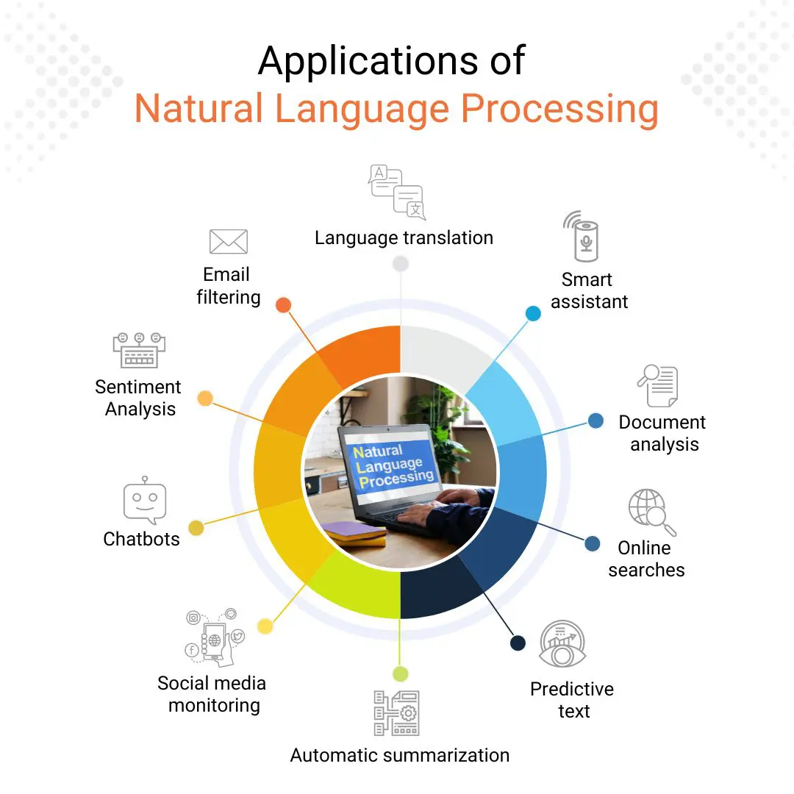
Introduction to Natural Language Processing(NLP)
NLP is a branch of artificial intelligence that deals languages that humans use naturally in order to interface with computer.
State of Art Techniques such as Large Language Models have create human-like interactions to everyday use-cases
https://datasciencedojo.com/blog/natural-language-processing-applications

Slide 3
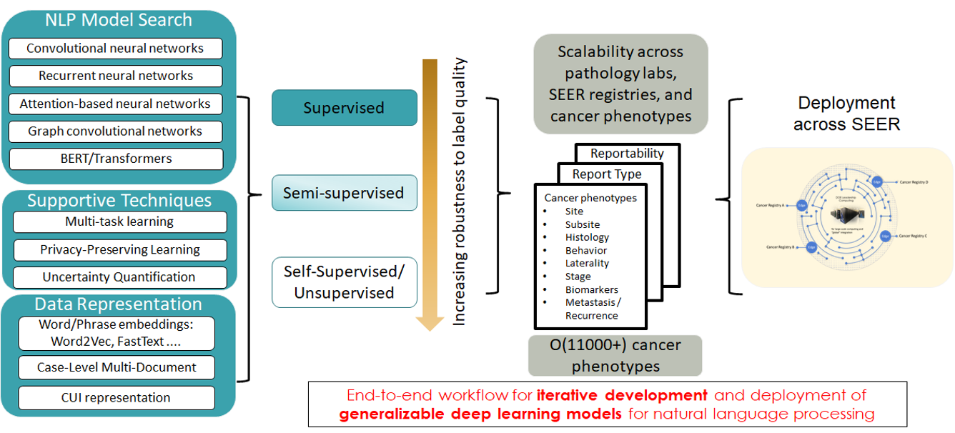
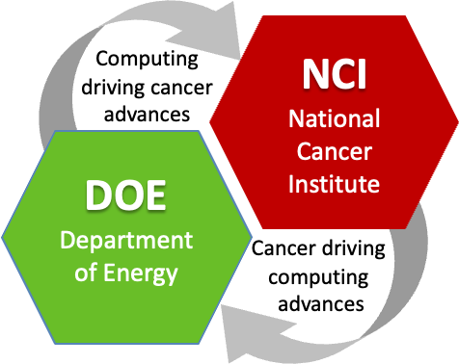


NLP Application – Biomedical text in MOSSAIC

Slide 4
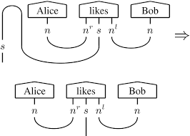

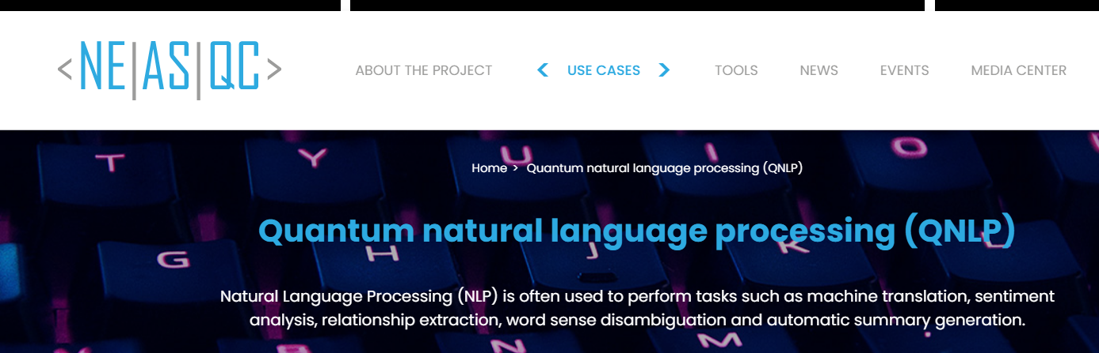

Quantum Natural Language Processing
QNLP has been thought as alternative to classical NLP , where QNLP can retain the grammatical and structural language integrity in the model.
DisCoCat Model
lambeq
https://www.neasqc.eu/use-case/quantum-natural-language-processing-qnlp/
Third year of QNLP Conference

Slide 5

QNLP Workflow on HPC+QC
Classical + Hybrid QNLP Approach
Categorical Compositional Distributional Model
Classical NLP Preprocessing
Lambeq/DisCoCat based preprocessing
QNN/QLSTM/QSVM for Text Classification
QLSTM
for
Binary Text Classification
POS Tag Classification
High Performance Computing Systems

Slide 6
Agenda
Session # 1 – 10AM to 11:30 AM PST
# | Topic | Speaker | Duration
1 | Introduction and Welcome | Team | 5 min
2 | QNLP Workflow on HPC + QC | In-Saeng Suh | 30 min
3 | Category Theory for QNLP | Francisco Rios | 30 min
4 | Classical NLP Modeling | Mayanka Chandrashekar & John Gounley | 25 min
5 | Session 1 Closing | Antonio Coello Perez | 5 min
Session # 2 – 1PM to 2:30 AM PST
# | Topic | Speaker | Duration
1 | Quantum Neural Network for Text Classification | Kathleen Hamilton | 30 min
2 | DisCoCat and QLSTM models for simple tasks | Antonio Coello Perez | 30 min
3 | Adiabatic Quantum Support Vector Machines | Prasanna Date & Dong Jun Woun | 30 min

Slide 7

Download Code for Hands-on Session
https://github.com/Tognognongo/QCE-tutorial

