Slide 1




PS Number :
Category :
Organization :
Domain Bucket :
Problem Statement Title
Photo
(Student 1)
Photo
(Student 2)
Photo
(Student 3)
Photo
(Student 3)
Photo
(Student 3)
Photo
(Student 3)
Student Name
VTU No.
Dept.
Student Name
VTU No.
Dept.
Student Name
VTU No.
Dept.
Student Name
VTU No.
Dept.
Student Name
VTU No.
Dept.
Student Name
VTU No.
Dept.

Slide 2
Index
1
Problem Statement
2
Concept of the Solution
3
Novelty / Scope of Solution
4
Pros and Cons of the solution
5
Technical Description
6
Implementation Plan or Working Model (as the case may be)
7
Validation/Testing/Analysis
8
Cost Estimate (If needed)
9
Assumptions(if any)
10
References

Slide 3
Problem Statement
To create an anti-theft auto security system that can extract registration number plate of a moving vehicle.
To capture and transfer the data to cloud, which can be available for further analysis of theft or proof reading.
To track and monitor the real-time location of the vehicle fleet transporting the coal.

Slide 4
Concept of the solution
The design of Convolutional neural network’s (CNNs) have resulted in significant increases in performance accuracies in many task.
The proposed model could harness the power of CNNs and capable of detecting and recognizing license number plates with low error rates.
The proposed algorithm is robust to variations in conditions and license plate templates which include size, design and formats.
This proposed model uses fully automated license plate recognition (ALPR) which use optical character recognition(OCR) on images to read and extract the vehicle data.

Slide 5
Novelty / Scope of Solution
The core technology of our system is built using a sequence of deep CNNs interlaced with accurate and efficient algorithms.
The CNNs are well trained and modified so that they are robust under different conditions and can work across a variety of templates which include variations in size, backgrounds and fonts.
The solution demonstrates an end-to-end license plate detection and recognition along with a novel deep CNNs.

Slide 6
Pros and Cons of the solution
What is novel in your mentioned idea and scope of the proposed solution

Slide 7
Technical Description
The Proposed model is divided into three stages: Data collection, Deep CNN training and finally testing.
The data is collected and prepared for two tasks: License plate detection and character detection/recognition.
The collected data is prepared and ready to be used for training into three stages: license plate detection, character detection and character recognition.
License plate detection determines the license plate and that image is given through the deep license plate detection network.
License plate recognition filters characters(A-Z, 0-9) from non-character segments using a character detection deep network.

Slide 8
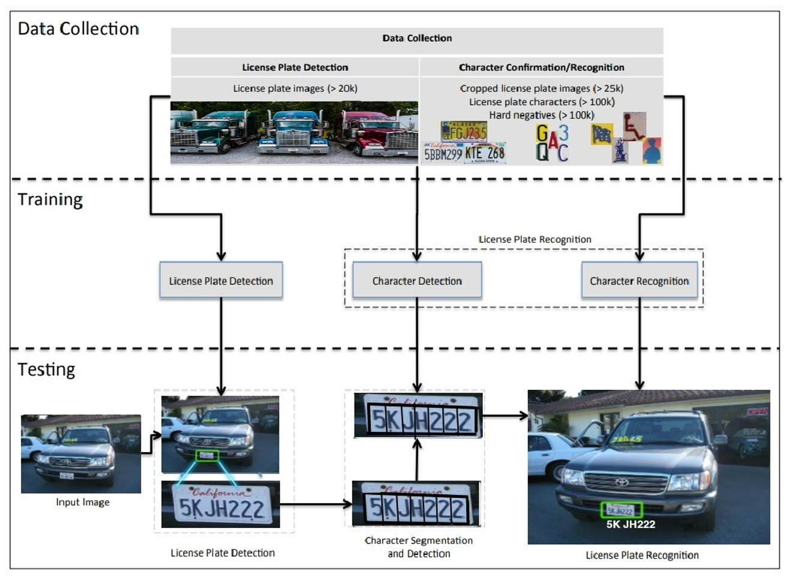
Implementation Plan/Working Model

Slide 9
Validation / Testing / Analysis
The Performance of the proposed model will be evaluated by using precision, recall and accuracy metrics.
In order to train the model to detect and recognize the license number plate, a database of real world images with license plates, along with context and tightly cropped license plates are collected.
Character segmentation is the best approach to segment/isolate each of the characters and perform character detection and recognition for each individual character before combining the results.
The dataset is a collection of open source available license plates containing 348 USA license plates and 608 European license plates.
70% of the data is used for training purpose and 30% of the data is used for testing purpose.

Slide 10
Cost Estimate(if required)

Slide 11
Assumptions(if any)
OpenCV and EasyOCR could be solved efficiently by using Deep-CNN architecture and design.
Design the short-term and long-term budgets to aid the formation of contracts where this might usually keep the overall project budget to be within the budgeted cost, thus avoiding the project to be over the actual budget.
It is presupposed that the system of the project is compatible, functions properly and stable for the project to take place smoothly.
All the resources allocated are sufficient for the project life-cycle. However, the project could still be at risk if the contributions from the resources are insufficient.

Slide 12
References
[1]Hsieh, J.W., Yu, S.H., Chen, Y.S.: Morphology-based license plate detection from complex scenes. In: IEEE International Conference on Pattern Recognition. (2002).
[2] Arth, C., Limberger, F., Bischof, H.: Real-time license plate recognition on an embedded dsp-platform. In: CVPR. (2007).
[3] Yuan, Y., Zou, W., Zhao, Y., Wang, X., Hu, X., Komodakis, N.: A robust and efficient approach to license plate detection. In: IEEE Transactions on Image Processing. Volume 26. (2017).
[4] Du, S., Ibrahim, M., Shehata, M., Member, S., Badawy, W.: Automatic license plate recognition (alpr): A state-of-the-art review. In: IEEE Transactions on Circuits and Systems for Video Technology. Volume 23. (2013).
[5] Li, H., Shen, C.: Reading car license plates using deep convolutional neural networks and lstms. In: arXiv:1601.05610. (2016).
[6] Cheang, T.K., Chong, Y.S., Tay, Y.H.: Segmentation-free vehicle license plate recognition using convnet-rnn. (2017).

Slide 13
THANK YOU

Slide 14
GUIDELINES
Not more than 12 slides
Do not give any theoretical fundamentals.
Illustrate with suitable means such as Drawings, examples, algorithms, flow chart etc
Use consistent format
Check for spelling and grammar – ensure no errors (spell check)
Highlight the major advantages of the technique/method proposed when compared with other techniques or conventional techniques
PPT file name should be your team name.

