Slide 1
Md. Tohidul Haque Sagar(2019-1-60-156)
Sadia Afrin Raisa (2019-1-60-146)
Bahauddin Ahmed (2020-1-60-271)
Submitted To
Dr.Md.Nawab Yousuf Ali
Professor
East West University
Binary Search Assembly Code 8086
Group No 8

Slide 2
Assembly Language Programming
Assembly language is a lingua franca which connects hardware with software.
Complete control over a system’s resources
Understanding processor and memory function
Direct access to hardware

Slide 3
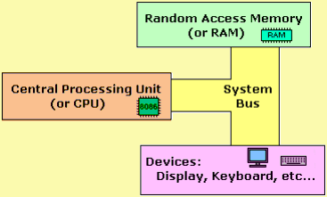
Organization of 8086

Slide 4
Simple Assembly Language Programs 8086
The assembly level programming 8086 code must be written in upper case letters
The labels must be followed by a colon, for example: label:
All labels and symbols must begin with a letter
All comments are typed in lower case
The last line of the program must be ended with the END directive

Slide 5
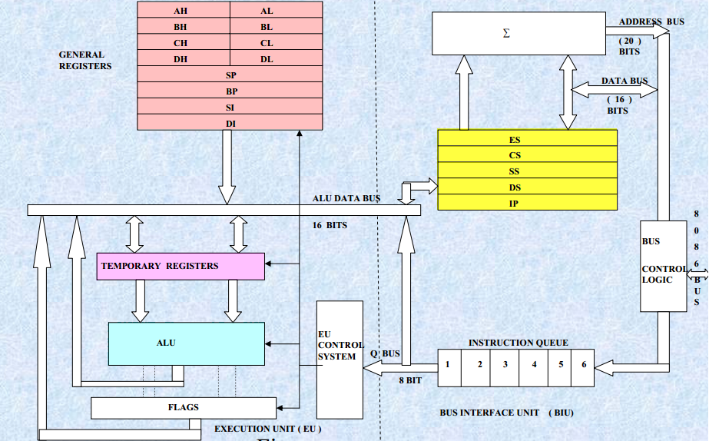
8086 Processor Architecture

Slide 6
Data Transfer Instructions
Arithmetic Instructions
Bit Manipulation Instructions
String Instructions
Program Execution Transfer Instructions (Branch & Loop Instructions)
Processor Control Instructions
Iteration Control Instructions
Interrupt Instructions
Instruction Set of 8086

Slide 7
Arithmetic instructions in 8086 microprocessor
Opcode | Operand | Description
ADD | D,S | Used to add the provided byte to byte/word to word.
ADC | D,S | Used to add with carry.
INC | D | Used to increment the provided byte/word by 1.
AAA | ---- | Used to adjust ASCII after addition.
DAA | ---- | Used to adjust the decimal after the addition/subtraction operation.
SUB | D,S | Used to subtract the byte from byte/word from word.
SBB | D,S | Used to perform subtraction with borrow.
DEC | D | Used to decrement the provided byte/word by 1.
NEG | D | Used to negate each bit of the provided byte/word and add 1/2’s complement.
CMP | D | Used to compare 2 provided byte/word.

Slide 8
How to Write program in 8086?
The assembly level programming 8086 code must be written in upper case letters.
The labels must be followed by a colon, for example: label:
All labels and symbols must begin with a letter.
All comments are typed in lower case.

Slide 9
Addressing modes in 8086 microprocessor
Register mode
Immediate mode
Displacement or direct mode
register indirect mode
Based indexed mode
Input/Output mode
Relative mode

Slide 10
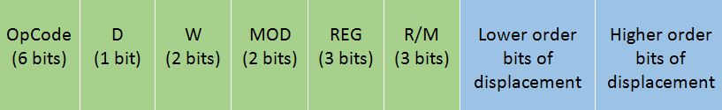
The general Instruction format of the 8086 microprocessor
The Opcode stands for Operation Code. Every Instruction has a unique 6-bit opcode. For example, the opcode for MOV is 100010.
D stands for direction If D=0, then the direction is from the register If D=1, then the direction is to the register
W stands for word If W=0, then only a byte is being transferred, i.e. 8 bits If W=1, then a whole word is being transferred, i.e. 16 bits

Slide 11
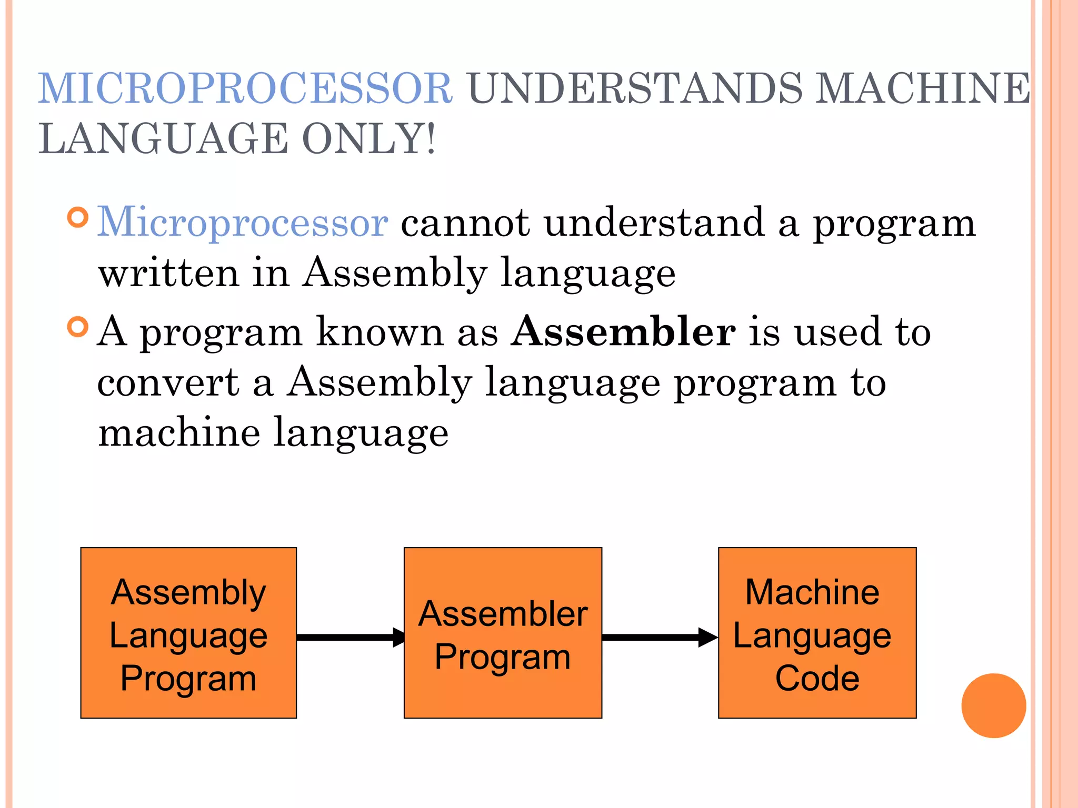

Slide 12
Binary Search is defined as a searching algorithm used in a sorted array by repeatedly dividing the search interval in half. The idea of binary search is to use the information that the array is sorted and reduce the time complexity to O(log N).
What is Binary Search?

Slide 13
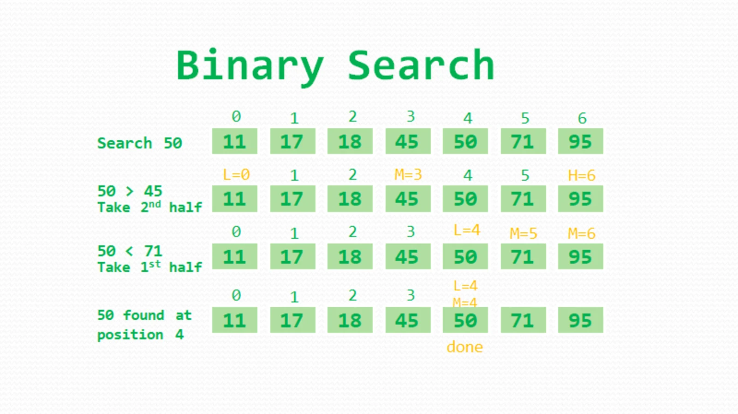
What is Binary Search?
Binary Search is defined as a searching algorithm used in a sorted array by repeatedly dividing the search interval in half. The idea of binary search is to use the information that the array is sorted and reduce the time complexity to O(log N).

Slide 14
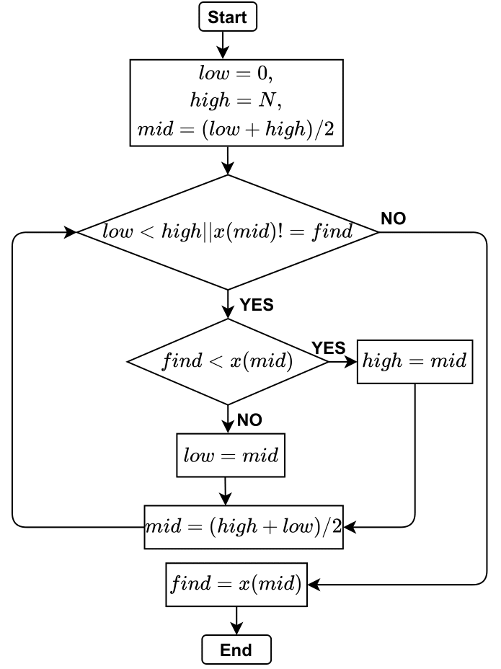
Flow Chart

Slide 15
Code and Description
.data section: This section defines data variables for messages, an array, and a key.
Out1, Out2, and failOut are strings used for output messages.
ArrList is an array of words (16-bit values).
ArrSz calculates the size of the array by subtracting the current location ($) from the start of ArrList and dividing by 2.
Key is defined as the value 228h to be searched for.
; Initializing necessary data
.data
Out1 db "Element Found At Position : "
Out2 db " !!$"
failOut db "Searched Element Not Found!!!"
ArrList dw 12h, 28h, 100h, 212h, 228h, 534h, 550h, 888h, 980h
ArrSz dw ($-ArrList)/2
Key equ 228h

Slide 16
Code and Description
; Starting main code
.code
main proc
mov ax, @data
mov ds, ax
mov bx, 00 ; Lower bound to base reg
mov dx, ArrSz ; Upper bound to data reg
mov cx, Key ; Key to count reg
The main procedure (main proc) begins by setting up the data segment register (ds) with the address of the data section.
mov bx, 00 initializes bx as the lower bound (0) for the binary search.
mov dx, ArrSz initializes dx with the upper bound, which is the size of the array.
mov cx, Key initializes cx with the key to be searched.

Slide 17
Code and Description
cmp bx, dx compares the lower bound (bx) with the upper bound (dx). If bx is greater than dx, it means the search has exhausted the possibilities, so it jumps to notMatched.
mov ax, bx copies the lower bound to ax.
add ax, dx adds the upper bound to ax.
shr ax, 1 divides ax by 2 by performing a right shift.
mov si, ax stores the calculated middle index in si.
add si, si is used to convert the middle index to an array index (since each element in the array is 2 bytes).
cmp cx, ArrList[si] compares the key (cx) with the value at the middle index in the array. If the key is greater than or equal to the middle element, it jumps to greaterEq.
; Main function
mainFunc:
cmp bx, dx
ja notMatched
mov ax, bx
add ax, dx
shr ax, 1
mov si, ax
add si, si
cmp cx, ArrList[si]
jae greaterEq

Slide 18
Code and Description
If the key is less than the middle element, it decrements the upper bound (dx) and continues the binary search by jumping back to mainFunc.
If the key is equal to the middle element, it jumps to ifMatched.
If the key is greater than the middle element, it increments the lower bound (bx) and continues the binary search by jumping back to mainFunc.
dec ax
mov dx, ax
jmp mainFunc
; If arrList[mid] <= key
greaterEq:
je ifMatched
inc ax
mov bx, ax
jmp mainFunc

Slide 19
Code and Description
If the key is found, it increments the character in al to convert it to a digit, appends it to the end of the string in Out2, and loads the address of Out1 into dx. Then, it jumps to dispOut.
If the key is not found (notMatched), it loads the address of failOut into dx.
; If arrList[mid] = key
ifMatched:
add al, 01
add al, 48
lea si, Out2
mov [si], al
lea dx, Out1
jmp dispOut
notMatched:
lea dx, failOut

Slide 20
Code and Description
dispOut is used to display the appropriate message. It uses DOS interrupt 21h to print the message.
main endp marks the end of the main procedure.
end main marks the end of the program.
dispOut:
mov ah, 09h
int 21h
mov ah, 4ch
int 21h
main endp
end main

Slide 21
Thank You

