Slide 1

DATA ANALYTICS PORTFOLIO
Customer Shopping Behavior Analysis
Turning 3,900 purchase records into clear strategy
An end-to-end portfolio study examining demographics, spending drivers, subscription dynamics, and promotional elasticity.
PORTFOLIO PROJECT · PYTHON · POSTGRESQL · POWER BI
Notes:
Welcome. This project analyzes 3,900 real customer shopping transactions to understand what actually drives basket size and lifetime revenue. Walk through the methodology, key findings across loyalty and subscriptions, and five strategic recommendations.

Slide 2
2
PROJECT OVERVIEW
3,900 purchases, one question: what drives spending?
3,900 transactions, 18 columns across demographics, purchase details, and shopping behavior
3,900
$59.76
3.75
Transactions
Average purchase
Average review rating
18 columns
Goal: uncover spending patterns, segments, product preferences, and subscription behavior to guide strategy
Notes:
Highlight the baseline: with 3,900 rows and $59.76 average spend, transactions are remarkably stable. The core challenge is finding where variance lives—demographics, loyalty, or marketing promos.

Slide 3
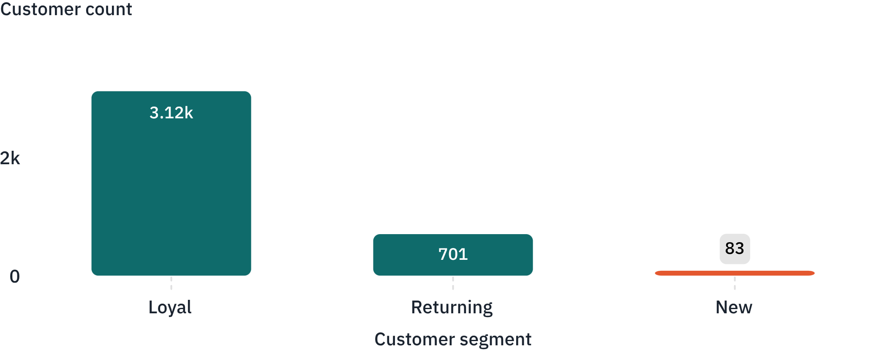
3
CUSTOMER SEGMENTATION
Loyal customers are the core of the business.
Over 79% of all transactions come from established buyers, while acquisition channels capture very few first-time entrants.
TOTAL CUSTOMERS BY SEGMENT (N = 3,900)
Segment breakdown
The revenue foundation relies almost entirely on existing retention:
Loyal 3,116 · Returning 701 · New 83
Among buyers with >5 purchases, 2,518 are non-subscribers compared to 958 subscribers, showing loyalty forms without program lock-in.
SOURCE · Behavioral RFM segmentation query via PostgreSQL
Notes:
Point out the extreme skew toward the Loyal group (3,116 buyers). New acquisition represents only 83 accounts in this sample. Retention is working, but top-of-funnel acquisition needs reinforcement.

Slide 4
4
SUBSCRIPTION ANALYSIS
Subscribers are a small group who spend the same
Membership drives predictability but has not yet created premium order values or basket expansion.
ENROLLMENT SHARE
AVERAGE ORDER VALUE
REVENUE SPLIT
27%
$59.49
$62,645
1,053 subscribers
vs. $59.87 non-subscriber
vs $170,436 standard
2,847 non-subscribers represent the remaining 73% of active shoppers.
Non-subscribers contribute 73.1% of total top-line gross receipts.
A difference of just $0.38 reveals an absence of premium spend tiers.
Core challenge: Subscription currently behaves as a convenience opt-in rather than an incentive engine that elevates order volume or margin.
Opportunity: Introduce exclusive product drops, member pricing, or volume tiers to convert existing loyalty into incremental cart value.
Notes:
Subscribers spend $59.49 on average versus $59.87 for non-subscribers. The program is leaving money on the table because it lacks tier incentives or minimum basket spend triggers.

Slide 5
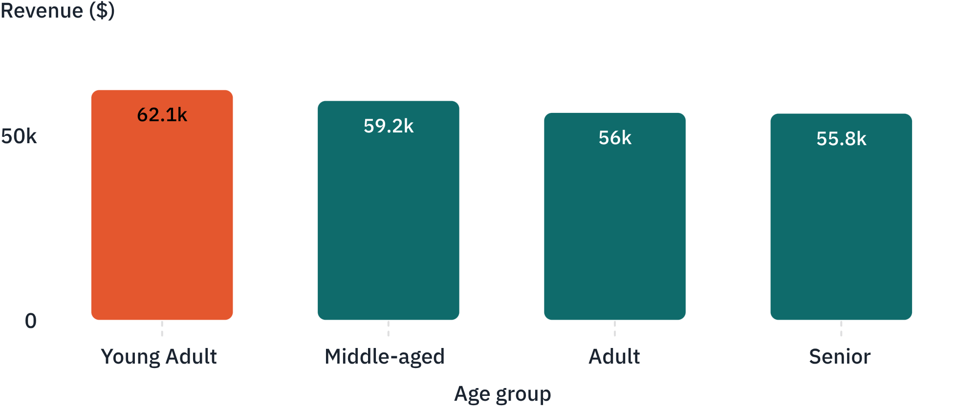
5
DEMOGRAPHIC & LOGISTICS DRIVERS
Revenue is spread across age groups, but men lead.
Age brackets generate remarkably balanced volume, while gender and fulfillment choices create clear revenue variance.
REVENUE BY AGE GROUP (USD)
Gender & shipping breakdown
Gender revenue distribution:
Male buyers | $157,890
Female buyers | $75,191
Fulfillment method impact:
Express shipping generates an average order value of $60.48 compared to $58.46 for standard delivery, validating premium basket incentives.
Young adults lead total yield, but age spread remains remarkably even across brackets.
Notes:
Male shoppers drive more than double the total revenue ($157.8K vs $75.2K). Meanwhile, age groups show consistent spending power, and express shipping customers have higher average order values.

Slide 6
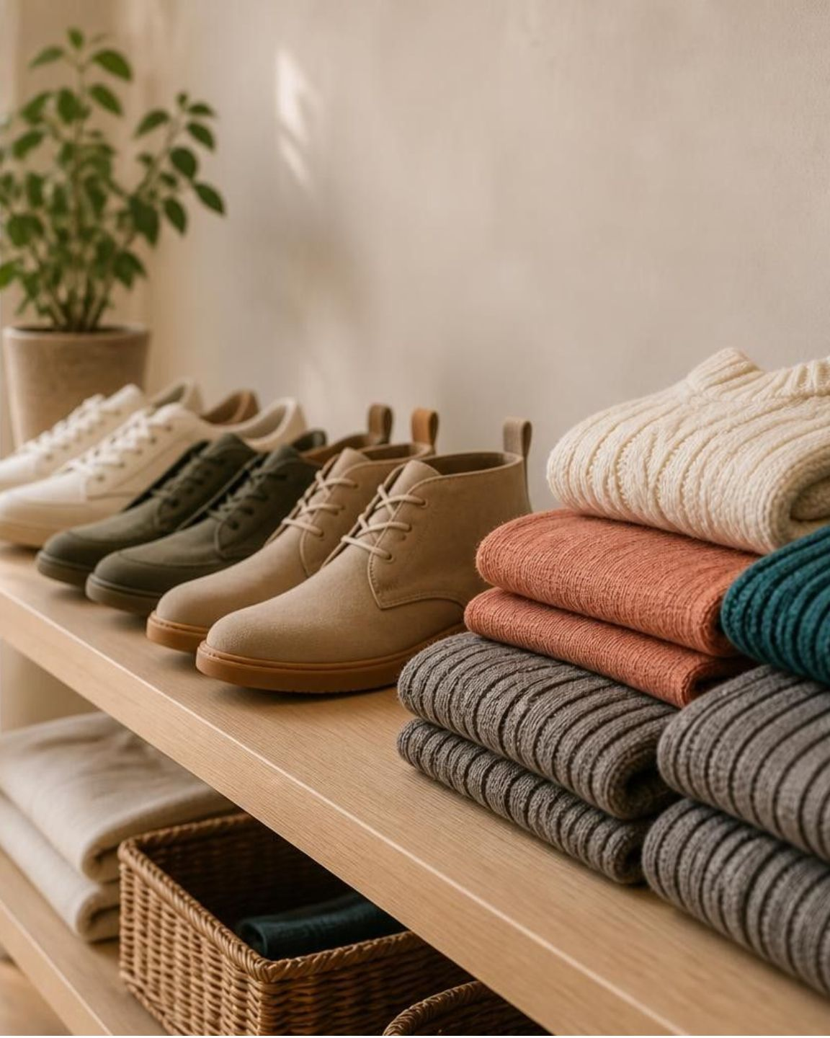
6
PRODUCT & PROMOTION DYNAMICS
Discounts drive a few products, and top-rated items differ
Promotional sensitivity clusters in seasonal apparel; high customer satisfaction concentrates in specialized accessories.
Most discount-dependent
Hat 50.00% · Sneakers 49.66% · Coat 49.07%
Top-rated
Gloves 3.86 · Sandals 3.84 · Boots 3.82
Half of key outerwear purchases rely on discounts to convert; footwear and handwear earn highest satisfaction, above the 3.75 site average.
839 customers used a discount and spent above $59.76, showing promotions can expand rather than erode order margin.
Notes:
Top discounted items (Hats, Sneakers, Coats) differ completely from top-rated items (Gloves, Sandals, Boots). Also highlight the 839 buyers who took discounts and still beat the average purchase price.

Slide 7
7
TECHNICAL WORKFLOW
From raw data to dashboard in three steps
A structured data engineering and analytics pipeline transforming transactional tables into executive business intelligence.
01
02
03
STEP 01 · DATA PREPARATION
STEP 02 · BUSINESS QUERIES
STEP 03 · VISUAL INTELLIGENCE
Python
SQL (PostgreSQL)
Power BI
Cleaned raw transactions, imputed 37 missing ratings with category medians, and engineered age_group and purchase frequency metrics.
Answered 10 business questions on revenue, segments, discounts and products, including demographic yield, loyalty segments and promotional elasticity.
Built an interactive Customer Behavior Dashboard enabling leadership to filter cross-sectional customer cohorts and monitor channel performance.
Pandas · Data cleaning · Feature engineering
Aggregations · Window functions · CTEs
Executive dashboard · Interactive KPI models
REPRODUCIBLE PIPELINE · VERIFIED ON POSTGRESQL 15 AND PYTHON 3.11
Notes:
Demonstrate the end-to-end data stack: handling null imputation and feature creation in Python, answering complex commercial logic in SQL, and delivering stakeholder dashboards in Power BI.

Slide 8

8
STRATEGIC ROADMAP
Five recommendations to act on
1
Boost subscriptions with exclusive benefits: member discounts, early access, and free shipping to create measurable spend differentiation.
2
Reward repeat buyers through loyalty programs: protect the 3,116-strong Loyal customer cohort with structured milestone perks and tier rewards.
3
Review discount policy to balance sales and margin: re-evaluate promo dependence on Hats and Sneakers; leverage offers to lift baskets above $59.76.
4
Feature top-rated and best-selling products in campaigns: spotlight Gloves, Sandals, and Boots across organic merchandising to exploit high user ratings.
5
Target high-revenue age groups and express-shipping users: tailor paid marketing to Young Adults and male shoppers, while offering express-delivery upsells.
Notes:
Summarize the five tactical takeaways: fix subscriber incentives, safeguard loyal buyers, protect margins on discounted items, cross-sell top-rated merchandise, and lean into high-performing demographics.

