Slide 1
Effective Code Review
Presenter: Hoanh Tran 3/10/2016

Slide 2
Agenda
What
Why
When
How & How Not
Code Review “Patterns”

Slide 3
The “What”
To read and understand the code.
Search for areas that are problematic.
Search for areas for improvement.
Not a witch hunt or assign blame.
To share knowledge between Sr and Jr developers.
Notes:
Problematic = algorithm.
Improvement = engineers make mistakes.

Slide 4
The “Why”
Very effective way to discover defects & difficult-to-find bugs.
Code review + unit test + Linting + automation tests =
High-quality product
Provides a check before code goes to production.
Encourage developers to write cleaner and better code since it will be looked at.
To learn from each other & share “tribal knowledge”.
Improve quality of the team & code.
Meet CMMI Level 3
Notes:
Show example of difficult to find bug = error case or exception handing.

Slide 5
The “Why” (cont)
Cons:
Add ~10% to development effort.
Cost $$$
Not suitable for “throw away” projects (e.g. test harness/drivers, proof of concept app )
Notes:
Show example of difficult to find bug = error case or exception handing.

Slide 6
The “When”
Right after a feature is completed.
For large feature set, review in piecemeal.
End of a short sprint.

Slide 7
The “How”
The Process
Code Complete
(author)
Submit for Review (author)
Perform Review (reviewer(s))
Merge to master
Rework
(author)

Slide 8
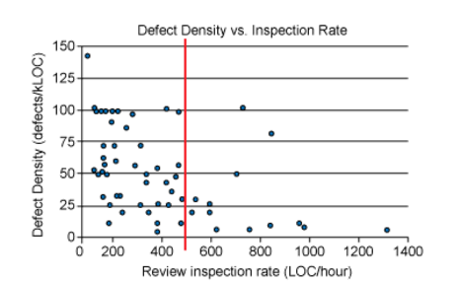
The “How” (cont)
Review Types:
Over-the-shoulder review
Formal review
Tool-assist review.
Review in small chunks.
200-400 SLOC/hr
Have a coding Style Guide or Checklist available.

Slide 9
The “How” (cont)
Goal: 100% coverage
75%+ coverage is still good.
No review of 3rd-party code.
Foster a positive culture.
“No Fear” & “No Retaliation” environment.
“No penalty” for rejecting code & may delay a release.

Slide 10

The “How” (cont)
Over-the-shoulder
Pros:
Suitable for couple dozens SLOC.
Less costly and low overhead.
Cons:
Reviewer may feel “rushed”.
Lack of audit or documentation of review comments.

Slide 11

The “How” (cont)
Formal Review
Pros:
Somewhat effective since all parties are in same room and same time.
Cons:
Costly – need to generate code review package.
Jr reviewer may feel intimidated.
Sr reviewers/architecture may not come prepared.
“Another meeting” to attend.

Slide 12
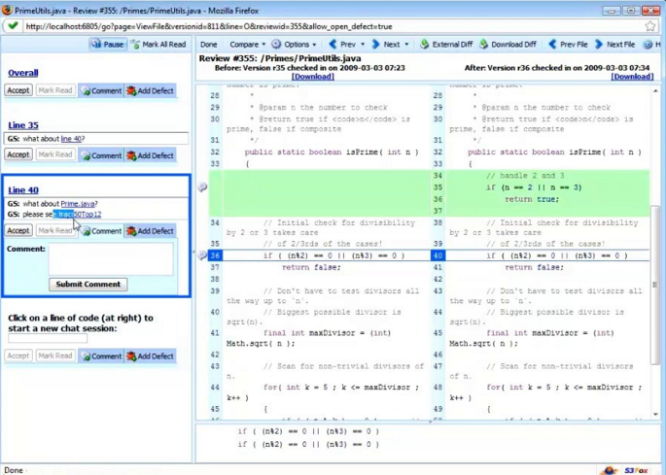

The “How” (cont)
Tool-Assisted Review
Pros:
Quite effective.
Reviewers can review at his own pace.
Reviewers has time to analyze the code under review.
All comments are tracked and documented for auditing.
Cons:
Cost of software purchase (Code Collab $500/seat).

Slide 13
The “How Not”
Use review as a “retaliation” or to “insult” other developers.
Use review “bug/defects” report to gauge employees’ annual performance.

Slide 14
Code Review Patterns
Readability
Consistency
DRY Principle
Testable
Miscellaneous.
Magic strings and number.
Large method body.

Slide 15
Code Review Patterns - Readability
Quite subjective.
Use style guide as a guideline.
Code should be readable & understandable 6 months or a year from now by different developers.
Code Demo.

Slide 16
Code Review Patterns – Readability (cont)
What is wrong?
Not liberal use of whitespaces.
Poorly-worded variable names.
Lengthy line.
Mixture of underscore_casing and camelCase.
How can we make it better?

Slide 17
Code Review Patterns – Consistency
New code’s styles, error handing, patterns, etc should match those of existing code.
Exception: old, legacy code prior to code review process
is exempt.
Coding Style Guide should help.
Code Demo.

Slide 18
Code Review Patterns – Consistency (cont)
What is wrong?
No precondition checks.
Inconsistent ways of logging errors.
Multiple return statements.
How can we make it better?

Slide 19
Code Review Patterns – DRY
Look for repeating code blocks. Results of copy/paste.
Look for repeating magic string and numbers.
Code Demo.

Slide 20
Code Review Patterns – DRY (cont)
What is wrong?
Duplication of magic number 7926 miles.
Copy/Paste same block of code
How can we make it better?

Slide 21
Code Review Patterns – Testable
Make liberal use of Dependency Injection and IoC Container (eg Spring, Ninject, etc)
Externalize “heavy weight” dependency.
Use “mocks”.
Code Demo(Java & Javascript).

Slide 22
Code Review Patterns – Testable (cont)
What is wrong?
Difficult to mock HttpClient and Logger.
Difficult to simulate error conditions.
Need to mock out ajax call.
How can we make it more testable?

Slide 23
Code Review Patterns – Misc
Large Method
60-80 lines is optimal and can fit in an IDE page.
Difficult to unit test large method due to multi paths.
Too many nested if/for/while code blocks.
Violate Single Responsibility Principle by doing too many things.
Code Demo

Slide 24
Code Review Patterns – Misc
Magic String and Numbers
Look for repeating occurrence of strings or numbers in several places.
“Static int MAX_LEN = 256” instead of sprinkle 256 in several places.

Slide 25
Conclusion
Discussed the 3 Ws and How.
Discussed the pros and cons of three review approaches.
Discussed various code review patterns and gotchas.

