Slide 1
Javascript Testing with Jasmine
Presenter: Hoanh Tran hoanh_tran@yahoo.com
Code Download:
https://github.com/h-t-tran/brown/tree/master/jamine

Slide 2
Agenda
What is Jasmine?
Testing of Javascript.
Testing of async Javascript code
Testing of ajax Javascript code.
Testing of UI Javascript code.
Karma test runner.

Slide 3
What is Jasmine?
Unit testing framework for Javascript. Jasmine is to Javascript as Junit is to Java or Nunit is to C#.
Used for white-box testing.
Uses Behavior Driven Development (BDD) to allows testers/developers to write tests using natural language.
“Testing framework of choice” for Angular apps.
Opened source with MIT license.

Slide 4
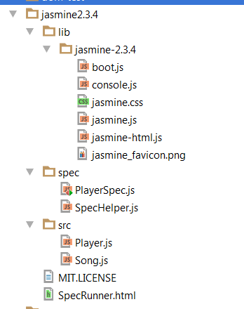
Downloading Jasmine?
Opened source http://jasmine.github.io/2.3/introduction.html

Slide 5
Jasmine Syntax
describe( <JS module> )
beforeEach() { }
afterEach() { }
describe ( <JS function > )
beforeEach() { }
afterEach() { }
it( “should do something ) { // test logic }
it( “should do something else ) { // test logic }

Slide 6
Jasmine “asserts”
Uses “fluent language” syntax to describe test expectation.
expect( testResult ).toBe( expectedResult)
expect( testResult ).not.toBe( expectedResult)

Slide 7
Jasmine matchers
toBe()
toThrowError()
toMatch()
toBeDefined()
toBeUndefined()
toBeNull()
toBeTruthy()
toEqual()
toContain()
toBeLessThan()
toBeGreaterThan()
toBeCloseTo()
toThrow()
toBeFalsy()
not.toBe()
not.toThrowError()
not.toMatch()
not.toBeDefined()
not.toBeUndefined()
not.toBeNull()
not.toBeTruthy()
not.toEqual()
not.toContain()
not.toBeLessThan()
not.toBeGreaterThan()
not.toBeCloseTo()
not.toThrow()
not.toBeFalsy()

Slide 8
Jasmine Spies
Use to replace actual calls with fakes.
Similar to various mocking libraries such as JMockit, RhinoMock, Moq.
spyOn(), jasmine.createSpy().

Slide 9
JS Module Under Test
Calculator module
Calculator.prototype.configure = function(successCallback,
errorCallback)
Calculator.prototype.add = function(x, y)
Calculator.prototype.asyncAdd = function(x, y)
Calculator.prototype.addAndDisplay = function(x, y, domEle)
Calculator.prototype.substract = function(x, y)
Calculator.prototype.multiply = function(x, y)
Calculator.prototype.divide = function(x, y)
Notes:
Show code

Slide 10
“Hello world” Jasmine Tests
Code demo

Slide 11
Async Testing for timeout()
Each test uses the convention
describe( <async function > )
if( “should… “, function(doneCallback) {
// execute async function
done ();
}, waitTimeout);
if( “should… “, function(doneCallback) {
// execute async function
done ();
}, waitTimeout);
Notes:
Code demo

Slide 12
Async Testing for timeout() (cont)
Use jasmine.clock() to speed up timeout expiration
Code demo

Slide 13
Async Testing for ajax
Use Spy to intercept $.ajax()
Syntax spyOn( object, “function to intercept” )
e.g. spyOn( $, “ajax” )
Some spying functions
spyOn().and.callThough()
spyOn().and.callFake()
spyOn().and.throwError()
spyOn().and.returnValue()
Some expections to perform on spied object
expect( $.ajax ).toHaveBeenCalled()
expect( $.ajax.calls.count() ).toEquals(1)

Slide 14
Async Testing for ajax (cont)
spyOn().and.callThough() – intercept and invoke the
real function

Slide 15
Async Testing for ajax (cont)
spyOn().and.callFake() – intercept and invoke mock functions.

Slide 16
Async Testing for ajax (cont)
Code Demo

Slide 17

Unit Testing with DOM Element
addAndDisplay(x, y, domEle)
Code Demo

Slide 18
Karma
Javascript unit test driver written in NodeJS by Angular team.
Constantly monitors your Javascript code and execute unit tests very fast.
Productivity tool. No need to leave your IDE to run unit tests.

Slide 19
Karma Installation
1st. Install NodeJS (eg. C:\nodejs)
2nd. In C:\nodejs, type “npm install karma --save-dev”
3rd. In C:\nodejs, type
“npm install karma-chrome-launcher --save-dev
4th. In C:\nodejs, type
“npm install karma-firefox-launcher --save-dev

Slide 20
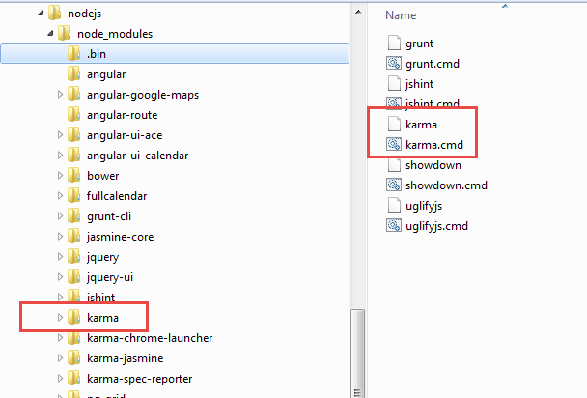
Karma Configuration
C:\nodejs npm install karma

Slide 21
Karma Configuration
Assume your Javascript code folder is C:\code
1st cd to C:\code, then type “karma init” to generate
karma.conf.js
2nd Modify karma.conf.js to your liking.
3rd. In C:\code, type “karma start” to run karma.
Code Demo

Slide 22
Conclusion
Introduction to Jasmine.
Use Jasmine to mock ajax and long running functions
Use Karma to improve productivity.
Questions or comments?

