Slide 1
More With LESS
Presenter: Hoanh Tran 12/5/2015

Slide 2
Agenda
CSS Pain.
Why LESS?
Grunt & LESS compiler

Slide 3
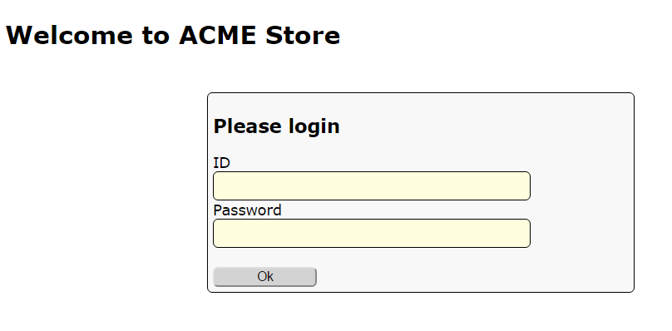
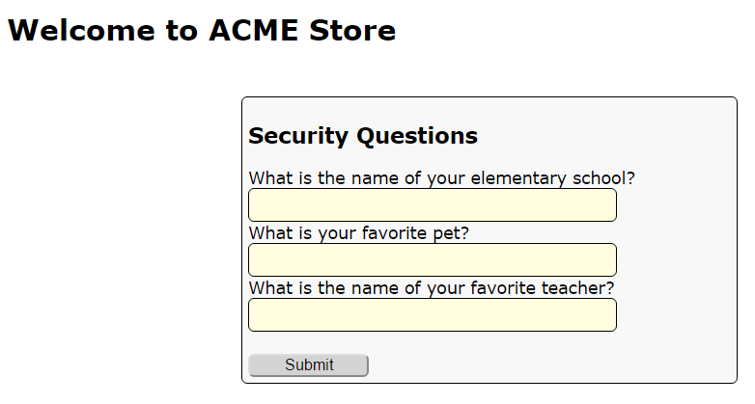
Demo App

Slide 4
CSS Pain
Style duplication – violation of DRY principle.
Magic number & lack of color names.
No support for mathematic calculation.
Cascading issues

Slide 5
Style duplication
#my-ok-button {
background: #FEFEFE;
font-size: 18px;
width: 20px;
}
#my-cancel-button {
background: #FEFEFE;
font-size: 18px;
width: 30px;
border-radius: 5px;
-moz-border-radius: 5px;
-webkit-border-radius: 5px;
}

Slide 6
Magic number & color name?
#my-ok-button {
background: #FEFEFE; /* important color */
font-size: 18px; /* important font */
}
#my-cancel-button {
background: #EEEEEE; /* unimportant color */
font-size: 15px; /* unimportant font */
}

Slide 7
No Support for Calculation
#my-ok-button {
background: #FEFEFE;
font-size: 18px;
width: 20px;
}
#my-cancel-button {
background: #FEFEFE;
font-size: 12px; /* must be 2/3 that of ok-
button */
width: 30px; /* must be 1.5 that of ok-
button */
}

Slide 8
Cascading Issues
<form id=“my-form”>
<div>
<label>Name</label>
<input type=text></input>
</div>
<div>
<label>Age</label>
<input type=text></input>
</div>
</form>
#my-form {
width: 200px;
background: #00FFFF;
margin: 5px;
}
#my-form input {
border-radius 5px;
}
#my-form div {
border: 1px;
}
#my-form label {
padding: 10px;
}

Slide 9
Code Demo

Slide 10
LESS to the rescue.
.less
.less
.css
.less
LESS Compiler

Slide 11
LESS Basics
Variables
@error-color: #FF0000;
@my-fonts: Times Roman, sans serif;
Comments
/* */
//
@import “other.less”
merge other .less files into single files for quicker download

Slide 12
LESS Basics (cont)
Operation
font-size: 5px + 4;
color: #00FFFF / 4;
Built-in Functions
color: lighten( #0F0F0F, 10%);
color: darken( @error-color, 10%);
color: saturate( @error-color, 10%);
color: fadein( @error-color, 10%);
color: fadeout( @error-color, 10%);
// Math
@pi: round(3.1456)

Slide 13
LESS Basics (cont)
Built-in Functions
@top: ceil(3.1456)
@bottom: floor(3.1456)
@my-width: percentage(0.15); // 15%

Slide 14
Code Demo

Slide 15
Cascading & Nested Styles
Allows more intuitive ways of specifying rules.
Instead of
#my-form { /* css rules go here */ }
#my-form div { /* css rules <div> within my-form*/ }
#my-form div span { /* css rules of <span> within
<div> within my-form*/ }
#my-form input { /* css rules <input> within my-form*/ }

Slide 16
Cascading & Nested Styles (cont)
We have this in LESS
#my-form {
/* css rules go here */
div {
/* css rules <div> within my-form*/
span {
/* css rules of <span> within <div> within my-form*/
}
}
input { /* css rules <input> within my-form*/
}
}

Slide 17
LESS Mix-in
Repeatable sections of styles.
LESS “functions”
Can accept parameters, overloads and default params.
Enforce DRY principle.

Slide 18
LESS Mix-in (cont)
.rounded-corners( @size ) {
border-radius: @size;
-webkit-border-radius: @size;
-moz-border-radius: @size;
border-style: solid; border-width: 2px;
}
// Usage
#my-button {
.rounded-corners( 3 px );
}

Slide 19
LESS Mix-in Overloads
.rounded-corners( @size ) {
border-radius: @size;
-webkit-border-radius: @size;
-moz-border-radius: @size;
}
.rounded-corners( @size, @factor ) {
border-radius: @size * @factor;
-webkit-border-radius: @size * @factor;
-moz-border-radius: @size * @factor;
}
// Usage
#error-button {
.rounded-corners( 3 px );
}
#error-button {
.rounded-corners( 3 px, 0.8 );
}

Slide 20
LESS Mix-in Guards
.rounded-corners( @size ) when (@size > 10px) {
border-radius: 10px;
}
.rounded-corners( @size) when (@size <= 10px) {
border-radius: @size;
}
// Usage
#error-button {
.rounded-corners( 3 px ); // radius will be 3 px
}
// Usage
#warn-button {
.rounded-corners( 30 px ); // radius will be 10 px
}

Slide 21
Code Demo

Slide 22
Namespace
Use for organizing groups of styles
#common-namespace {
.error-button { color: orange; font-size: 15px; }
}
#login-namespace {
.error-button { color: red; font-size: 20px; }
}
// usage:
#submit-failure-button {
#login-namespace > .error-button;
}

Slide 23
Scope
@error-color: #FF0000; // red
#my-namespace {
@error-color: #FF9100; // orange. Override the global.
.error-button {
font-size: 20px;
background: @error-color; // orange
}
}
// usage: #login-failed-button {
#my-namespace > .error-button;
}
#login-failed-button {
font-size: 20px;
background: #FF9100;
}

Slide 24
Grunt Task Runner
Node JS app.
Monitor for changes and execute tasks (eg LESS compiler)
1st. Install Node JS
2nd. [NodeJS_INSTALLDIR] npm install grunt --save-dev
3rd. [YOUR_PROJDIR] npm install grunt-contrib-watch --save-dev
4th. [YOUR_PROJDIR] npm install grunt-contrib-less --save-dev
5th. Create the GruntFile.js in YOUR_PROJDIR.
6th. [YOUR_PROJDIR] grunt watch

Slide 25
Grunt Task Runner Demo

Slide 26
Conclusion
LESS Basics – variables, operations, built-in functions.
Nested & Cascading rules
Mixins – overload and guards
Namespace
Scope
Brief discussion of Grunt.

