Slide 1
Effective Code Review
Presenter: Hoanh Tran 3/10/2016

Slide 2
Agenda
What
Why
When
How & How Not
Code Review “Patterns”

Slide 3
The “What”
To read and understand the code.
Search for areas that are problematic.
Search for areas for improvement.
Not a witch hunt or assign blame.
To share knowledge between Sr and Jr developers.
Notes:
Problematic = algorithm.
Improvement = engineers make mistakes.

Slide 4
The “Why”
Very effective way to discover defects & difficult-to-find bugs.
Code review + unit test + Linting + automation tests =
high quality product
Provides a check before code goes to production.
To learn from each other and be better developers.
Improve quality of the team & code.
Meet CMMI Level 3
Notes:
Show example of difficult to find bug = error case or exception handing.

Slide 5
The “Why” (cont)
Cons:
Add ~10% to development effort.
Cost $$$
Not suitable for “throw away” projects (e.g. test harness/drivers, proof of concept app )
Notes:
Show example of difficult to find bug = error case or exception handing.

Slide 6
The “When”
Right after a feature is completed.
For large feature set, review in piecemeal.
End of a short sprint.

Slide 7
The “How”
The Process
Code Complete
(author)
Submit for Review (author)
Perform Review (reviewer(s))
Merge to master
Rework
(author)

Slide 8
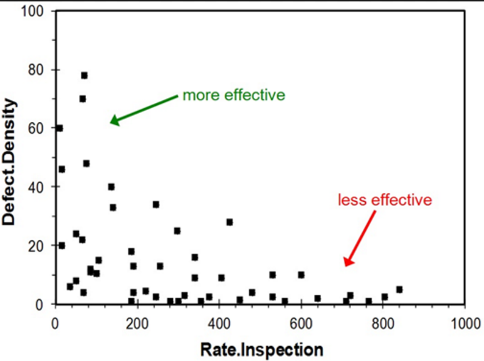
The “How” (cont)
Review Types:
Over-the-shoulder review
Formal review
Tool-assist review.
Review in small chunks.
200 SLOC/hr
Have a coding Style Guide available.

Slide 9
The “How” (cont)
Goal: 100% review (best)
75%+ is still good.
No review of 3rd-party code.
“No Fear” & “No Retaliation Mentality” environment.
“No penalty” for rejecting code which may delay a release.

Slide 10

The “How” (cont)
Over-the-shoulder
Pros:
Suitable for couple dozens SLOC.
Less costly and low overhead.
Cons:
Reviewer may feel “rushed”.
Lack of audit or documentation of review comments.

Slide 11

The “How” (cont)
Formal Review
Pros:
Somewhat effective since all parties are in same room and same time.
Cons:
Costly – need to generate code review package.
Jr reviewer may feel intimidated.
Sr reviewers/architecture may not come prepared.
“Another meeting” to attend.

Slide 12
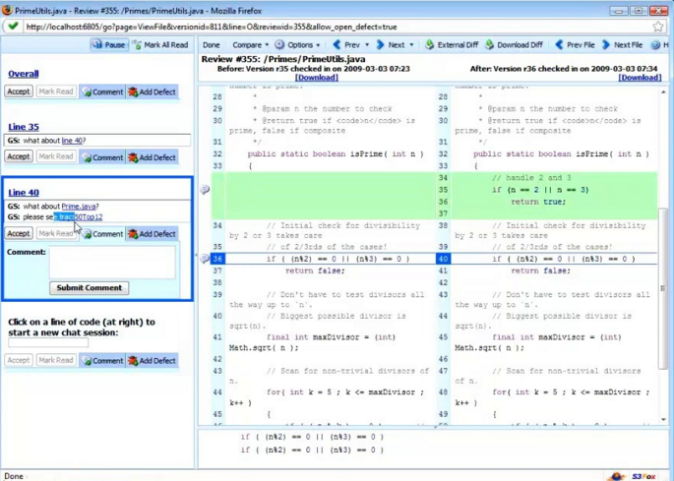

The “How” (cont)
Tool-Assisted Review
Pros:
Quite effective.
Reviewers can review at his own pace.
Reviewers has time to analyze the code under review.
All comments are tracked and documented for auditing.
Cons:
Cost of software purchase (Code Collab $500/seat).

Slide 13
The “How Not”
TODO

Slide 14
Code Review Patterns
Readability
DRY Principle
Testable
Consistency
Miscellaneous.
Magic strings and number.
Large method body.

Slide 15
Code Review Patterns (cont)
Readability
Xx
Code Demo

Slide 16
Code Review Patterns (cont)
DRY
Xx
Code Demo

Slide 17
Code Review Patterns (cont)
Testable
Xx
Code Demo

Slide 18
Code Review Patterns (cont)
Consistency
Xx
Code Demo

Slide 19
Code Review Patterns (cont)
Readability
Xx
Code Demo

Slide 20
Code Review Patterns (cont)
Misc
Xx
Code Demo

Slide 21
Conclusion
Discussed the 3 Ws and How.
Discussed the pros and cons of three review approaches.
Discussed various code review patterns and gotchas.

Slide 22
xx

Slide 23
Conclusion
Introduction to Jasmine.
Use Jasmine to mock ajax and long running functions
Use Karma to improve productivity.
Questions?

