Slide 1

MDD ASSIGNMENT
MYXPRI011 and mkltok002

Slide 2
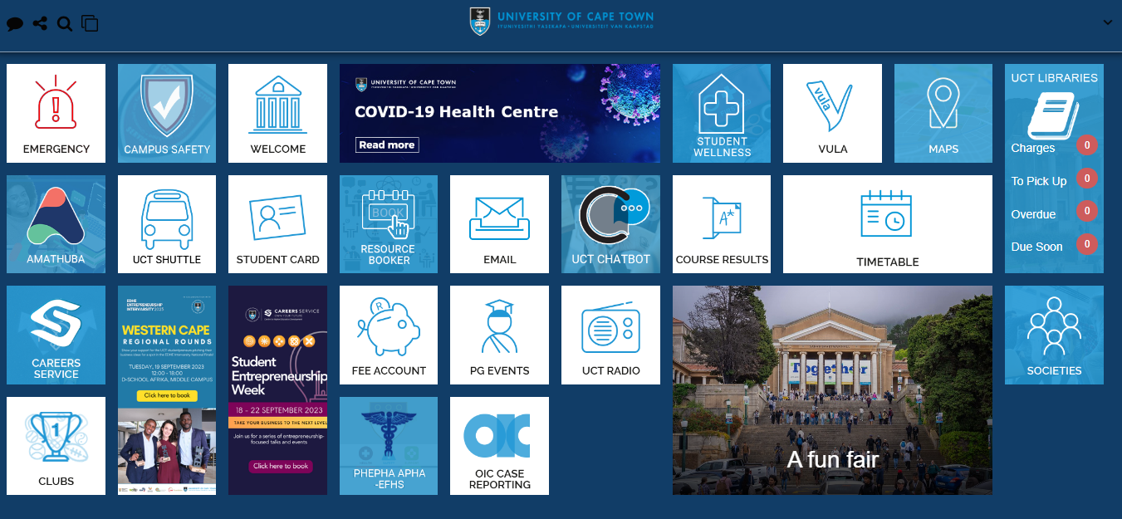
Evaluation of the overall UCT Mobile interface
Two things we liked
Two things we did not like

Slide 3
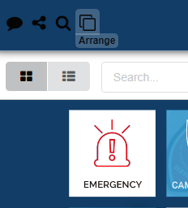
1. Two things we liked
1. The Arrange feature.
- The use of tiles for various services allows for quick and intuitive navigation, adhering to the design principle of visibility and simplicity. Users can easily locate and access services, contributing to a positive user experience.
Design principles: Affordances, User control and freedom, Clarity and consistency
User feedback: Ease of navigation, Reducing decision time, Customization preference.

Slide 4
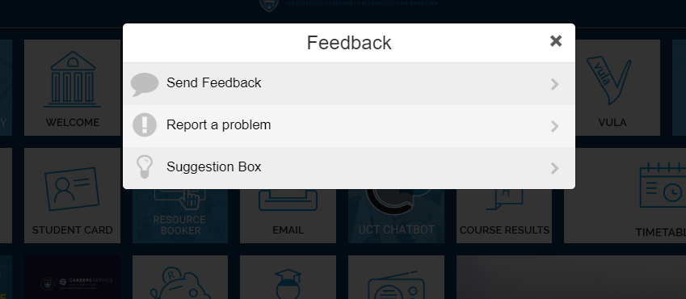
2. Feedback Feature
- The inclusion of a Feedback button reflects a commitment to user engagement and continuous improvement. This aligns with user-centered design principles, providing users with a channel to voice their opinions and contribute to the app's enhancement.
Design Principles: User feedback loop, Visibility and Accessibility, user-centered design.
User feedback: User empowerment, transparency and accountability, Idea contribution.

Slide 5
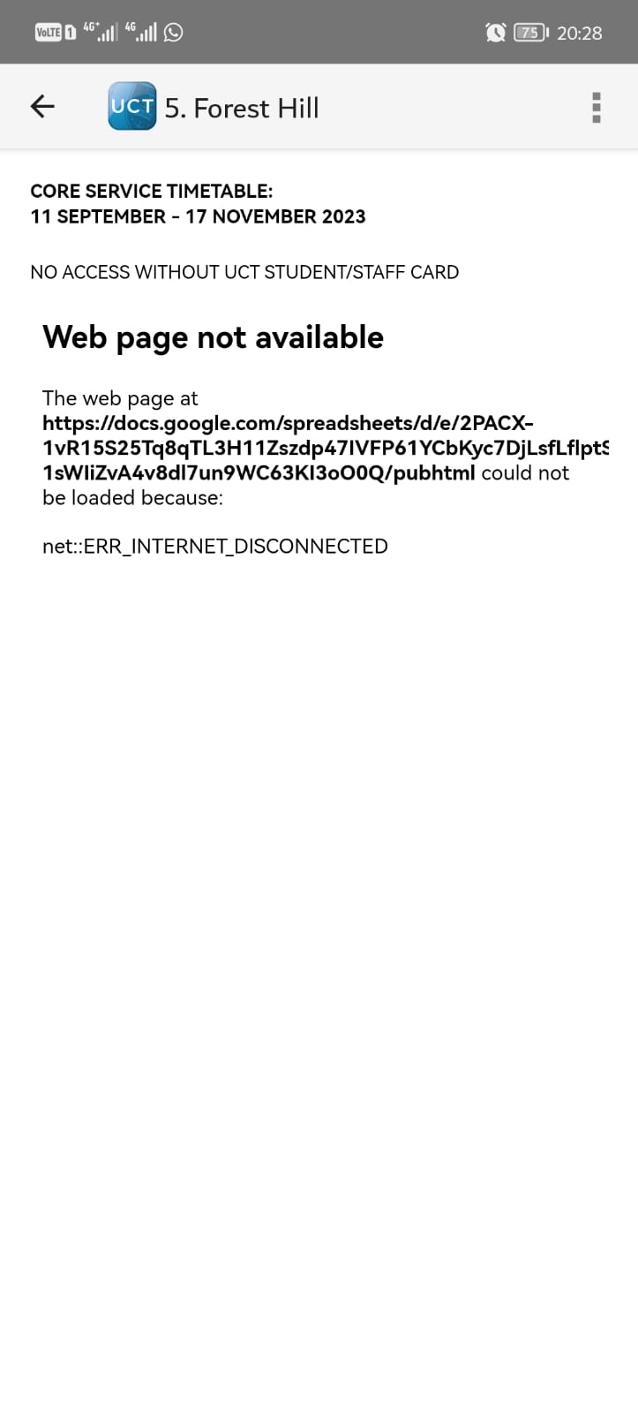
2. Two things we did not like
1. Dependency on internet connection for shuttle information.
Design principles violated: Accessibility, User-centered design, Reliability.
User expectations: Real-time accessibility, Emergency situations.

Slide 6
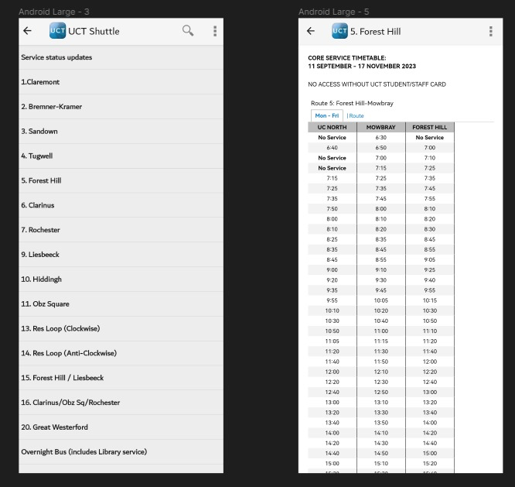
The solution is to implement offline functionality for the shuttle tile.

Slide 7

2. Non-Responsive Emergency tile.
Design principles violated: Responsiveness, User-centered design.
User Expectations: Immediate access

Slide 8
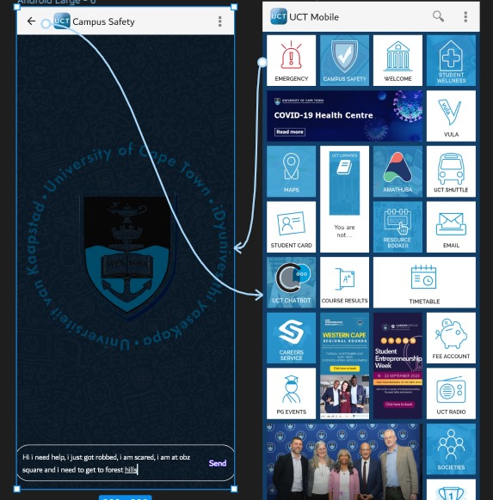
Our proposed improvement involves transforming the Emergency tile into a responsive element. Clicking on the tile should open a chat interface, providing users with a direct communication channel to Campus Protection Services.

Slide 9
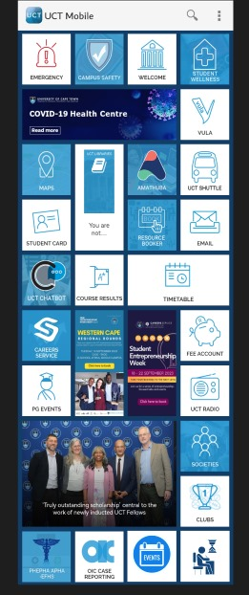
Overview of the re-designed interface
Events tile
Classes tile

Slide 10
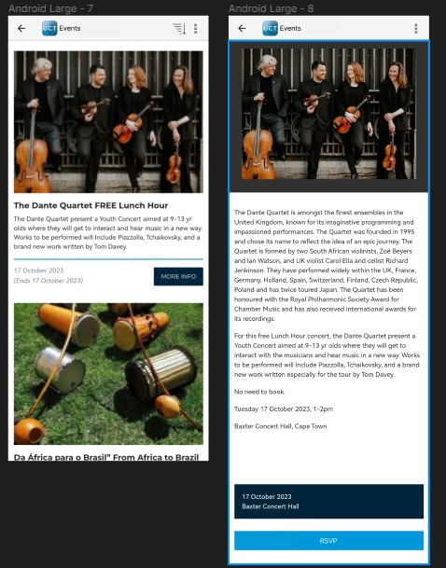
1. Events Tile
Provides quick access to information about upcoming university events.
It has Events list, Sorting functionality, Events details page, RSVP Button.
Standards and models: HCI Standards, Nielsen’s Heuristics, User-centred design models.
Justification: Usability and control, Engagement and interaction, Consistency and clarity.

Slide 11
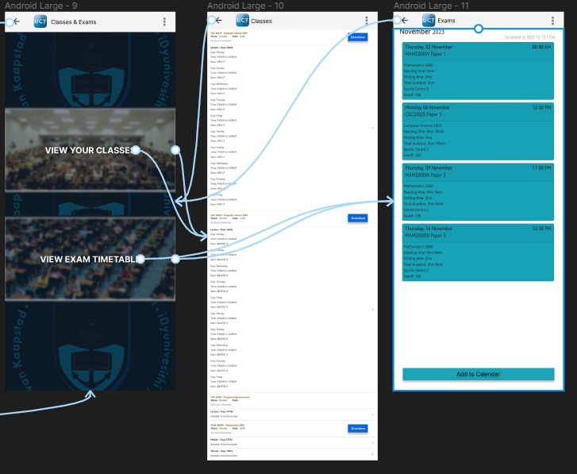
2. Classes Tile
By clicking on the Classes Tile, users are presented with a dedicated page offering comprehensive access to vital academic information.
It has View Your Classes option, View Examination Timetable option, Direction button for classes and exam.
Standards and Models: HCI Standards, Nielsen’s Heuristics, User-centered design model.
Justification: Efficient information retrieval, User-friendly navigation, Consistency with design patterns, Inclusivity for new students.

Slide 12
https://www.figma.com/file/aYTwzBNg55lKiZqKqmMsWp/Untitled?type=design&node-id=2%3A3&mode=design&t=A85o765cqMFORgJu-1

