Slide 1
D.
CONFIDENTIAL · INTERNAL
D.
Dexter Sports Co.
● COACH REPRESENTATION · NIL GUIDANCE
Protect the talent.
Shape the opportunity.
Build what lasts.
An advocate for coaches — especially women coaches and the assistants the big agencies overlook — and for athletes and families navigating NIL.
SEED INVESTMENT OVERVIEW
Women-Owned Social Enterprise · Confidential 2026

Slide 2




CONFIDENTIAL · INTERNAL
● WHY NOW
The coaches the big agencies overlook.
Female coaches are underrepresented
Women fill the assistant pipeline but rarely reach the top jobs. Dedicated, outcomes-focused representation is scarce.
$500K–$5M+
NIL has reached high school
Typical collegiate head-coaching salary range.
North and South Carolina now permit HS NIL — a first-mover market for athletes and families navigating offers.
Representation is fragmented
A single placement at up to 3% is a meaningful, repeatable fee.
Coaches and athletes manage contracts, brand, and career moves with little integrated, values-aligned support.
Dexter Sports Co. · The Opportunity

Slide 3




CONFIDENTIAL · INTERNAL
● WHY WE EXIST
A full pipeline that stalls before the top.
Women fill the assistant-coach pipeline but rarely reach the head jobs — representation is scarcest exactly there.
~2/3 *
46% *
7.3% **
43 / 55% *
of full-time assistant coaches are women — the pipeline we serve
of coaches on women's college teams are women (2024) — below the 1980s peak
of women's-team head coaches are women of color; 44% of D-I schools employ none
women are 43% of varsity athletes but 55% of undergraduates
A full pipeline, a narrow top. The largest agencies compete for Power-conference head coaches and star athletes. Women coaches and mid-career assistants — especially at mid-major, D-II and D-III, and in sports beyond basketball — rarely get an advocate. That's who Dexter is built for.
* The Collective Think Tank, Women in NCAA Intercollegiate Athletics (2026), via WIA Report. ** Tucker Center / WeCOACH, Women in College Coaching Report Card 2025–26 (94 D-I schools). Populations differ: Tucker covers D-I head coaches; the Collective Think Tank covers all coaches across 1,000+ schools.

Slide 4
CONFIDENTIAL · INTERNAL
● BY THE NUMBERS
More women in the game than ever.
Record participation and a fast-growing NIL market mean more opportunities, and more contracts and offers that need a careful advocate.
242,341 *
3.54M **
$1.67B ***
10.2% ***
women competed in NCAA sports in 2024–25, a record
girls played high school sports in 2024–25, also a record
projected NIL market in 2024–25, up from $917M in 2021–22
of commercial NIL pay went to women's basketball, passing men's basketball (8.6%)
Bigger market, uneven share. Brand deals reward women athletes, but donor-funded collectives still send most of their money to football and men's basketball (women's volleyball gets under 1%). Women head coaches grew 13% in a decade to 5,126.* Demand for a careful advocate is growing on both sides.
* NCAA, Sports Sponsorship and Participation Rates Report (2024–25) and Demographics Database (2025), via NCAA.org. ** NFHS, High School Athletics Participation Survey 2024–25 (Sept 2025). *** Opendorse, NIL at 3: The Annual Opendorse Report (July 2024); market figures are Opendorse projections.

Slide 5


CONFIDENTIAL · INTERNAL
● COMPETITIVE LANDSCAPE
The middle of the market is wide open.
The giants fight over the top. Dexter owns the underserved middle — women coaches and assistants, mid-major to D-III.
Elite agents
Women-founded boutiques
School-paid search firms
Power-5 heads & pro stars
Niche by sport / role
Flat $25K–120K / search
DEXTER
CAA
Athletes First
Octagon
Excel
KMM Sports
OneForOne
Spisak
BDS Agency
Parker
TurnkeyZRG
Collegiate Sports
Women coaches & assistants, all sports, mid-major → D-III
Power-5 heads & men's-led → assistants, mid-major, D-II/III
Football & basketball → women's & all sports
Positioning is illustrative. Sources: Sportico, Pollstar, Front Office Sports, Hunt Scanlon; coaching-equity data per The Collective Think Tank (2026) and Tucker Center / WeCOACH (2025–26).

Slide 6
CONFIDENTIAL · INTERNAL
● WHO WE COMPETE WITH
Capital is flowing into representation.
Boutiques with defensible rosters are acquisition targets — a credible exit path for Dexter.
Company
Model
Scale
Reported financials / transactions
CAA Sports
Elite agent, ~3–4%
50+ FBS coaches
~$578M sports revenue; ~$7B valuation (2023)
Athletes First
Athlete & coach agent
450+ clients
$50M val. (2015) → VC majority, well above
The BDS Agency
Boutique coach agent
200+ D-I renegotiations
Private; none reported
Parker Executive Search
School-paid search
1,750+ searches
$60K–$120K per head-coach search
Opendorse
NIL platform
100K+ athletes
~$26M–$40M raised; $20M round (2022)
KMM Sports
Women-founded, attorney/NFLPA
HS → pro & Olympic
Private; 2026 Borchetta platform partnership
Dexter Sports Co.
Coach rep + NIL
Women coaches, all sports
3% fee, $6K floor; search-desk line
Our edge: a founder with a Juris Master in contracting & compliance (FSU), a decade of corporate partnerships and major gifts, and SEC-university advancement experience — building the agency women coaches haven't had.
Sources: Sportico, Pollstar, SportsBusiness Journal, Front Office Sports, CBS Sports, Hunt Scanlon, company sites. Private firms marked none reported.

Slide 7

● OUR CLOSEST PEERS
CONFIDENTIAL · INTERNAL
A small cohort of women-founded agencies.
Our truest comps aren't the giants — they're founder-led, women-built agencies. Each owns a niche; none owns ours.
KMM Sports
OneForOne Agency
Spisak Agency
Oklahoma City · est. 2005
Female athletes · brands
Washington, DC · NWSL
Attorney & NFLPA-certified founder (Kelli Masters). Full-service, HS → pro & Olympic. 'Represent the whole person.'
Female-founded, female-supported. Bridges brands and female athletes with creative & marketing services.
'By women. For women.' Founded by pro soccer star & coach KJ Spisak. Representation, advocacy, brand building.
Pro & NFL athletes
NIL & brand deals
Women's soccer
Dexter's open lane: women coaches and assistants (not just athletes), across all sports, at mid-major / D-II / D-III, plus NIL for Carolina athletes and families. No peer combines coach representation, NIL, and this geography.
Sources: company sites; Shore Fire Media; Soccer America; Adweek Most Powerful Women in Sports 2026. Private firms report no financials.

Slide 8
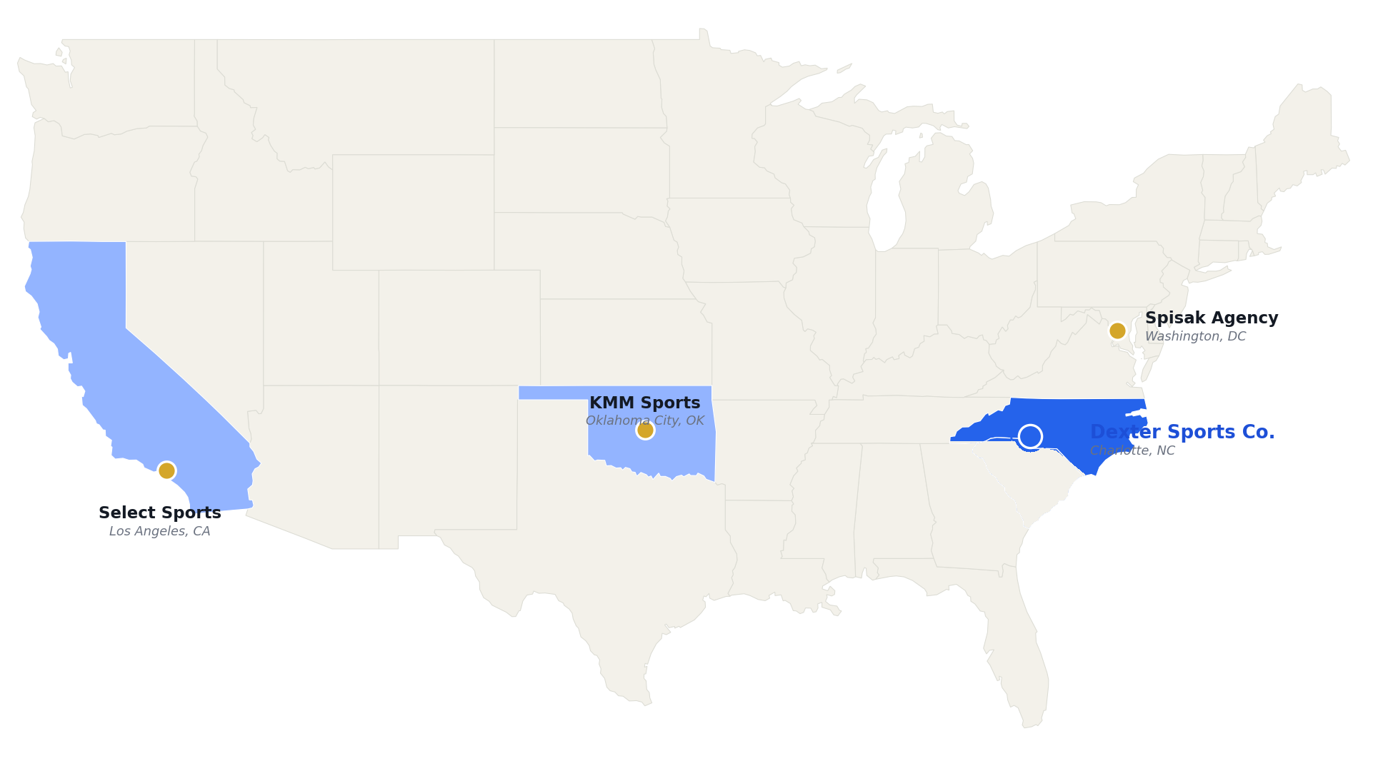
● HEADQUARTERS
CONFIDENTIAL · INTERNAL
Where each agency is headquartered.
Founder-led, women-built agencies are based across the country. Dexter Sports Co. is headquartered in Charlotte, NC.
HEADQUARTERS
KMM Sports
Oklahoma City, OK
Spisak Agency
Washington, DC
Select Sports
Los Angeles, CA
Dexter Sports Co.
Charlotte, NC
OneForOne
National / online
Dexter Sports Co.: the only agency in this group headquartered in the Carolinas.
HQ locations per company sites, LinkedIn, and press. OneForOne publishes no single HQ. Shading marks each agency's headquarters state.

Slide 9



CONFIDENTIAL · INTERNAL
● BUILT FOR THIS WORK
Led by a former Division I athlete.
Contract-trained, partnership-tested. Kim Dexter's background maps onto exactly what competitors charge for.
Kim Dexter
Founder · Charlotte, NC
Legal & contracting
Partnerships & gifts
CFRE
JURIS MASTER · FSU
D-I · HOWARD
A Juris Master in risk management and compliance — she reviews and negotiates contracts, buyouts and NIL deals directly.
CFRE with 10+ years in major gifts, corporate partnerships and sponsorship — the second revenue line, as a core skill.
Inside a Power-5
Athlete credibility
Associate Director of Development at Arkansas (SEC) — she knows how advancement, donors and ADs actually operate.
A former Howard volleyball student-athlete with a natural HBCU and women's-sports network the giants don't prioritize.
Dexter Sports Co. · Founder

Slide 10




CONFIDENTIAL · INTERNAL
● WHAT WE DO
Two specialties. One advocate.
From the next contract to the first NIL offer — coach representation and NIL guidance are the co-equal core.
Coach Representation
NIL & Brand Partnerships
Contract and career representation for head and assistant coaches in every sport — focused on the women and mid-career assistants the big agencies overlook.
Guidance and deal management for athletes and families navigating NIL — a co-equal specialty and the lead engine for the Before You Sign toolkit.
EXPANSION LINES
Search Desk
NFLPA Agent Rep
Flat-fee searches for mid-major & D-II/III — paid by the school.
Represent NFL players once Kim is certified — 3% of contract.
Dexter Sports Co. · What We Do

Slide 11

CONFIDENTIAL · INTERNAL
● MISSION
Mission and margin, moving together.
Our commercial model directly advances outcomes for women in sport — impact is embedded, not bolted on.
Women-owned
Female-coach outcomes
Youth opportunity
Aligned economics
Founded and led by Kim Dexter — ownership and decisions rest with a woman operator in a male-dominated field.
We prioritize placing and advancing women into higher-paid, higher-visibility roles.
NIL guidance helps Carolina athletes and families — including young women — build value early and equitably.
Success-based fees mean we win only when clients win. No conflict between doing well and doing good.
Dexter Sports Co. · Social Enterprise

Slide 12

CONFIDENTIAL · INTERNAL
● HOW WE EARN
Four success-based revenue lines.
Revenue on both sides of the market — coaches and schools — plus two expansion lines.
Coach Representation
Up to 3%, min $6K/hire
Core
Fee per placement across all levels — a floor protects revenue on lower-salary roles.
NIL & Brand Partnerships
% of facilitated deal
Core
Guidance and deal management for athletes and families — co-equal core line.
School-Paid Search Desk
Flat ~$15K / search
Expansion
Searches for mid-major & D-II/III, priced below the big firms.
NFLPA Agent Commission
Up to 3% of contract
Expansion
Commission on NFL player contracts once Kim is certified.
Dexter Sports Co. · Revenue Model

Slide 13

CONFIDENTIAL · INTERNAL
● SEQUENCING
Each phase unlocks the next.
Relationships built representing coaches and guiding NIL become the pipeline for search and agent work.
PHASE 1
PHASE 2
PHASE 3
Representation + NIL
Search Desk
NFLPA Agent Rep
Launch the two core specialties; build the coach roster and the NIL newsletter funnel.
Add school-paid searches for mid-major & D-II/III — revenue on both sides of the market.
Add NFL player representation on certification — the highest-value engagements.
Dexter Sports Co. · Growth Roadmap

Slide 14

CONFIDENTIAL · INTERNAL
● ILLUSTRATIVE FINANCIALS
Two scenarios, reaching breakeven by Year 5.
Placeholder model with all four lines active. The school-paid search desk pushes EBITDA positive by Year 5.
BASE
~$574K
Y5 revenue · EBITDA +$31K · 35 coaches placed by Y5
UPSIDE
~$729K
Y5 revenue · EBITDA +$8K · 62 coaches placed by Y5
Breakeven in Year 5. Adding the school-paid search desk turns EBITDA positive by Y5 in both cases.
Figures are placeholders for illustration only and do not constitute a forecast. All four lines active from their launch years.

Slide 15



CONFIDENTIAL · INTERNAL
● GOVERNANCE
Built to manage conflicts from day one.
Representing both coaches and the players they recruit draws scrutiny. We address it before it's a problem.
The risk
Our policy
Agencies that represent college coaches and NFL players at once face public criticism and conflict-of-interest questions.
A written conflict policy before NFLPA certification — separate the coach and player books, with disclosure and client consent.
Search-desk discipline
Founder fit
We don't negotiate for a coach and take a school fee on the same hire without disclosure and consent.
Kim's Juris Master in contracting and compliance makes governance a credibility asset, not an afterthought.
Dexter Sports Co. · Governance

Slide 16




CONFIDENTIAL · INTERNAL
● THE ASK
Building the base for a multi-line business.
We're raising a seed round to build the team, systems, and certifications behind a phased representation firm.
Team & network
NFLPA certification
Representation and NIL staff plus the relationships to drive deal flow on both sides of the market.
Fund the path to certified agent status and NFL client acquisition.
NIL platform
Brand & marketing
Compliance, tooling, and BD behind the Before You Sign toolkit and newsletter funnel.
Establish Dexter Sports Co. as the values-aligned name in representation.
803-203-5435
dextersportsco.com

