Slide 1
D.
D.
Dexter Sports Co.
● COACH REPRESENTATION · NIL GUIDANCE
Protect the talent.
Shape the opportunity.
Build what lasts.
An advocate for coaches — especially women coaches and the assistants the big agencies overlook — and for athletes and families navigating NIL.
ATHLETE & COACH REPRESENTATION
Women-Owned Social Enterprise · Charlotte, NC

Slide 2




● WHY NOW
The coaches the big agencies overlook.
Female coaches are underrepresented
Women fill the assistant pipeline but rarely reach the top jobs. Dedicated, outcomes-focused representation is scarce.
$500K–$5M+
NIL has reached high school
Typical collegiate head-coaching salary range.
North and South Carolina now permit HS NIL — a first-mover market for athletes and families navigating offers.
Representation is fragmented
A market where one placed coach can change a career — and a program.
Coaches and athletes manage contracts, brand, and career moves with little integrated, values-aligned support.
Dexter Sports Co. · The Opportunity

Slide 3




● WHY WE EXIST
A full pipeline that stalls before the top.
Women fill the assistant-coach pipeline but rarely reach the head jobs — representation is scarcest exactly there.
~2/3 *
46% *
7.3% **
43 / 55% *
of full-time assistant coaches are women — the pipeline we serve
of coaches on women's college teams are women (2024) — below the 1980s peak
of women's-team head coaches are women of color; 44% of D-I schools employ none
women are 43% of varsity athletes but 55% of undergraduates
A full pipeline, a narrow top. The largest agencies compete for Power-conference head coaches and star athletes. Women coaches and mid-career assistants — especially at mid-major, D-II and D-III, and in sports beyond basketball — rarely get an advocate. That's who Dexter is built for.
* The Collective Think Tank, Women in NCAA Intercollegiate Athletics (2026), via WIA Report. ** Tucker Center / WeCOACH, Women in College Coaching Report Card 2025–26 (94 D-I schools). Populations differ: Tucker covers D-I head coaches; the Collective Think Tank covers all coaches across 1,000+ schools.

Slide 4
● BY THE NUMBERS
More women in the game than ever.
Record participation and a fast-growing NIL market mean more opportunities, and more contracts and offers that need a careful advocate.
242,341 *
3.54M **
$1.67B ***
10.2% ***
women competed in NCAA sports in 2024–25, a record
girls played high school sports in 2024–25, also a record
projected NIL market in 2024–25, up from $917M in 2021–22
of commercial NIL pay went to women's basketball, passing men's basketball (8.6%)
Bigger market, uneven share. Brand deals reward women athletes, but donor-funded collectives still send most of their money to football and men's basketball (women's volleyball gets under 1%). Women head coaches grew 13% in a decade to 5,126.* Demand for a careful advocate is growing on both sides.
* NCAA, Sports Sponsorship and Participation Rates Report (2024–25) and Demographics Database (2025), via NCAA.org. ** NFHS, High School Athletics Participation Survey 2024–25 (Sept 2025). *** Opendorse, NIL at 3: The Annual Opendorse Report (July 2024); market figures are Opendorse projections.

Slide 5



● WHERE WE FOCUS
The coaches the big agencies overlook.
The largest agencies compete for the very top. We advocate for the coaches and athletes who rarely get one.
Women coaches & assistants
Mid-major to Division III
Athletes & families on NIL
Head and assistant coaches in every sport — with a focus on the women and mid-career assistants most often overlooked.
Programs beyond the Power-conference spotlight, where dedicated representation is scarcest.
Guidance for athletes and families navigating NIL offers, brand deals, and what they mean for the future.
Dexter Sports Co. · Where We Focus

Slide 6


● IN GOOD COMPANY
Part of a new wave of women-built agencies.
A growing cohort of founder-led, women-built agencies is reshaping representation. Dexter brings coaches and NIL together.
KMM Sports
OneForOne Agency
Spisak Agency
Attorney-founder; full-service representation from high school to the professional ranks.
Female-founded, female-supported — connecting female athletes with brand partnerships.
Founded by a pro soccer star and coach. By women, for women, in the NWSL.
Pro athletes
NIL & brands
Women's soccer
Dexter's focus — coach representation and NIL guidance together, for women coaches and Carolina athletes — is its own lane.
Dexter Sports Co. · In Good Company

Slide 7
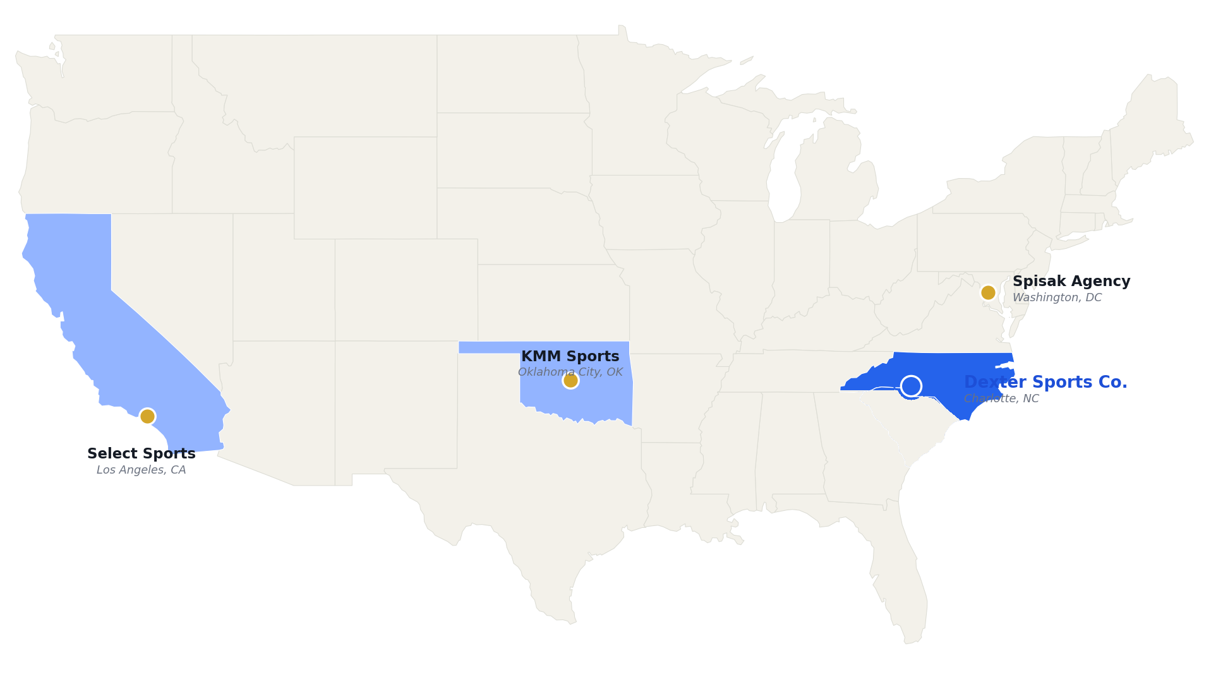
● HEADQUARTERS
Where each agency is headquartered.
Founder-led, women-built agencies are based across the country. Dexter Sports Co. is headquartered in Charlotte, NC.
HEADQUARTERS
KMM Sports
Oklahoma City, OK
Spisak Agency
Washington, DC
Select Sports
Los Angeles, CA
Dexter Sports Co.
Charlotte, NC
OneForOne
National / online
HQ locations per company sites and press. OneForOne publishes no single HQ. Shading marks each agency's headquarters state.

Slide 8



● BUILT FOR THIS WORK
Led by a former Division I athlete.
Contract-trained, partnership-tested. Kim Dexter's background maps onto exactly what competitors charge for.
Kim Dexter
Founder · Charlotte, NC
Legal & contracting
Partnerships & gifts
CFRE
JURIS MASTER · FSU
D-I · HOWARD
A Juris Master in risk management and compliance — she reviews and negotiates contracts, buyouts and NIL deals directly.
CFRE with 10+ years in major gifts, corporate partnerships and sponsorship — the second revenue line, as a core skill.
Inside a Power-5
Athlete credibility
Associate Director of Development at Arkansas (SEC) — she knows how advancement, donors and ADs actually operate.
A former Howard volleyball student-athlete with a natural HBCU and women's-sports network the giants don't prioritize.
Dexter Sports Co. · Founder

Slide 9


● WHAT WE DO
Two specialties. One advocate.
From the next contract to the first NIL offer — we help clients understand what's on the table, what it really costs, and what it means for the future.
Coach Representation
NIL & Brand Partnerships
Contract and career representation for head and assistant coaches in every sport — contracts, extensions, buyouts, and your next move, with a focus on the women and mid-career assistants the big agencies overlook.
Guidance and deal management for athletes and families navigating NIL — evaluating offers, asking informed questions, and managing brand partnerships, from the first offer onward.
Dexter Sports Co. · What We Do

Slide 10

● MISSION
Mission and margin, moving together.
Our commercial model directly advances outcomes for women in sport — impact is embedded, not bolted on.
Women-owned
Female-coach outcomes
Youth opportunity
Aligned economics
Founded and led by Kim Dexter — ownership and decisions rest with a woman operator in a male-dominated field.
We prioritize placing and advancing women into higher-paid, higher-visibility roles.
NIL guidance helps Carolina athletes and families — including young women — build value early and equitably.
Success-based fees mean we win only when clients win. No conflict between doing well and doing good.
Dexter Sports Co. · Social Enterprise

Slide 11


D.
D.
Dexter Sports Co.
Protect the talent. Shape the opportunity.
Representation and NIL guidance, built for the coaches and athletes the big agencies overlook — led by a former Division I athlete.
803-203-5435
dextersportsco.com

