Slide 1


LOST
By Telapoka 14.02.04.066 - Tokey
14.02.04.070 - Niloy
14.02.04.080 - Naimul

Slide 2
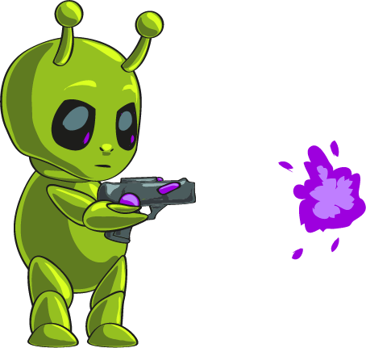
Story
Young Alien in a quest for crystals in unknown planets faces many challenges and difficulty.

Slide 3



How to play?
Player can jump and attack. He can attack at
a short range and as well as from a long
range . Before he can attack from long range

Slide 4



How to play?
He has to collect blaster in each level. He
can collect different gems and battery
To unlock different levels.

Slide 5
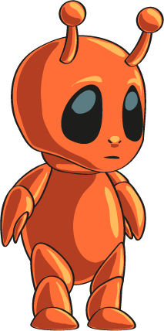



Characters
Player: we call him Zuno
Enemy:

Slide 6





Obstacles and Probs
Spike:
Lock:
Blade:
Spring:
Key:

Slide 7
Class Diagram

Slide 8
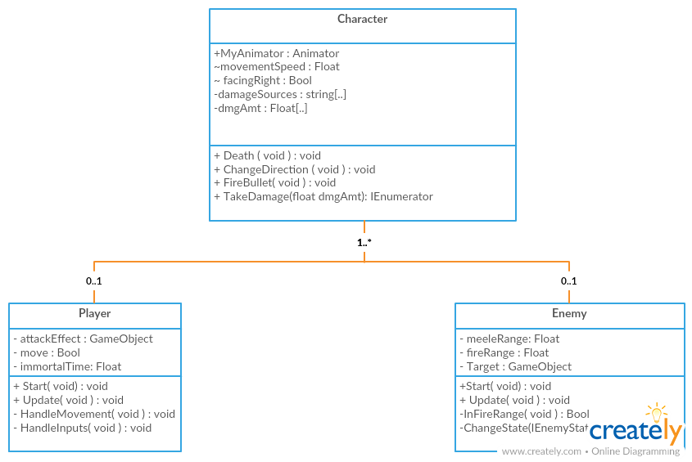

Slide 9
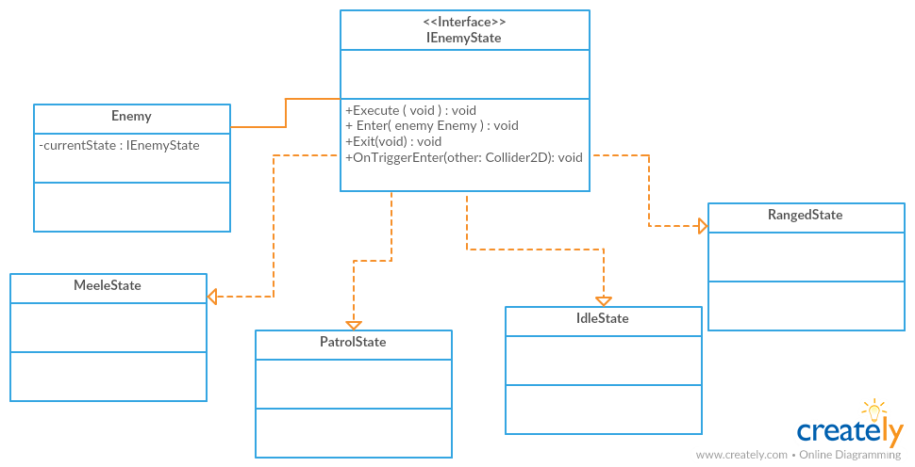

Slide 10
Demonstration

