Slide 1


Introduction to Spring Security

Slide 2
What is Spring Security?
Spring Security is a powerful and flexible security framework for Java-based applications.
It provides authentication, authorization, and session management features.
Spring Security is widely used in enterprise applications to protect against common security threats.
Cross-Site Scripting (XSS).
Cross-Site Request Forgery (CSRF).
Broken Authentication and Session Management.
Insufficient Cryptography.
Malware.
Denial-of-Service (DoS) and Distributed Denial-of-Service (DDoS) Attacks.
documentation

Slide 3
Spring Security Architecture
The Spring Security architecture consists of different modules that work together to provide a comprehensive security solution.
The core module provides basic security features, such as authentication and authorization.
Other modules extend the core module to support additional features, such as OAuth, OpenID Connect, and more.

Slide 4
Authentication in Spring Security
Authentication is the process of verifying the identity of a user.
Spring Security supports multiple authentication mechanisms, such as form-based login, HTTP basic authentication, and OAuth.
You can customize the authentication process using different authentication providers, such as in-memory, JDBC, and LDAP.

Slide 5
Authorization in Spring Security
Authorization is the process of controlling access to resources based on user roles or permissions.
Spring Security supports role-based access control (RBAC) and other types of authorization.
You can define access control rules using Spring Security's expression language, which allows you to specify complex rules for controlling access to resources.

Slide 6
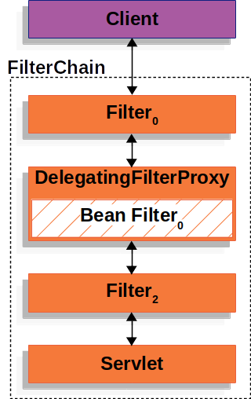
DelegatingFilterProxy
Spring provides a Filter implementation named DelegatingFilterProxy that allows bridging between the Servlet container’s lifecycle and Spring’s ApplicationContext. The Servlet container allows registering Filter instances by using its own standards, but it is not aware of Spring-defined Beans. You can register DelegatingFilterProxy through the standard Servlet container mechanisms but delegate all the work to a Spring Bean that implements Filter.
How Spring Security Works

Slide 7
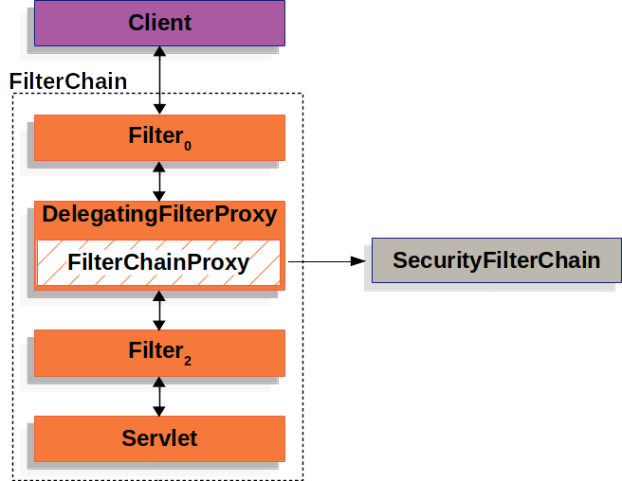
FilterChainProxy
Spring Security’s Servlet support is contained within FilterChainProxy. FilterChainProxy is a special Filter provided by Spring Security that allows delegating to many Filter instances through SecurityFilterChain. Since FilterChainProxy is a Bean, it is typically wrapped in a DelegatingFilterProxy.
How Spring Security Works

Slide 8
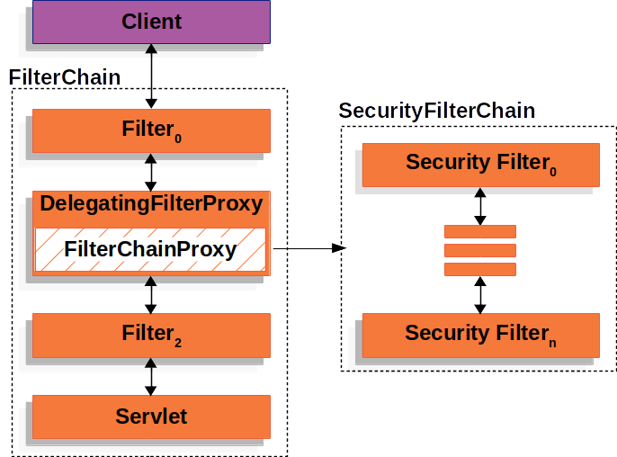
SecurityFilterChain is used by FilterChainProxy to determine which Spring Security Filter instances should be invoked for the current request.
How Spring Security Works

Slide 9
Spring Security Dependencies
<dependency>
<groupId>org.springframework.security</groupId>
<artifactId>spring-security-core</artifactId>
<version>version</version>
</dependency>
<dependency>
<groupId>org.springframework.security</groupId>
<artifactId>spring-security-web</artifactId>
<version>version</version>
</dependency>
<dependency>
<groupId>org.springframework.security</groupId>
<artifactId>spring-security-config</artifactId>
<version>version</version>
</dependency>

Slide 10


Slide 11
Interview Questions

