Slide 1

Pyglet Chess
Josef Komínek

Slide 2

Creating a chess pieces
There is used only one RGB for more pieces. We just use an image peice as a

Slide 3
Creating a chess piece
King('b', self.images['b_king'], self.pieces_zoom)
This line describes figure. Each chessman have its own class. This is very useful especially when describing each type’s enabled moves.
Each piece’s color is also important attribute. You should not be able to take your own color.

Slide 4
There can be more than one
Knight('w', self.images['w_knight'], self.pieces_zoom, 2)
If we index multiple same looking and behaving pieces, we can draw more than just one identical and independent chess piece.

Slide 5
Pawn’s speciality
def reset(self): .
self.taken = False .
self.row = 2 if self.color == ‘w’ else 7 .
self.col = self.number def move(self):
self.state = ‘r’ …
. self.state = ‘n’
. Return True
.

Slide 6
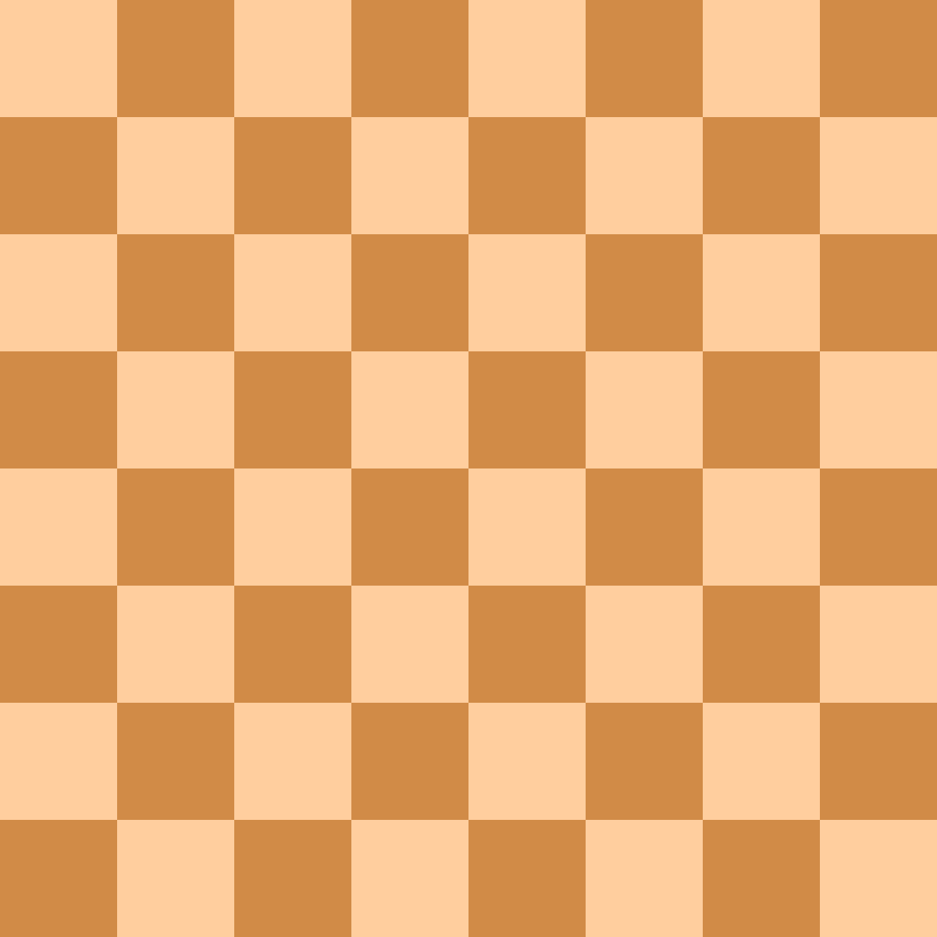
The same size is not the same for this picture
You can use width or either 618 steps or 8 steps.
This is why we use matrix_board…

Slide 7

Unbeaten challenges
It cannot perform castling. State parameter (the same as Pawn has) would be used to detect if the requied castling is still legal.
It cannot detect chess, niether forbit any movement that would keep you checked.

Slide 8
Most annoying and prolonging mistakes?
def reset(self):
…
self.taken = False
def take(self):
…
self.take = True

Slide 9
Thank you

