Slide 1
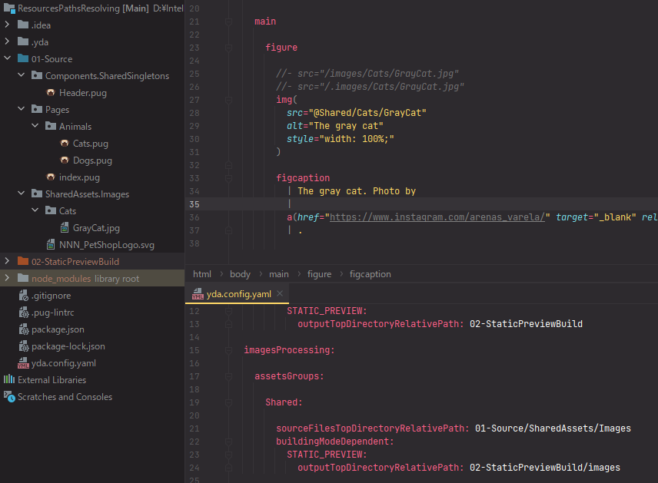

Slide 2
Reference prefix
@Shared/Cats/GrayCat.jpg
Resources group
reference
Path relative to
Optional extension

