Slide 1
Toronto Hospitality
Restaurant investment recommendation analysis

Slide 2
Hospitality in Toronto
Like every industry, the world of hospitality changes continuously
The hospitality industry in Canada is registering growing numbers year-on-year
Toronto restaurant business is diversified into several distinct categories, and although there are a lot of new pop-up restaurant openings across the city each year, the classical cuisines remain to dominant the city culinary scene, namely: Italian, American, French, and Asian restaurants.

Slide 3
Data Aquisition and Cleaning
This analysis leveraged the list of city-designated neighbourhoods in Toronto to obtain a detailed information pertaining to postcodes. These postcodes were further used to obtain a geographical data, specifically latitude and longitude, through Foursquare API.
Data Cleaning Process:
Creating Data Frames ->
Obtaining Geo Locations ->
Clustering Data ->
Exploring Neighbourhoods

Slide 4
Data Analysis
Sample Size
The dataset chosen for this study included 1219 venues of various types from across Toronto (see Figure 3 for an example).
Data Analysis
Data analysis included reducing venues from across Toronto into two categories: Central Bay Street and St. James Town. After these data frames were clustered, they were further examined to define what venues are most common in each area

Slide 5
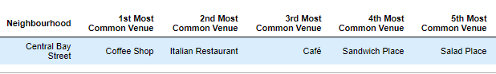
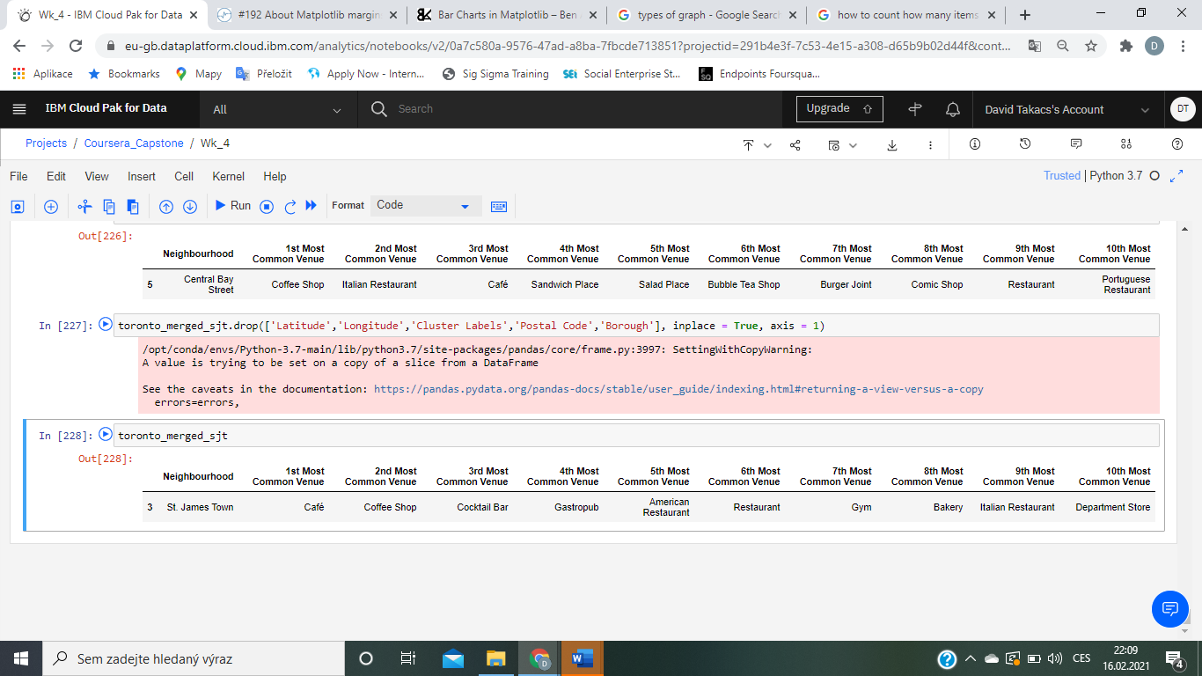
Occurence of Venues

Slide 6
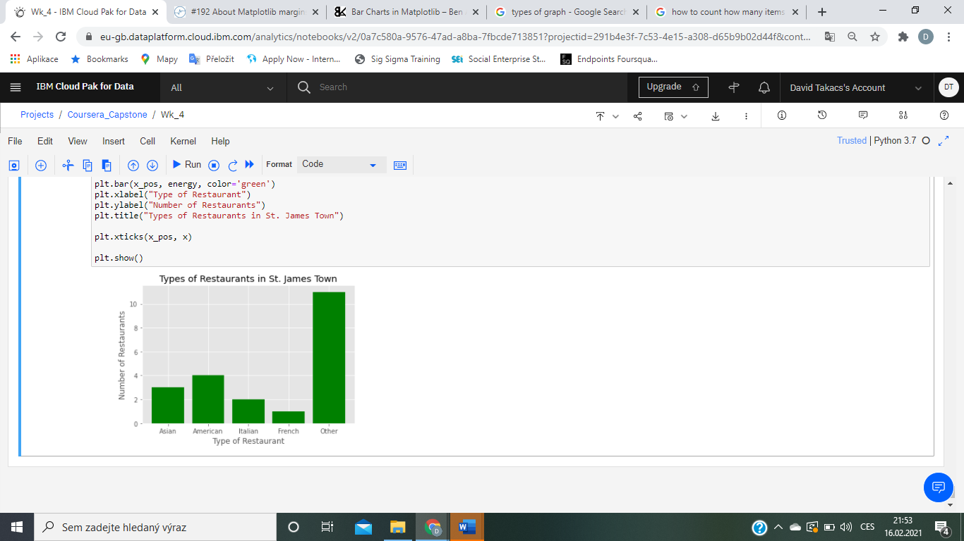
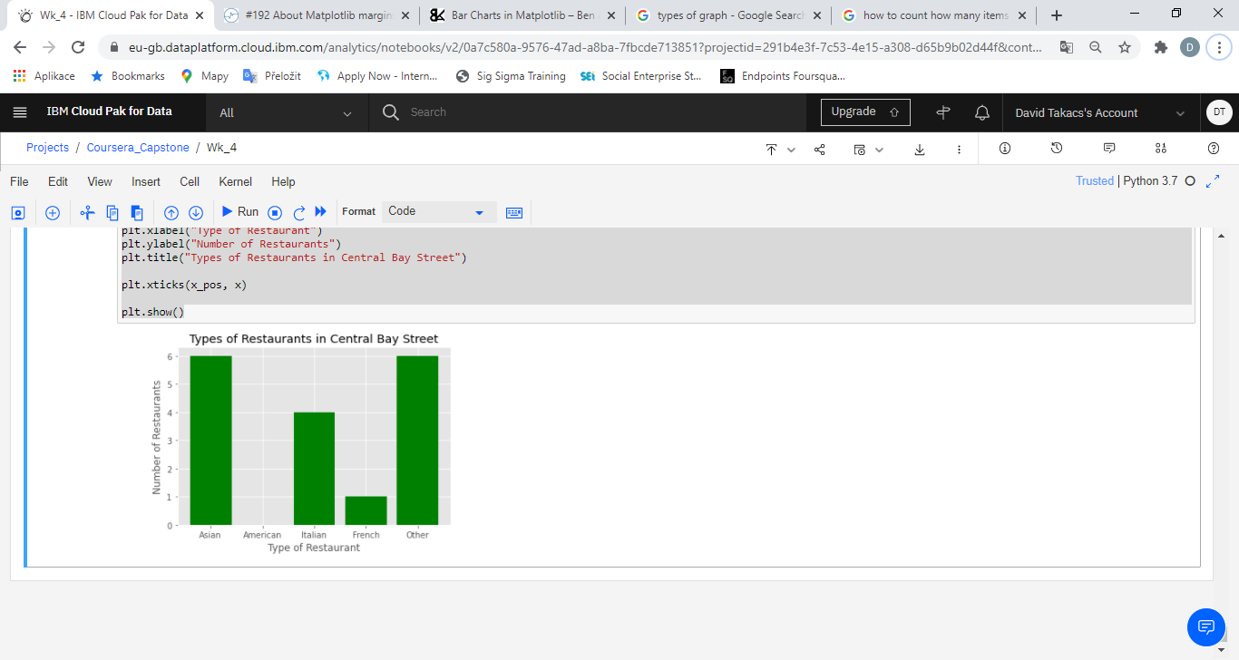
Frequency of Restaurant Venues

Slide 7
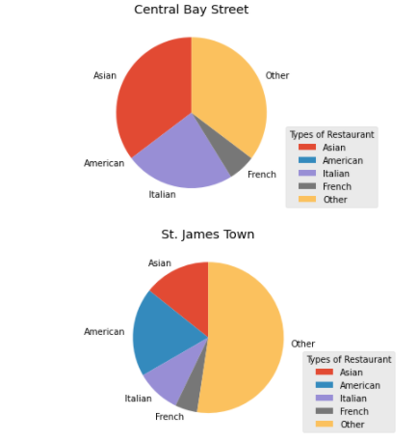
Types of Restaurant Venues
Each neighbourhood is infiltrated by different restaurant venues, while St. James Town appears to be highly fragmented which suggests lower market entry barriers, Central Bay Street seems to be dominated by two main restaurant venue types: Asian and Italian.

Slide 8
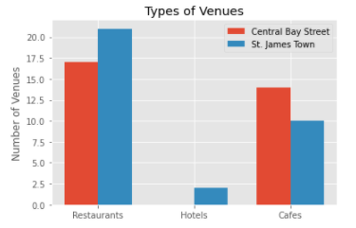
Relationship with Other Venues
Our findings suggest, that although St. James Town is overpopulated with restaurants, there are also other venues such as hotels which might support the hospitality growth in the area. On the other hand, Central Bay Street has lower density of such venues which might suggest lower demand for hospitality services.

Slide 9
Recommendation
After an in-depth analysis, it can be concluded that although St. James Town is more populated with restaurant venues, the market fragmentation is relatively high, which together with higher density of tourism venues, represents a better opportunity for potential investment.
Therefore, taken together, St. James Town should be considered for as a future restaurant venue location.

