Slide 1
Text Modification Tool Tutorial

Slide 2
Contents
How the tool work (slide 3-9)
Tutorial (slide)

Slide 3
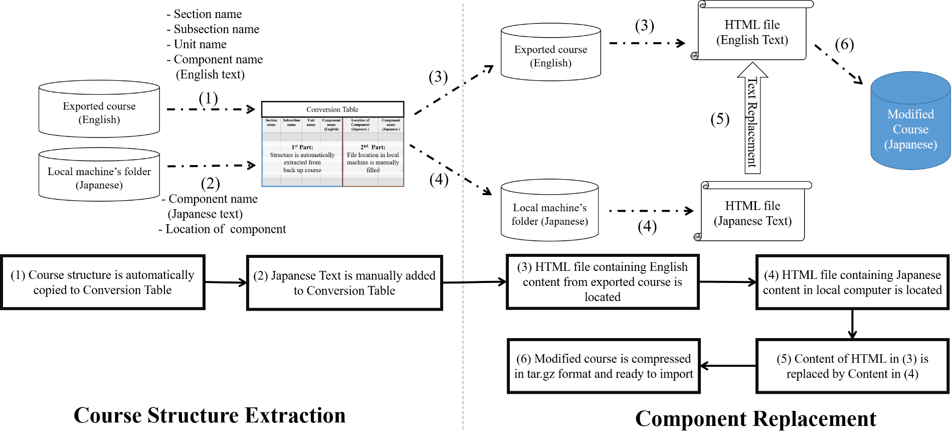
Overview of Text Modification Tool
Consists of 2 subprocess

Slide 4

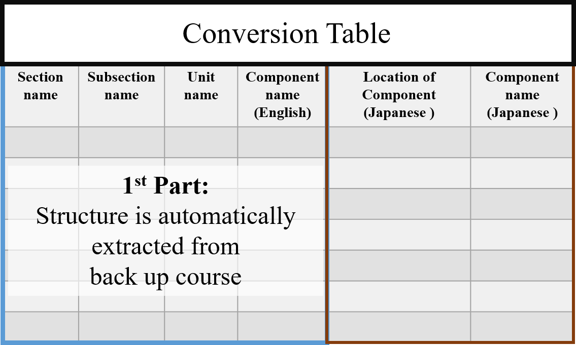





Course Structure Extraction-1
Course structures (name) are copied into the table
Exported course
Notes:
1. Course structure is automatically copied to Conversion Table
Python script searches through exported course (as slide 4)
4-level hierarchy names are copied into 1st Part of Conversion Table

Slide 5


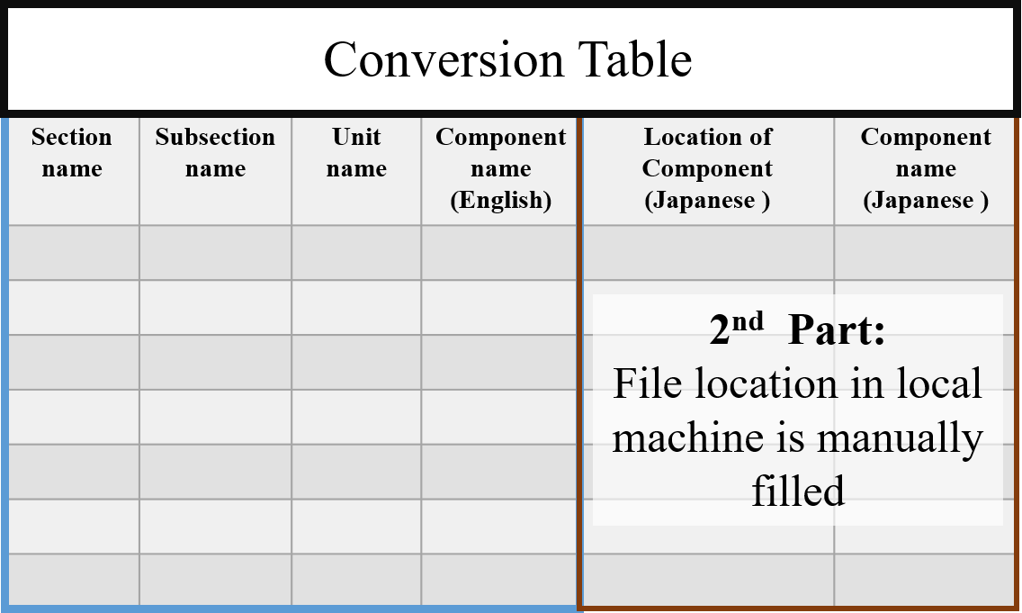


Course Structure Extraction-2
Copy translated Files and location to the table
Translated text folder
Copy and Paste
Notes:
2. Translated text is manually added to Conversion Table
- HTML filename of Japanese text and directory should be manually added in 2nd Part of Conversion Table according to course structure in 1st part

Slide 6




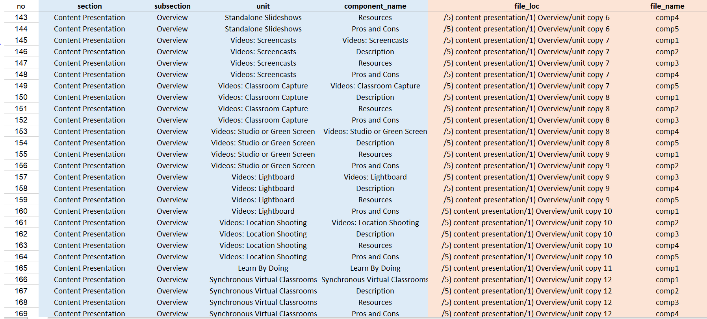
Example of Conversion Table
section
subsection
unit
Text component
Local directory
HTML filename
1st Part: automated task
2nd Part: manual task

Slide 7



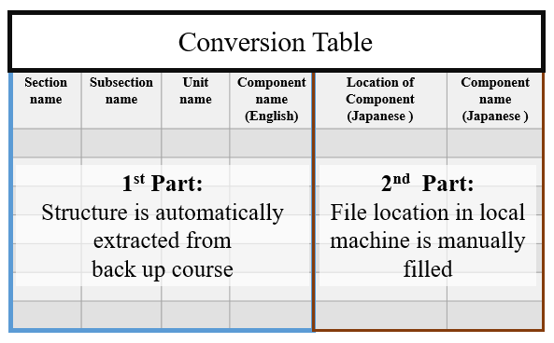



Component replacement-1
Tool locates target HTML files (English text) in exported course
Tool locates desired HTML files (Translated text) in local directory
Course contents
(Japanese)
Notes:
Tool locates
a target HTML file (English text) in exported course
a desired HTML file (Japanese text) in local directory

Slide 8


Component replacement-2
English text blocks in backup course will be iteratively replaced by translated text.
Course contents
(Japanese)
Notes:
Tool locates
a target HTML file (English text) in exported course
a desired HTML file (Japanese text) in local directory

Slide 9




Component replacement-3
Course with translated text is compressed in tar.gz (edX’s uploadable format)
Output file
Use edX’s import function to upload the modified course online
Course contents
(Japanese)
Notes:
Tool locates
a target HTML file (English text) in exported course
a desired HTML file (Japanese text) in local directory

Slide 10
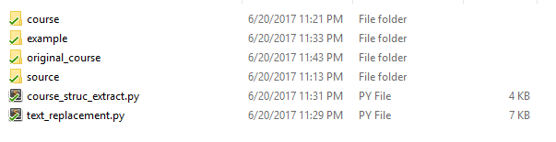
Workspace folder
Python Dependence distribution
lxml, xlrd, xlwt, beautifulsoup4
List of scripts
Course structure extraction:
generates an excel file ‘conversion table’
Component replacement: replaces text components to exported course

Slide 11

Files and Folders preparation
Unzip an exported edX course
1.1 Rename folder of exported course as ‘course’
2. Create ‘original_course’ folder
2.1 Copy the ‘course’ folder into this directory
Create ‘source’ folder
3.1 Move all files of translated text(HTML file) to ‘source’
1. Directory of exported course
2. Directory of exported course
3. Directory of Translated Texts (HTML files)

Slide 12
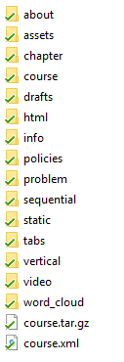
Example of exported course
Offline course structure

Slide 13
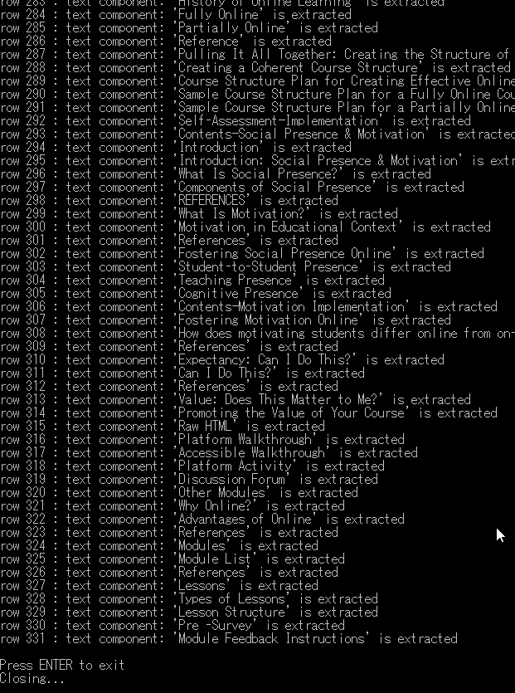
How to run the program
Run a python script
Program show list of extracted course contents

Slide 14
How to run the program
Run a python script ‘course_struc_extract.py’
excel file ‘conversion_table.xlm’ will be created in the work space folder

Slide 15
How to run the program
2. Open the conversion_table.xlm
name of Section, Subsection, Unit and text components are automatically input in the table

Slide 16


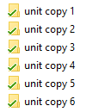
How to run the program
2. Open the conversion_table.xlm
manually add the path location of translated texts (HTML files) contained inside ‘source’ folder
For example: File of translated text ‘Resources’ components is located

Slide 17

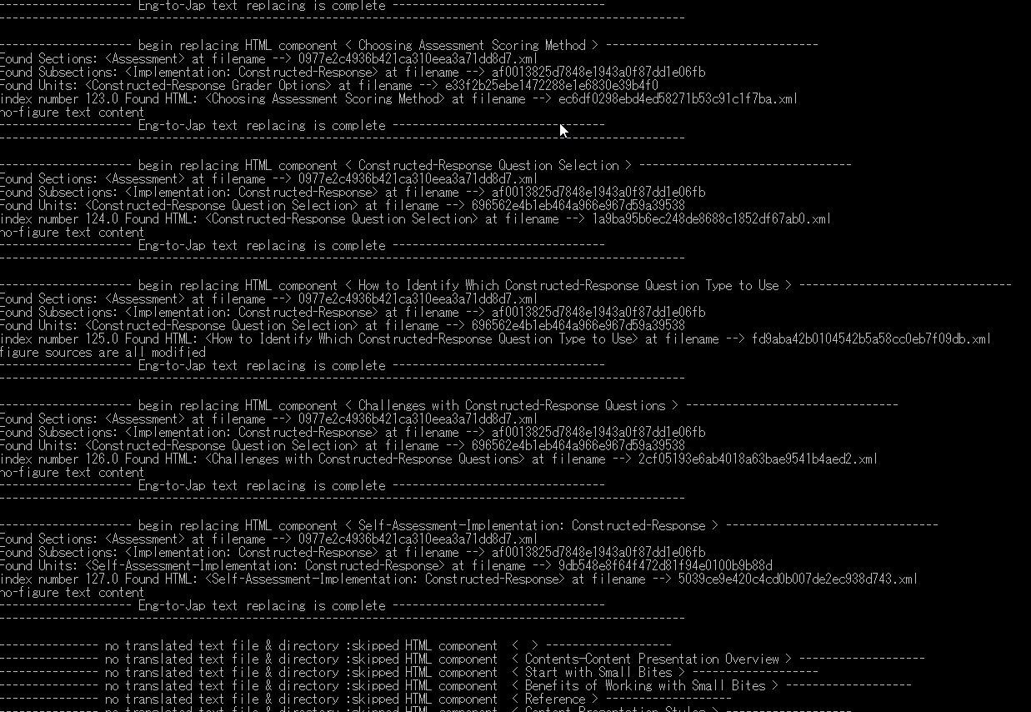
How to run the program
3. Run a python script
List of replaced text
contents are not replaced. No translated text on the list

Slide 18
How to run the program
4. If program is successfully executed, ready-to-upload course (course.tar.gz) is created inside the course folder
Offline course structure

Slide 19
Notice
This script is only tested with 1 edX course. Therefore, unexpected error should happen while using the program.
There is a bug after uploading course back to edX. It is found that some text components disappeared in edX page. In our test, 1 component is missing.
Some HTML component listed in ‘error_files.txt’ will not have figures showed properly in edX. This happens when original component (Eng) and translated component (local language) have different number of figures

