Slide 1
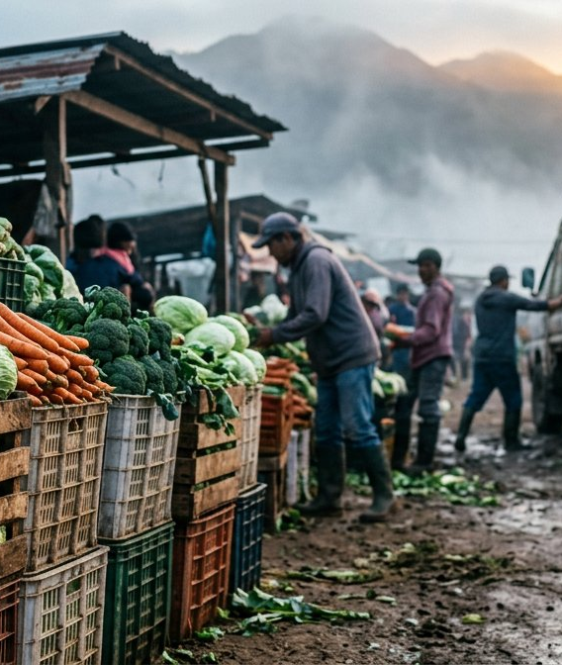

PHILIPPINE STARTUP CHALLENGE XI · CONCEPT NOTE
FRESKO
Farm-side cooling, shared.
Solar cold rooms + freshness AI for highland vegetable farmers —
turning a 35% post-harvest loss into income.
Team: [TEAM NAME]
[Member 1] · [Member 2] · [Member 3]
Mentor: [MENTOR NAME]
Beachhead: Benguet → Metro Manila highland-vegetable corridor
Asking ₱2,400,000 seed · 3 hubs · 120 partner farmers in 12 months
Solution type: software + IoT, ideation → MVP stage
Pre-cool within 2 hours · pay in 24 · every kilo counts
3 hubs · 120 farmers · 12-month pilot in Benguet
Notes:
Good morning. We are [TEAM NAME], and we are building Fresko. One in every three kilos of highland vegetables is lost before it reaches a buyer. Fresko puts solar-powered cooling right at the farm, shared by 40 farms per hub, so every kilo counts. In the next few minutes: the problem, our solution, our business model, and our ask of 2.4 million pesos.

Slide 2
30"
THE 30-SECOND VERSION
If the judges only remember four numbers
35%
PROBLEM
of highland vegetables spoil between farm and market — no cooling, no market data.
₱0
SOLUTION
upfront for farmers: a shared 2-tonne solar cold room + freshness AI + guaranteed offtake.
₱1.20
BUSINESS MODEL
per kilo per day, plus a 6% offtake commission. Payback: 14.5 months per hub.
₱2.4M
THE ASK
seed for 3 pilot hubs, the app/IoT stack, and a 12-month proof of impact.
Fresko is not a cold-storage company. We sell 20% more sellable kilos and 24-hour payment to farmers who today watch their harvest rot on the roadside.
Why now: 540,000 pallet-position cold-chain gap
SDG 2 · 8 · 9 · 12 · 13
Software + IoT solution
Sources: PSA RSSO-CAR 2024 · UN-CSAM/Mopera · PCAARRD 2025 · SEARCA/ADB 2022. All financials are concept-level projections.
Notes:
The problem: cooling is missing at the first mile. Our solution: a 2-tonne solar cold room plus an app that predicts shelf life and matches buyers. The model: farmers pay nothing upfront; we earn storage fees and a commission on offtake. The ask: 2.4 million pesos for three hubs and a 12-month pilot.

Slide 3
I
SUMMARY
A brief overview of the Fresko idea
One shared cold room per 40 farms, one app, one promise — no farmer pays to start.
1 The problem
▪ Vegetables travel 6–8 hours unrefrigerated from Benguet to Manila.
▪ 27–42% of fruits and vegetables are lost post-harvest, peaking at the trading post.
▪ Farmers sell at ₱4–6/kg while city retail reaches ₱60/kg.
2 The solution
▪ Fresko Hub — modular 2-tonne solar cold room at the barangay or cooperative.
▪ Fresko App — books shared cooling slots, predicts shelf life, matches buyers.
▪ Fresko Route — consolidated refrigerated dispatch and 24-hour digital payout.
3 The value proposition
▪ Same harvest, ~20% more sellable kilos.
▪ Payment in 24 hours instead of 7–30 days.
▪ Zero capex for farmers — pay-as-you-store, settled from the sale.
2 tonnes
PER HUB CAPACITY
40 farms
SHARED PER HUB
35% → 15%
TARGET LOSS RATE
₱0
FARMER UPFRONT COST
Sources: Mopera (2016) in UN-CSAM Post-harvest Technology in the Philippines (42% vegetables / 28% fruits) · PSA RSSO-CAR (2024) · PCAARRD (2025).
Notes:
Summary. The problem is a missing first mile: farmers in Benguet harvest at dawn and their produce sits unrefrigerated for six to eight hours. The solution is the Fresko Hub — a shared, solar-powered cold room the size of a small container, paired with an offline-first app. The value proposition: same harvest, more sellable kilos, paid in 24 hours, zero upfront cost.

Slide 4
II
BACKGROUND OF THE PROBLEM
Fresh food dies in the first mile, not the market
27–42%
FRUIT & VEGETABLE LOSS
Philippine post-harvest losses by commodity.
860k / 1.4M
COLD-CHAIN PALLET POSITIONS
~540k shortfall, concentrated in Metro Manila.
6–8 hrs
UNREFRIGERATED HAUL
Benguet trading post to Manila bagsakan.
₱4 vs ₱60
FARMGATE VS RETAIL / KG
Tomato: ₱4–6 farmgate, ₱25–60 Metro Manila retail.
◔ Where a Benguet harvest actually goes
✕ Root causes we attack
▪ No cooling at or near the farm — the nearest cold room is a truck ride and a day away.
▪ Oversupply shocks: tomato farmgate fell to ₱4/kg in Feb 2025 while Manila paid ₱25–60.
▪ No grading, traceability or market information, so farmers sell blind as price-takers.
■ Sold / usable — 65% ■ Lost, dumped or degraded — 35%
Benguet high-value vegetable harvest, 2024: 253,544 MT
Estimated volume lost at a 28% loss rate: ≈ 71,000 MT
Conservative farmgate value lost: ≈ ₱2.1 B per year
Assumes ₱30/kg average farmgate. Sources: PSA RSSO-CAR (2024) · UN-CSAM · PCAARRD (2025) · FAST Logistics cold-chain estimate (industry) · UN Food Systems PH Pathway.
Notes:
Background. The Philippines has cold storage — but only about 860,000 of the 1.4 million pallet positions we need, and it sits in Metro Manila, not where food is grown. In Benguet alone, 253,544 metric tons of high-value vegetables were harvested in 2024. At a conservative 28% loss, that is roughly 71,000 tonnes — about 2.1 billion pesos — that never gets eaten.

Slide 5
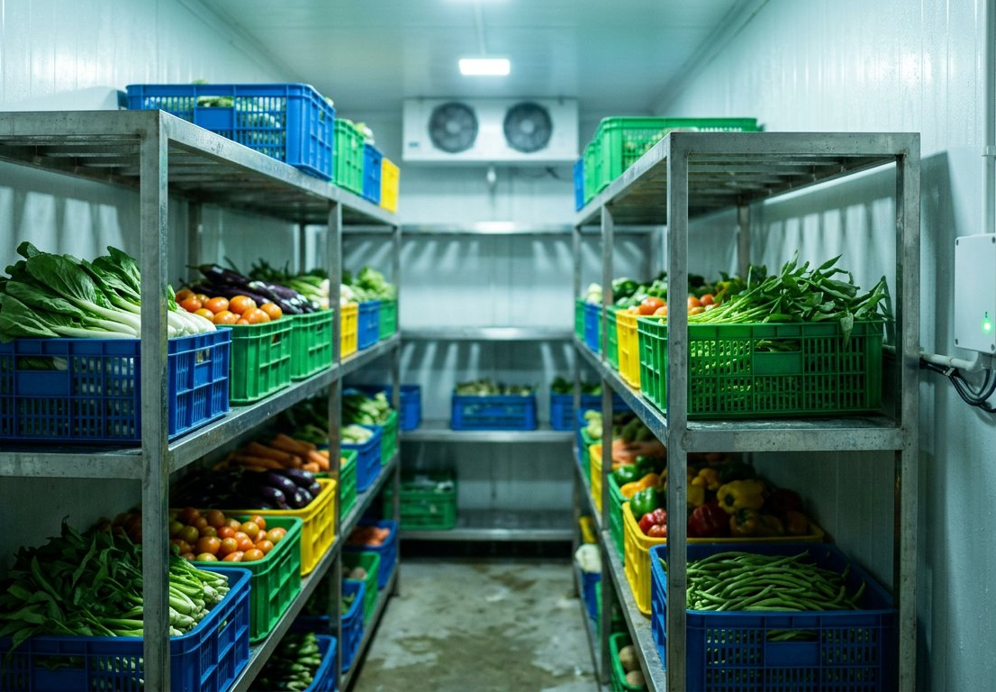
III
PROPOSED STARTUP SOLUTION
The Fresko Hub: cooling, intelligence and a buyer in one loop
01 Book & harvest
The farmer reserves a cold-room slot in the app; harvest is timed to that booking.
02 Pre-cool in 2 hrs
Produce reaches the hub within 2 hours and is pre-cooled to 4–8 °C on solar power.
03 Grade & predict
IoT sensors + freshness AI score remaining shelf life and grade batches A/B/C.
04 Match & pay
Matched to a verified buyer, consolidated dispatch, e-wallet payout within 24 hours.
›
›
›
▣ Hardware
▪ 2-tonne insulated chamber, 3 kWp solar + 5 kWh battery
▪ 2 HP inverter compressor, 4–8 °C, 99% uptime target
◎ Priority SDG — 12: Responsible Consumption & Production
Target 12.3: halve per-capita food waste and reduce food losses by 2030 — measured in kilograms, against a same-week control group.
▪ SDG 2 Zero Hunger — 84 t of food kept edible in Year 1
▪ SDG 8 Decent Work — +35% net income per kg sold
▪ SDG 9 Industry & Innovation — farm-side rural IoT
▪ SDG 13 Climate Action — solar cooling displaces diesel
⌗ Software
▪ Offline-first app in Filipino & Ilocano
▪ Shelf-life AI + shared-capacity booking + escrow payouts
Design rule: every farmer-facing step must work on a ₱4,000 Android phone with intermittent signal.
Notes:
Our solution has three parts: the hub, the app, the route. A farmer books a slot, harvests, and delivers within two hours. IoT sensors log temperature and our freshness model grades the batch. We then match the produce to a verified buyer and pay out within 24 hours. Priority SDG is SDG 12 — specifically target 12.3, halving food loss — supported by SDGs 2, 8, 9 and 13.

Slide 6
IV
OBJECTIVES
Eight measurable goals by Month 12
Baseline: 3-farm / 4-week pre-pilot audit in Buguias, Benguet (Q1 2026).
3
HUBS INSTALLED
2 t each: Buguias, Atok, La Trinidad.
120
FARMER-MEMBERS
≥40% women-led farm households.
240 t
PRODUCE COOLED
Cumulative throughput, Year 1.
35→15%
POST-HARVEST LOSS
Measured in kg vs control group.
+35%
FARMER NET INCOME
Per kg sold, vs pre-pilot baseline.
18 t
CO₂E AVOIDED
Food-loss + diesel reefer avoided.
99%
HUB UPTIME
Temperature-log compliance ≥98%.
24 hrs
PAYOUT TURNAROUND
Delivery to e-wallet credit.
◎ Impact objectives
Cut measurable food loss, raise household income, and displace diesel-based reefer hauling with solar-cooled consolidation — all verified against a control group.
⚙ Operational objectives
Prove a repeatable hub playbook: install in 21 days, onboard a farmer in under 15 minutes, and reach ₱33,000 monthly contribution per hub by Month 12.
Notes:
Our objectives are SMART and dated. By month 12: three hubs installed, 120 farmer-members onboarded, 240 tonnes of produce cooled, loss rate down from 35 to 15 percent, farmer net income up 35 percent, 18 tonnes of CO2e avoided, and 99 percent hub uptime. Every one has a metric we will report monthly.

Slide 7
V
TARGET MARKET / BENEFICIARIES
Who we serve, and who pays
◉ Primary — beneficiaries
~60,000
smallholder vegetable farmers in Benguet (average farm size 1.3 ha), plus their cooperatives and PCAs.
▪ Gross income ₱2,000–5,000/month; ages 45–65
▪ Mobile-first but low digital literacy today
▪ Pain: spoilage, 7–30 day payment, no grading
◍ Secondary — the paying side
▪ Market vendors and bagsakan traders need graded stock with longer shelf life.
▪ Restaurants, carinderias and e-grocery suppliers need consistent volumes.
▪ Processors and exporters need traceable raw materials.
▪ Cooperatives and LGUs need loss-reduction analytics and reporting.
◆ Persona: Mang Ben, 52
▪ 1.3 ha in Buguias; harvests carrots and cabbage twice a week.
▪ Grade-2 kilos sell for ₱5/kg — often left at the roadside.
▪ Paid 7–30 days later by a disposer.
▪ Wants: a fair price, paid fast, and no spoilage.
EXPANSION PATH
Beachhead 2026 · Buguias, Atok, La Trinidad
Year 2 · Nueva Vizcaya, Mountain Province
Year 3 · Ilocos tomato, Cebu, Davao
From 40 farm interviews: 7 of 10 would pay ₱1–1.50 per kilo per day for cooling that prevents spoilage; 9 of 10 want settlement within 48 hours.
Notes:
Our primary beneficiaries are smallholder highland vegetable farmers — average farm size 1.3 hectares — and the cooperatives that aggregate them. Secondary customers are market vendors, restaurants and processors who need consistent, verified grade-A produce. We start in three Benguet municipalities, then expand to Nueva Vizcaya, the Ilocos tomato corridor, and eventually Cebu and Davao.

Slide 8
VI
VALUE PROPOSITION
No capex. Less spoilage. Cash in 24 hours.
What the farmer cares about
Fresko
Trading post (status quo)
Buy own cold room
Reefer 3PL
Upfront cost
₱0
₱0
₱1.2 M+
Per-trip minimum
Post-harvest loss
~15%
35%
8–12%
~10%
Payment terms
24 hours
7–30 days
—
30 days
Market access & grading
AI grade + matched buyer
Blind, price-taker
None
None
Traceability / cold proof
Per-batch log
None
Partial
Partial
Who runs it
Co-op + Fresko
Trader
Farmer alone
Logistics firm
↑ The promise, per 1,000 kg
+200 kg sold instead of dumped — about ₱6,000 more income at conservative grade-2 prices.
⏱ Why farmers stay
Payout in 24 hours, plus data they never had: what grade they grew and what buyers will pay.
⛨ Why it is defensible
Farm-side assets in barangays are slow to replicate, and our loss-reduction dataset compounds with every hub.
Value-per-kilo assumptions audited with the partner cooperative; grade-2 pricing used to stay conservative.
Notes:
Compared with the status quo, a farmer-owned cold room, or third-party reefer logistics, Fresko wins on three things: zero upfront cost, materially lower loss, and fast, verifiable payment. No capex, fewer spoilage kilos, cash in 24 hours — that is the whole pitch.

Slide 9
VII
BUSINESS MODEL
Create value, deliver it, and capture a slice
✦ 1 · Create
The cooperative provides land and an operator; Fresko provides the solar cold room, sensors, app and buyer network. Capex stays on our books, so farmer cost stays at zero.
⇉ 2 · Deliver
Shared capacity instead of ownership, consolidated refrigerated dispatch, digital settlement, and monthly loss reports for the cooperative.
₱ 3 · Capture
Four recurring revenue lines, all tied to produce actually saved — our income grows only when farmers earn.
1 · Storage fee
₱1.20 / kg / day — billed to the buyer at dispatch and deducted from the farmer's settlement.
2 · Offtake commission
6% of matched GMV — charged only when we find the buyer and clear payment.
▤ Unit economics · one 2-tonne hub
Capex per hub (grant-funded)
₱480,000
Monthly opex
₱28,000
3 · Co-op analytics
₱499 / month — grade mix, loss trends, buyer price benchmarks, traceability.
4 · Impact reporting
₱25k–60k / contract — verified loss-reduction and CO₂e reports for LGUs and corporates.
Monthly revenue at 55% utilisation
₱61,000
Contribution margin
₱33,000 / mo
Gross margin
54%
Payback per hub
≈ 14.5 months
Utilisation ramp assumed: 35% (M1–M3) → 55% (M4–M12) → 70% (Year 2). 80/20 revenue share with the cooperative. Concept-level projections for a 12-month pilot.
Notes:
How we make money: a storage fee of 1.20 pesos per kilo per day, a 6 percent commission on matched offtake, a monthly analytics subscription for cooperatives, and ESG reporting for agri-corporates and LGUs. One hub costs 480,000 pesos, runs at 28,000 a month, returns about 61,000 — contribution of 33,000 and payback in roughly 14 and a half months.

Slide 10
VIII
MARKET ANALYSIS
A ₱4.6 B market — 1% capture is already a real business
₱4.6 B
TAM · NATIONAL
Cold storage + post-harvest services for highland vegetables and fruits.
₱1.1 B
SAM · SERVICEABLE
Cordillera + Northern Luzon corridors — ~1,200 t/day moving to Manila.
₱12 M
SOM · YEAR 3
30 hubs × ₱735k — roughly 1% of SAM.
◈ Positioning: farm-side assets vs demand intelligence
↗ Trends we ride
▪ ~540,000 pallet-position cold-chain gap; DA/PRDP grants for farm-side facilities.
▪ Food inflation keeps loss reduction high on LGU agendas.
▪ E-grocery and food service want traceable, graded local produce.
▪ Rising demand for verified food-loss and emissions reporting.
⚔ Competitors & our edge
▪ Trading posts — no cooling; we plug in as buyers instead of replacing them.
▪ Urban cold storage — too late in the chain to recover lost shelf life.
▪ Cold-chain 3PLs — urban, per-trip; we make small volumes shareable.
▪ Solar cold-room suppliers — hardware only; we bundle demand and payment.
▪ B2B agri platforms — listings without cold assurance; we guarantee freshness.
FRESKO
Urban cold storage
Cold-chain suppliers
Digital agri marketplaces
Farm-side infrastructure →
Assumptions: TAM = national highland-vegetable value × ~10% addressable service wallet; SAM = Cordillera/Northern Luzon share; SOM = Year-3 installed hubs. Model inputs are the team's, ready for judge Q&A.
Notes:
Market size. TAM about 4.6 billion pesos a year in cold-storage and post-harvest services. SAM 1.1 billion in the Cordillera and Northern Luzon corridors we can physically serve. SOM 12 million pesos by Year 3 with 30 hubs — only 1% of SAM, which is what makes it credible. Competitors exist in software and in urban cold storage, but nobody owns the farm-side shared cooling layer.

Slide 11
IX
OPERATIONS PLAN
Install in 21 days · operate in one barangay · clone it
→ Phase 0 · Partnership & site readiness
→ Phase 1 · Hub 1 live + 40-farmer pilot
→ Phase 2 · 3 hubs, app GA, route partner
→ Scale · co-op-operated franchise
M1–M3
MOA with the partner cooperative (land + operator), LGU permits, DA endorsement, baseline loss audit on 3 farms, hub technician hired.
M4–M6
Install and commission hub #1 (21 days), onboard 40 farmers in under 15 minutes each, launch app v1 offline-first, first matched offtake cycles.
M7–M12
Clone the playbook to Atok and La Trinidad, integrate e-wallet escrow payouts, contract refrigerated dispatch, publish the first impact report.
Y2
12 hubs on an 80/20 revenue share: the co-op runs day-to-day while Fresko supplies technology, training and demand.
✓ Standard operating procedure
▪ Pre-cool within 2 hours of harvest; hourly temperature logs with alerts above 9 °C.
▪ HACCP-aligned handling and crate hygiene; FEFO dispatch rotation.
▪ Weekly preventive maintenance, monthly audits, zero mixing of spoiled stock.
⌗ Tech architecture
▪ LoRaWAN/GSM sensors → cloud time-series store, logged every 15 minutes.
▪ Shelf-life model + rule engine for grading and routing.
▪ Offline-first app (Filipino/Ilocano, SMS fallback); GCash/Maya escrow API.
⚠ Risks & mitigation
▪ Power interruptions → solar + 5 kWh battery + genset hook-up.
▪ Low initial utilisation → anchor offtake contracts before install.
▪ Trust and adoption → co-op-led onboarding, free first month.
Team: [Member 1] CEO / farmer partnerships · [Member 2] CTO / IoT & app · [Member 3] COO / hub operations & logistics · [MENTOR NAME] mentor, agribusiness & cold chain.
Notes:
Operations. Phase zero is partnership and permits in months one to three. Phase one installs hub number one and runs a 40-farmer pilot. Phase two scales to three hubs with the app in general availability. Year two moves to twelve hubs under a cooperative-operated franchise model: the co-op supplies land and staff, we supply technology and demand.

Slide 12
X
FINANCIAL REQUIREMENT
₱2,400,000 seed → breakeven in month 19
◕ Use of funds
3-year projection
Year 1
Year 2
Year 3
Hubs live
3
12
30
Cold-room units (3 × ₱480,000)
₱1,440,000
60.0%
Revenue (₱M)
1.2
6.9
17.9
App & IoT stack
₱360,000
15.0%
Operating cost (₱M)
2.0
5.1
11.2
Pilot operations & logistics
₱300,000
12.5%
EBITDA (₱M)
(0.8)
+1.8
+6.7
Training & cooperative onboarding
₱180,000
7.5%
Payback per hub
Farmer income per ₱1
Contingency
₱120,000
5.0%
14.5 months
₱8.50 generated
✓ Funding structure & sustainability
Grant/seed equity covers capex, and each hub becomes a revenue-generating asset from month 4. Year-2 growth can be financed from hub cash flow plus a DA/PRDP facility and cooperative in-kind equity (land and labour), keeping dilution minimal.
Assumptions: 55–70% utilisation · ₱1.20/kg/day storage · 6% offtake commission · 80/20 co-op revenue share · ₱480k hub capex. Full model available on request.
Notes:
We are asking for 2.4 million pesos. 60 percent goes to three pilot cold rooms, 15 percent to the app and IoT stack, 12.5 percent to pilot operations, 7.5 percent to farmer training, and 5 percent to contingency. With that we reach three hubs and 120 farmers in Year 1, twelve hubs in Year 2, and thirty hubs with 6.7 million EBITDA in Year 3. Breakeven in month 19.

Slide 13
◎
IMPACT & SDG ALIGNMENT
Year-one impact we can audit, not just claim
84 t
FOOD SAVED
Edible produce not lost — about 560,000 meals.
₱2.5 M
FARMER INCOME UNLOCKED
120 households, Year 1.
18 tCO₂e
EMISSIONS AVOIDED
Food loss + diesel reefer avoided.
392 hrs
COOLING HOURS LOGGED
Across 3 hubs, monitored per batch.
◎ SDG contributions
📈 How we measure
▪ Control-group comparison: same barangay, same crop, same week.
▪ Temperature logs and weight reconciliation per batch.
▪ E-wallet settlement records as proof of income change.
▪ Third-party verification by the cooperative and LGU agri office.
SDG 2 Zero hunger
84 t of food kept edible in Year 1
SDG 8 Decent work & growth
+35% net income per kg sold; 6 hub jobs
SDG 9 Industry & innovation
Farm-side IoT infrastructure in rural areas
SDG 12 Responsible production (priority)
Loss 35% → 15% — target 12.3
→ 3-year roadmap
SDG 13 Climate action
Solar cooling displaces diesel reefer
Y1
3 hubs · 120 farmers
Y2
12 hubs · 600 farmers
Y3
30 hubs · 1,500 farmers
Notes:
Impact. Every peso we deploy is designed to move three things: farmer income, food actually eaten, and emissions avoided. By month twelve that means 120 farm households earning more, 84 tonnes of food saved, and 18 tonnes of CO2e avoided — squarely on SDG 12.3 and SDG 2.

Slide 14
CLOSING
Cooling exists.
It just isn't at the farm.
Fresko puts it there — shared, solar-powered, and backed by real demand. Every kilo counts.
Thank you
Team [TEAM NAME]
[Member 1] · [Member 2] · [Member 3]
Mentor: [MENTOR NAME]
[email] · [mobile]
Ask ① ₱2.4 M seed funding
Ask ② 3 cooperative partners
Ask ③ 1 logistics partner
Notes:
To close: cooling already exists in the Philippines — it just does not exist at the farm. Fresko puts it there: shared, solar-powered, and demand-backed. We are asking for 2.4 million pesos, three cooperative partners, and one logistics partner. Every kilo counts. Thank you — we are ready for your questions.

Slide 15
A
APPENDIX
Sources & assumptions
⌘ Sources
▪ PSA RSSO-CAR — Situation of Selected High-Value Vegetable Crops in Benguet, 2024 (253,543.95 MT).
▪ UN-CSAM / Mopera — Post-harvest Technology in the Philippines (42% vegetables, 28% fruits lost).
▪ PCAARRD (2025) — Luzon tomato farmgate ₱4–6/kg vs Metro Manila retail ₱25–60/kg.
▪ SEARCA / ADB post-harvest loss study (2022) — mango, tomato and onion route losses.
▪ UN Food Systems — Philippine Agrifood System Transformation Pathway (cold-chain gap).
▪ Industry estimate: ~860,000 of ~1.4 M cold-storage pallet positions available.
Σ Key assumptions
▪ Hub capex ₱480,000 · opex ₱28,000/month · storage ₱1.20/kg/day.
▪ Utilisation ramp 35% → 55% → 70%; 2-tonne nominal capacity.
▪ Offtake commission 6% on matched GMV; 80/20 co-op revenue share.
▪ Loss reduction 35% → 15% validated against a same-week control group.
▪ ₱30/kg average farmgate for value-of-loss estimates.
▪ All financials are concept-level projections for the 12-month pilot.
Ask us the hard questions — unit economics, permitting, or the model behind the 15% loss target. We brought the spreadsheet.
Notes:
Appendix for Q and A: our sources and every assumption behind the numbers. All figures are traceable, and every projection has a stated utilisation and pricing assumption.

