Slide 1

PCR
Polymerase Chain Reaction

Slide 2
Agenda
Bio
Electronics
Firmware
Ensclosure

Slide 3
Bio
Amplify the DNA to billions of copies easier to detect pathogens bad bacteria etc.
Different bio protocols in each topic
It needs 45-50 min to complete a full cycle

Slide 4
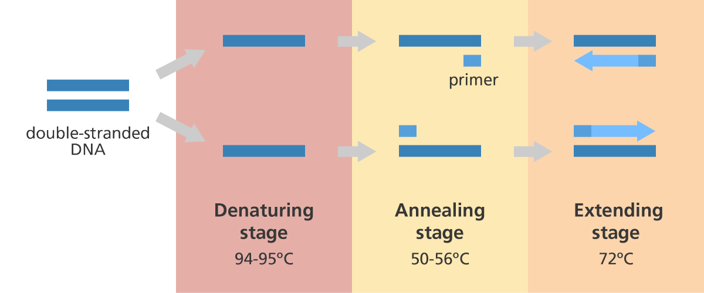
PCR stages
Denaturing
Annealing
Extension

Slide 5
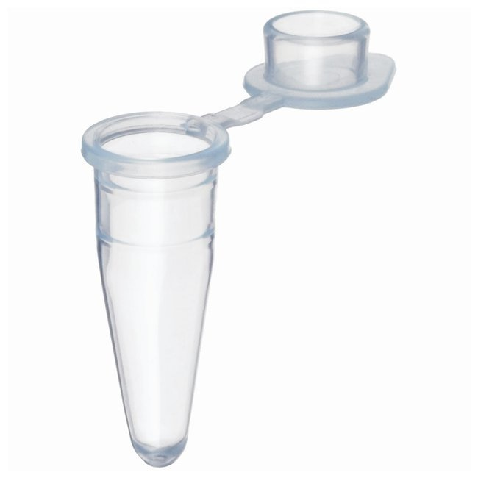
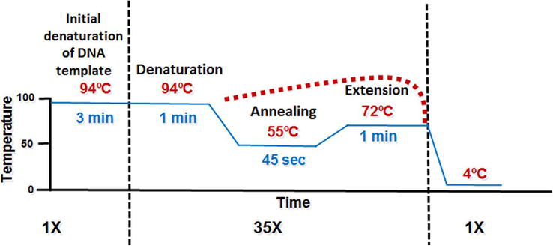
PCR cycles

Slide 6
Electronics
MCU 32-bit to control all the peripherals (STM32F…)
LCD 4x20
Rotary encoder settings for the menu
3 temperature sensors (thermocouple or RTD)
Step motor – driver (trinamics TMC2208)
H – Bridge to control the peltier (top and bottom)
Buzzer

Slide 7
Firmware
LCD driver
Rotary encoder driver
Configure ADC (future 16bit ADC via I2C) for the temp sensors
Configure Timers + Interrupts
PWM for peltier
PID

Slide 8
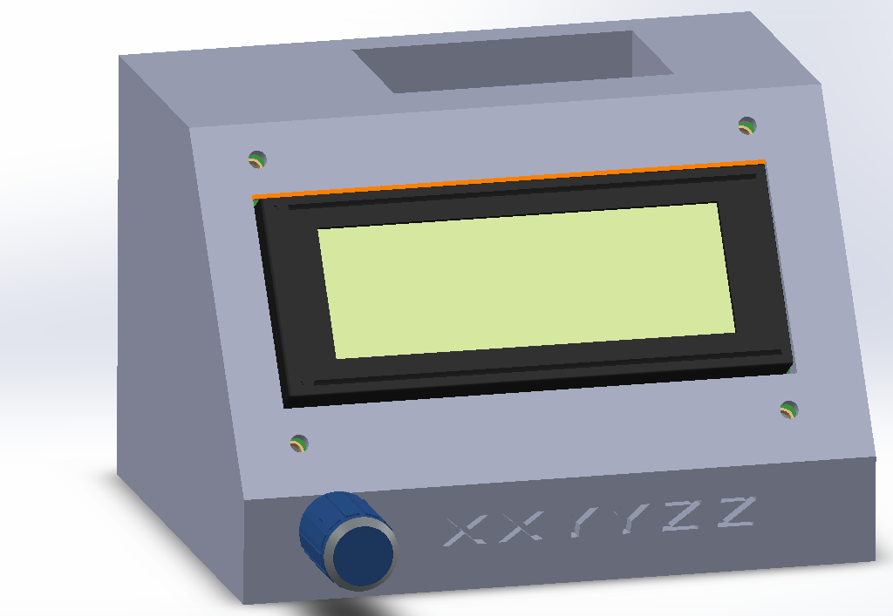
Enclosure
3D print with PETG for proto future ESD filament

