Slide 1
Promotion Analysis Case Study
PART A - Clustering
Questions and Answers
PART B – Prediction
Model Results
Promotion 5
Question and Answer
REPORT
Interpreting Results
Recommendations
Statistics for all models used
About Data Need

Slide 2
1. PART A - Clustering
Questions and Answers

Slide 3
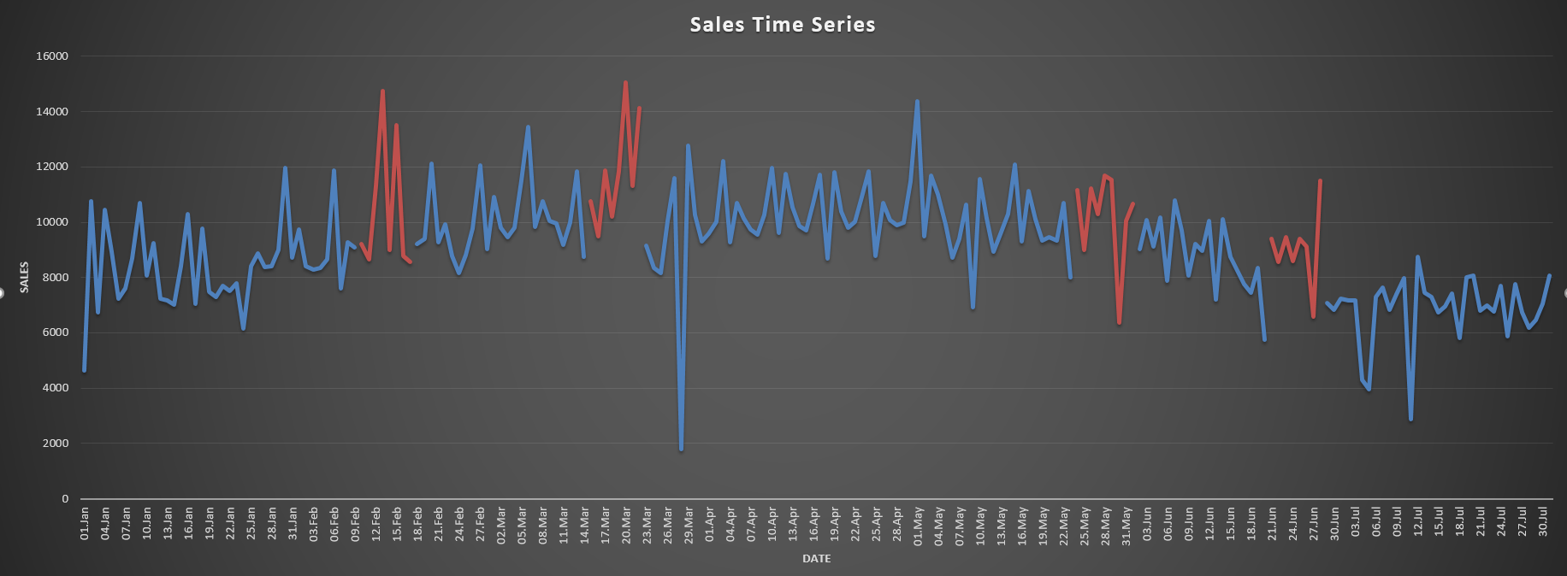
Overview on Train Sales Graph with Promotions

Slide 4
Question What are your criteria for separating Fast, Medium and Slow items? Why?
Answer
Instructions says only sales data is abled to be used on clustering. Because of that, i created a 'Weekly Sales Share' metric (=Store_Weekly_Sales/Total_Weekly_Sales) to use on clustering and promotion effectiveness. With this metrics, model will effect less by high variented sales increasing or decreasing of store's sales.

Slide 5
Question What are your criteria for separating Fast, Medium and Slow Stores? Why?
Answer
I created an 'Adjusted_Weekly_Sales' metric. Calculation of this is Average_Weekly_Sales_Products/Average_Weekly_Sales_Store. Some of products may be sold on fast stores. This metric eliminates the effect of stores' fastness and makes products clustering more fair.

Slide 6
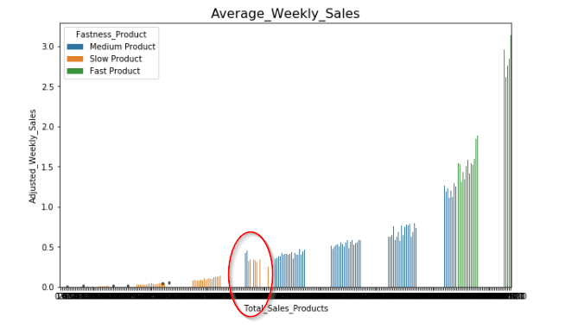
Because of added metric, blue products on left have low sales quantity but they performed better though sold on slow stores. Also, opposite of that, some medium products sold on fast stores.

Slide 7
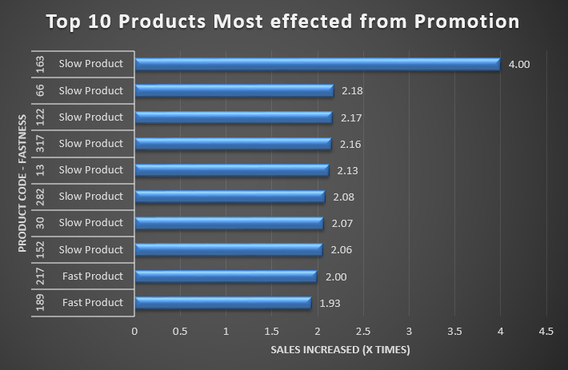
Question Which items experienced the biggest sale increase during promotions?
Answer
Top 10 Most increased Product Codes are (163,66,122,317,13,282,30,152,217,189). Product with 155 code sold 4 times of its weekly sales in no-promotion times.

Slide 8
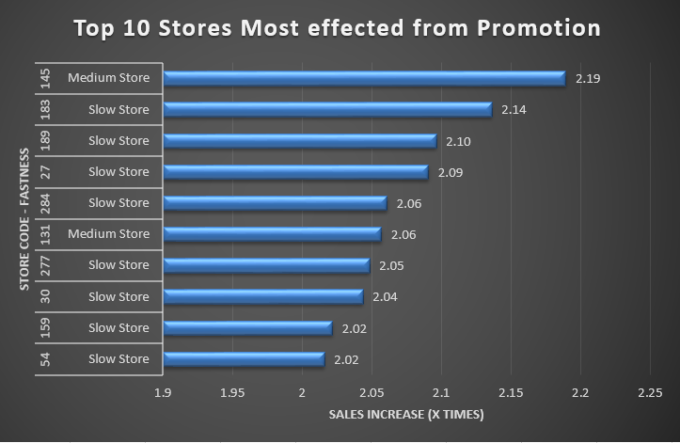
Question Are there stores that have higher promotion reaction?
Answer
Mean of promotion effect is 1.64 and std is 0.22. That means there is not so much difference but still some of stores effected more. Top 10 is (145,183,189,27,284,131,277,30,159,54)

Slide 9
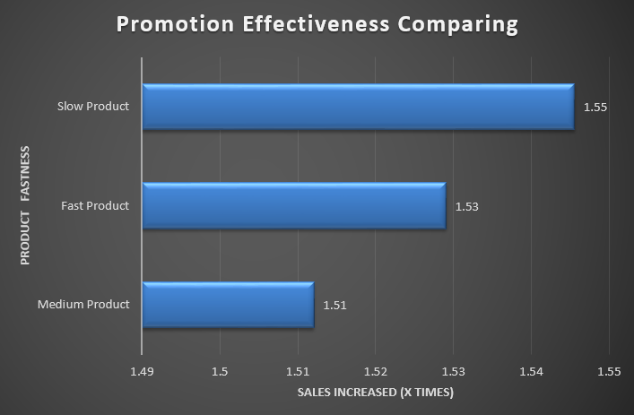
Question Is there any significant difference between promotion impacts of the Fast versus Slow items?
Answer
Mean of promotion effect is 1.62 and std is 0.26. That means there is not so much difference but still some of stores effected more. Top 10 is (143,179,185,25,279,129,272,28,156,52)

Slide 10
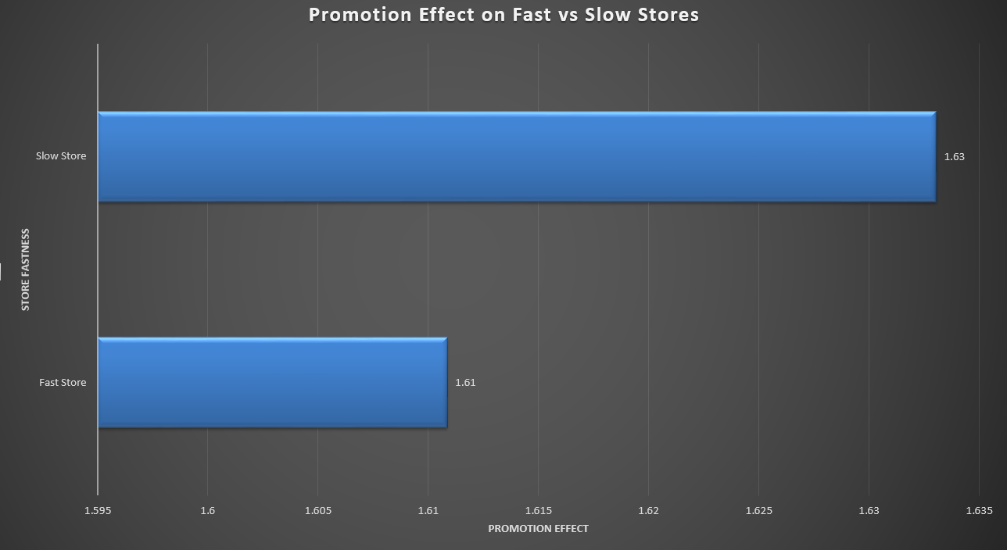
Question Is there any significant difference between promotion impacts of the Fast versus Slow stores?
Answer
There is no significan difference between Fast vs. Slow stores. Slow stores sales increased just %2 more then Fast stores.

Slide 11
2. PART B - Prediction
Model Result

Slide 12
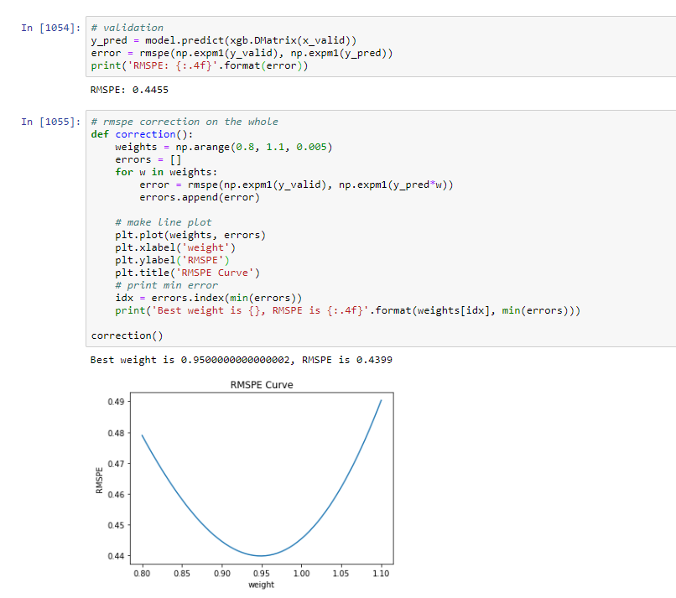

Evaluation Metric : Root Mean Squared Percent Error
Calculation:
Applying:
RMSPE : 0.4399

Slide 13
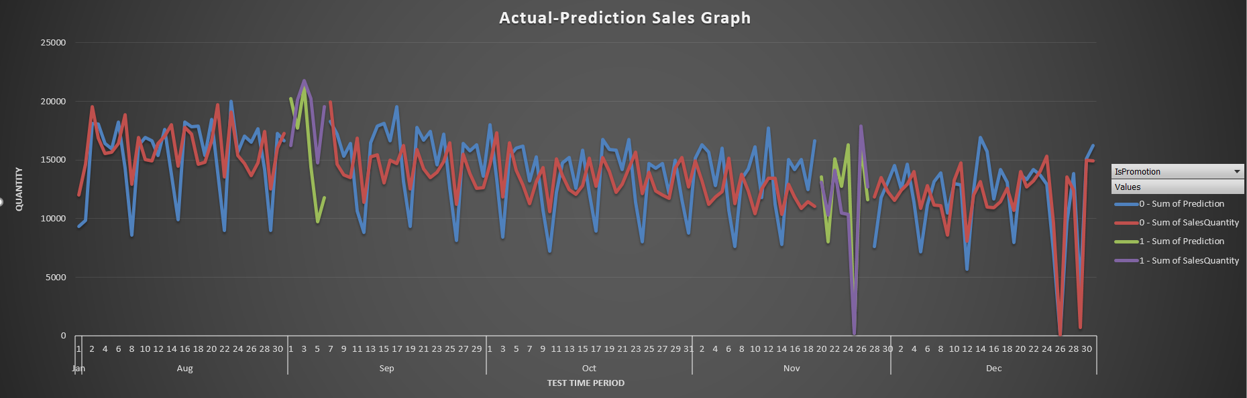
SALES PREDICTION ON TEST DATA

Slide 14
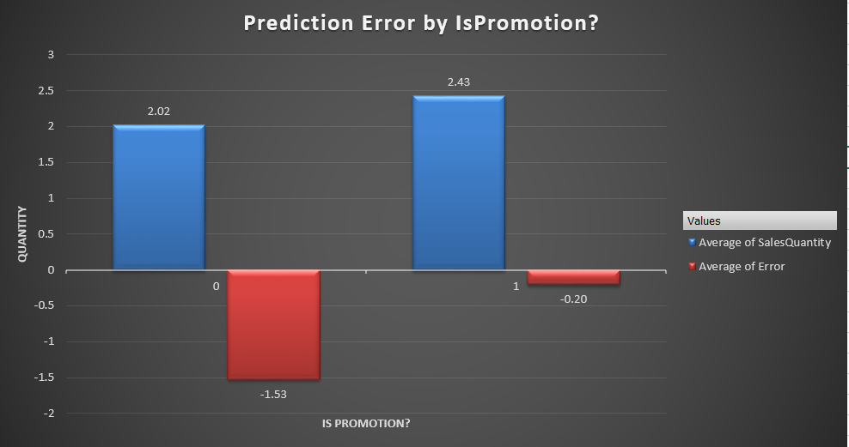
Prediction error on On/Off Promotion Period

Slide 15
2. PART B - Prediction
Promotion 5

Slide 16
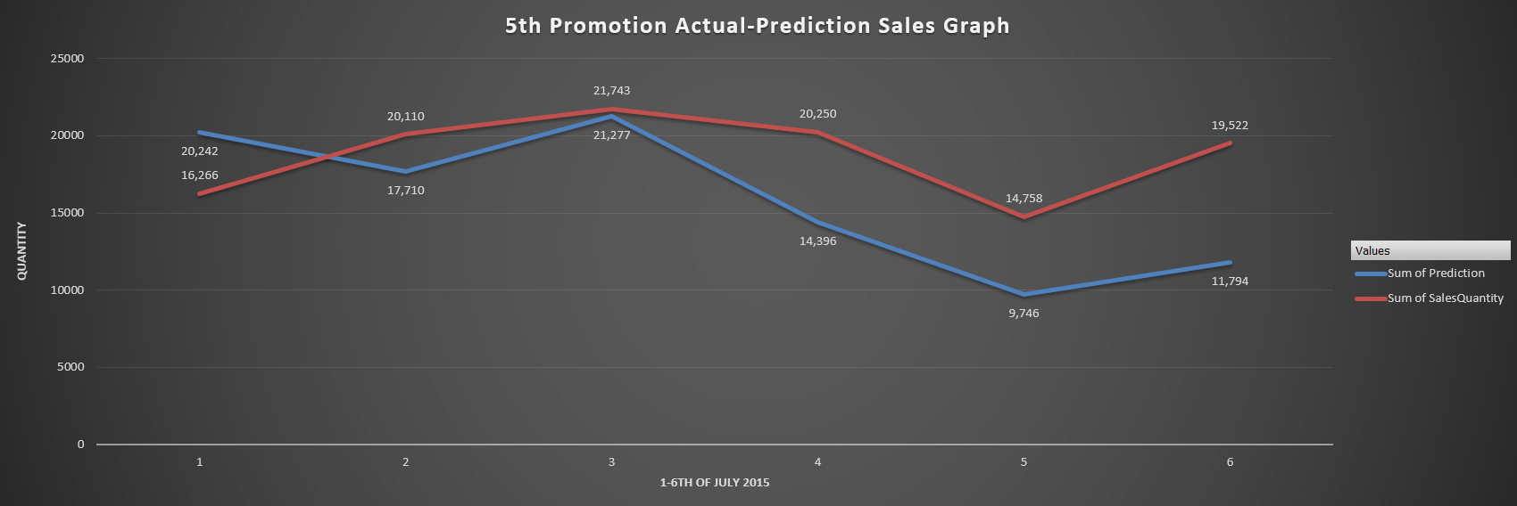
5th Promotion Date Prediction-Actual Sales

Slide 17
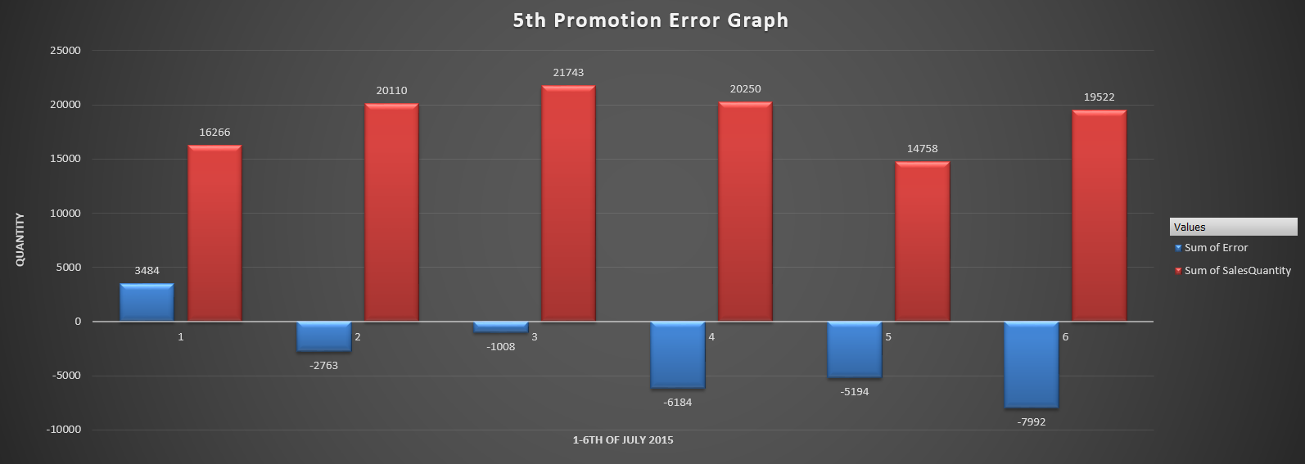
Prediction error and sum of sales by day

Slide 18
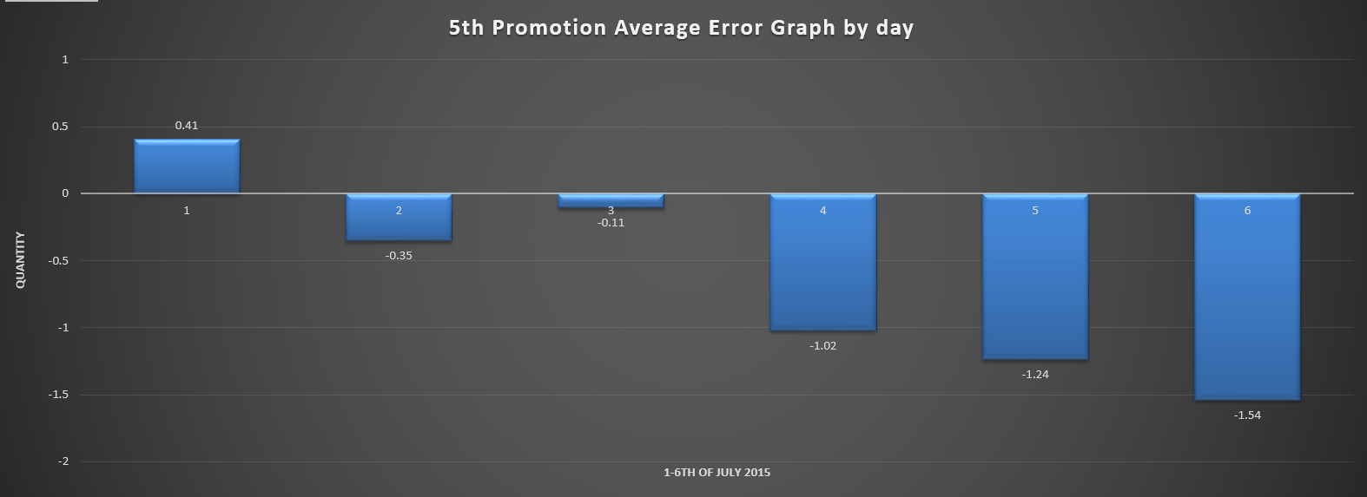
Average Prediction error quantity by day

Slide 19
2. PART B - Prediction
Questions and Answers

Slide 20
What measure would you use for goodness of fit?
I would use one of these test to measure goodness of fit
The chi-square
Kolmogorov-Smirnov
Anderson-Darling
Shipiro-Wilk

Slide 21
How good is your model developed in step 1?
Prediction algorithms are not my strongest part. I could not have a chance to try different models to compare and pick best. Even XGBoost model that I used work on more then 2 hours. So it is not an optimum model development process.

Slide 22
What are the main problem points causing bad fits?
The model was biased to overfit. Because some features had more effect on predictions. I tried to create a validation part to observer overfitting and see how model works. In XGBoost model, RMSPE was always growing after minimum value while RME was decreasing.

Slide 23
What would you change in step 1?
I would like to spend more time on feature engineering. I just had few chances to go back, look what to do to get better results. Also, as I mentioned, I would like to try different models too. But circumstances.. ☺

Slide 24
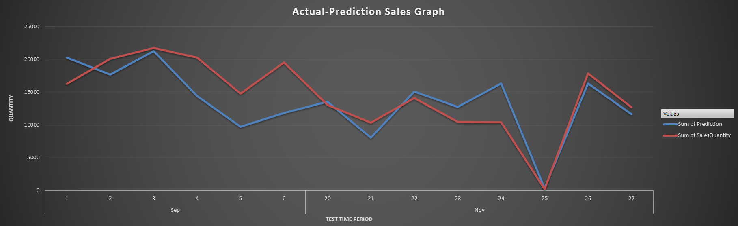
3. REPORT - Interpreting Results
The main theme of the work is about promotion. Because of that I especially focused to create successful predict on Promotion dates. When we look at 5th and 6th promotions prediction, result is looking not so bad. At least we can say model can catch ups and downs on sales.

Slide 25
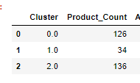

3. REPORT - Interpreting Results
Clustering of Products and Stores fastness was a little unbalanced. I used K-Means to cluster. So there are some pros and cons of that algorithm. I did not really focused to cluster optimum way. I tried to stick on main goal of work.

Slide 26
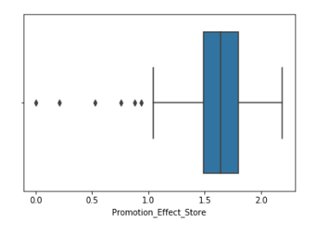
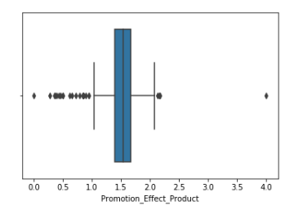
3. REPORT - Interpreting Results
About Promotions;
We can say promotions increased sales and I did not observed Cannibal effect on Product groups. Less then 10 stores effected negatively during promotions. But I can say sales decreased after a few days of promotion.

Slide 27
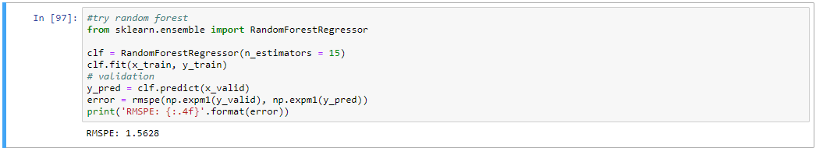
3. REPORT - Statistics for all models used
I tried a Random Forest as prediction model but RMSPE was high. So did not move on with it.
After that, tried XGBoost and stats were better.

Slide 28
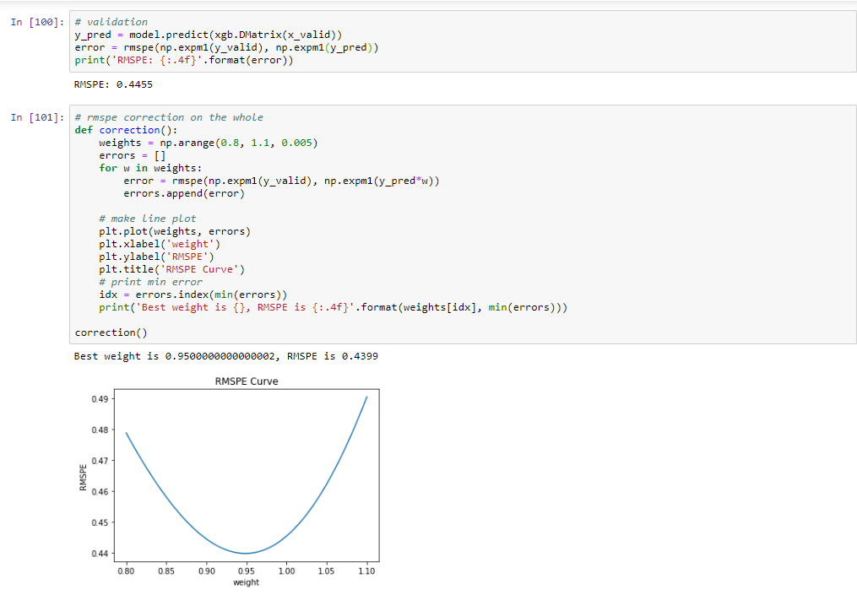
3. REPORT - Statistics for all models used
After that, tried XGBoost and stats were better.

Slide 29
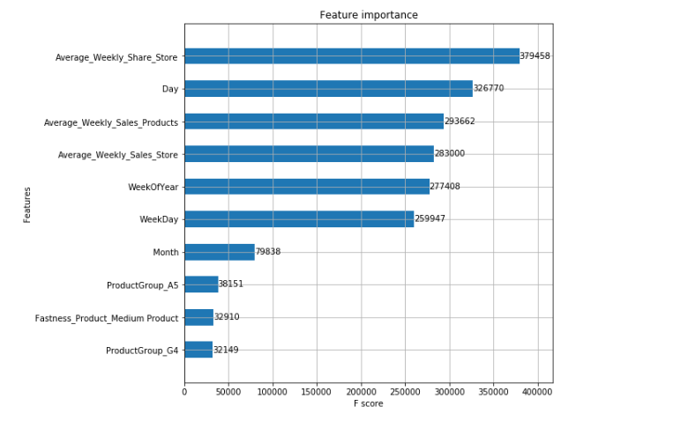
3. REPORT - Statistics for all models used
Feature Importances

Slide 30
3. REPORT
Recommendations

Slide 31
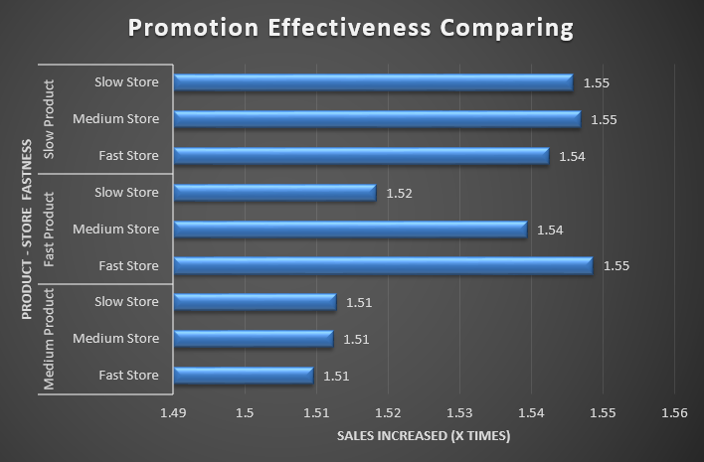
Which items and stores combinations to apply promotion?
When we look at the graph, if we are planning to apply promotion to fast products, we should do that on fast store. In total, Slow products reacted better to promotions. Because of that I would pick first slow products to apply promotion.

Slide 32
REPORT - Is there any data set that you would like to use in addition to tables provided for this assignment? What are those data sets? How would you obtain them?
I believe if I had dimensional information about products,stores,special days,Price data,wide range transactional data (eg. Last 4 years sales),e-commerce click data if exist,etc I would create a good model that really creates value for firm.
We have no data about customers. There are 2 terms I would like to mention. CAR(Customer Analytic Record) and CIF(Customer Information File). CAR is like footprint of customers and CIF includes all kind of information about them. If you wish to create really effective models, first need to create that data structure.

