Slide 1

Pickle and Shelve:
Object Persistence

Slide 2


objectives
Reading from text files
Writing to text files
Read and write more complex data with files
Intercept and handle errors during a program’s execution

Slide 3
Storing Complex Data in Python

Slide 4
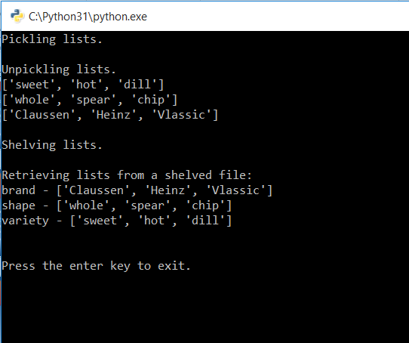

Storing complex data in files
The Pickle It Program
Text files flexible but limited
Can only store data as strings
Cannot store as lists or dictionaries
Python pickle module (needs Imported)
What does ‘pickling’ mean?

Slide 5
pickling modules
Pickle – allows you to pickle and store complex data in a file
Shelve – allows you to store and randomly access pickled objects in a file
Writes objects to file instead of a series of characters
Must store as binary file, not text file
Can pickle – Numbers, strings, tuples, lists, dictionaries

Slide 6
Selected binary file access methods
What do you notice is different about these arguments vs. the text file arguments?
Mode | Description
“rb” | Read from a binary file. If the file doesn’t exist, Python will error.
“wb” | Write to a binary file. If the file exists, the contents are overwritten. If the file doesn’t exist, it is created.
“ab” | Append a binary file. If the file exists, new data is appended to it. If the file doesn’t exist, it is created.
“rb+” | Read from and write to a binary file. If the file doesn’t exist, Python will error.
“wb+” | Write to and read from a binary file. If the file exists, its contents are overwritten. If the file doesn’t exist, it is created.
“ab+” | Append and read from a binary file. If the file exists, new data is appended to it. If the file doesn’t exist it is created.

Slide 7
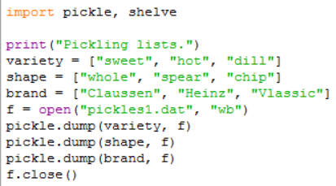
Pickling and writing to a file
pickle.dump() function
Takes 2 arguments
Data to pickle
File to store data
Open as a binary file with ‘write’ access

Slide 8
Pickling and writing to a file
pickle.dump() function
Each list is pickled and written to the binary file as an object to the file pickles1.dat

Slide 9
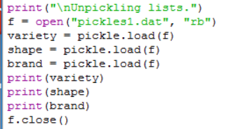

Reading data from A file & unpickling
pickle.load() function
Takes 1 argument, the file to read data from
Notice we still need to open() & close() the file we are working with

Slide 10
Reading data from A file & unpickling
pickle.load() function
Reads the first object in the file
unpickles it to produce the list named ‘variety’
Reads the first object in the file
unpickles it to produce the list named ‘variety’
Reads the second object in the file
unpickles it to produce the list named ‘shape’

Slide 11
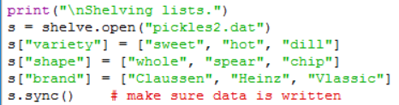
Storing pickled data
Shelve function
Only works with pickled objects, not characters
Takes one argument – the file name
Create a shelve with shelve.open()
Acts like a dictionary
Left side is the ‘key’
Right side is the ‘value’
Name_of_shelf.sync()
Close the file with the .close()
* Python only periodically syncs the file while it is open .sync() method ensures changes to the shelf.

Slide 12
Shelve access modes
It is important to note the ‘shelves’ have their own access modes:
Mode | Description
“c” | Open a file for reading or writing. If the file doesn’t exist, it is created.
“n” | Create a new file for reading or writing. If the file exists, its contents are overwritten.
“r” | Read from a file. If the file doesn’t exist, Python will give an error.
“w” | Write to a file. If the file doesn’t exist, Python will give an error.

Slide 13
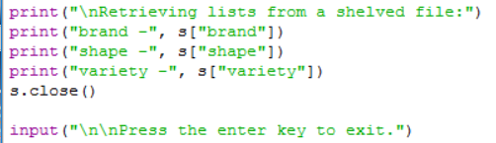
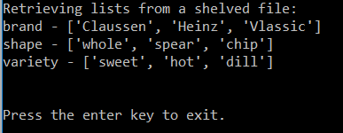
Using a shelf to retrieve pickled data
Shelve acts like a dictionary
Access pickled objects by supplying a key
**In the real world, more complex data would be stored in databases instead of pickling

Slide 14
Using a shelf to retrieve pickled data
Shelve acts like a dictionary
Access pickled objects by supplying a key
Example:
Access pickled list reverse order
**In the real world, more complex data would be stored in databases instead of pickling

Slide 16
Pickling Demo
https://www.youtube.com/watch?v=Pl4Hp8qwwes

Slide 17
Handling Exceptions

Slide 18
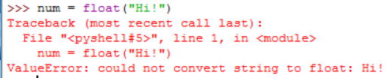
Handling exceptions
Errors: stop program execution & displays an error message
Known as ‘raising an exception’
If nothing is done with the exception, Python halts program
Example:

Slide 19
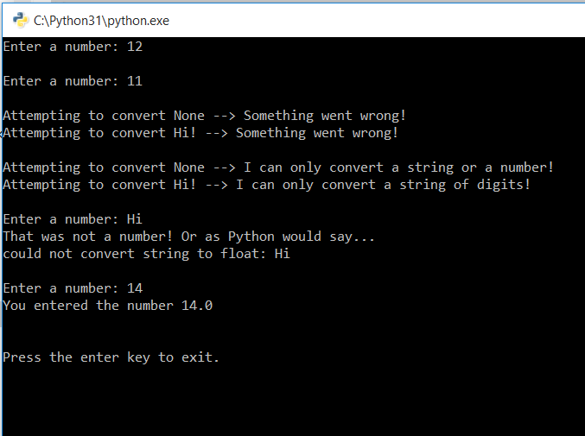
The handle it program
Program open to exceptions from user input
Generates custom exception messages
Runs to completion instead of halting
Handles the exceptions

Slide 20
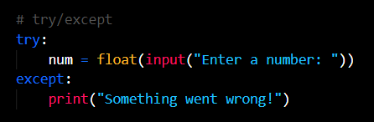
Using ‘try’ statement with ‘except’ clause
First example in handle_it.py
Prompts for a number
Attempts to convert to a float
If any exception, prints “Something went wrong!”

Slide 21
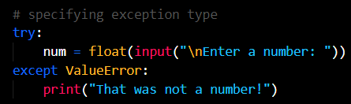
Specifying an exception type
Second example
Same as first – prompts for number
Attempts to convert to float
Only prints “That was not a number!” if the exception type was ValueError
If any other type of exception is raised, the program will halt execution

Slide 22
Selected exception types
Exception Type | Description
IOError | Raised when an I/O operation fails, such as when an attempt is made to open a nonexistent file in read mode.
IndexError | Raised when a sequence is indexed with a number of a nonexistent element.
KeyError | Raised when a dictionary key is not found.
NameError | Raised when a name (of a variable or function, for example) is not found.
SyntaxError | Raised when a syntax error is encountered.
TypeError | Raised when a built-in function is applied to an object of the wrong type.
ValueError | Raised when a built-in function receives an argument that has the right type but an inappropriate value.
ZeroDivisionError | Raised when the second argument of a division or modulo operation is zero.

Slide 23
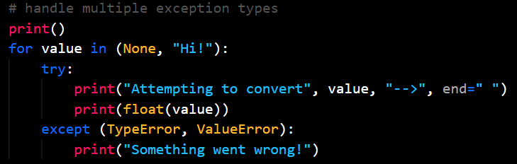
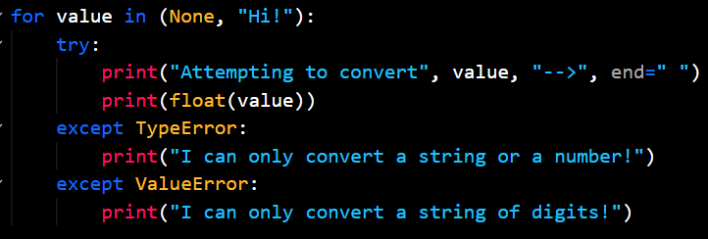
Handling multiple exception types
Third example
Code could result in more than one error type
Except clause can have multiple types
List them comma separated for same message
List them separately for separate messages

Slide 24
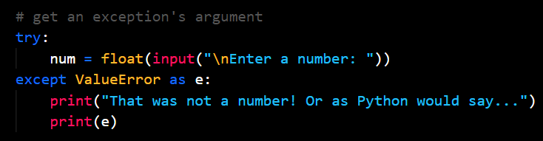
Getting an exception’s argument
The argument of the exception is Python’s description of the problem.
You can capture the argument if you specify variable after the exception type

Slide 25
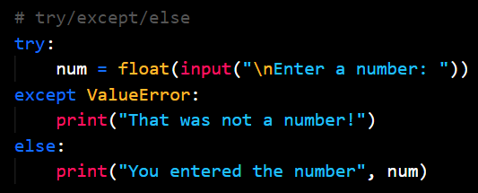
Adding an else clause
You can add a single else clause after all except clauses in a try statement
Else block executes only if no exception is raised in the try block

Slide 27

Challenges
With a partner:
Improve trivia challenge game (pg. 216)

Slide 28
Lab 7 Assignment
Our Classroom → Assignments → Week 5 → Lab 7
Three Projects:
The Trivia Challenge Game
Challenges: Telephone Database program
telephone-lastname.py
Challenges: Word Frequency program
word-frequency-lastname.py
Submit to Blackboard or Schoology by Friday at Noon

