Slide 1
Biodiversity in National Parks Analysis
“Seeing the forest for the trees.”

Slide 2
Overview
This project is designed to review various trends for the Biodiversity in National Parks datasets provided by the US National Parks and Wildlife service.

Slide 3
Dataset Overview
This project analysed data from drawn from two different data frames:
‘species_info’, which has information regarding the species information, such as category, scientific name, and conservation status.
‘observations’ which has information regarding which species were spotted at which NP, and in what quantities.
Data was cleaned by removing double ups in species types (by scientific names) and summing species observations by NP.

Slide 4
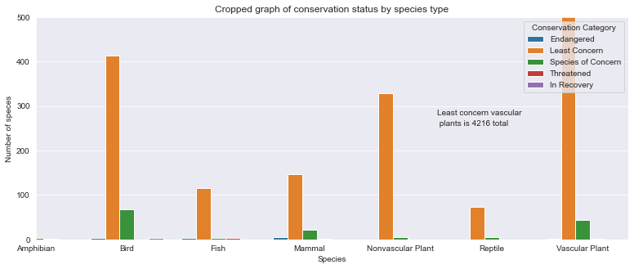
What’s the conservation status makeup of each species?
Most species are classified as least concern.
Vascular plans make up an overwhelming majority of named species, followed by birds.

Slide 5
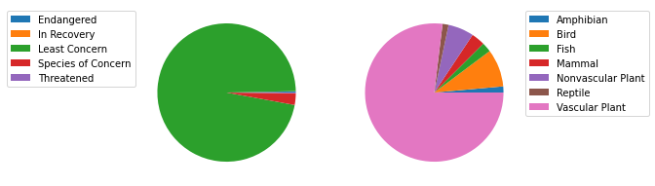
What is the conservation status/species proportion of all creatures?
The above shows total proportions of named species by conservation status and species type.

Slide 6
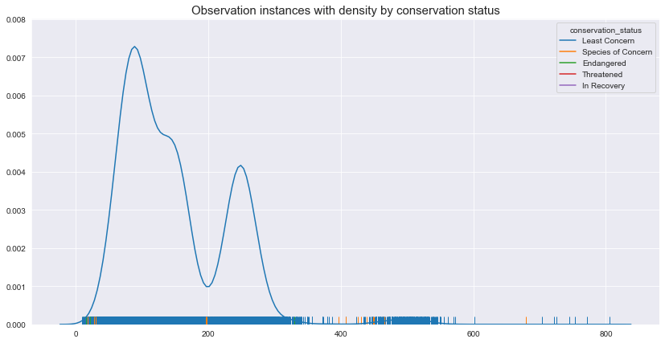
What is the distribution of observations by conservation status?
Most observations lie between about 50 and 350.
As the colours in the rug-plot show, threatened/ endangered species are likely to be seen in lower quantities.
So now that we have a background in what type of species are likely to be endangered, is there a significant difference in the conservation status among species?

Slide 7
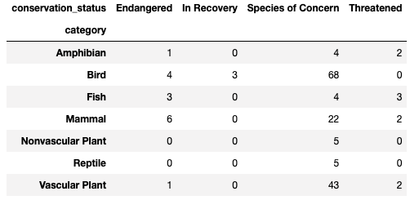
Is there significant difference between species by conservation status?
A chi2 test was carried out on the associated cross tab to see if some species were more likely be classified as a certain conservation status than others.
It was found to be statistically significant (p = ~0) to suggest that certain species are more likely to be of one status than others.
So, what is the distribution of species observations?

Slide 8
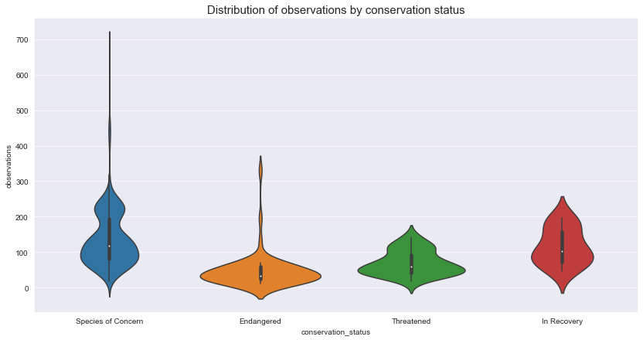
What is the distribution of observations by conservation status?
As can be seen, endangered species are least likely to be seen in large numbers, followed by threatened and species of concern / in recover.
This aligns with the rug-plot from before.
Next, where are such species likely to be found?

Slide 9
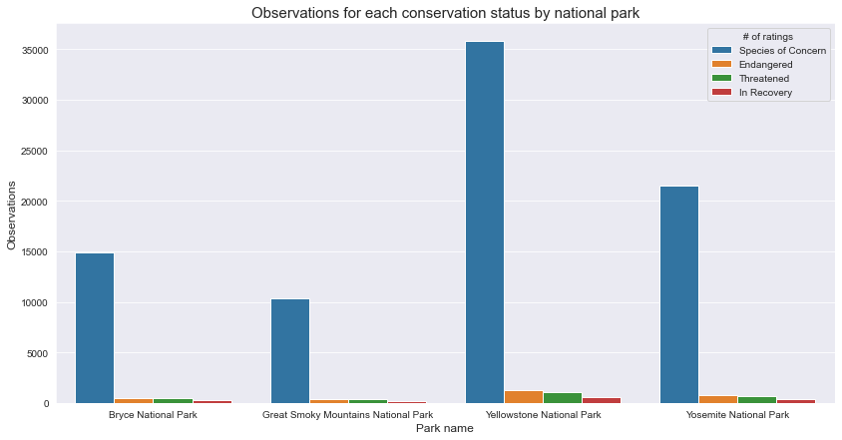
How many observations were made in each NP by conservation status?
Every species classification is most likely to be spotted in Yellowstone.
The number of species likely to be seen is: 1) ‘Species of concern’ 2) ‘Endangered’ 3) ‘Threatened’ 4) ‘In recovery’

Slide 10
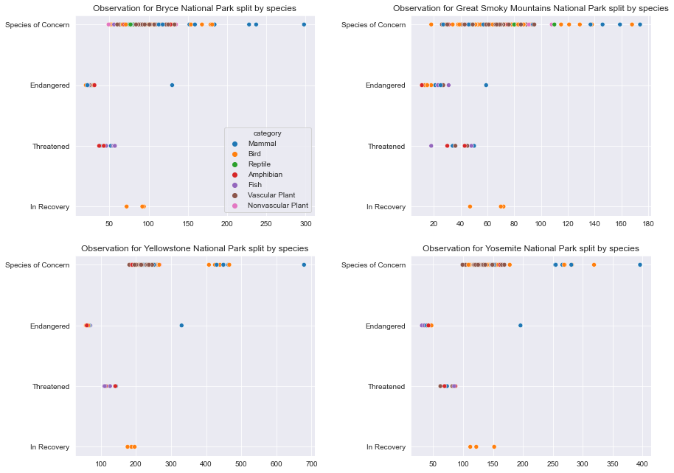
How many observation instances in each NP?
All ‘In Recovery’ species are birds.
‘Threatened species’ are made up of Amphibians, Fish, Mammals and Vascular plants.
‘Endangered’ species are likely to have the least observations for every NP.
Reptiles seem to be be least vulnerable to endangerment (though they are the least common species)

Slide 11
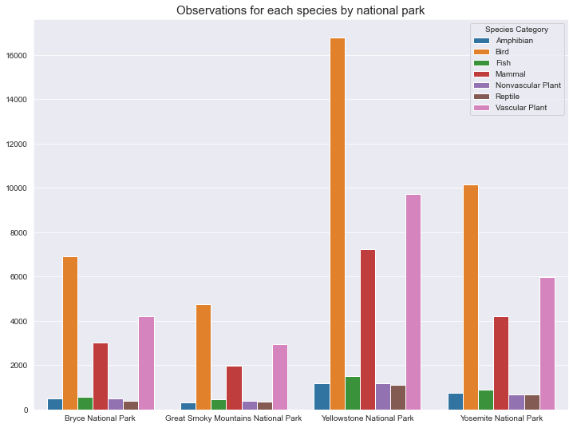
How many total observations in each NP by species?
Birds tend to be the most observed species (perhaps related to a large number being ‘In Recovery’)
Mammals and vascular plants are also seen quite a bit.
Amphibians and reptiles are consistently among the least seen animals

Slide 12
Recommendations
Endangered species seem to have the lowest populations (measured by observations thereof); special focus should be given to their conservation.
Birds, Mammals, Amphibians and Fish seem to be consistently among the most Endangered and Threatened by all NPs. More studies should be conducted to see what’s impacting them and how they can be helped.
For future research, this is a strong correlation between observation sizes and endangered status. If the number of observations for a species drops, this should be a strong warning that the species might be under stress - this should be taken into consideration for future planning.
Yellowstone seems to have the greatest density of species life, with Grey Smokey Mountain NP being the least. This should be considered when assigning funding.

