Slide 1
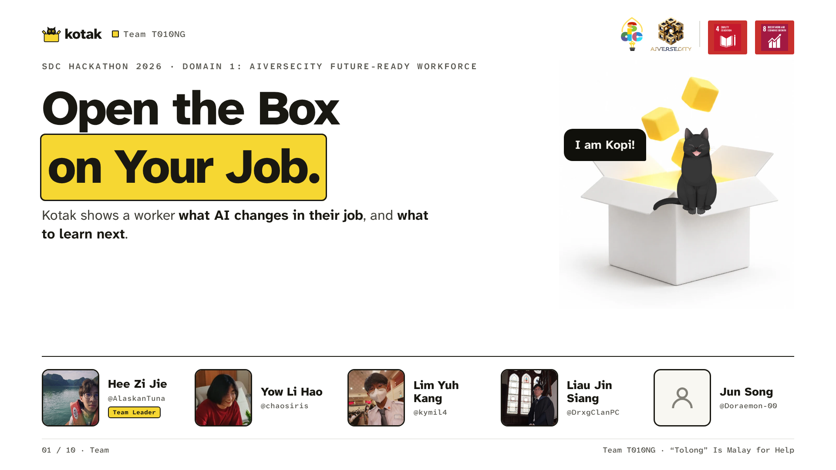
Notes:
Hi, we're Team T010NG. Tolong is Malay for help. We're in Domain 1, the future-ready workforce, and we built Kotak. It shows a worker what AI is changing in their job, and what to learn next.

Slide 2
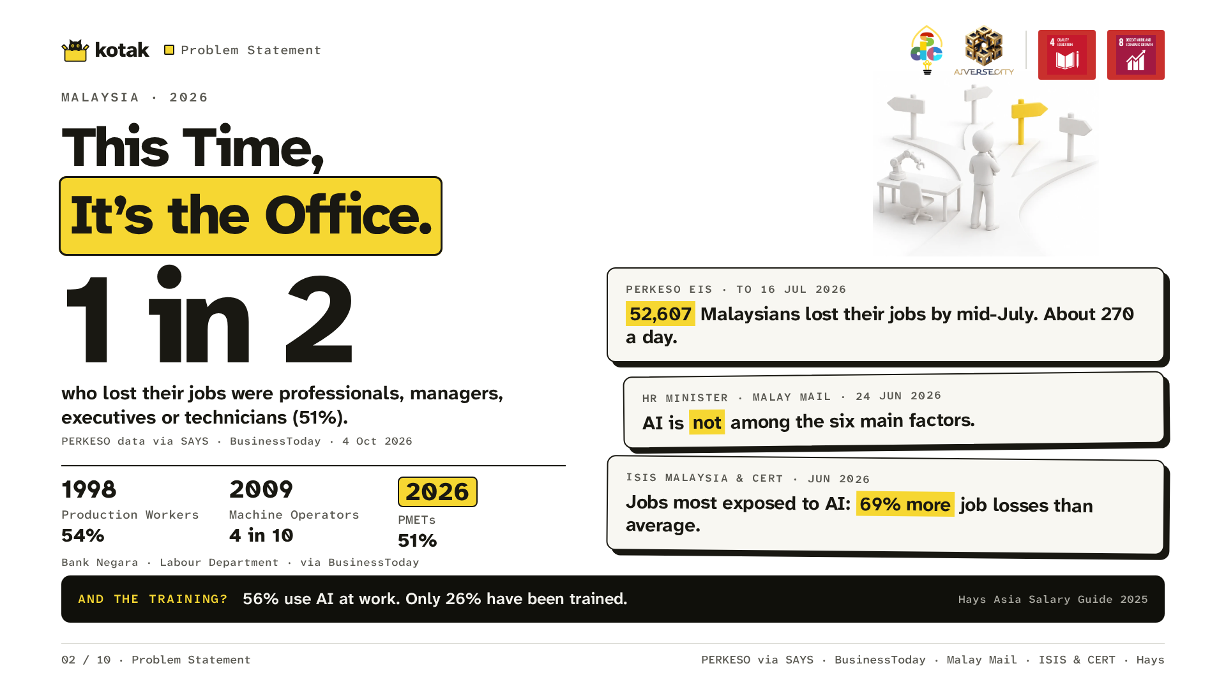
Notes:
By mid-July 2026, 52,607 Malaysians had lost their jobs, about 270 a day. Half were professionals, managers, executives or technicians; in 1998 and 2009 production workers were hit hardest. This time, it's the office. The minister says AI isn't a main cause yet, but ISIS Malaysia found the most AI-exposed jobs see 69% more job losses than average. 56% of Malaysian professionals use AI at work; only 26% have been trained.

Slide 3
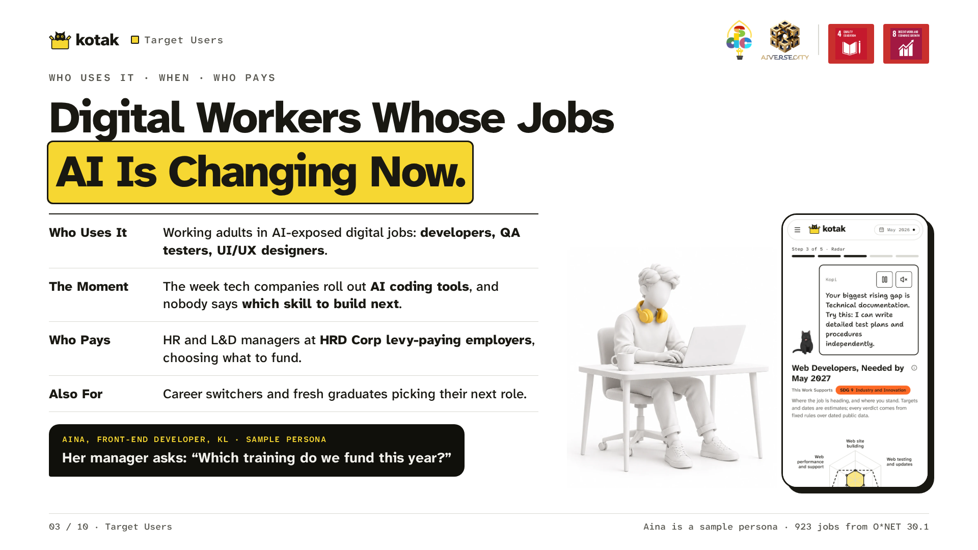
Notes:
Kotak is for working adults in AI-exposed digital jobs: developers, QA testers and UI/UX designers, the week tech companies roll out AI coding tools. HR and L&D managers at HRD Corp levy-paying employers pay. Aina is a sample persona at a tech company; her manager asks which training to fund.

Slide 4
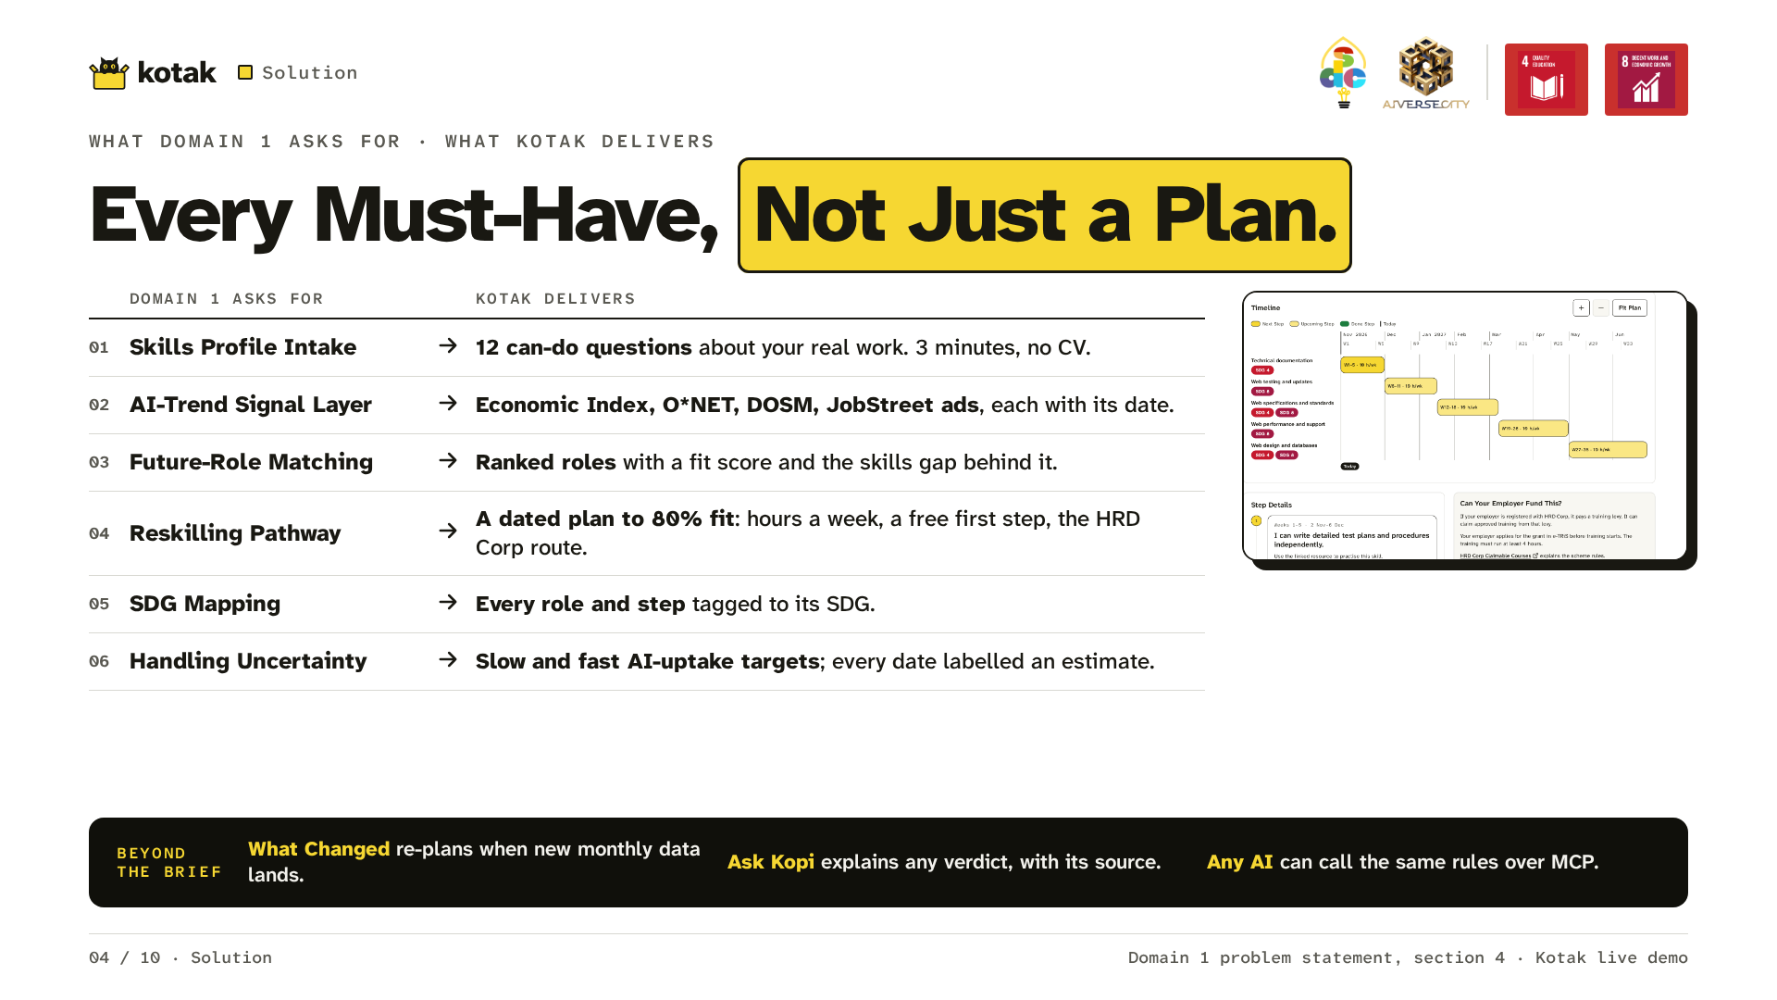
Notes:
A course list can't answer that. Kotak can, in a three-minute check-up: 12 questions, no CV. She leaves with a dated plan: a week-by-week reskilling calendar, from her start date to 80% fit for her job, with which skill first, the hours each week, a free step for each skill, and her employer's funding route. And it covers all six must-haves in the Domain 1 brief.

Slide 5
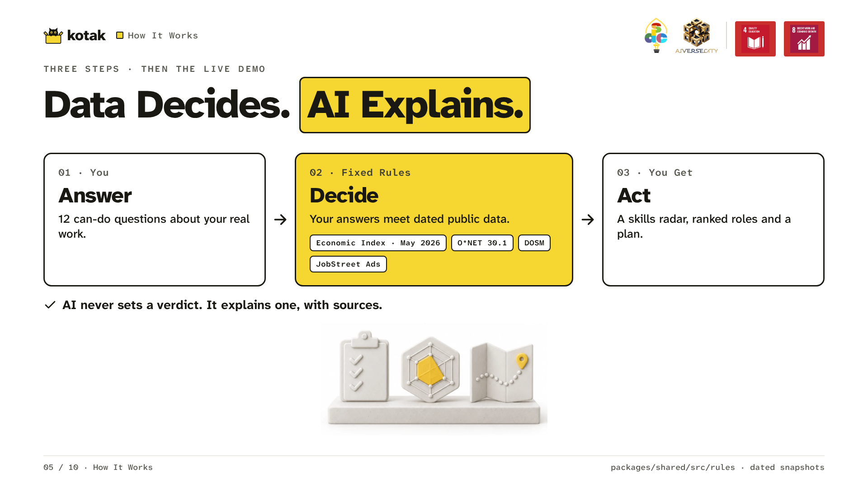
Notes:
Data decides, AI explains. Answer 12 questions; fixed rules compare them with dated public data; you get a radar, ranked roles and a plan. AI never sets a verdict.

Slide 6
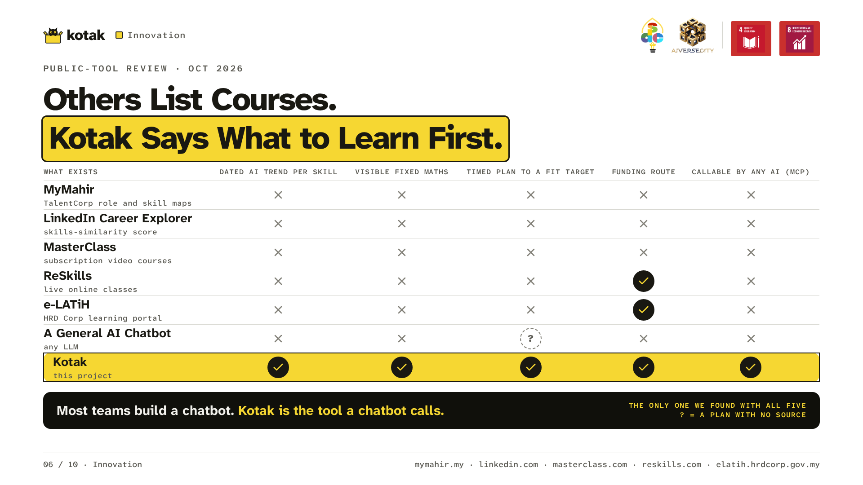
Notes:
MyMahir and LinkedIn map skills; MasterClass, ReSkills and e-LATiH offer courses; a chatbot can't say where its plan came from. Kotak is the only one we found that dates each skill's AI trend, shows its maths, times the plan, points to funding, and lets any AI call the same rules. Course sites tell you what you could learn. Kotak tells you what to learn first, and why.

Slide 7
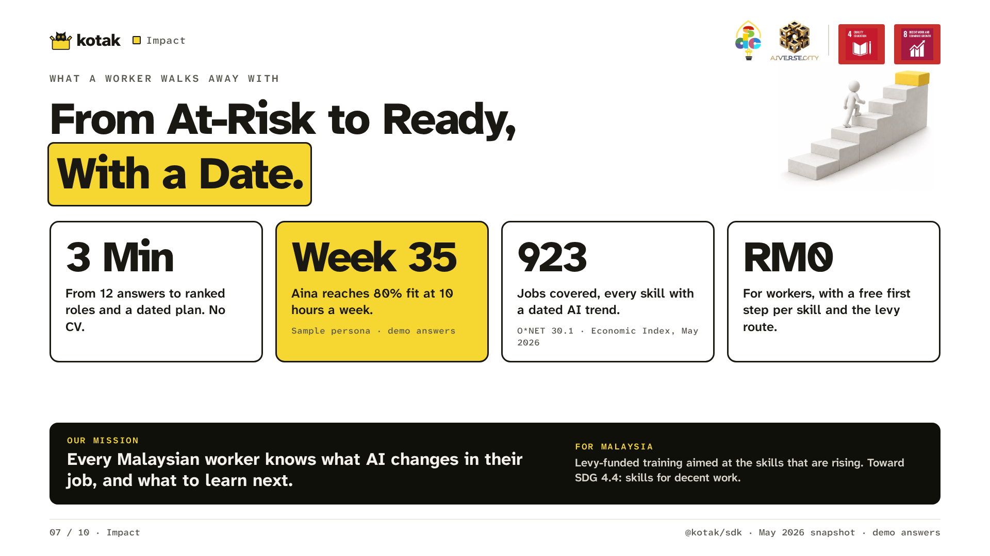
Notes:
For a worker, the gain is plain: three minutes, a plan to 80% fit, and nothing to pay, across 923 jobs. For Malaysia, the levy already funds training; Kotak helps aim it at the rising skills. That's SDG 4.4: skills for decent work.

Slide 8
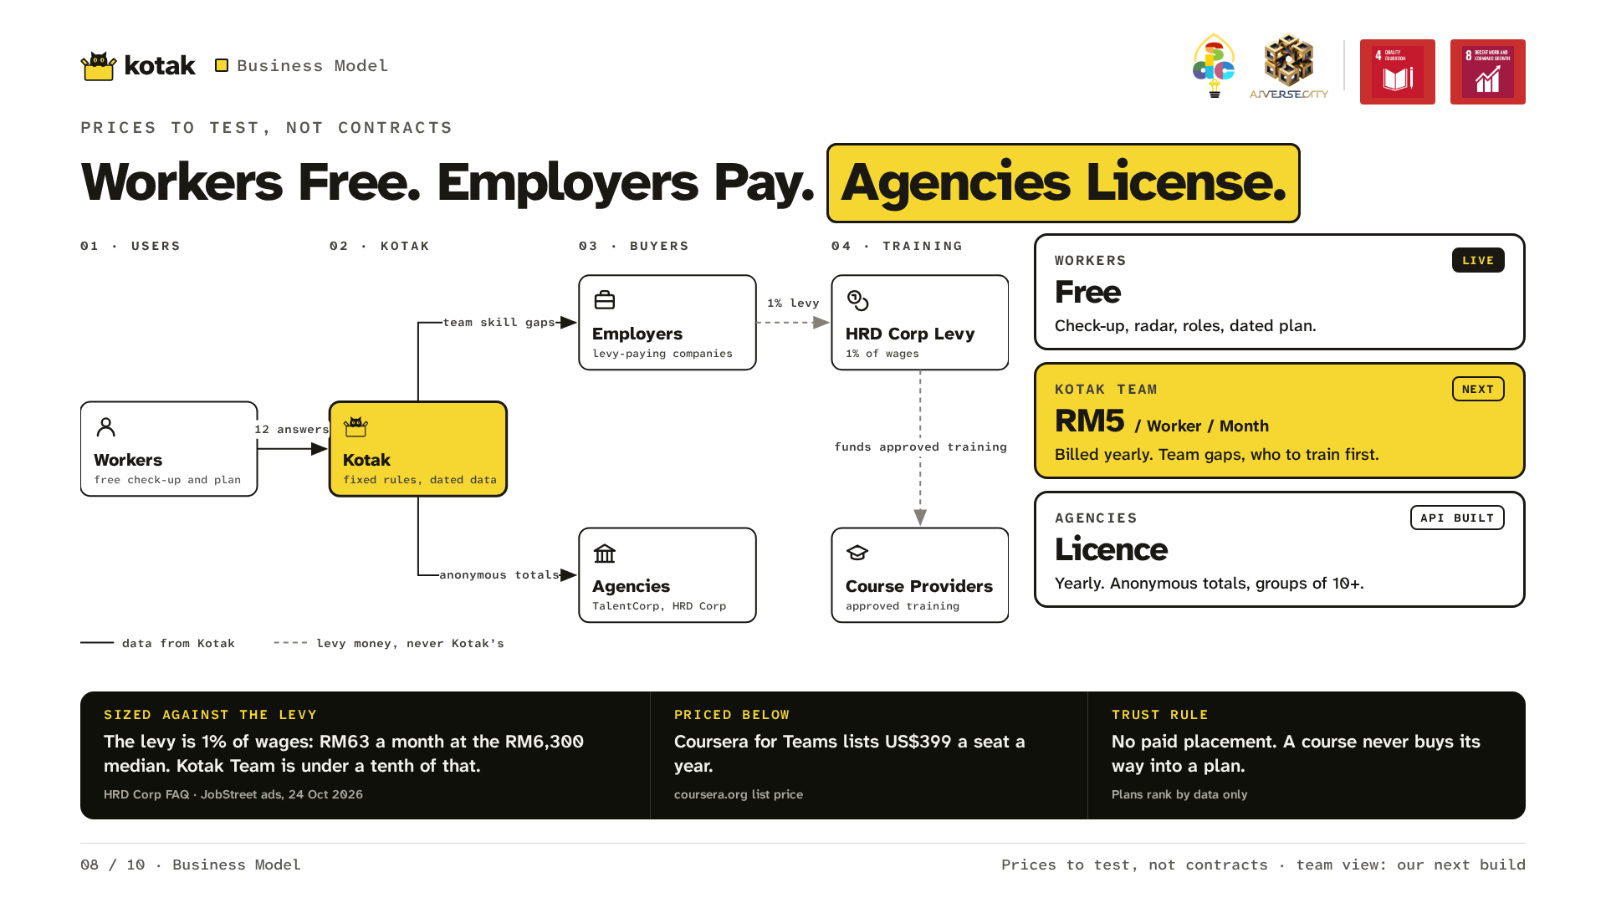
Notes:
Workers use Kotak free. Employers pay for a team view: RM5 per worker a month. For a developer on the median advertised pay the levy is RM63 a month, so Kotak costs under a tenth of it. Agencies license anonymous national totals. Prices to test, not contracts; the team view is our next build.

Slide 9
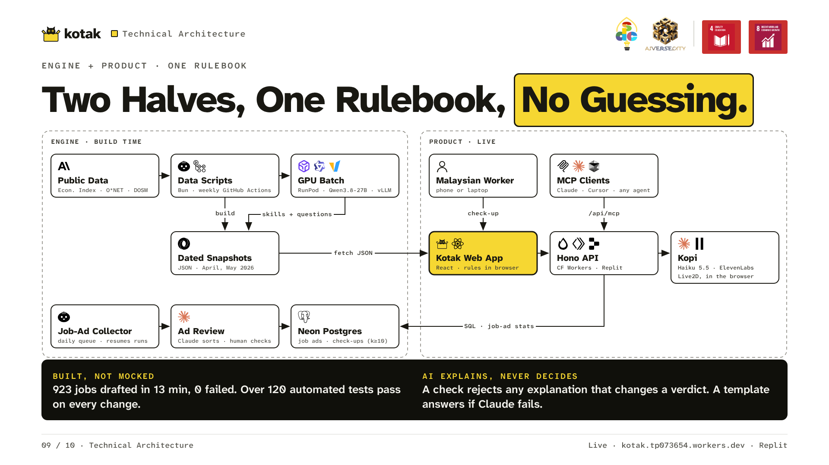
Notes:
Two halves share one rulebook. Every week, dated public data becomes a snapshot; every day, new JobStreet ads come in, Claude sorts them and a person checks them. RunPod drafted skills and questions for 923 jobs in 13 minutes. In the app, the rules run in your browser. Claude Haiku explains, and a check rejects any explanation that changes a verdict. Live on Replit; over 120 automated tests pass on every change.

Slide 10
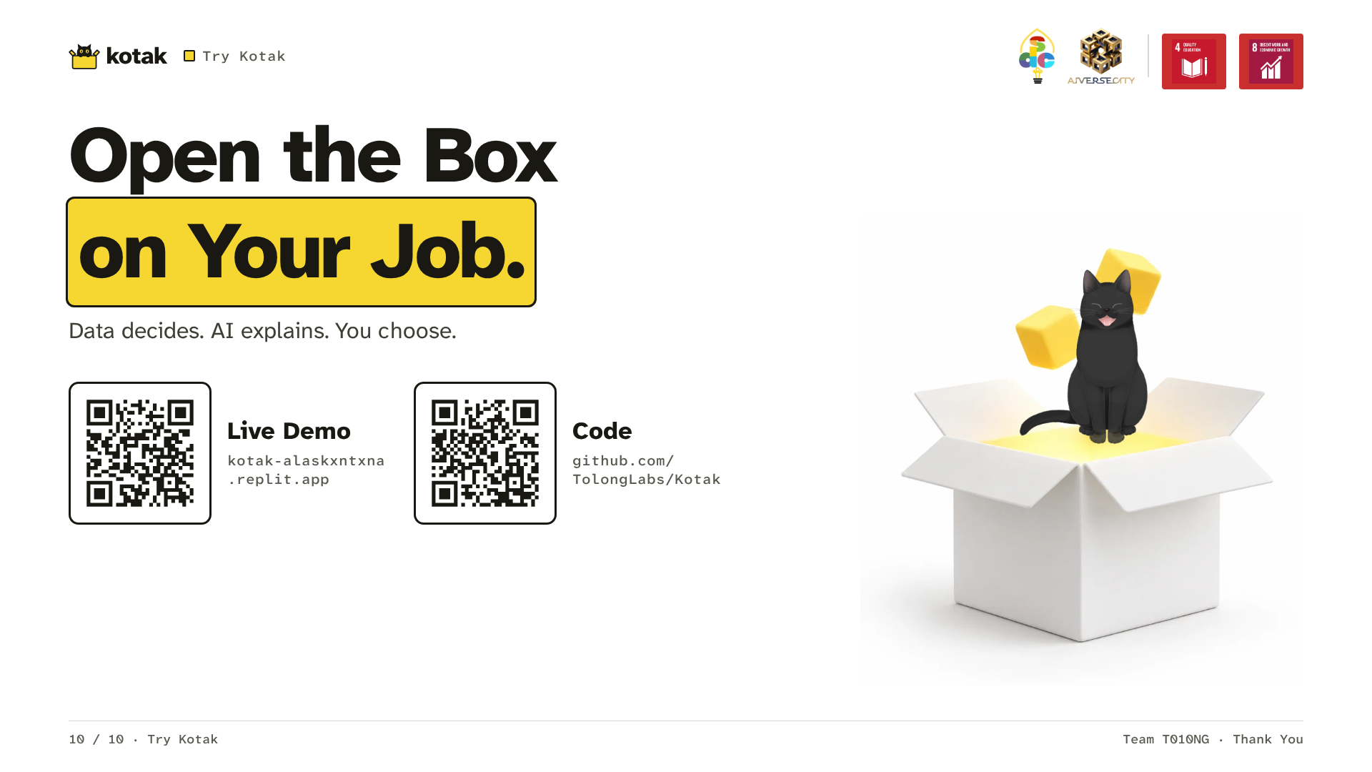
Notes:
Aina doesn't need another course list. She needs to know where to start. Kotak is Malay for box. Data decides. AI explains. We're Team T010NG. Thank you.

