Slide 1
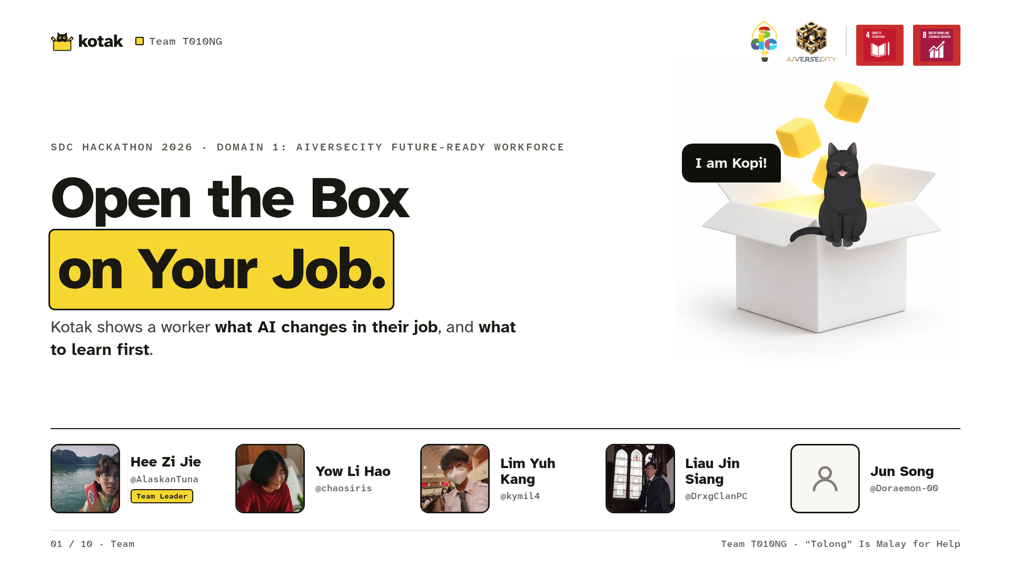
Notes:
Good morning, judges. We're Team T010NG. Domain 1, Aiversecity. We built Kotak, Malay for box. It tells you how AI is changing your job and what to learn first, with dates. Before we show you, a question for the room.

Slide 2
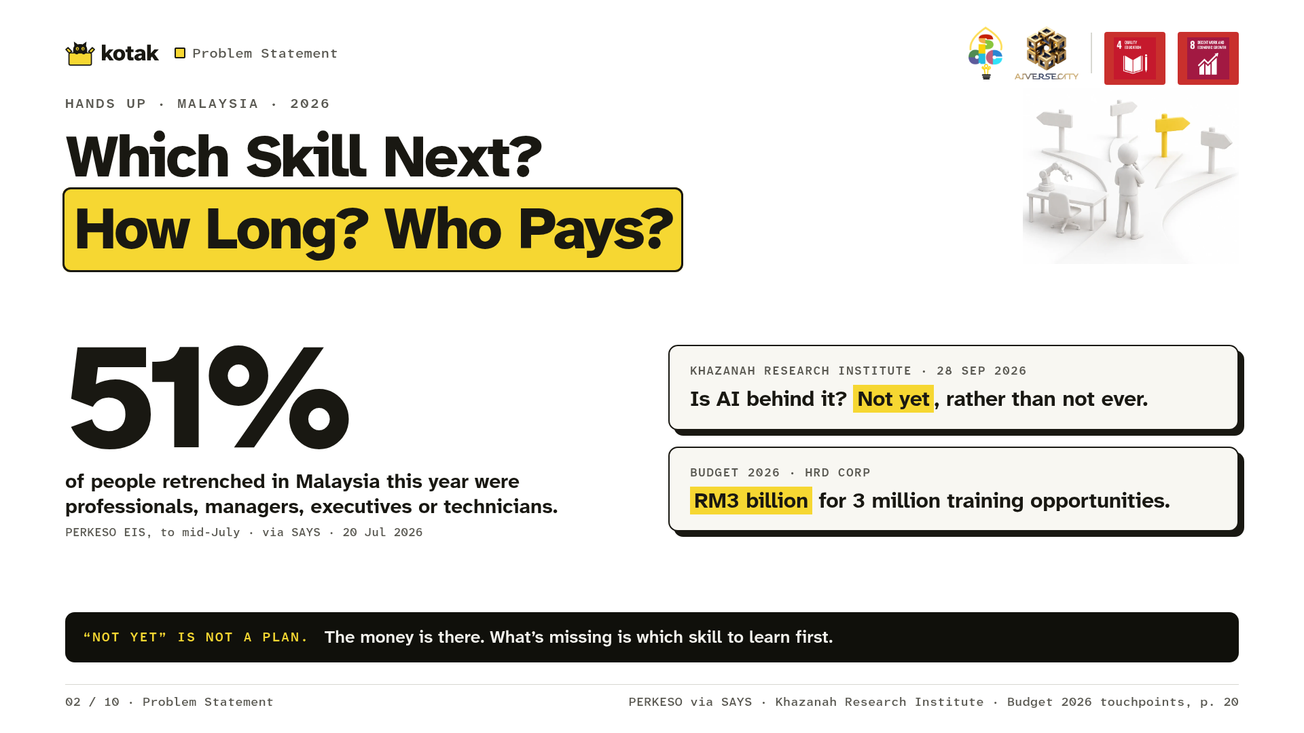
Notes:
Hands up if you used AI at work or in class this week. [Pause 2 s.] Now, keep your hand up if you know which skill to learn next, how many hours it takes, and who pays. [Pause 2 s. Hands drop.] That's the problem. More than half of those retrenched in Malaysia this year were professionals, managers, executives and technicians. People like many of us here. Is AI behind it? Khazanah Research Institute says: not yet, rather than not ever. But "not yet" is not a plan. You see, the money to retrain is there: RM3 billion for HRD Corp training in Budget 2026. However, what's missing is actually knowing which skill to learn first.

Slide 3
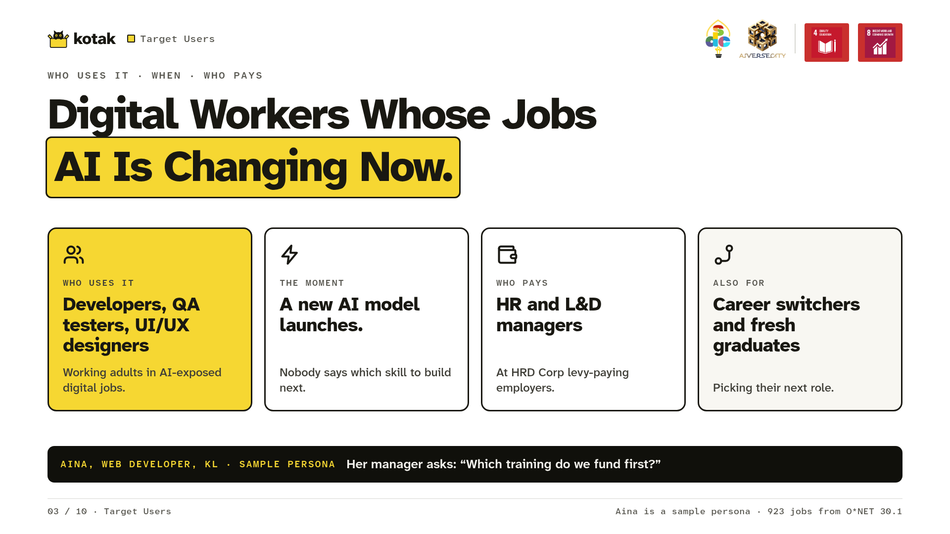
Notes:
So who is Kotak for? Well, people in digital jobs; jobs that AI is changing now. Like Aina, our sample user, a web developer in KL. Every time a new AI model launches, she asks: is my job next? Fortunately, her manager has HRD Corp levy money, but faces one crucial question: which training do we fund first?

Slide 4
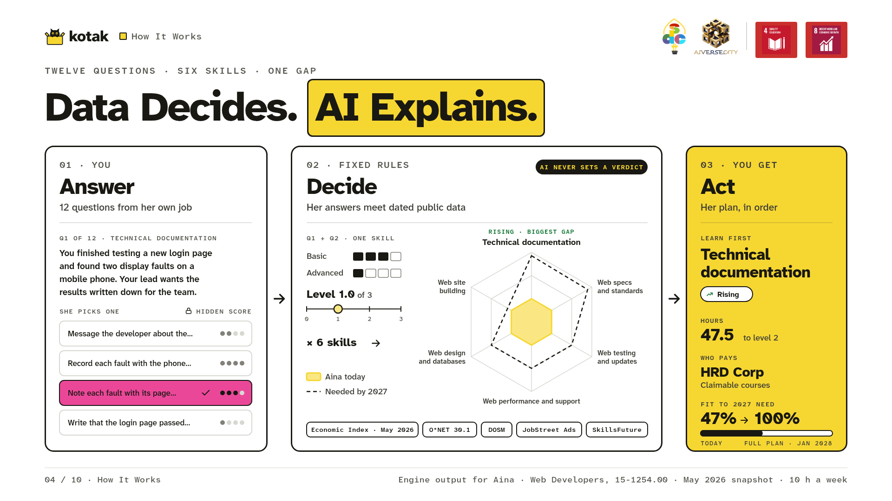
Notes:
Here's how Kotak works, in three steps. One: Aina answers twelve questions about what she'd do at work. Two: Kotak checks her answers against dated public data on AI use and jobs in Malaysia. Fixed rules decide every result. AI only explains it. Three: she gets her plan. The skill to learn first, the hours, and who pays. Data decides. AI explains. Let's run Aina's check-up, live. [Advance to slide 5.]

Slide 5
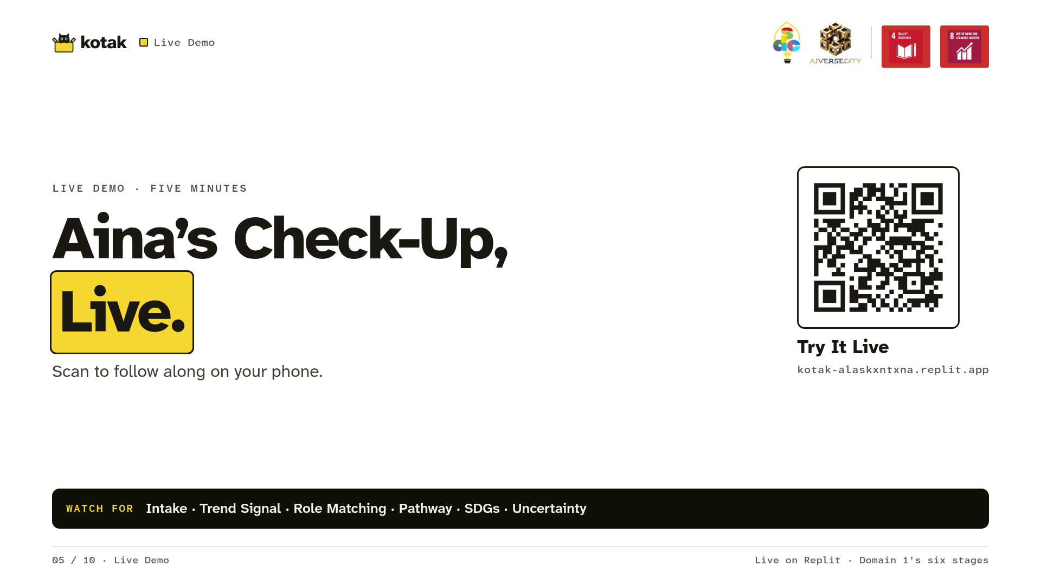
Notes:
Now, without further ado, let's see how things work in action. [The driver switches windows to the browser.] Live demo, five minutes: follow D1 to D8 in the pitch script, and name each stage aloud as it appears. Stage 1 of 6, intake. 2, the trend signal. 3, matching. 4, her pathway. 5, the SDGs. 6, uncertainty, in the 3D space. Then the change test: say when. [The driver switches back to the deck, on slide 6.]

Slide 6
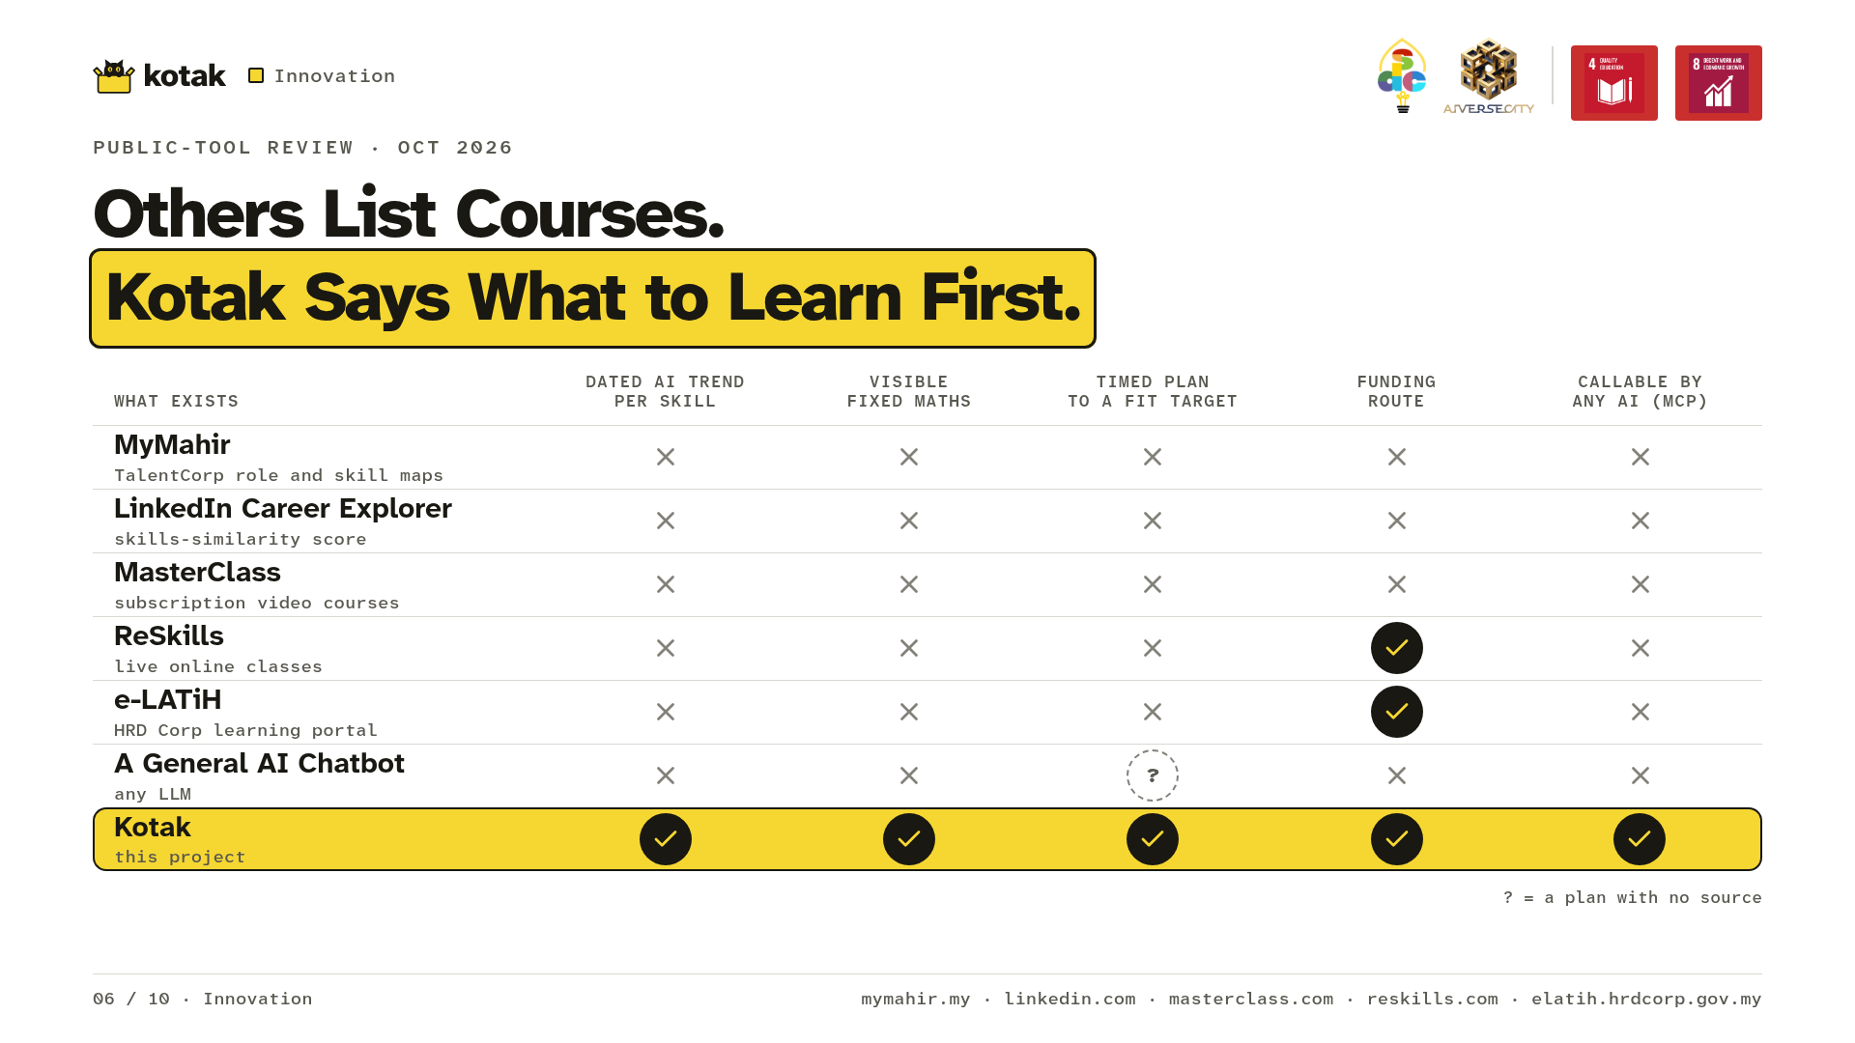
Notes:
Now, why Kotak? We compared it with MyMahir, LinkedIn, e-LATiH and a general chatbot. Kotak is the only one we found with all five you just saw: a dated AI trend for each skill, the maths shown, a timed plan, a funding route, and even a MCP server your AI can call.

Slide 7
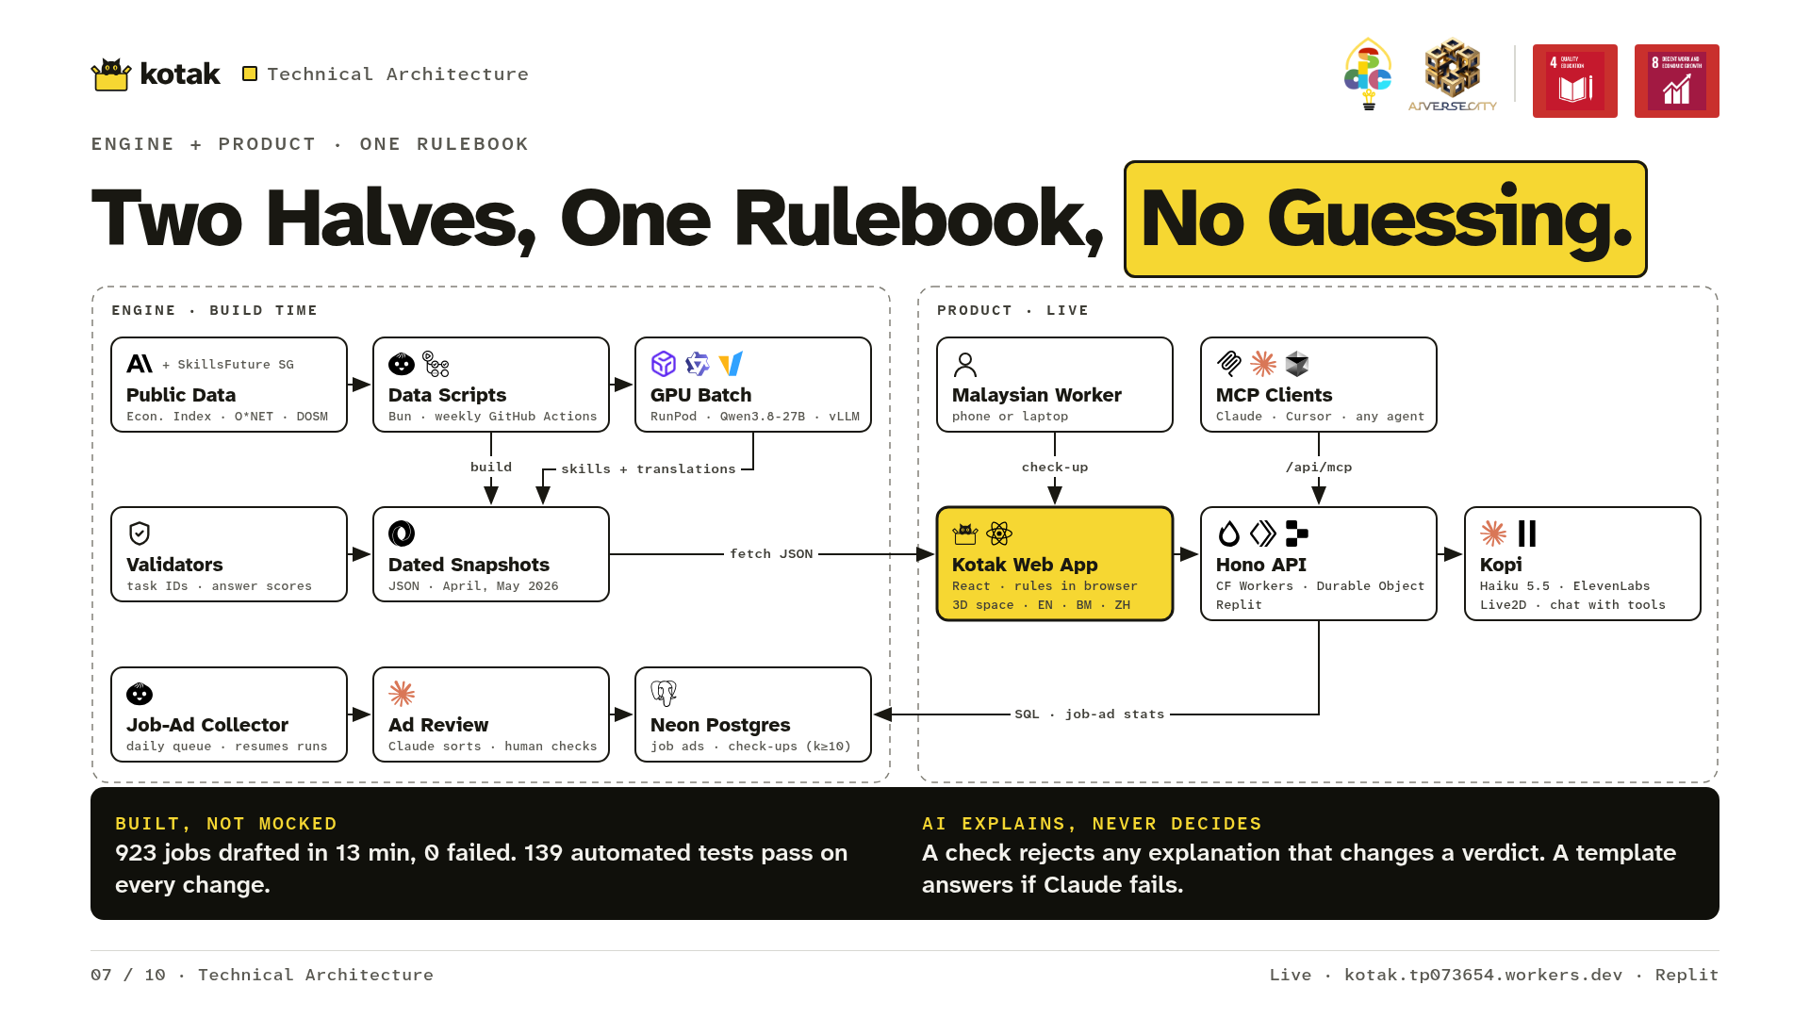
Notes:
Under the hood: two halves, one rulebook. First, the engine, at build time. Bun pipelines turn the Economic Index, ONET and DOSM into dated monthly snapshots. Each skill's AI trend resolves Malaysia-first, down six ONET levels, before any global figure. SkillsFuture Singapore adds skill names, never verdicts. Then a RunPod GPU batch, Qwen on vLLM, drafted skills for all 923 jobs in 13 minutes, and validators reject any task that isn't the job's own. Finally the product. One TypeScript rulebook runs in your browser and on our edge API, so every result is reproducible. Claude Haiku only explains: a verifier keeps its text only if it names the exact verdict, cites each source by date, and adds no number.

Slide 8
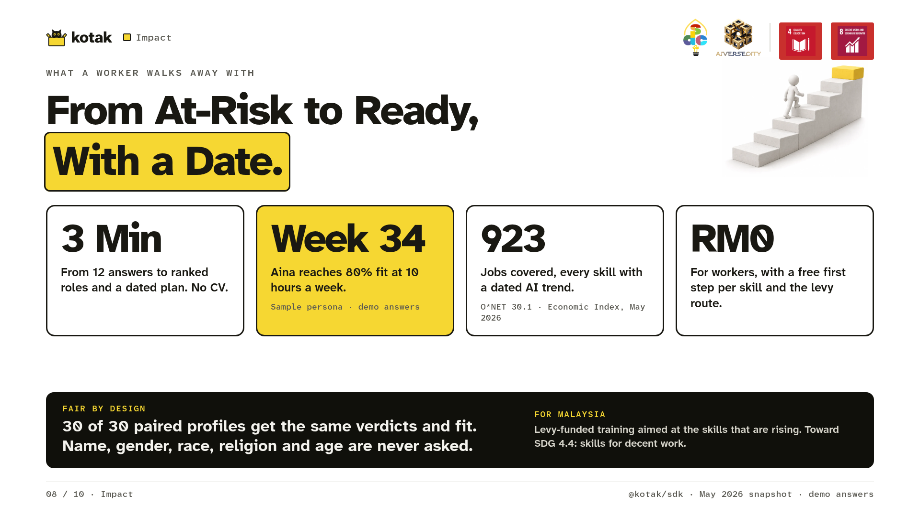
Notes:
Here's what Aina gets. Her check-up took about three minutes. Her plan reaches 80% fit by week 34 at ten hours a week. Every step has a free course. For her, it costs nothing. [Only once #378 has run:] Across 20 test profiles, all 20 reached a plan in under three minutes, with every step cited. Is it fair? We tested 30 pairs of profiles differing only in situation, years or qualification. Verdicts and fit matched in all 30. Kotak never asks for name, gender, race, religion or age. Aina's answers stay on her device.

Slide 9
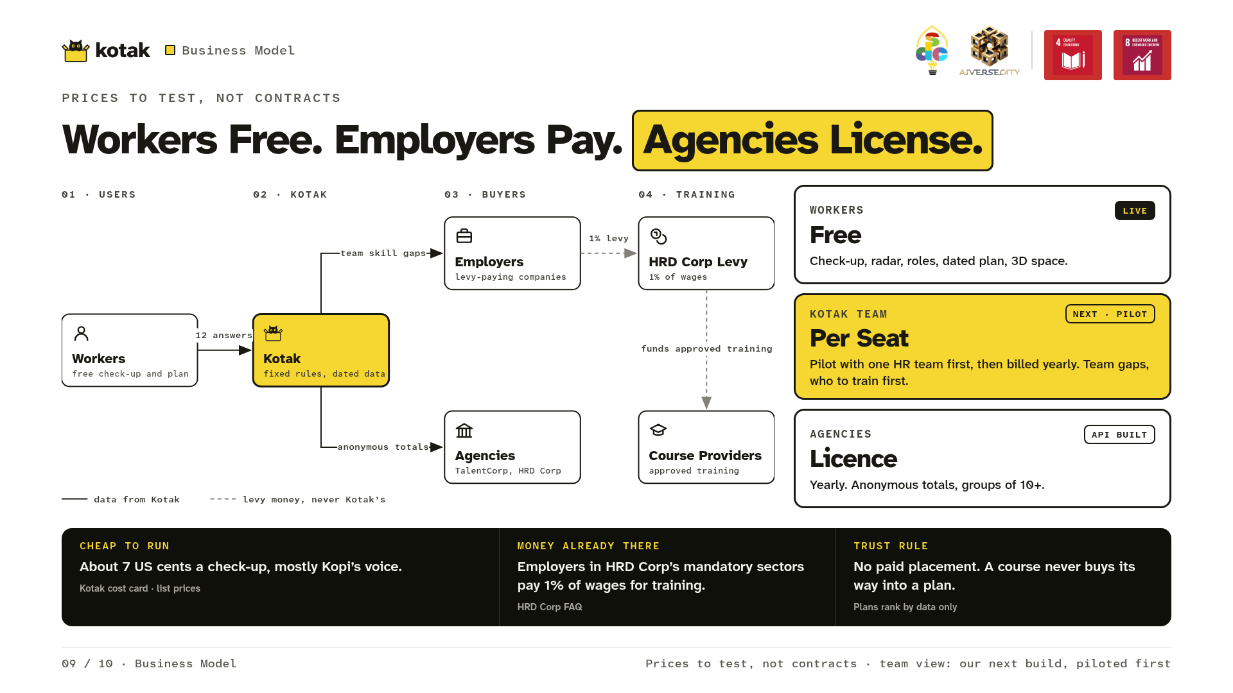
Notes:
Now, who pays? Never the worker. Employers in HRD Corp's mandatory sectors already pay a training levy of 1% of wages. Kotak shows which skills to fund. Next, we're building a team view for HR, and we'll pilot it first with one HR team and their staff. Agencies get anonymous totals, only for groups of ten or more. It's cheap to run: about 7 US cents a check-up.

Slide 10
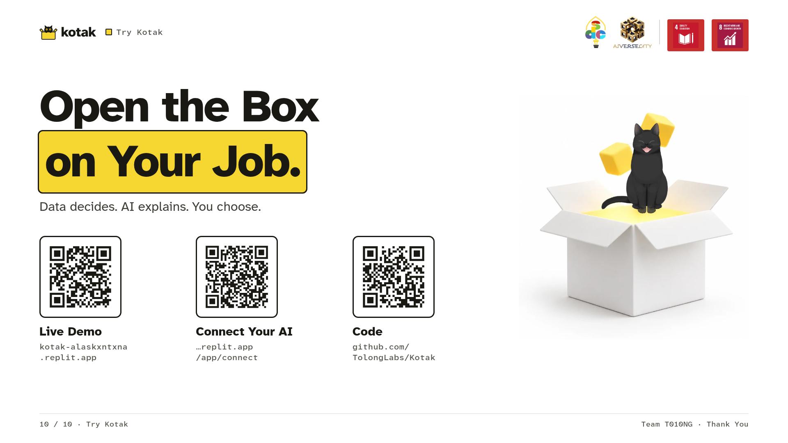
Notes:
Kotak means box, and we built it to open the box on your job. Thank you. [Hold 3 seconds on the QR codes.]

