Slide 1
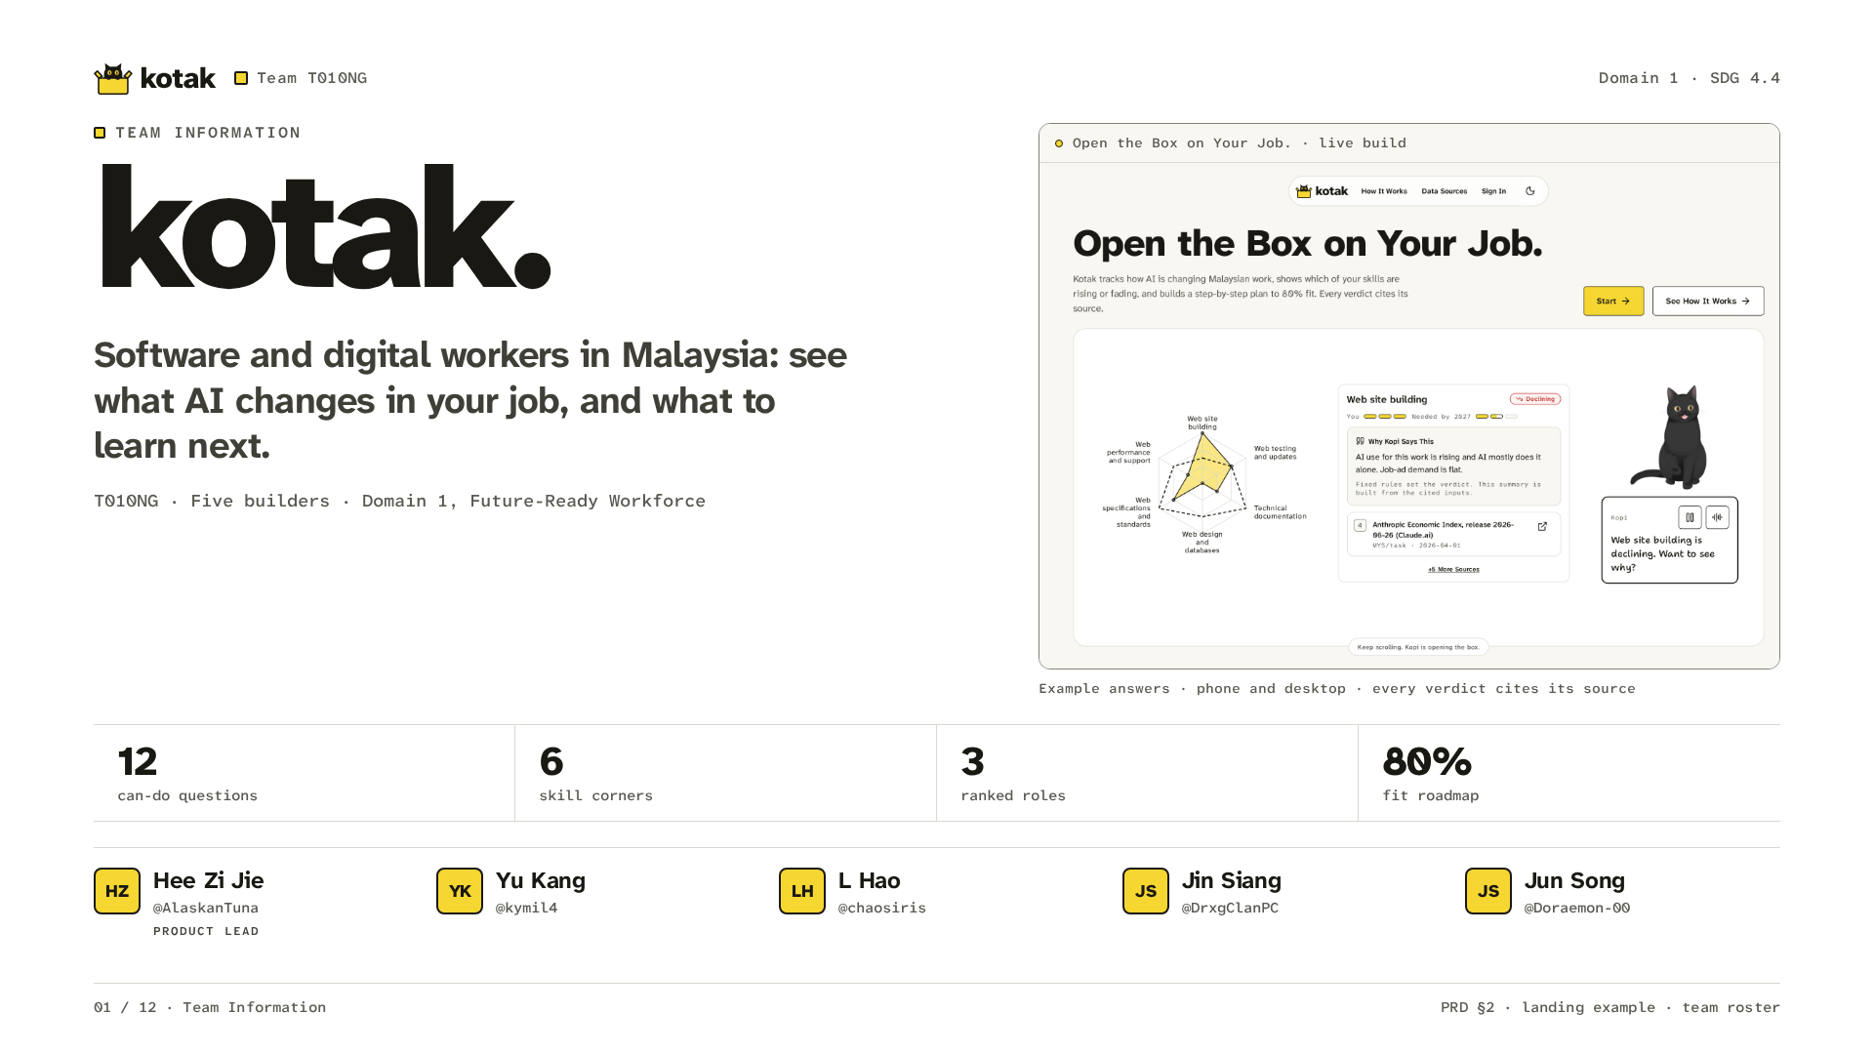
Notes:
Kotak is for software and digital workers in Malaysia. We focus on developers, testers and designers at employers that pay the HRD Corp levy. They get a plan for what to learn next. We are Team T010NG. The build is live on Replit.

Slide 2
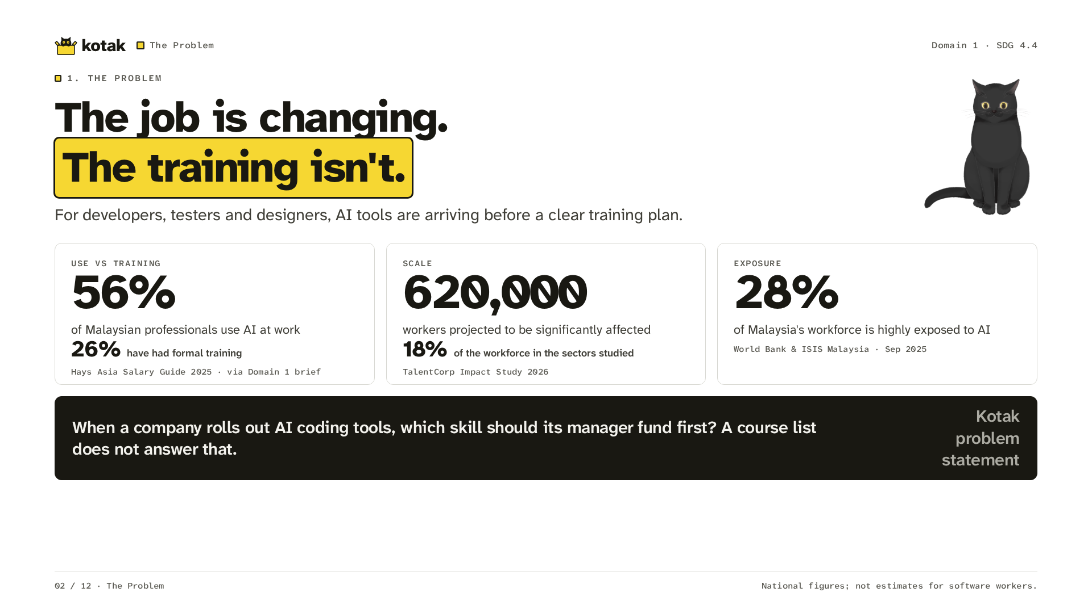
Notes:
These are national figures, not figures for software workers alone. Hays reports 56 percent use AI and 26 percent have formal training. TalentCorp projects 620,000 workers affected in the sectors studied. World Bank and ISIS Malaysia report 28 percent highly exposed. Our moment is a manager deciding what training to fund as AI coding tools arrive.

Slide 3
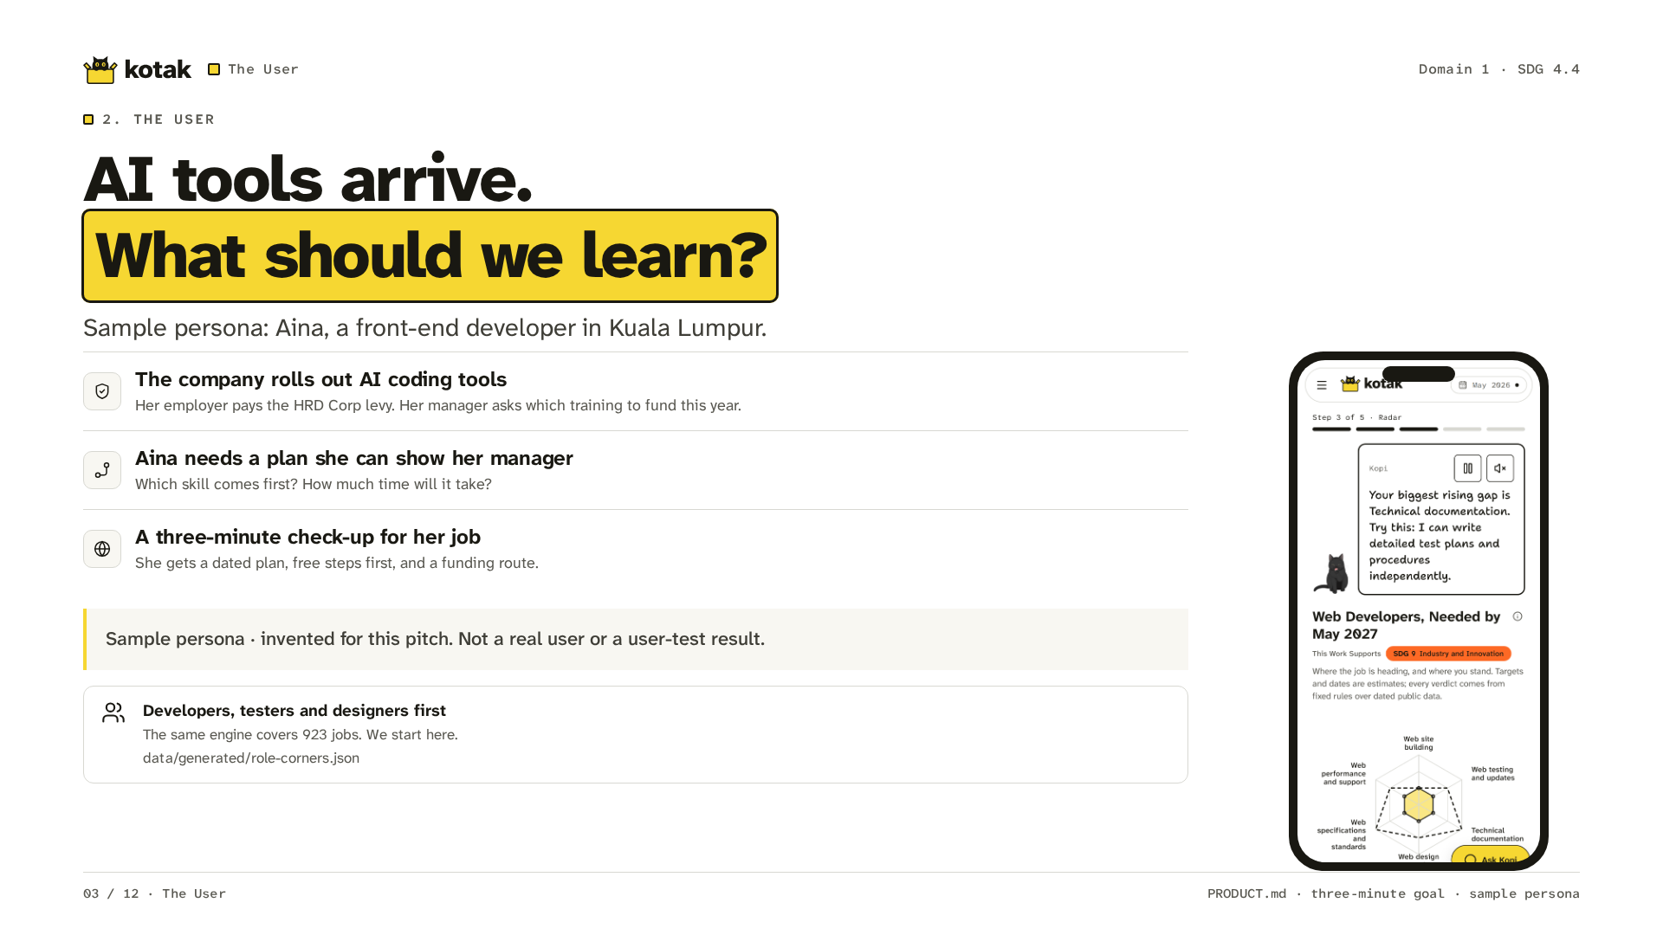
Notes:
Aina is a sample persona. We invented her for this pitch. She is a front-end developer in Kuala Lumpur. Her employer pays the HRD Corp levy. The company rolls out AI coding tools. Her manager asks what training to fund this year. She needs a plan she can show him. The engine covers 923 jobs. Our first group is software and digital workers.

Slide 4
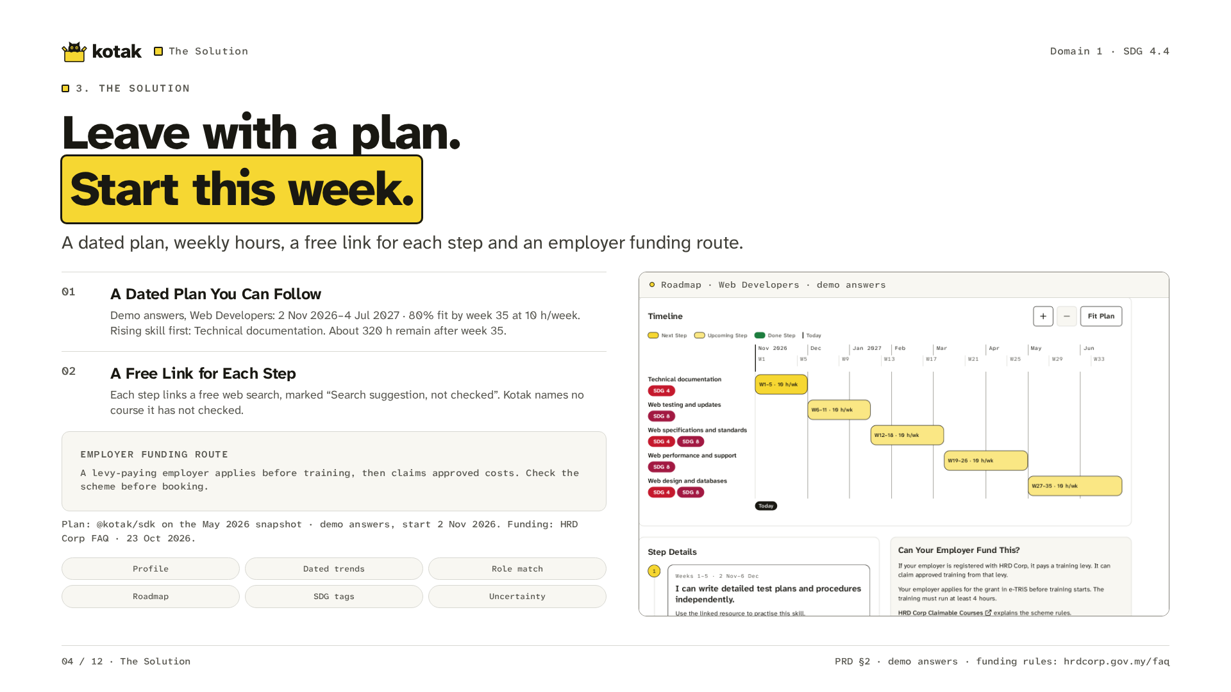
Notes:
Aina leaves with a dated plan. On screen is the plan for her job, Web Developers, with the demo answers. At ten hours a week it starts on 2 November 2026 and reaches 80 percent fit by week 35, on 4 July 2027. The Rising skill comes first: Technical documentation, then Web testing and updates. About 320 hours of the full path remain after week 35. Each step links a free web search, labelled as a suggestion Kotak has not checked. The funding card tells a levy-paying employer to apply before training and claim only approved costs.

Slide 5
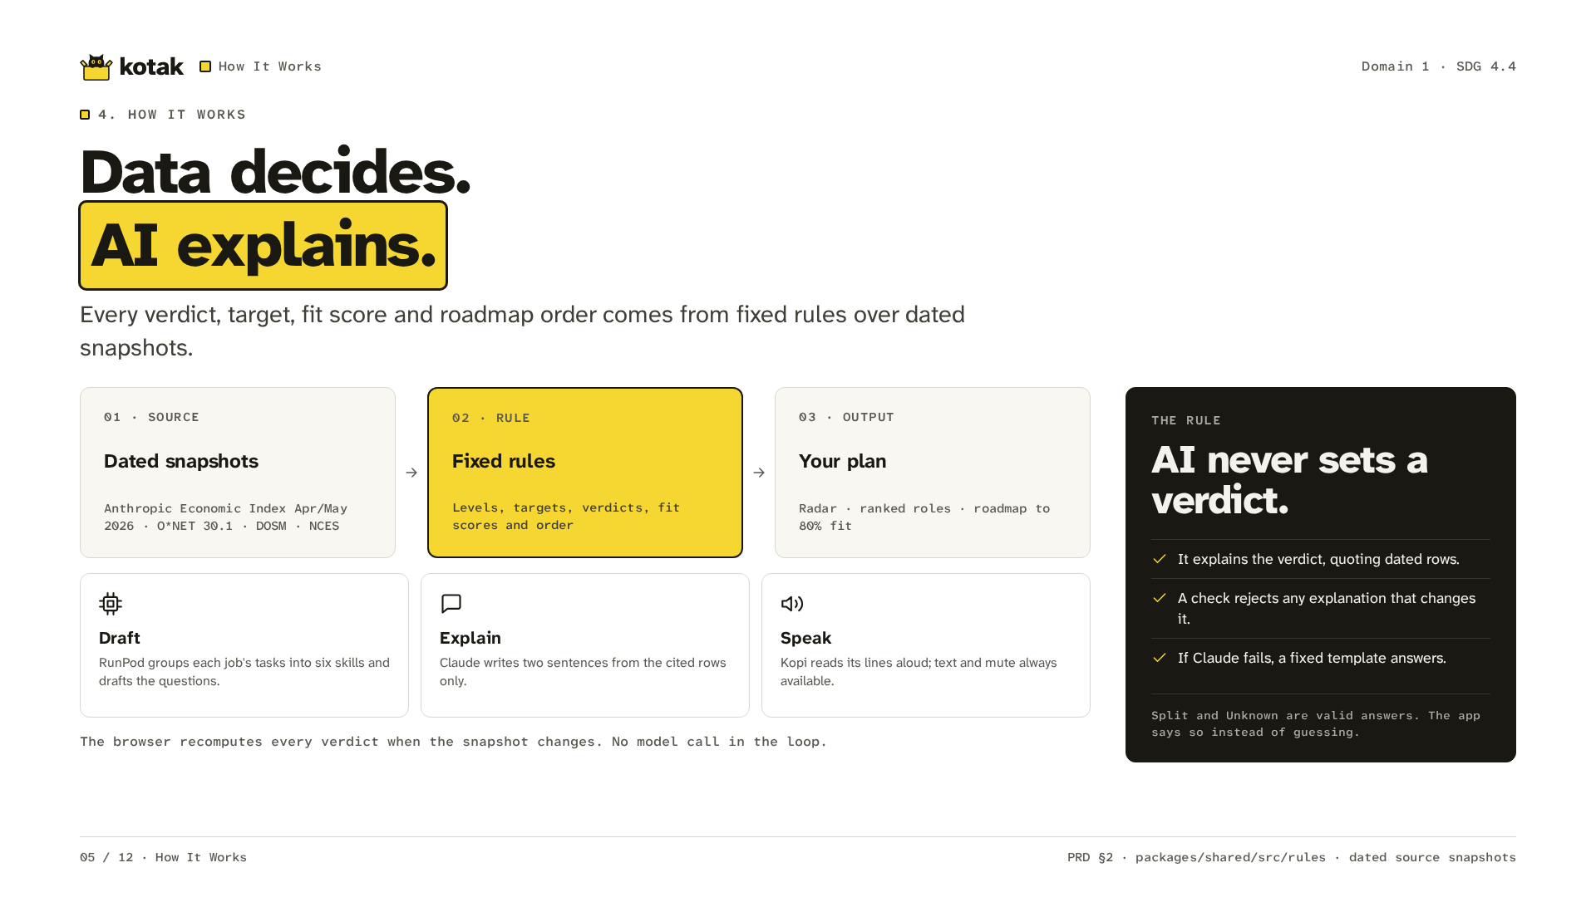
Notes:
Dated snapshots feed fixed rules. The browser sets verdicts, scores and plan order. RunPod drafts skills and questions offline. Claude explains the cited rows. Kopi reads its lines aloud. Text and mute stay available. AI never sets a verdict. If it fails, a fixed template answers. Split and Unknown are valid results.

Slide 6
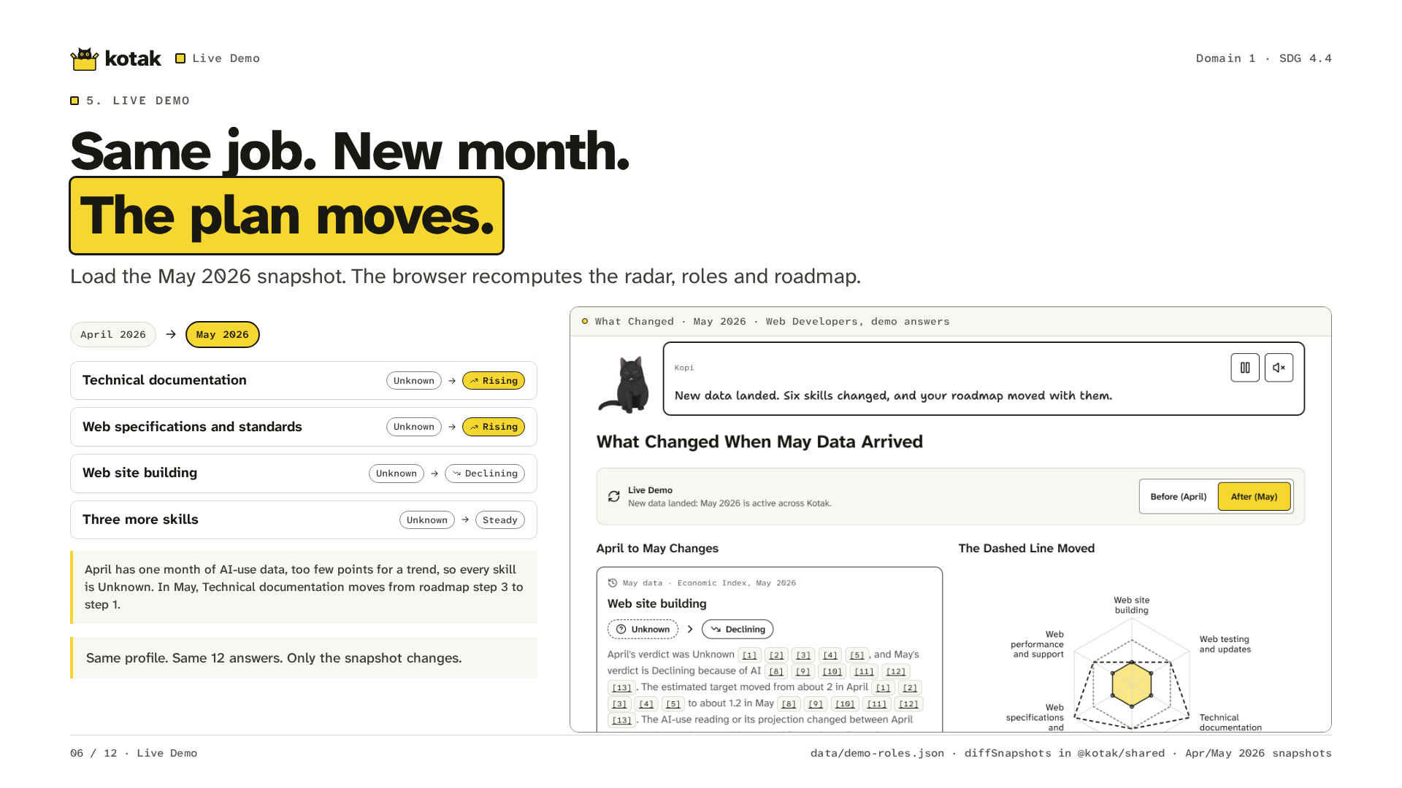
Notes:
This is the live demo, on the real snapshots. Keep the same profile and the same 12 answers: Web Developers, level 1 on every skill. In April, Kotak has one month of AI-use data, too few points for a trend, so every skill reads Unknown. Change April to May. Technical documentation and Web specifications and standards turn Rising. Web site building turns Declining. The other three turn Steady. Technical documentation moves from roadmap step 3 to step 1. Only the snapshot changed.

Slide 7
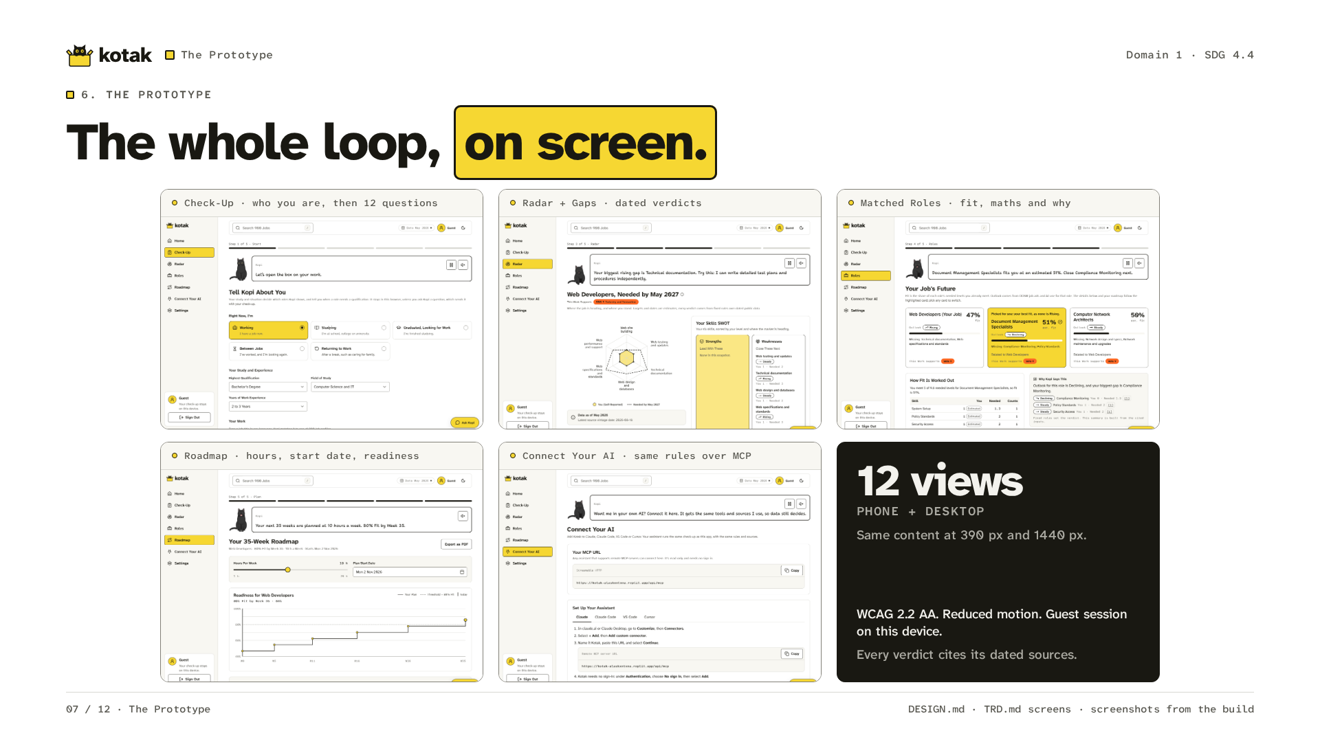
Notes:
These are screens from the prototype. The check-up starts with who the worker is: their situation, study, job and goal. Then the radar, roles and roadmap form the loop. Each role says why it is there, and the highlighted one says why Kopi picked it. Connect Your AI gives any assistant the same read-only tools over MCP. The app has phone and desktop layouts, and every verdict cites its dated sources.

Slide 8
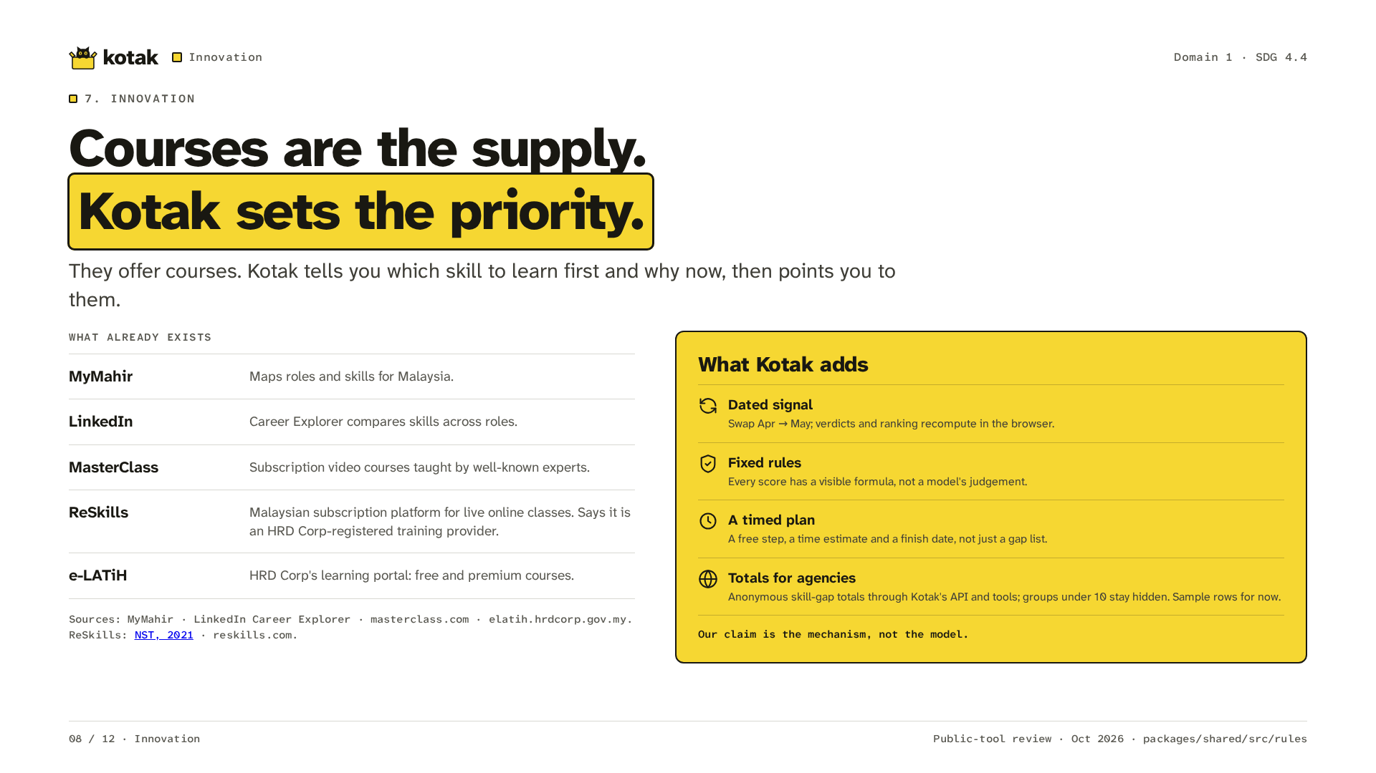
Notes:
MyMahir maps roles and skills. LinkedIn compares skills across roles. MasterClass offers expert video courses by subscription. ReSkills is a Malaysian subscription platform for live online classes. Its provider claim is attributed to NST in 2021. e-LATiH offers free and premium courses. They offer courses. Kotak tells you which skill to learn first and why now, then points you to them. The dated rules and timed plan are our contribution.

Slide 9
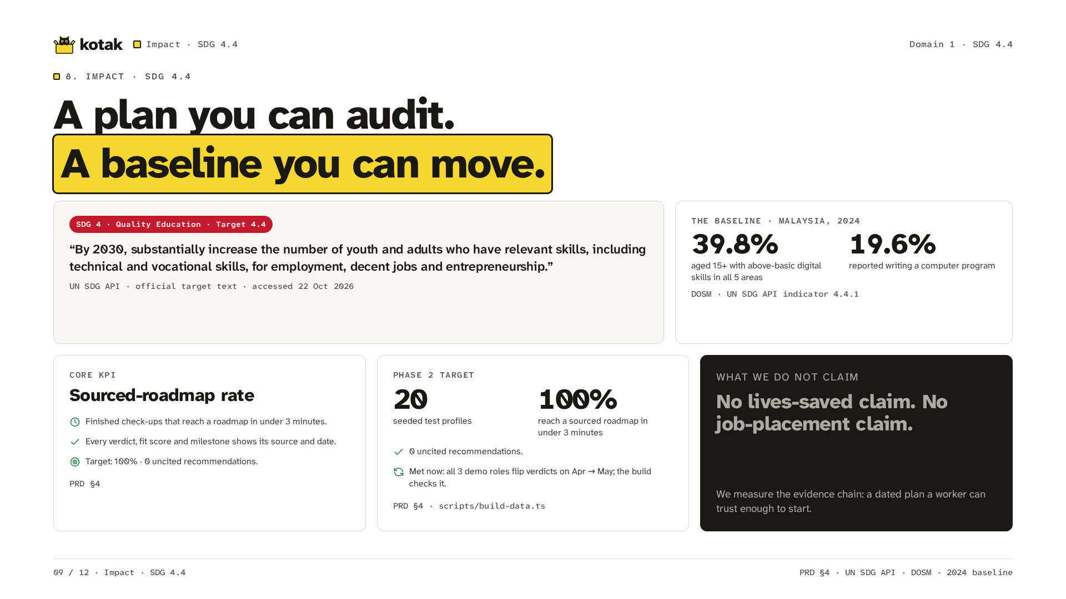
Notes:
SDG target 4.4 concerns skills for work. DOSM provides the Malaysia baseline through the UN SDG API. Our target is a sourced roadmap in under three minutes, with no uncited recommendations. The 20 seeded profiles are a Phase 2 technical test, a target and not yet a result. They are not user research or proof of job placements. One check is met now: the build fails unless all three demo roles flip a verdict from April to May. We measure whether a worker gets a dated plan they can start.

Slide 10
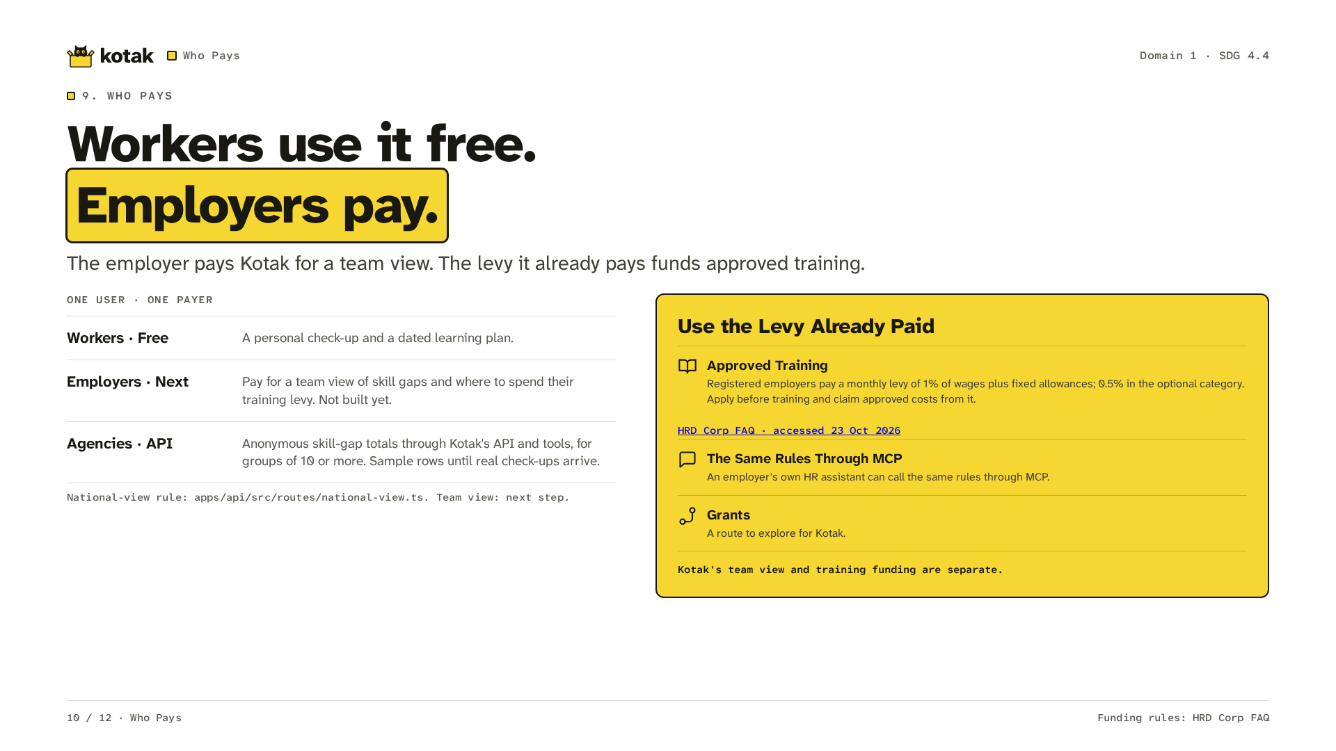
Notes:
Workers use Kotak free. Employers are the payer. Next, they pay Kotak for a team view that helps them decide where to spend their training levy. That view is not built yet. The levy is separate from payment for Kotak. Registered employers pay one percent of wages plus fixed allowances each month, or half a percent in the optional category. They apply before training and claim approved costs. The HRD Corp FAQ is the source. Agencies can read anonymous skill-gap totals through Kotak's summary API and its AI tools, for groups of ten or more. Until real check-ups are collected, those totals are labelled sample rows. An employer's own HR assistant can call the same rules through MCP. Grants are a route to explore.

Slide 11
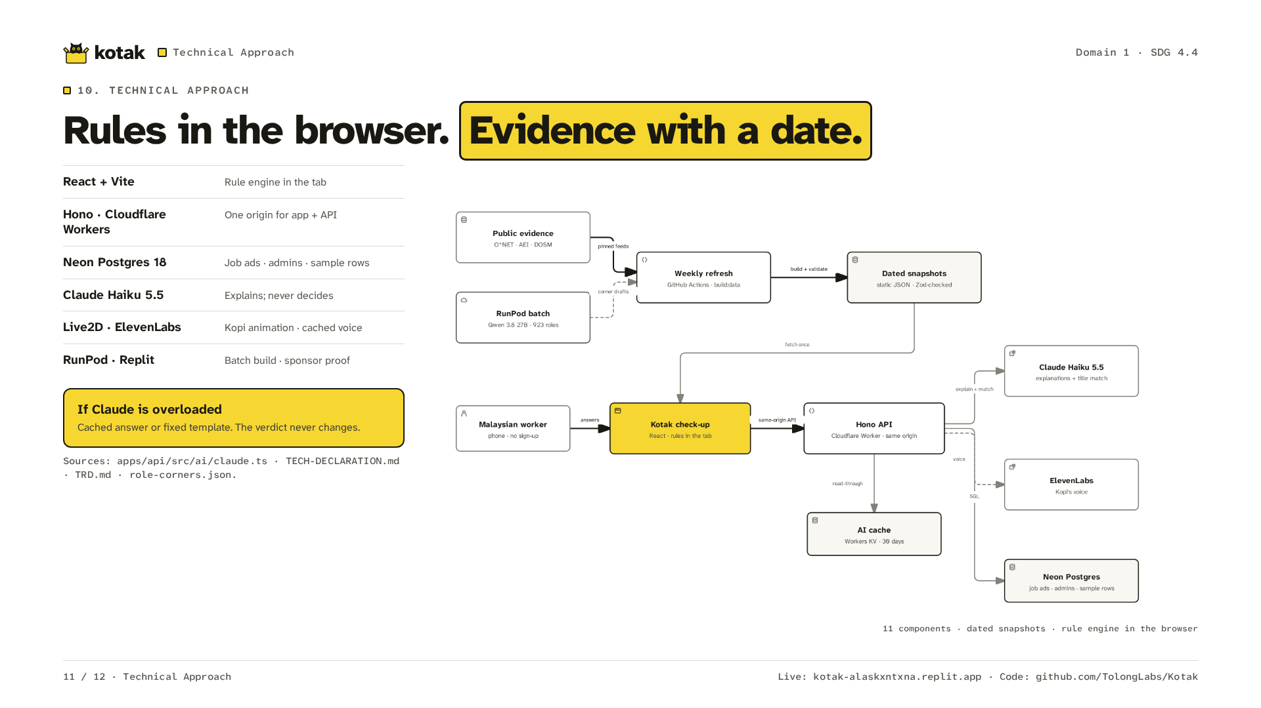
Notes:
The browser runs the rules over committed snapshots. A Cloudflare Worker serves the app and API. Neon stores the JobStreet listings and reviews, the admin accounts and the national view's sample rows. Claude Haiku 5.5 explains the results; this matches the code. Live2D animates Kopi. ElevenLabs supplies cached voice. RunPod supports the batch build. Replit hosts the live demo. Cached answers and fixed text keep the verdict unchanged when Claude fails.

Slide 12
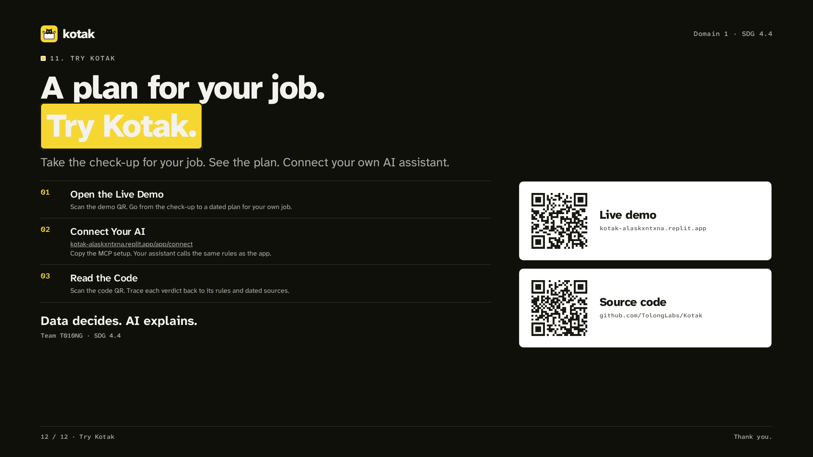
Notes:
Try the live demo with your own job. The demo QR opens the app. The code QR opens the Kotak repository. Connect Your AI is at slash app slash connect. Copy the MCP setup there. Your assistant calls the same rules as the web app. Data decides. AI explains.

