Slide 1

Aurotone Molecule
Person:
Developers
Users
Person
Problem:
Developers sometimes run out of ideas for apps that would solve people's problems
Users don’t have a generic way as consumers to be able to request problems be solved in an open-source context
Solution:
To make a web-app for people to provide ideas to open-source developers
Problem
Solution

Slide 2
Empathize:
Someone who solves problems for other humans who struggle with daily routine tasks and repetitive actions with technology
Behavior:
Contribute to software communities through open source
Volunteers within society
Follow through with projects and keep promises
Demographic:
Age: any
Gender: any
Industry: I.T.
Location: United States
Kids: none
Goals
Help people
Attain knowledge
Solve problems
Work with other people on projects
Develop open-source software

Slide 3
Empathize:
A random person who lives in the United States has an idea of how to improve their life, but they have problem. The idea involves using technology and they do not have an outlet to post the idea or display their want for that specific thing to exist.
Behavior:
Uses Technology
Report/Give feedback on technology
Forgetful
Demographic:
Age: 18-65
Industry: any
Has a Job: Yes
Location: United States
Goals
To be a part of a solution to problems

Slide 4
Developer
Receive:
Email
Solution
Have a drive to solve a problem
Go to the app to get a problem
Select a problem from a problem board
Develop a solution to the problem
Submit the solution to the problem
Give:
Problem

Slide 5
User
The problem is archived(new)
Receive:
Email
Problem
Solution
Wait until a developer has provided a solution or a user references a similar solution
Have a problem that they think should be solved with technology
Go to the app to submit the problem
Submit the problem
Review the solution and accept it or reject it
Is the solution a reference or a new solution?
The problem is deleted(referenced)
Is scrolling through the app problems
Find a problem that they know a solution for
Provide a solution to that problem
Give:
Solution

Slide 6
Aurotone
LandingPage
Submit a problem, discover a solution
Use node-machine-id package to skip this page after visiting the computer once
Have you ever had a problem and you thought “there must be a better way”. Here at Aurotone we promote problem solving, and anyone can pose a problem that they wish to be solved or help contribute to solve other problems. If there is already a solution made, anyone can recommend those solutions as well.
Discover your solution
logo

Slide 7
LoginPage
Aurotone
Email:
Submit
Logo

Slide 8
Logo
Aurotone
Navbar
ProblemBoardPage
Suggest A Problem
My problems
Keywords:
cats
Problem
Solution
Last Update
things

Slide 9
Logo
Aurotone
Navbar
ProblemBoardPage(non-User)
Keywords:
cats
Problem
Solution
Last Update
things

Slide 10
Logo
Aurotone
Navbar
ProfilePage
Email:
email@email.com
Turn off email notifications:
things

Slide 11
Logo
Aurotone
Navbar
SubmitProblemPage
Problem:
Submit
Cancel
things

Slide 12
Logo
Aurotone
Navbar
ProblemMatchPage
Keywords:
Problem
Solution
Pass
Match
things

Slide 13
Logo
Aurotone
Navbar
ProblemPage(User)
Problem
Solution
I need something other than photoshop to edit photos
gimp
Activity
Is this problem specific to your industry?
It is
[User has suggested “gimp” for a solution]
No, I haven’t thanked you for providing the answer
[Poster has accepted “gimp” as the solution]
Type message here
Send
Submit
Solution:
Enter solution here
things

Slide 14
Logo
Aurotone
Navbar
ProblemPage(non-User)
Problem
Solution
I need something other than photoshop to edit photos
gimp
Activity
Is this problem specific to your industry?
It is
[User has suggested “gimp” for a solution]
No, I haven’t thanked you for providing the answer
[Poster has accepted “gimp” as the solution]
things

Slide 15
Logo
Aurotone
Navbar
ProblemPage(Poster)
Problem
Solution
I need something other than photoshop to edit photos
gimp
Activity
Is this problem specific to your industry?
It is
[User has suggested “gimp” for a solution]
No, I haven’t thanked you for providing the answer
[Poster has accepted “gimp” as the solution]
Type message here
Send
Suggestion Dropdown
Accept
Deny
things

Slide 16
The C2 Manager:
Stores Ids
ips/ports of every DataNode
Scalability
Each C2Server has:
The IDs and IPs of all of the DataNodes
We need a max number per server(default 1000)
C2Servers serve customers their data
C2Manager
Database
C2Node1
C2ManagerAPI
C2API
Database
Each DataNode, given a number and a data key, gives back that many of the given data key
API
API
API
Database
Database
Database
DataNode1
DataNode2
DataNode3

Slide 17
DataNode Schema

Slide 18
DataNode API Endpoints

Slide 19
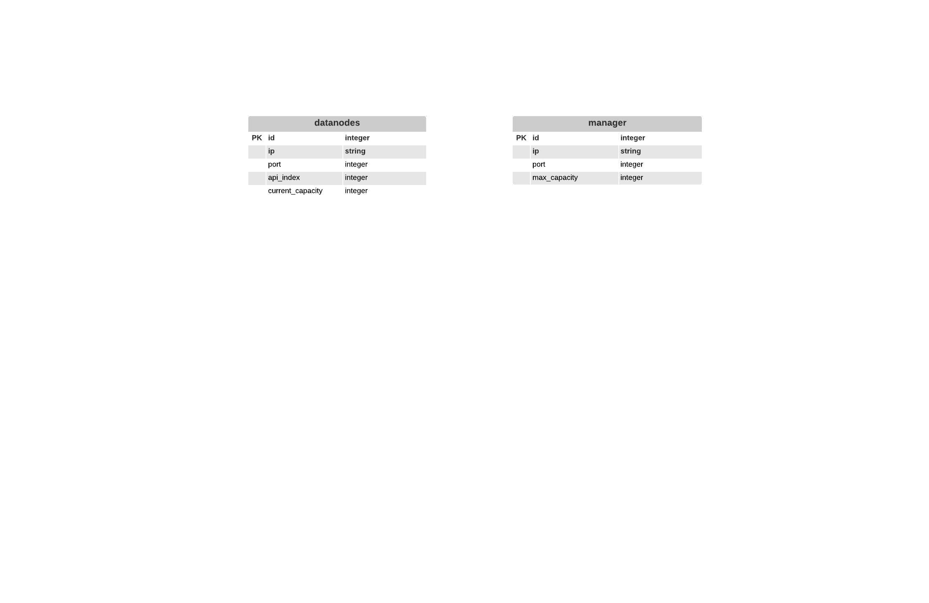
C2Node Schema

Slide 20
C2Node API Endpoints

Slide 21
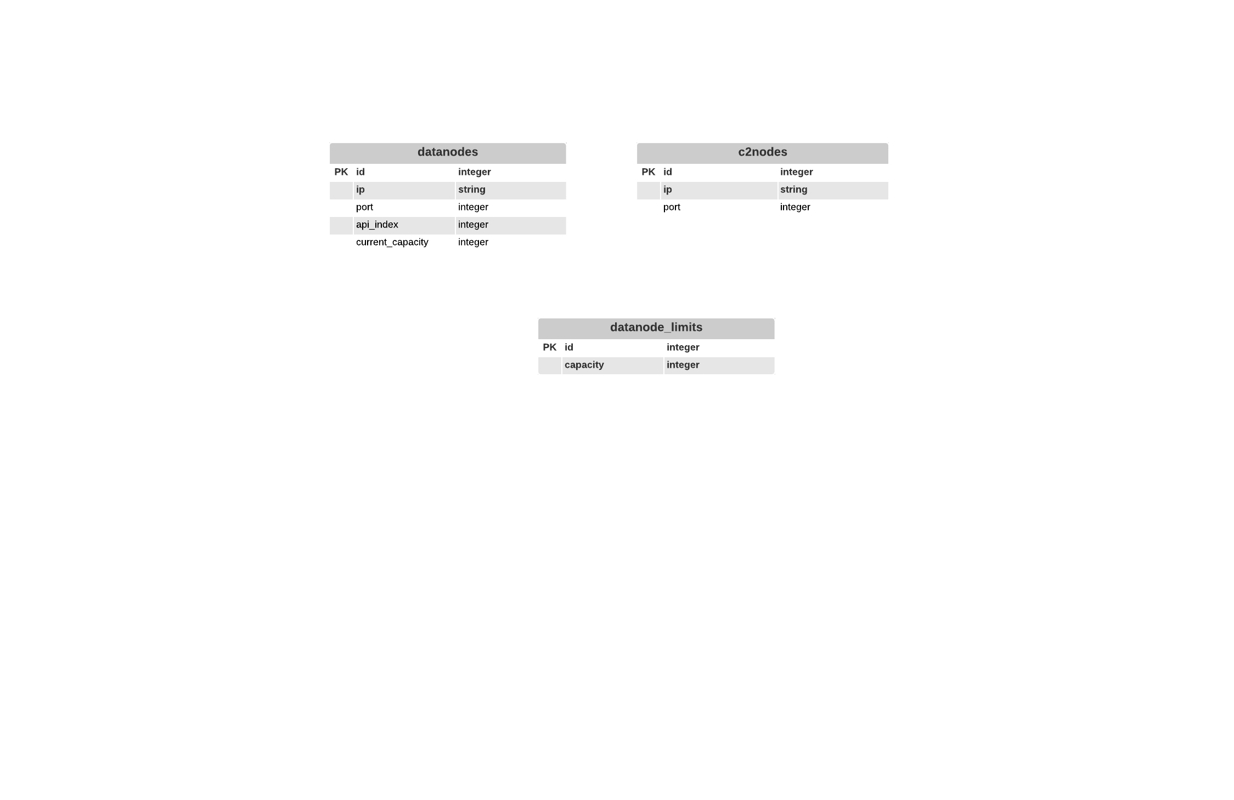
C2Manager Schema

Slide 22
ManagerNode API Endpoints

