Slide 1

LEVERAGING DATA SCIENCE FOR CAR PRICING AT DEALERSHIP
ORINA TOLULOPE O.

Slide 2
EXECUTIVE SUMMARY
The prices of new cars in the industry is fixed by the manufacturer with some additional costs incurred by the Government in the form of taxes.
So, customers buying a new car can be assured of the money they invest to be worthy.
But due to the increased price of new cars and the incapability of customers to buy new cars due to the lack of funds, used cars sales prices of new cars in the industry is fixed by the manufacturer with some additional costs incurred by the Government are on a global increase.
There is a need for a used car price prediction system to effectively determine the worthiness of the car using a variety of features.
It is also important to know their actual market value while both buying and selling.
Analysis was carried out on collected data to predict the price of cars given specific features/attributes.
In order to take company wide action as to appropriate used cars’ pricing at the dealership, Attributes such as transmission type, model, mileage, etc. are often considered.

Slide 3
SUMMARY CONTD.
Hypothetical Questions:
Is there a relationship between the price of cars and mileage?
Does fuel type determine car prices?
Can we predict the car prices with minimum error?
To Bring to the fore about the analysis, the results show viable and actionable insights.
It also gives us very close predictions of car prices.

Slide 4
INTRODUCTION
The prices of new cars in the industry is fixed by the manufacturer with some additional costs incurred by the Government in the form of taxes.
So, customers buying a new car can be assured of the money they invest to be worthy.
But due to the increased price of new cars and the incapability of customers to buy new cars due to the lack of funds, used cars sales prices of new cars in the industry is fixed by the manufacturer with some additional costs incurred by the Government are on a global increase.
There is a need for a used car price prediction system to effectively determine the worthiness of the car using a variety of features.
Even though there are websites that offers this service, their prediction method may not be the best.
Besides, different models and systems may contribute on predicting power for a used car’s actual market value. It is important to know their actual market value while both buying and selling.

Slide 5
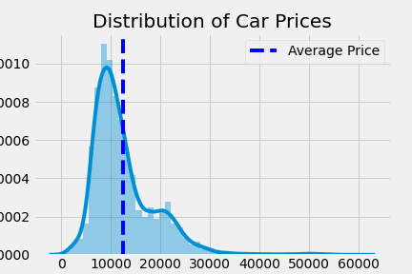
INSIGHTS GATHERED
Notes:
The Average Car Price was around £12500. With the price distribution being right skewed

Slide 6
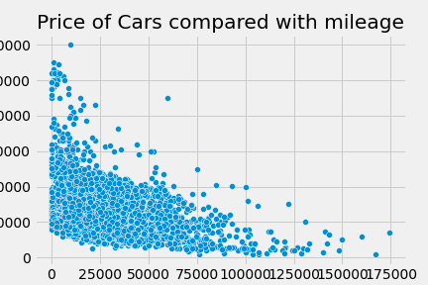
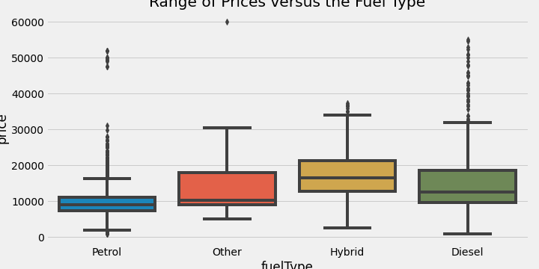
INSIGHTS CONTD.
Notes:
Price of Car/ Range of Prices:
The more the mileage the lesser the estimated price of the car, an exponential decrease
Cars with hybrid fuel type tend to be generally more expensive, next to it is diesel

Slide 7
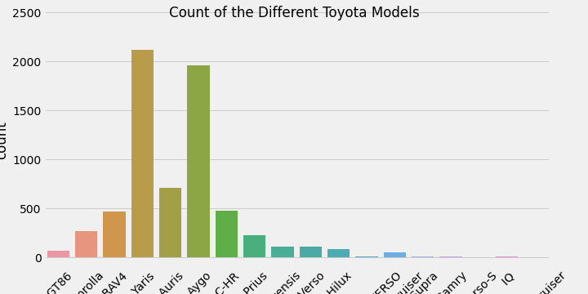
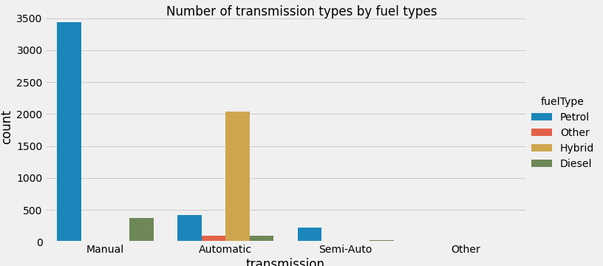
OBSERVED COUNTS
Notes:
The Counts of the Models and transmission types

Slide 8
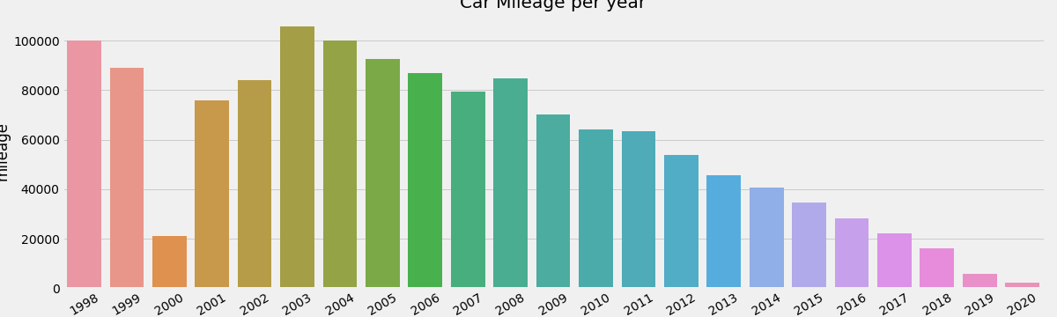
INSIGHTS CONTD.
Notes:
The older the Car the more the mileage

Slide 9
fuel Type | Count
Petrol | 4087
Hybrid | 2043
Diesel | 503
Other | 105
index | TRUE | Predictions | Absolute Difference
0 | 37440 | 35767.12083 | 1672.9
1 | 4159 | 4216.474393 | 57.5
2 | 10600 | 11494.35483 | 894.4
3 | 8995 | 10932.29052 | 1937.3
4 | 11000 | 9530.563158 | 1469.4
5 | 11215 | 10459.43776 | 755.6
6 | 11295 | 11310.00894 | 15
7 | 11995 | 13847.09535 | 1852.1
8 | 19998 | 21168.33805 | 1170.3
9 | 11295 | 11328.04394 | 33
Notes:
Mean Price Difference from the Predictions was £920

Slide 10
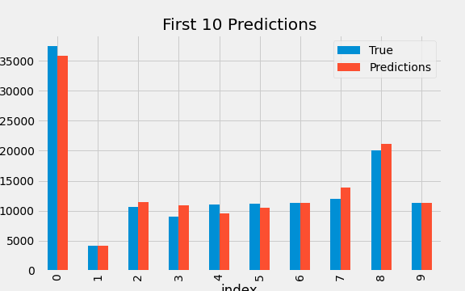
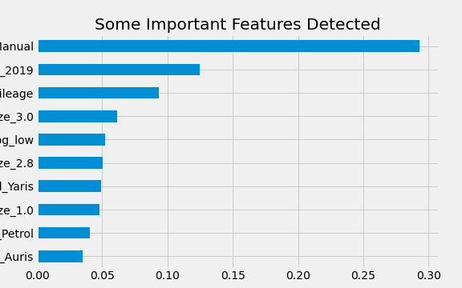
Notes:
The First Chart shows the first 10 predictions and true values from the modelling and analysis
The Second Chart illustrates some of the most important features that were detected

Slide 11
CONCLUSION
The Project aimed to develop a model that can predict car prices with maximum loss of £1500.
Using the Data available, I was able to achieve a predictive power with mean error/loss of £920.15.
MY RECOMMENDATIONS
Incorporation of the our research into the sales department, as this would aid near accurate price within the aforementioned confidence interval/range.
Getting more data from more cars and other products in order to improve our predictive power and accuracy.

Slide 12


