Slide 1
AICA – AI Incident Communications Assistant
Pitch Deck – Tolulope Akinlabi

Slide 2
1. Problem & Context
Manual incident communications are slow, inconsistent, and risky.
ICs/CSEs split focus; increased incident load.

Slide 3
2. Solution Overview
AICA generates customer-ready drafts across incident stages.
Guardrails enforce tone, safety, and non-disclosure.

Slide 4
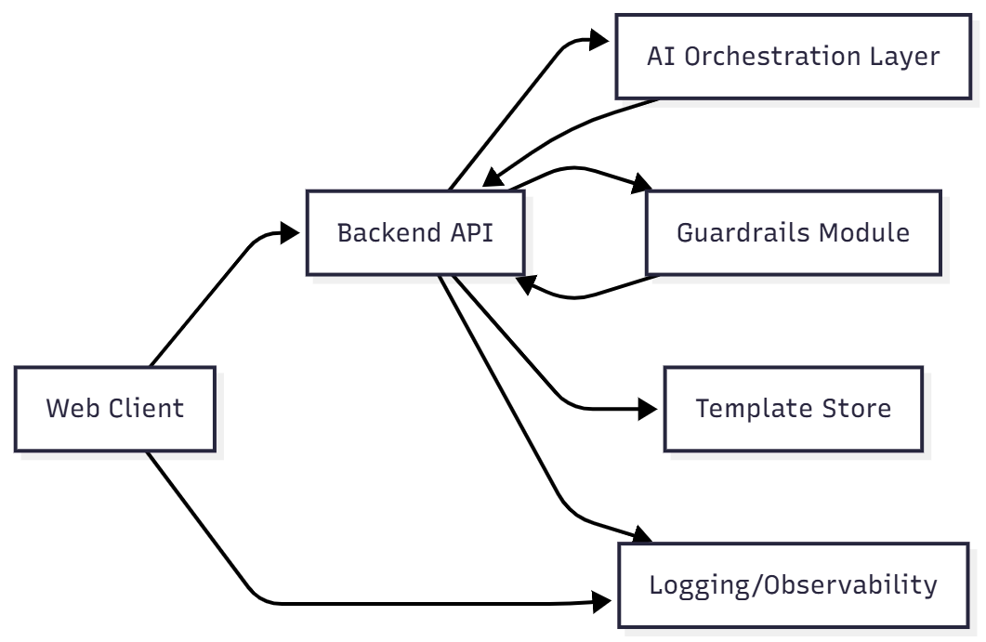
3. Workflow & UX

Slide 5
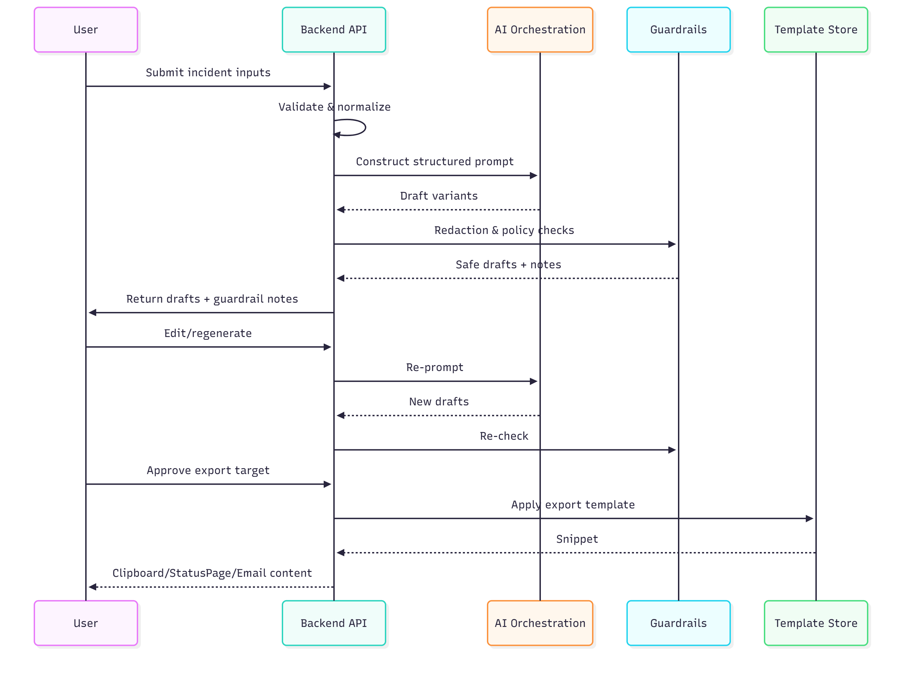
4. Architecture

Slide 6
5. Safety & Security
Policy matrix; redaction; PII/DLP.
Ephemeral sessions; retention options; observability.

Slide 7
6. Success Metrics & Acceptance
Time reduction, tone consistency, latency, adoption.
v1 acceptance: end-to-end prototype; severity cadence; export templates.

Slide 8
7. Demo Script
Create incident; set SEV2; generate variants.
Show guardrail catch; edit; approve.
Export StatusPage snippet and email template.

Slide 9
8. Roadmap & Open Questions
Slack ingestion, training data, multilingual support.
LLM choice & hosting, customer-specific tone options.

