Slide 1

Legacy of WCPC’s Impact in the Greater Worcester Area
Student Researchers:
Adam Beckman, Toluwani Akomolafe, Malak Haida
Advisor:
Courtney Kurlanska
Sponsor:
Amanda Wittman
Notes:
For twenty-five years, the WCPC has been the bridge between WPI students and organizations like yours, the ones doing the real, daily task of working closely with our community.
More than 260 projects have been completed. More than 100 partnerships have been formed.
But here's the thing that brought us here today: the full story of that impact has never been told.
Not because the work wasn't meaningful we know it was. But because when you're busy serving the community, when you're managing food banks or running art programs or supporting people with disabilities, you don't always have time to stop and document the ripple effects. You don't always get to see how one student project from five years ago ended up changing the way an entire organization operates.
So that's what we set out to do: to find those stories. To document them. And to build something that would let the WCPC's legacy be seen, understood, and celebrated.

Slide 2
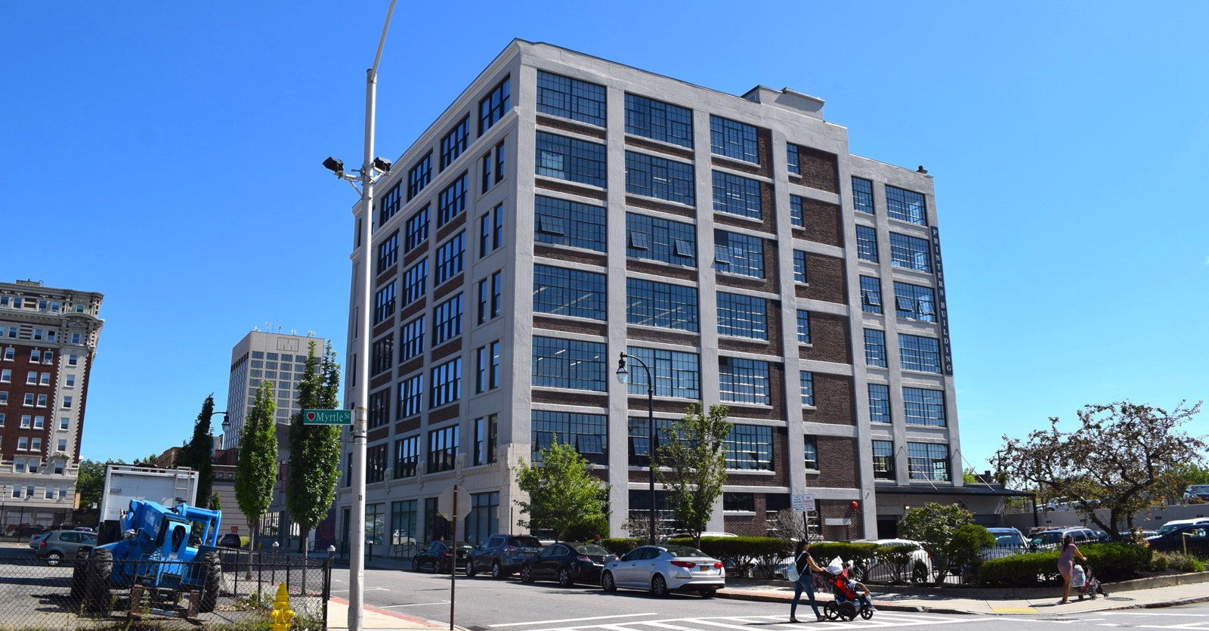
Our Project Documents The Stories And The Impact Of The Worcester Community Project Center
Notes:
Adam
What is the WCPC?
A project center composed of students and WPI faculty that collaborates with organizations to solve real world problems and serve the community.
What is the their goal?
Develop pragmatic solutions to pressing community challenges
Who is Amanda (our sponsor)?
Assistant Teaching Professor in the Department of Global and Integrative Studies at WPI
Focuses on data driven storytelling
What is our Project Goal?
Our project goal is to document the stories and impact of the WCPC on the community
Why it matters?
Even though the WCPC keeps track of the projects it was involved in, much of the WCPC’s impact still remains unseen
Thus we would like to consolidate information of the WCPC’s impact for a wide audience to enjoy

Slide 3
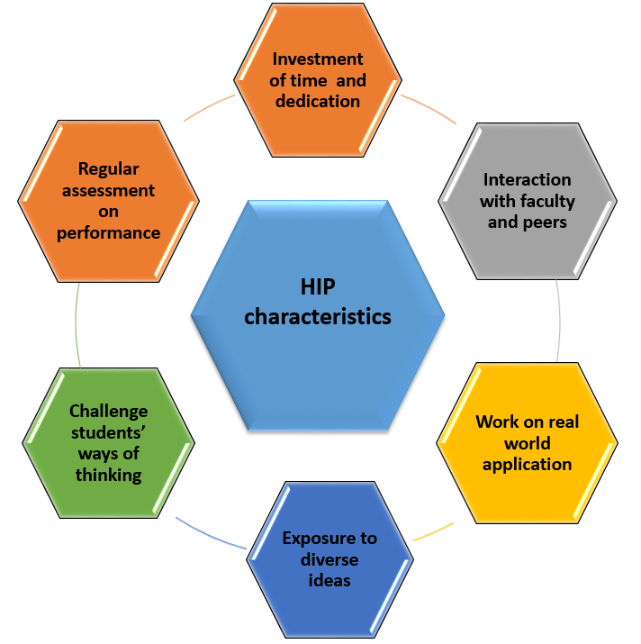
High Impact Learning Connects Universities, Students & The Community
Project Based Learning (PBL)
Community Engaged Learning (CEL)
Notes:
TOLU:
Before getting into what we found, we wanted to start with why WCPC projects matter. WCPC sits at a unique intersection of project‑based learning and community‑engaged learning. It’s a space where students are not just completing assignments—they’re collaborating with organizations across Worcester to solve problems that actually exist outside the classroom.
For 25 years, students have partnered with local organizations on issues that are real, urgent, and tied directly to Worcester’s well‑being. And what students create, whether it’s a model, a dashboard, a program, or a tool, gets used by real people trying to serve real communities. This connection between learning and impact is the heart of WCPC’s work, and it’s the context we needed before diving into the long‑term trends.

Slide 4
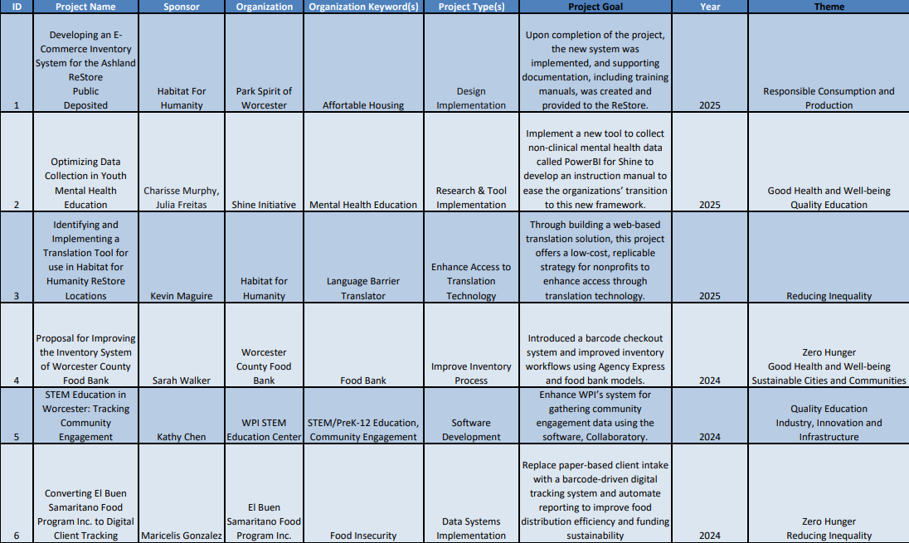
Content Analysis Provided The Foundation For Understanding WCPC Projects
Content Analysis
Examined all 264 projects
Coding the data
Notes:
TOLU
To understand WCPC’s impact over a quarter century, we started with a content analysis of all 264 projects. We pulled project goals, keywords, and partner descriptions, and then coded each project so we could compare them in a systematic way.
This step transformed 25 years of individual stories into a structured dataset. Suddenly, we could see patterns across time, across organizations, and across issue areas. Instead of isolated projects, we now had a way to understand WCPC’s work as a whole.
Once we had this foundation, the next step was to identify the broader themes beneath those keywords.

Slide 5
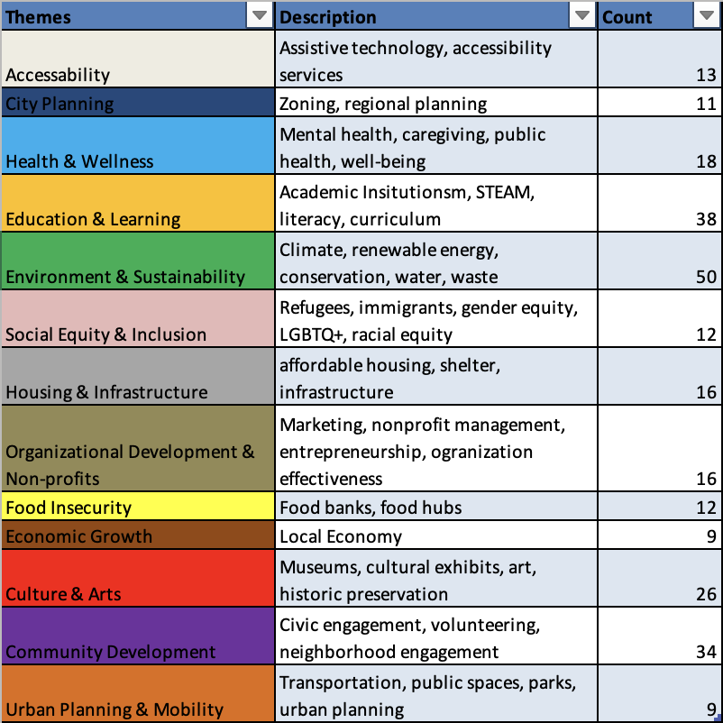
Coding From Our Content Analysis Helped Derive Themes
Notes:
TOLU
After coding every project, we grouped related keywords together to form larger “umbrella” themes. These themes weren’t just academic categories—they reflected the biggest challenges Worcester organizations consistently bring to WCPC to help the community.
By identifying these themes, we could see which community needs reappear again and again, and where WCPC has contributed sustained support. These themes also helped us decide which organizations to prioritize for interviews. We wanted to hear directly from partners who have been working in areas where challenges persist.
But themes alone only tell part of the story.

Slide 6
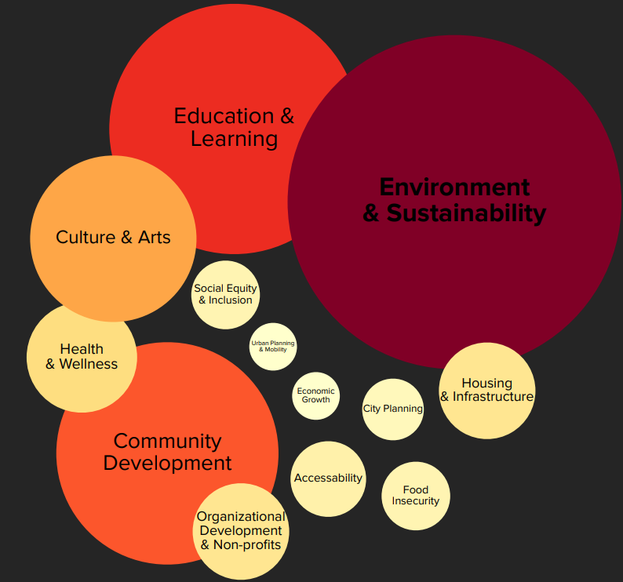
FINDING 1: WCPC Has Helped 168 Organizations In Different Themes With Student Projects.
most frequent across all projects
Notes:
TOLU
From our analysis, we learned that WCPC has supported 168 organizations across these themes. The heat map helps us visualize which issues were most common among partners. Three themes clearly stood out:
Environment & Sustainability
Education & Learning
Community Development
This wasn’t random, it reflects what Worcester needs. For example, 50 organizations have partnered on environmental issues, 38 on education, and 34 on community development. These themes also helped us understand what these organizations were looking for. Education‑focused partners needed tools to support learning. Community development organizations often needed help with outreach, accessibility, or strengthening neighborhood services. And some of these projects have had remarkable ripple effects that we will discuss later. Other projects helped shape climate‑planning tools and water‑quality resources, making complex data usable for the communities that need it.
So Finding 1 didn’t just show us common themes, it helped us understand the landscape of community needs and guided which partners we reached out to next.

Slide 7
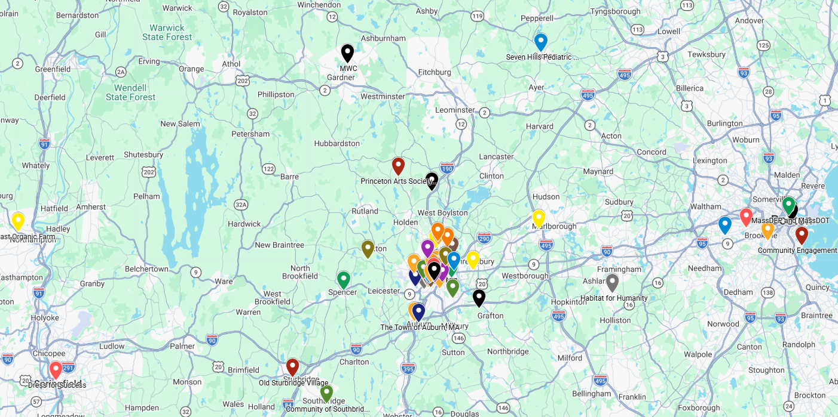
Geographic Mapping Highlights WCPC’s Strong Community Presence
Finding 1
Notes:
Adam
This map shows the locations of many of the organizations the WCPC has collaborated with in the past.
Each mark is color coded based on the organization themes we described earlier.
Most of these organizations are located near downtown Worcester which is also nearby the WCPC and WPI. Close by organizations make interactions between students, universities, organizations, and community members easier.
However, many organizations also reside in boston which shows that the WCPC’s collaborations and impact is not limited to Worcester.

Slide 8
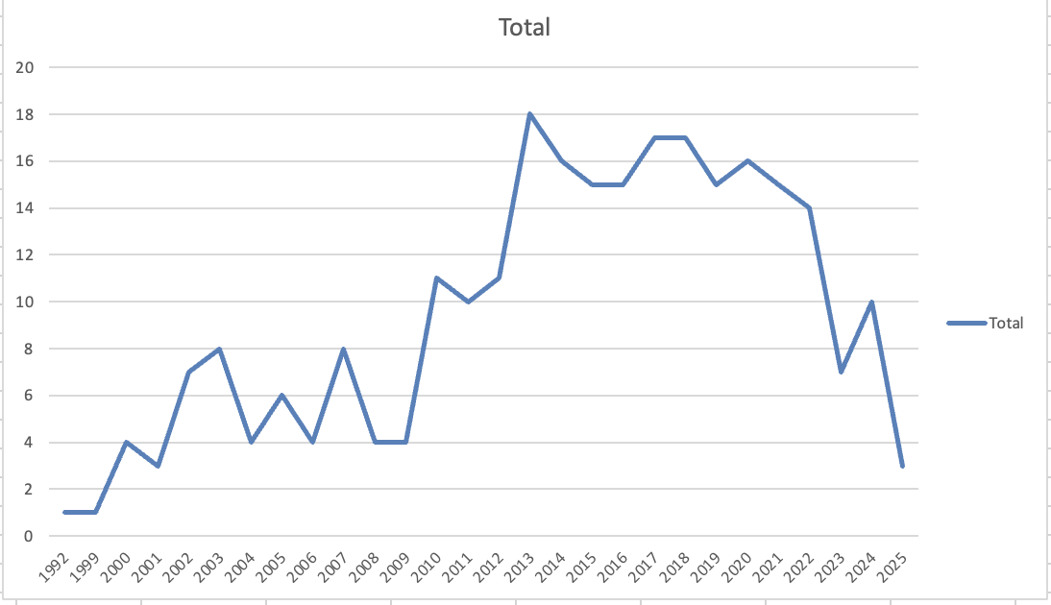
How The WCPC’s Involvement In The Community Evolved
Total Projects Per Year
Finding 1
Notes:
We also wanted to understand how the WCPC's work has changed over time.
This graph shows the number of projects completed each year since 2000.
For nearly two decades, project center activity generally increased or stayed the same.
The Center was growing. More students were choosing to stay local. More organizations were finding partners in WPI teams. But then you notice something: starting around 2020, the numbers begin to decline.
We wanted to understand why. So we sat down with the director of projects at the WCPC: Here's what we learned.
In 2018, WPI introduced the $5,000 Global IQP Scholarship—making international IQPs much more accessible financially. Suddenly, the cost barrier that had kept some students local was gone.
But the decline doesn't happen immediately in 2018. Why?
Because 2020 happened. COVID-19 shut down international travel completely. For that period, students couldn't go abroad, so local projects remained strong.
But once travel restrictions lifted? The effect became visible. And the numbers started dropping.
So what does this mean to us?
The demand is still there—organizations still need students' help. But the Center now has to compete differently for student attention. And thats why The story of local impact has to be told more compellingly than ever.

Slide 9
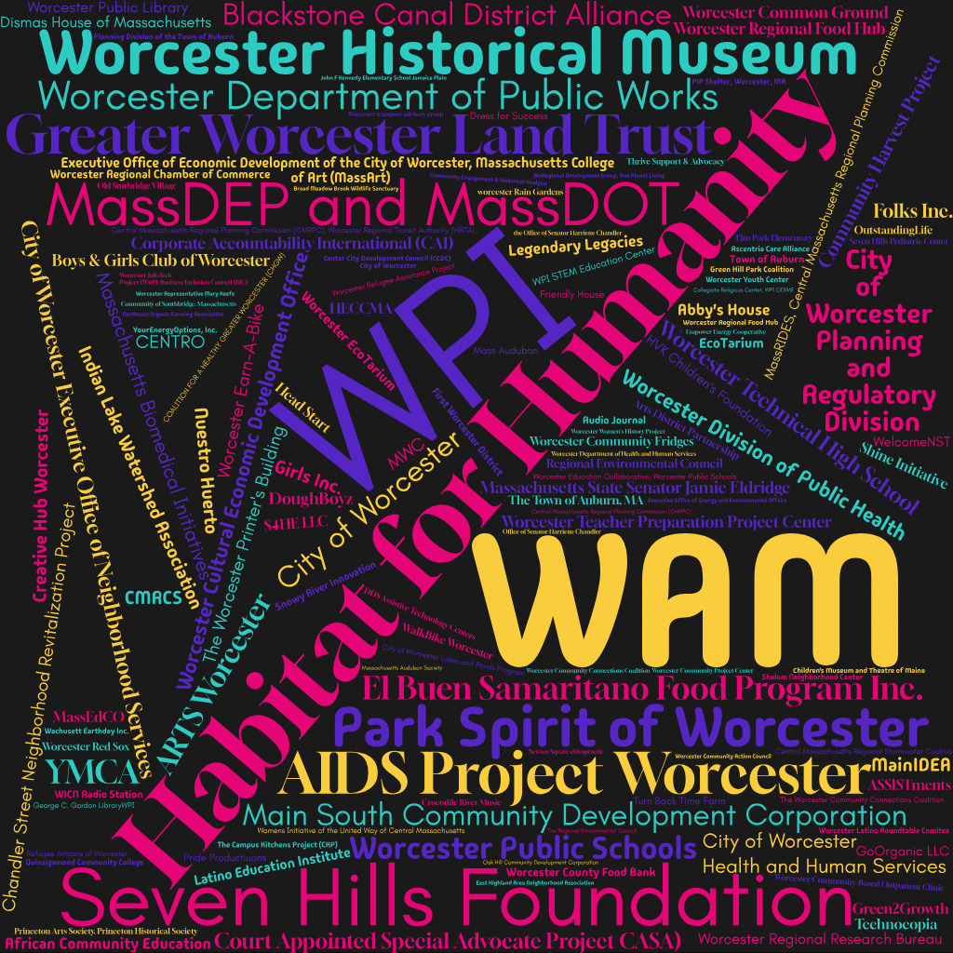
FINDING 2: WCPC Created Long-Term Relationships With Real-Word Impact
organizations that partnered with WCPC
Notes:
Adam
The WCPC has collaborated with a total of 168 different organizations.
The WCPC has collaborated with numerous organizations more than once.
Habitat for Humanity, WAM, and the Seven Hills Foundation make up about 12% of collaborations with the WCPC.
These repeated collaborations clearly indicate robust and long term relationships between the WCPC and other organizations.

Slide 10
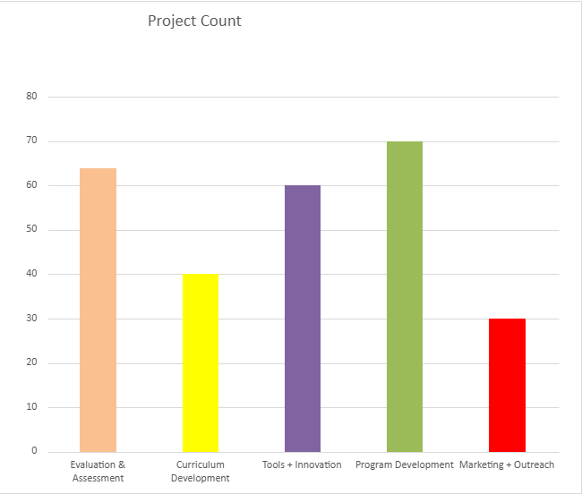
Most Projects Focused On Program Development
Project Themes by Count from Content Analysis
Finding 2
Notes:
When we first started looking through 264 project reports, we expected to find a little bit of everything—and we did. But when we stepped back and looked at the patterns, something really interesting emerged.
The majority of WCPC projects 27% weren't just one-time tasks. They were about building capacity.
When we looked deeper at what students were actually doing, we saw project after project focused on program development—creating tools, systems, and resources that organizations could keep using long after the students graduated.
Think about what that means. A nonprofit organization gets a team of capable students who spend an entire project term focused on one question: "How can we help you do your work better?"
For instance, the waste‑diversion model created with Habitat for Humanity helped quantify environmental impact in a way funders could trust. What started as a local tool is now used in Restores across the country and globally.
When we looked deeper, we saw that many student projects were actually program development — building things like food system tools, communication systems, design implementations, and climate‑planning tools. These are practical systems that organizations continue using long after the project ends, which is why these themes kept appearing again and again
Behind each scene is the same WCPC approach: students partner with organizations to build useful, durable tools. A tonnage model that strengthens environmental reporting. A translation tool that welcomes more people through the door. An assistive‑technology database for Seven Hills that helps staff quickly find the right app for a client. A storytelling project that helps a nonprofit explain its mission so the community can rally around it. These are the reasons our heat map shines brightest in Environment & Sustainability, Education & Learning, and Community Development. The themes aren’t just labels; they’re the places where student work became lasting infrastructure.

Slide 11
FINDING 3: Organizations Emphasized That WCPC Projects Help Them Address Capacity Gaps
Lack of Time
Insufficient Funding
Notes:
Adam
Many organizations are not able to innovate in as many projects because they lack sufficient funding and lack the bandwidth to make initiatives happen. Organizations are forced to prioritize.
From several project sponsors, we learned that several organizations the WCPC has collaborated with have came and went due to these challenges.
Covid 19 in particular exacerbated these challenges in the midst of a lockdown and a recession.
One might think that the projects the WCPC helps coordinate mainly benefits students.
However, we learned from project sponsors that these projects are also of significant value to the organizations that collaborate with the WCPC.

Slide 12
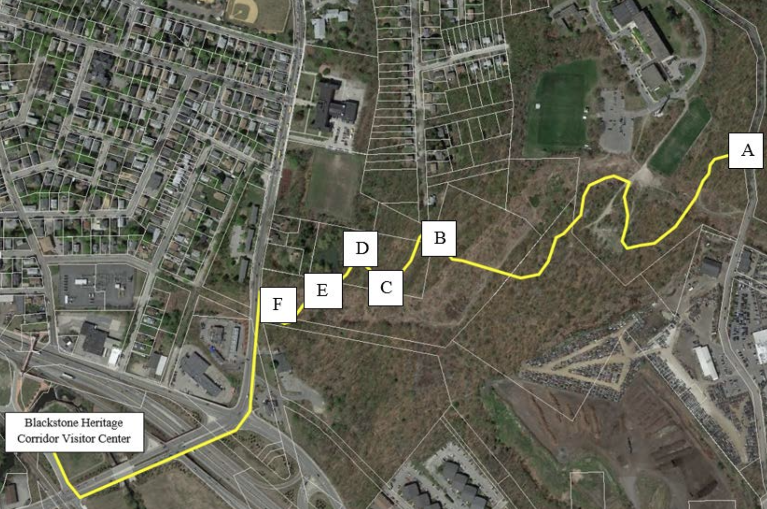
Students Apply Their Skills To Build Practical Resources That Strengthen Organizational Capacity
Project Examples
Translation tool
Assistive technology
Community outreach
Finding 3
Notes:
Here are some of the actual things that students built.
First, a calculation model.
One team worked with Habitat for Humanity to work a standardized way to estimate the weight of donated items at ReStores.
What it means is that suddenly, Habitat could actually tell how much waste was being diverted from landfills. That data helped them make their environmental story more powerful and unlocked access to new grants.
Second, a translation tool. This transformed who could walk through the door. Spanish-speaking staff, donors, and customers could suddenly communicate fully.
The sponsor told us: "It changed the relationship between the shoppers, the donors, and our organization. People came in, and they could communicate.
And then some other projects evolving around assistive technology..
What connects all of these? Students applied their classroom knowledge to build things that lasted. These are real solutions to real problems that organizations face every day.

Slide 13
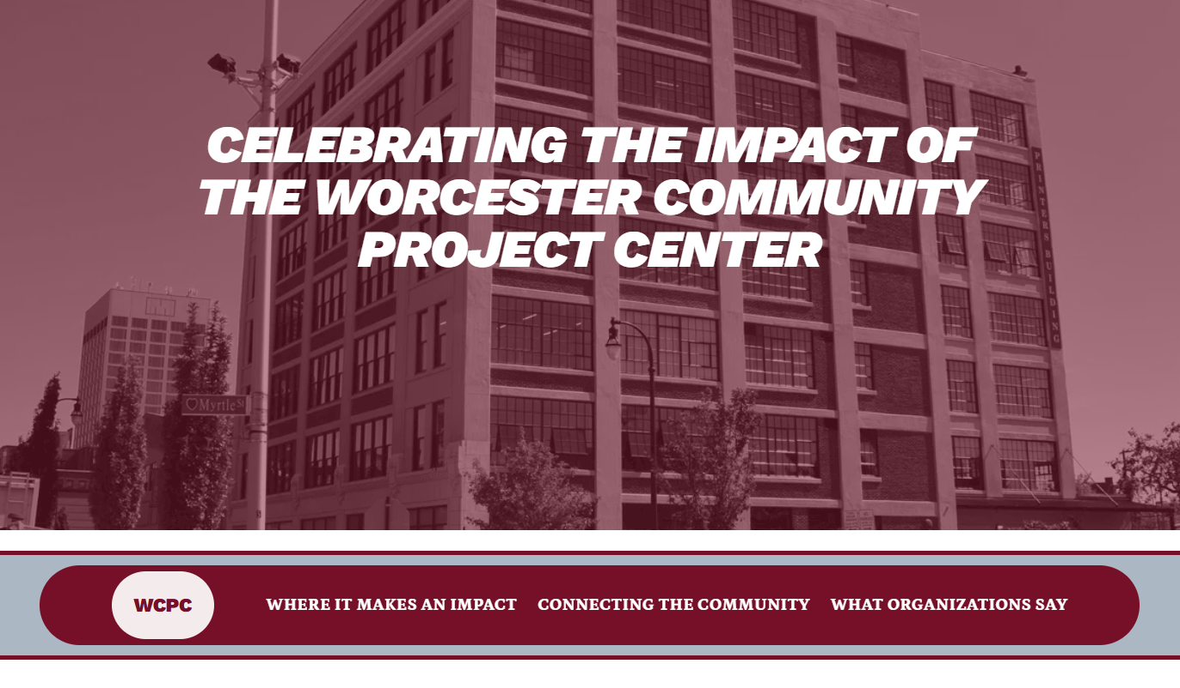
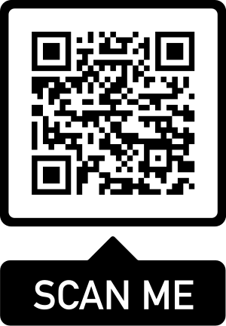
Our Deliverable Was The Best Way To Consolidate Information About WCPC’s Impact
https://tbakomolafe-pqasu.wordpress.com/
Notes:
Adam
For our final deliverable, made a website page that shows what we have learned
(Open the website ourselves and give a tour)
Connect the Website Contents with this presentation!!!
This website shows a lot of what we presented here.
Front Page:
Describe that the website describes what the WCPC is and how it connects with students
Describe that the website describes our motivation of the project
Equivalent to what we presented at the beginning of this presentation
Where it makes an impact:
What areas the wcpc makes an impact (first and second findings)
Also describes project specifics and how those projects helped organization in those area
Shows what student projects focused on
Connecting With the Community:
All the organizations the WCPC has worked with
The top ten organizations by collaboration count
Quotes from organizations about how partnering with the WCPC helped solve problems
The geographic map is interactive!!!
What organizations say:
What we learned from organizations
WCPC
ILWA
Habitat for Humanity
Speak as if the audience has seen the components of the website!!! (cause they have!!!)

Slide 14
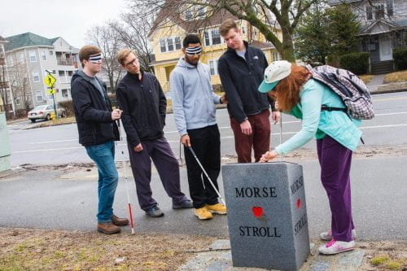
Recommendations (What WCPC Should Do Next)
Maintain a living archive
Adopt standard tags
Networking and Feedback
Notes:
Adam
Maintain Living Archive:
The WCPC website only has projects from 2012 and later
The Digital WPI database has all of the projects
Since the WCPC website is more of a public facing place to learn about the WCPC, we recommend adding all of the projects since 1992 to the WCPC website
Add SDG’s to every Digital WPI project entry
Adopt Standard Tags:
Categorize projects based on the themes we made
Annual Networking Event:
Give organizations an opportunity to interact with eachother and wider community member
Public partners page
Shows the list of organizations the WCPC has partnered with
Lists the years and number of projects each organization collaborated with the WCPC
Give community members an opportunity to give feedback on project deliverables

Slide 15
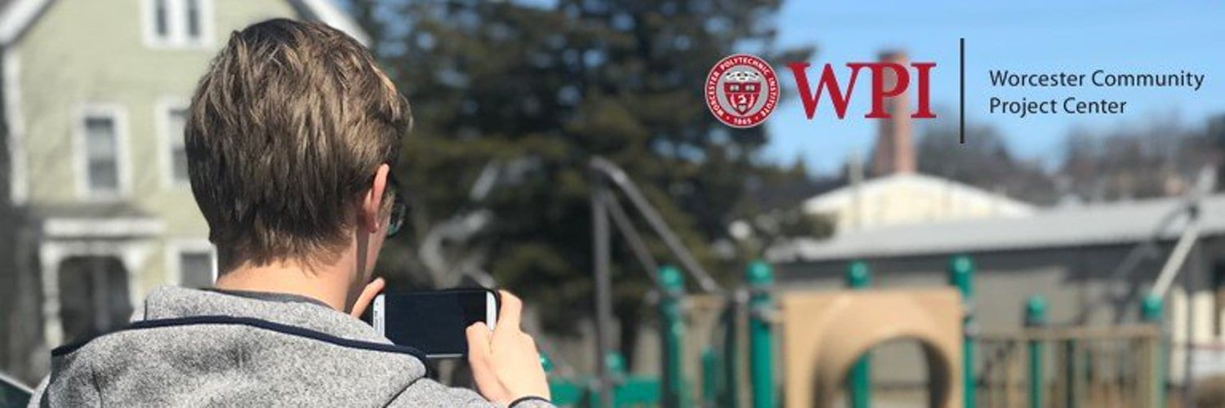
THANK YOU!!
ANY QUESTIONS?

