Slide 1


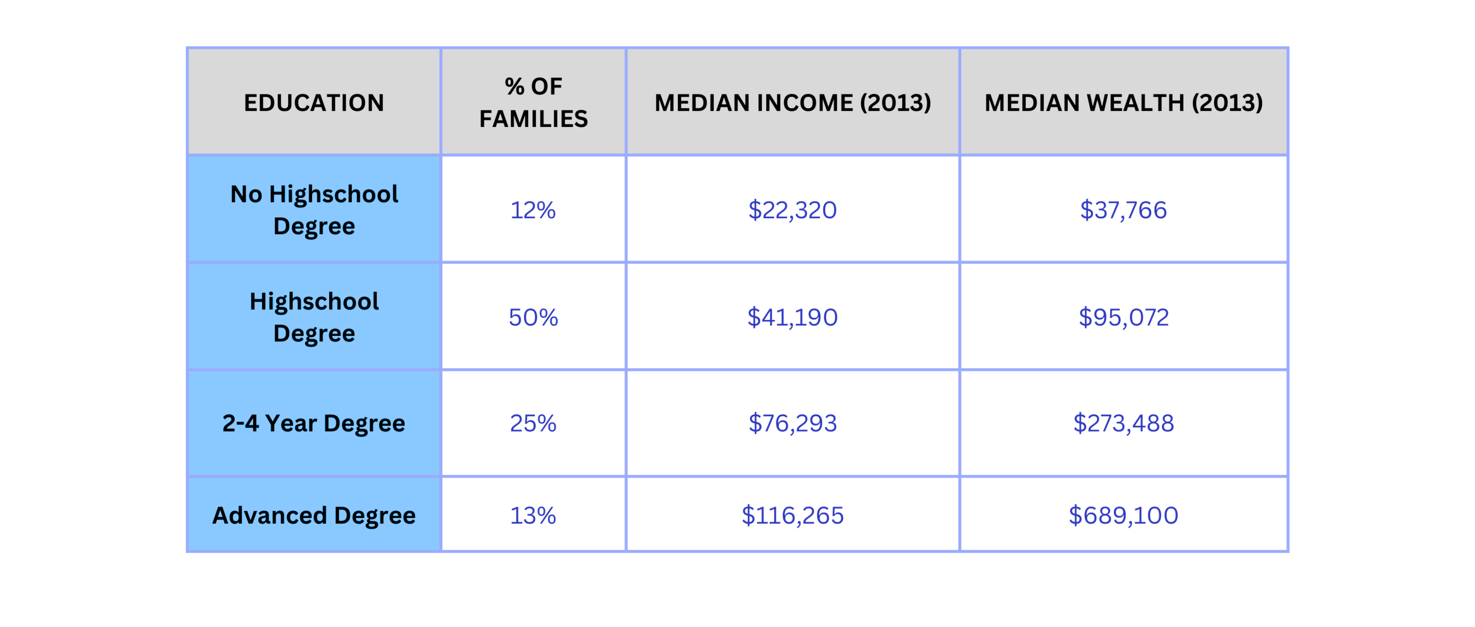
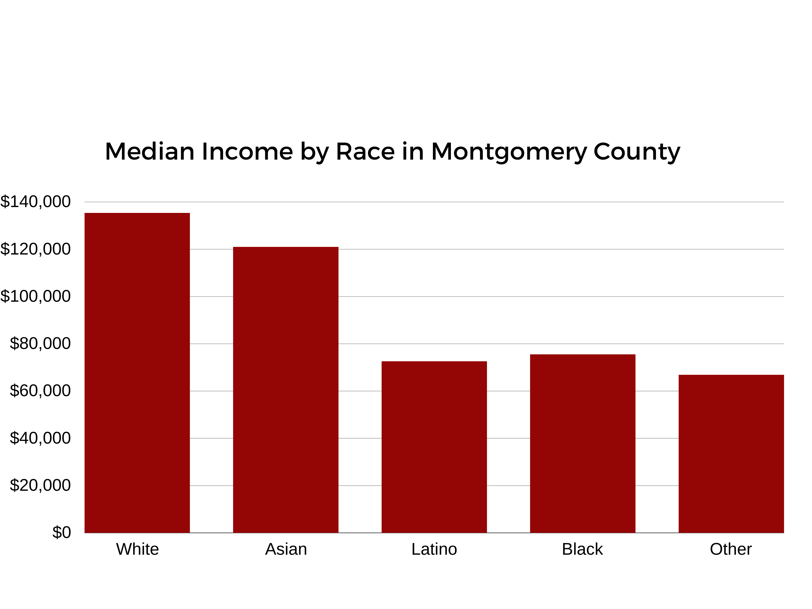
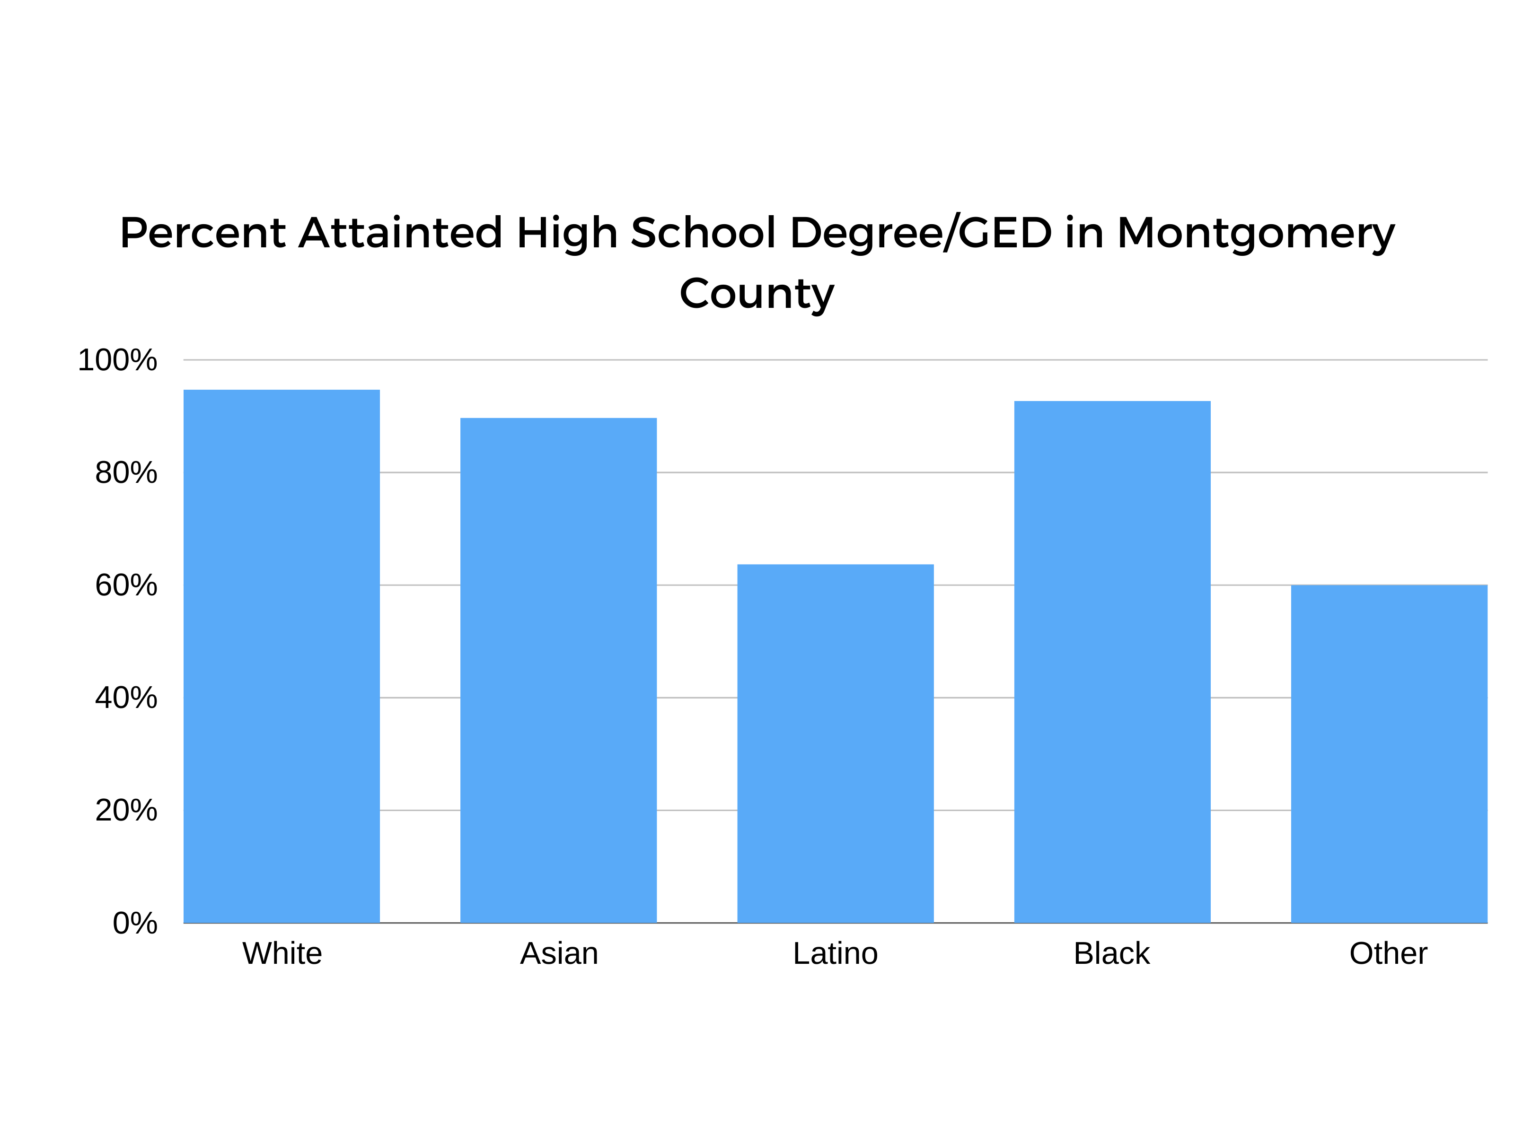
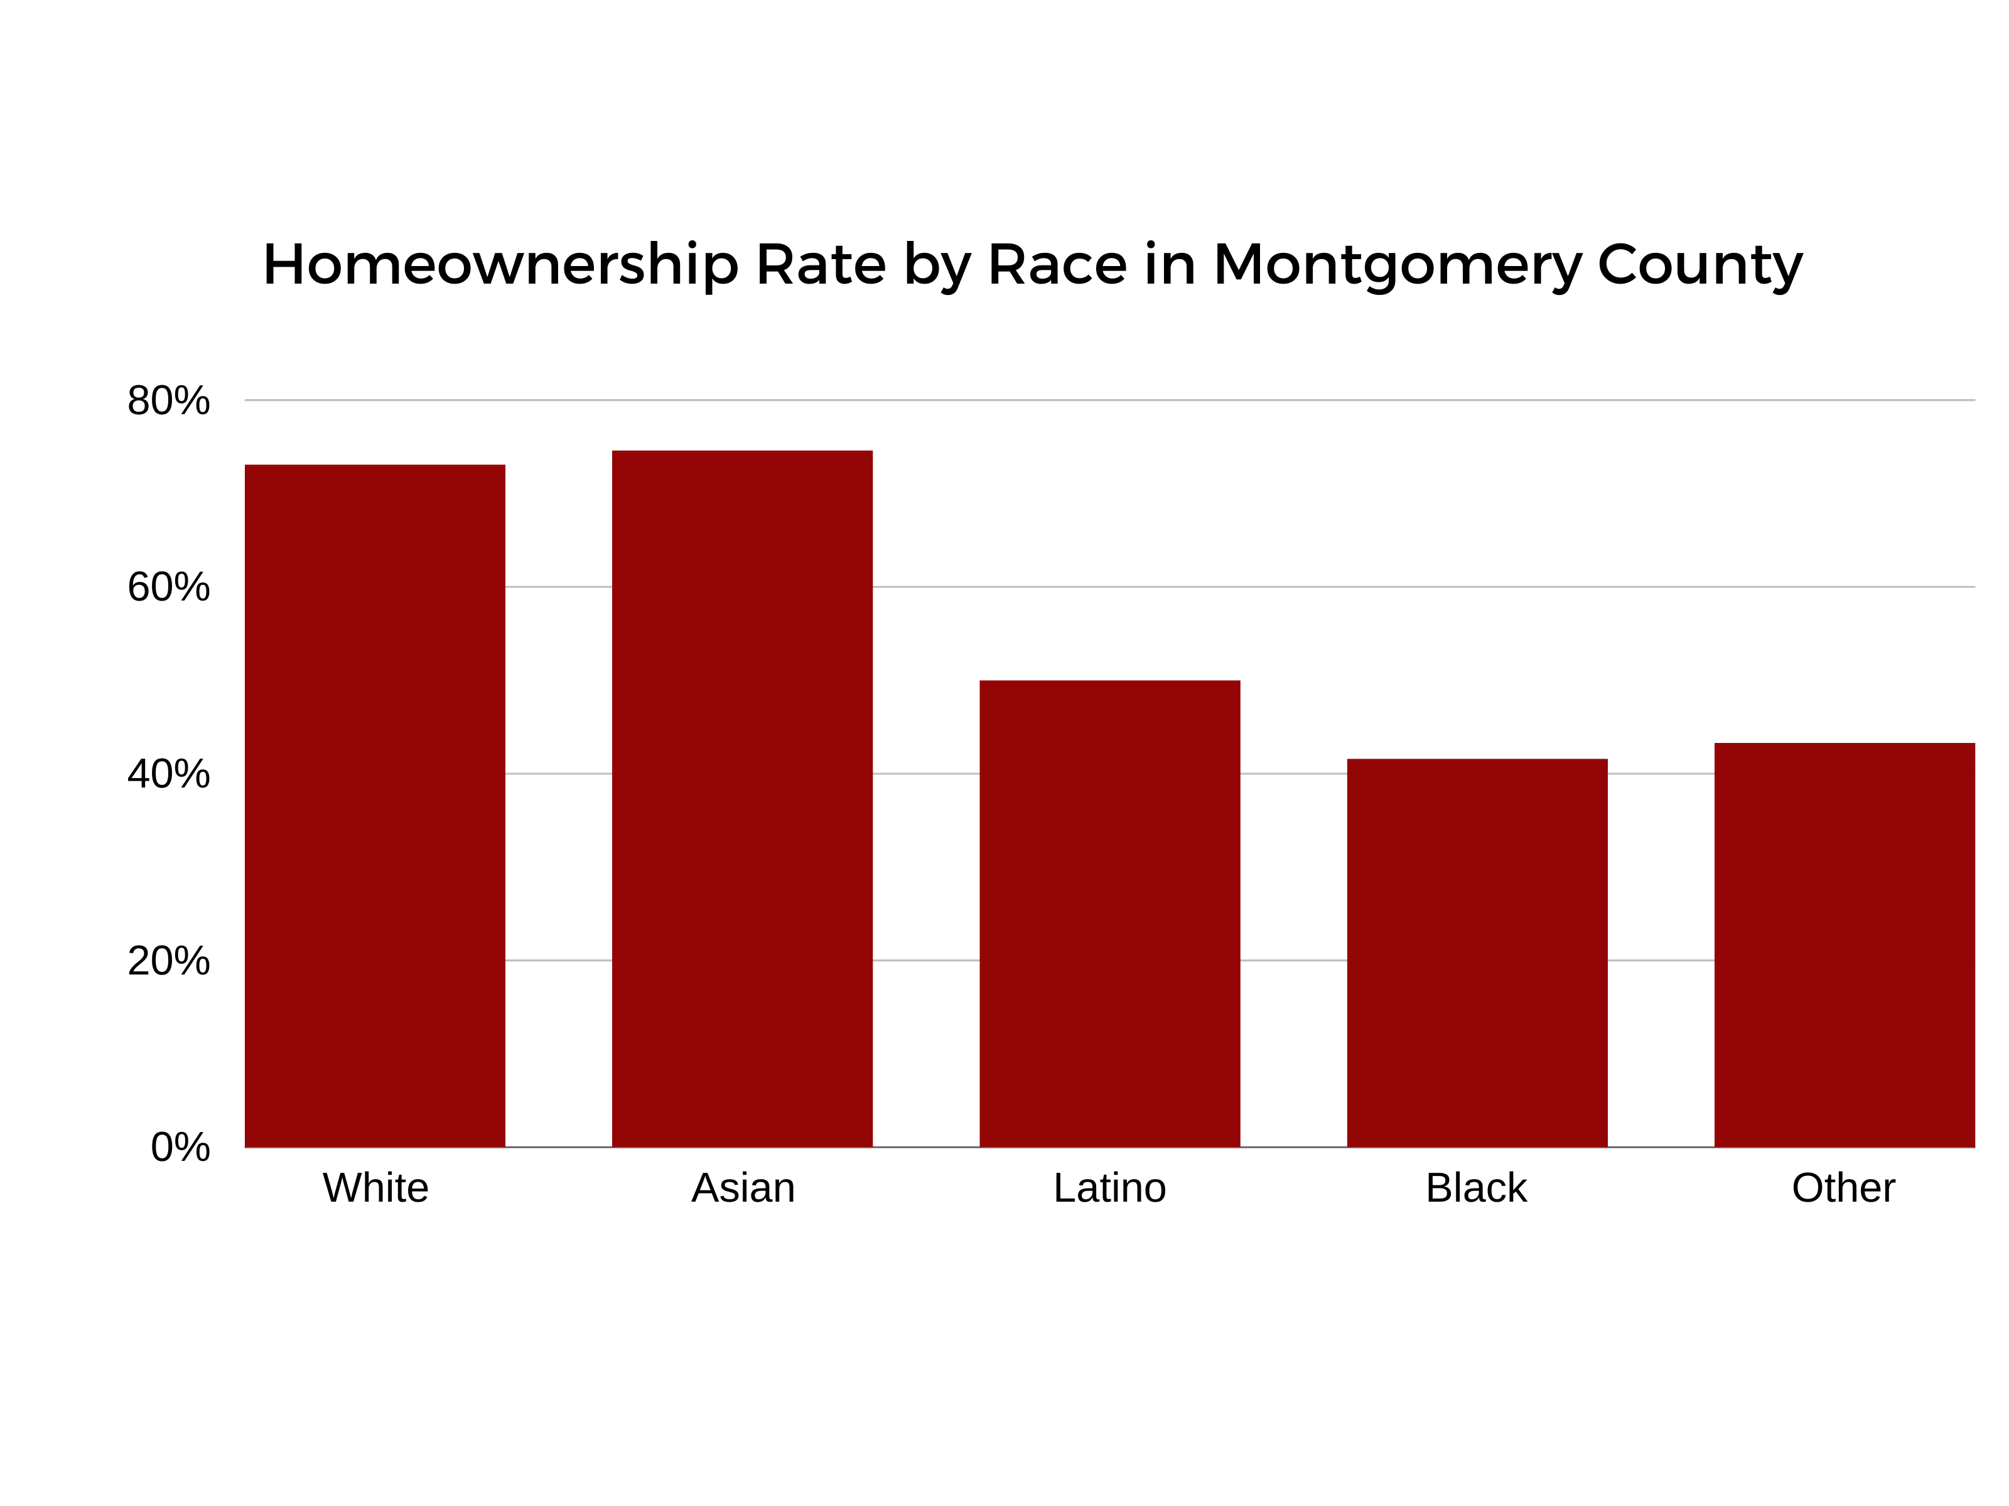
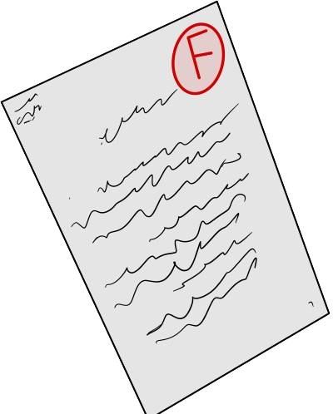
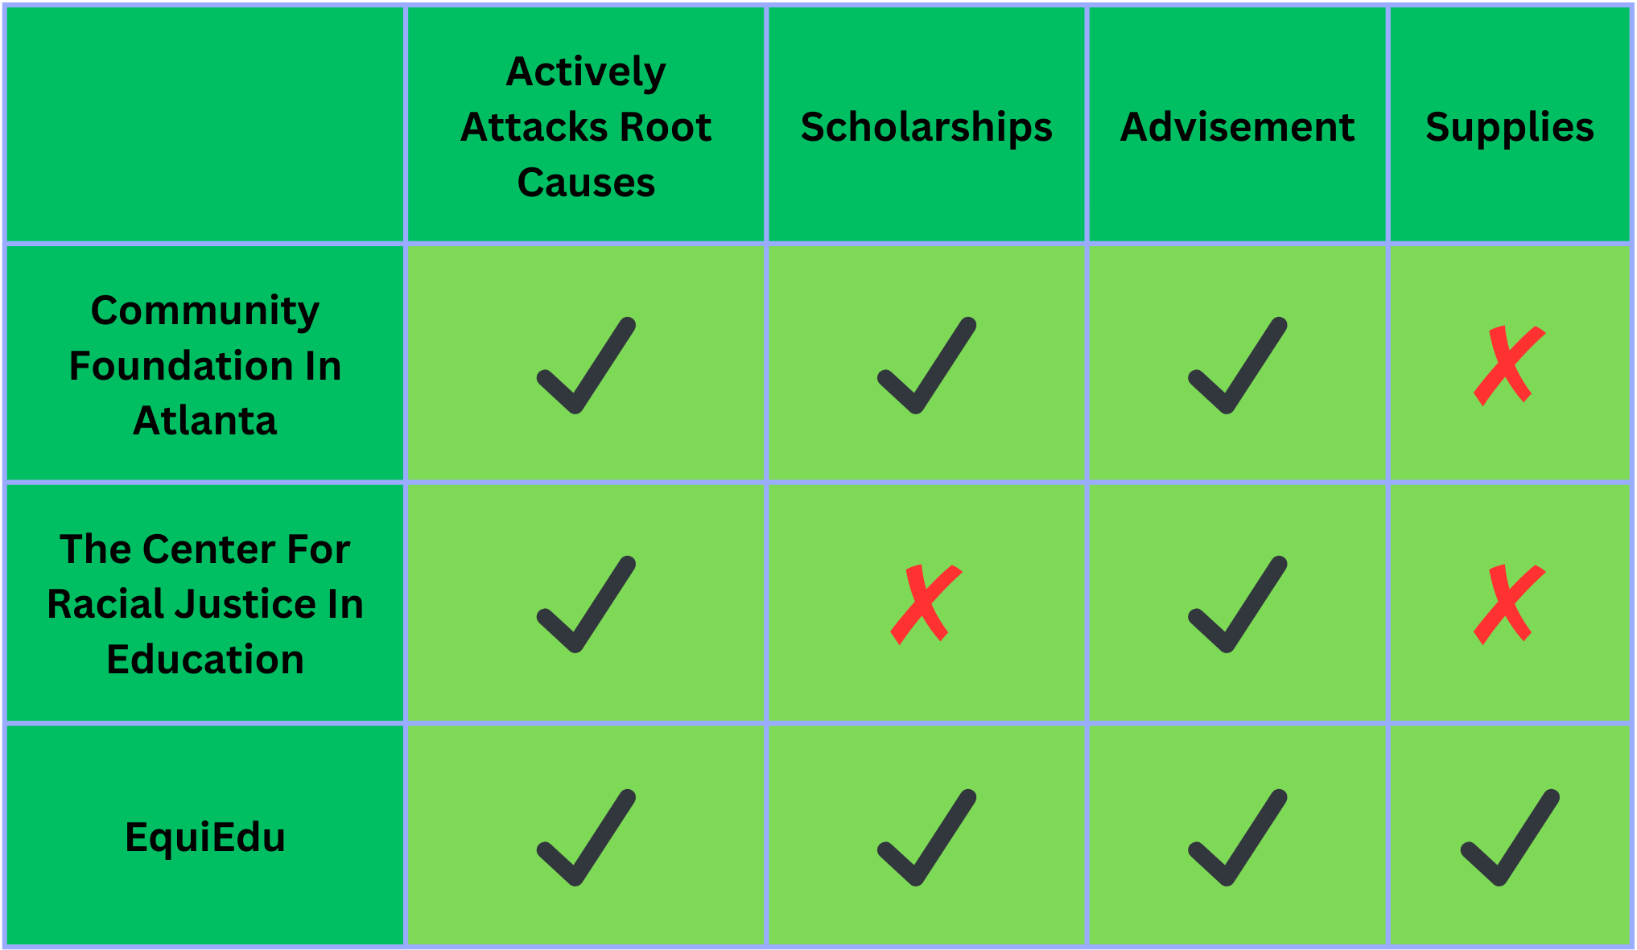
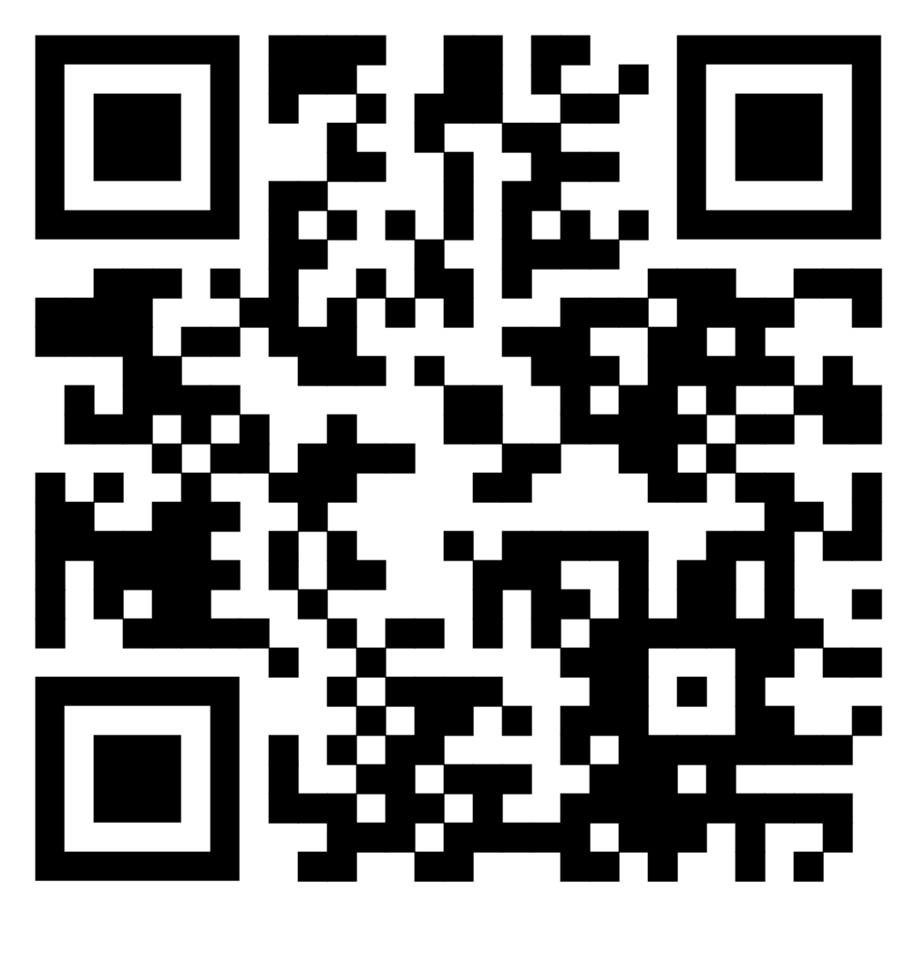
Wealth
In Montgomery County, MD
The Racial
Divide
The Issue
Our Focus
Our Solution
Minority communities often face higher rates of housing insecurity, lower income rates, and limited access to quality education due to past and current systemic disadvantages.
Studies show a correlation between K-12 academic success and wealth later in life
EquiEdu works to support the educational journey of disadvantaged non-White students, helping them succeed later in life
Wealth & Income In Relation To Education In The US as of 2013
Goals
Narrow the racial wealth gap
Provide advisement & academic support unique to each school
Assist families in purchasing supplies
Provide Scholarships
Direct Impact
Advisors will guide students in course selection and the college application process, ensuring preparedness in their future educational journey.
Reduce families' financial stress by decreasing cost of education.
These factors combined lead to a
self-perpetuating cycle of wealth inequality, as affected families find it harder to grow wealth as time goes on, while the privileged continue to become wealthier.
Latinos were more than 6 times as likely to have no high school degree than Whites in the County
Why EquiEdu is Unique
Vs.
Matthew L. Singh
Toluwani B. Akomolafe
Connor T. Sagan
Prof. Courtney Kurlanska
Prof. Laura Roberts
PLA Gabriella Ferullo
PLA Tera Keang
Resources -

