Slide 1

Smart Data Analytics Challenge 2018

Slide 2
Problem Solved
Since early treatment for Opioid addiction has been identified as one of the most important factors in battling the epidemic and preventing overdoses, we wanted explore the access to treatment clinics and Naloxone access.
In order to understand which areas are lacking treatment resources for opioid addiction, we analyzed city level data that highlighted areas that may need more resources to help treat opioid addiction.
The idea being that if we can identify areas that need more treatment centers, we can try and get more resource to those areas and use this same methodology for other cities in Colorado.
In order to do this we focused on the city of Denver and analyzed the following things:
Drug Crime Arrests
Substance Abuse Clinics
Naloxone Access
2018 Submission Template

Slide 3
2. Impact
From the intake session we learned that domain experts are experiencing recourse allocation problem. Hence, to address this problem we created a mapping solution that shows where in the Colorado regions there are high rate and low rate of opioid crisis
Since early treatment for Opioid addiction has been identified as one of the most important factors in battling the epidemic and preventing overdoses, we chose to focus on treatment clinics and Naloxone access
This micro-level analysis highlighted the need for treatment resources in specific Denver neighborhoods that were identified as high risk based on the distribution of drug crime rates within Denver
Since this analysis breaks out emergency treatment such as Naloxone distribution and treatment clinics, the analysts can isolate which resource is lacking in a high-risk area
People who are homeless, struggle from opioid addiction and have limited transportation options are particularly vulnerable in areas where they have to travel further for treatment options
2018 Submission Template

Slide 4
3. Methodology
Drug Crime Data
Analyzed Denver crime arrest data by geo-location, filtering out marijuana crimes from 2017 onwards
Plotted drug crime arrests in Denver
Added neighborhood polygon data to the map and color coded neighborhoods based on drug crime risk
Based on the distributions of crime arrests, neighborhoods with less than 20 crimes were considered low risk, 20-50 as medium and 50+ as high risk
Substance Abuse Clinics and Naloxone Access Data
Filtered substance abuse and detox clinics to Denver metro area
Removed clinics that do not treat opioid addiction
Combined this data with Naloxone Distribution Centers dataset
Pulled Geo Coordinates using Map Quest API (when latitude and longitude wasn’t available)
Plotted this data over the existing Denver map
Calculated the average distance to nearest clinic per neighborhood by converting latitude and longitude points to miles.
Analyzed which at-risk neighborhoods were the furthest from the aforementioned treatment options
Predictive Model Identifying At-Risk Areas by Census Tract
We wrangled together a dataset but found it to be too small for reliable results. However, the code can be helpful for future research
2018 Submission Template

Slide 5
4. The Data
Drug Crimes Dataset : https://www.denvergov.org/opendata/dataset/city-and-county-of-denver-crime
Denver Statistical Neighborhoods: https://data.colorado.gov/Municipal/Denver-Statistical-Neighborhoods/6g4b-w8bd
ArcGIS Naloxone Distribution: https://services3.arcgis.com/1pxU2hJU9ZszJDcX/ArcGIS/rest/services/PrescriptionDrugLocations/FeatureServer/0
SAMSHA_Colorado_Substance_Abuse_and_Mental_Health_Service_Providers : https://data-cdphe.opendata.arcgis.com/datasets/samsha-colorado-substance-abuse-and-mental-health-service-providers
The raw data for this project can also be found here: https://github.com/Colorado-Data-Analytics-Challenge/opiod-sos/tree/master/data
2018 Submission Template

Slide 6
5. Feasibility
Future Directions
For future analysis, we can use the methodology in this analysis to identify other at-risk areas in the state that badly need more centers and Naloxone access
Future analyses can also add public transportation data to get a more accurate estimate of how easy it is for people to reach clinics and other services
This data can further be combined with other city-level data to explore the relationships between crime rates and distance from treatment with overdose and prescription rates
Limitations/Expertise
We reduced the sample size of drug crime data in order to get more recent data points. We felt this tradeoff was worth it since Denver is currently experiencing a large amount of change in its neighborhoods and older data may not accurately reflect the each neighborhood’s current state
In order to run the analysis for other cities, the person should be familiar with Python
Furthermore, this analysis is limited by the data that can fit into memory on a single machine but can be refactored to work on larger datasets
2018 Submission Template

Slide 7
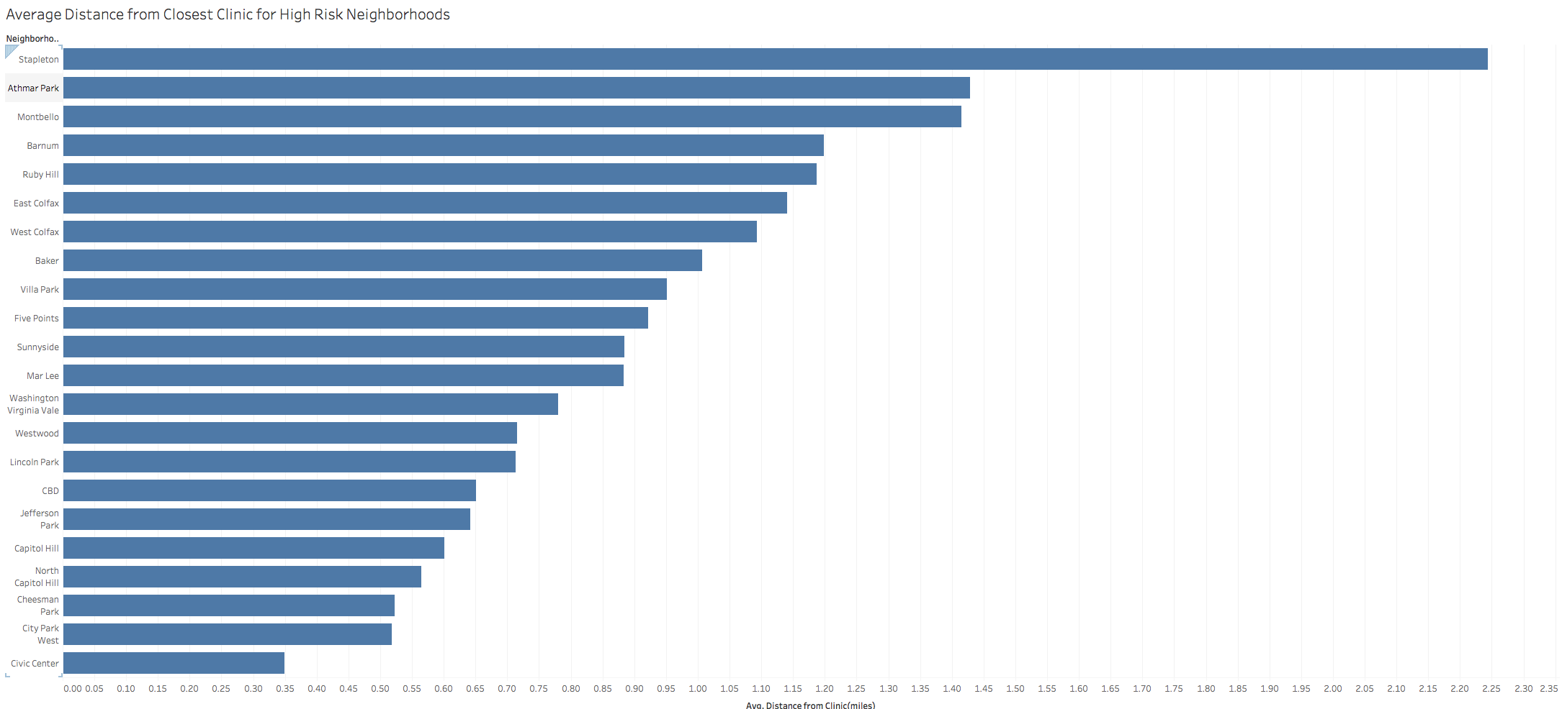
6. Results: Neighborhoods Furthest from Treatment Clinics
The data above shows that Stapleton, Athmar Park and Montbello, are the top 3 neighborhoods for having high drug crimes and being furthest from treatment centers.
People who live in these neighborhoods, struggle with opioid addiction and have limited access to transportations are particularly vulnerable
2018 Submission Template

Slide 8
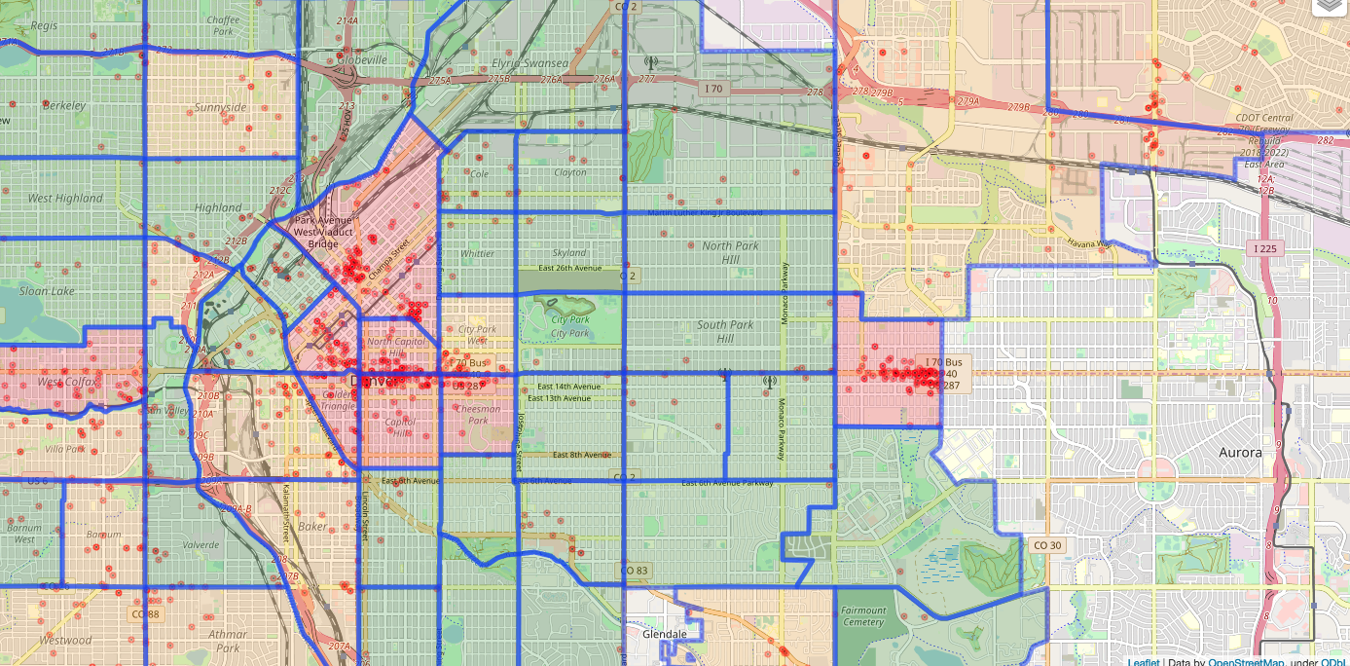
6. Results: Drug Crimes
The map shows the density of drug crimes (red dots) by neighborhood
West Colfax, the neighborhood I live in for example, is color coded as red (high risk) due to having a large number of drug related arrests
2018 Submission Template

Slide 9
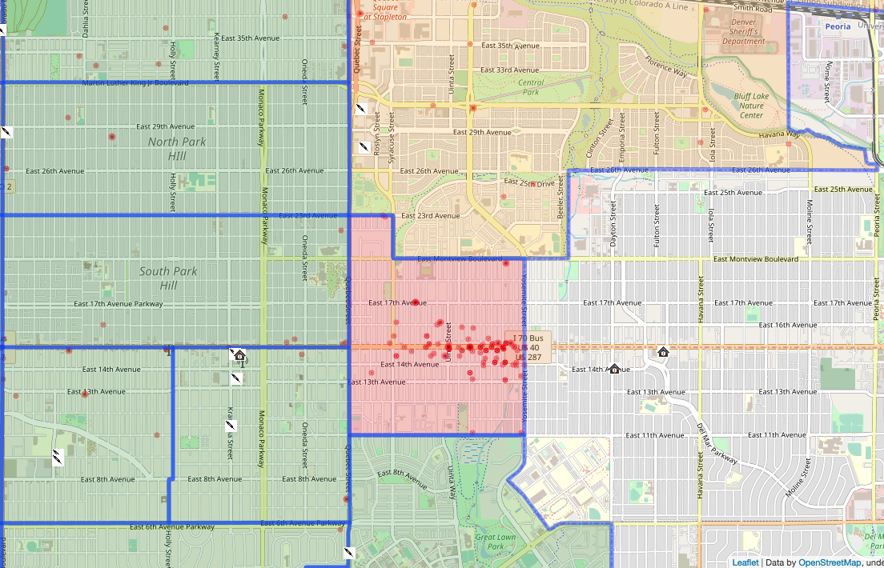
6. Results: Treatment Centers and Naloxone Access
Adding the clinics and Naloxone data, as indicated by their associated icons, you can see that East Colfax is an both area that could use more treatment resources as evidenced by a lack of clinics and Naloxone access
There are other neighborhoods that need these resources even more due to large travel distance needed to reach them (Please use the interactive map to explore those areas).
You can view the full map here : Interactive Map
2018 Submission Template

Slide 10
Appendix
Interactive Map
Data and Python Scripts : https://github.com/Colorado-Data-Analytics-Challenge/opiod-sos
2018 Submission Template

Slide 11
Smart Data Analytics Challenge 2018

