Slide 1
Ahead of the Game? Course-Taking Patterns under a Math Pathways Reform
Elizabeth Huffaker, Sarah Novicoff, & Thomas Dee
AEFP—March 24, 2023

Slide 2
The multiple contexts around math-education reform
Math achievement—and taking advanced courses—feature prominently in discussions of school performance & international competitiveness
Advanced math coursework linked with longer-run economic success (e.g., Altonji, 1995; Goodman, 2019; Long et al., 2012)
Large & persistent ethnoracial gaps in advanced-math take-up
Calculus among 2019 HS graduates (US DoED, 2021): Black (6%), Hispanic (9%), white (17.5%), Asian (43%)
During the CCSS transition period, a backlash to an earlier movement to accelerate math (e.g., grade-8 “Algebra for All”)

Slide 3
San Francisco’s Math Pathways Reform
In 2014, SFUSD replaced its grade-8 Algebra I course with CCSS Math 8 and CCSS Algebra I, arguing it was “much more rigorous”
These changes were also part of a large “Pathways” reform that placed Algebra I in 9th grade & encouraged no “curricular branching” (i.e., no tracking) before 11th grade..

Slide 4
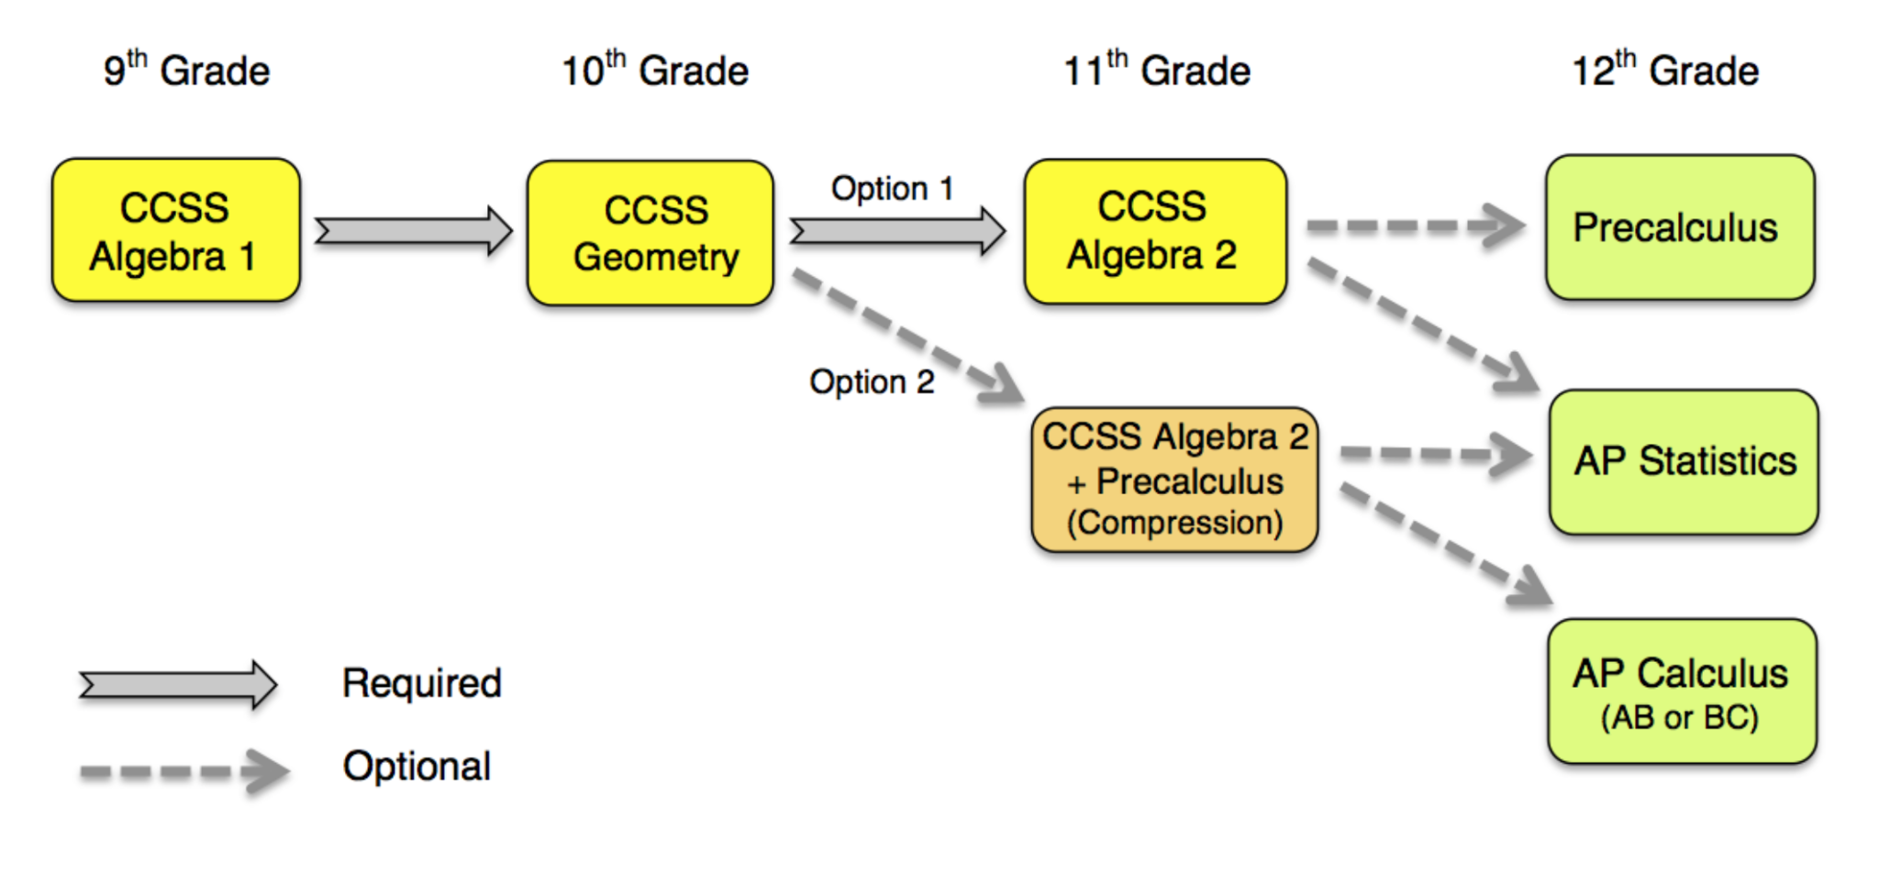

Slide 5
San Francisco’s Math Pathways Reform
SFUSD motivated this change as a rejection of acceleration that compelled students to make consequential decisions at a younger age
“Why is no one else compressing like us? We’re ahead of the game…Others considered going our way, but found it too hard. San Francisco always goes first, the rest eventually catch up”—Superintendent Carranza
Concerns about equity also figured prominently. Superintendent Carranza noted that at one high-performing SFUSD high school
“Of the 928 students who took those AP Math courses at this high school over the past two years, only 7 were African American, and only 21 were Latino: NOT 7 and 21 percent, but 7 and 21 actual students.”

Slide 6
San Francisco’s Math Pathways Reform
SFUSD stated that they would maintain an option for HS students to take Algebra I and Geometry simultaneously and that students would not be diverted from advanced math
Some parents and community members are engaged in significant and sustained opposition to the reform, criticizing both the Alg2/Precalculus compression course and a “leveling down” approach to equity
The contentious debate has centered on competing perspectives on how “advanced” math course-taking has changed under the reform
Our study seeks to provide independent evidence on this question

Slide 7
Data
Student-level transcript data used to build longitudinal profiles of HS math course-taking across six cohorts of SFUSD students (n=23,309)
We define graduation cohorts based on when they first entered grade 9 for 3 pre-reform cohorts (classes of 2016, 2017, & 2018) and 3 post-reform cohorts (classes of 2019, 2020, and 2021)
Similar results when focused on graduating students (figures A2-A4)
Paralleling the debate, we focus on course-taking but find similar results when focused on course completion (Tables A5, A6)
Following IES guidance for descriptive research, we do not center inference but do show two forms of inference in the appendix
Obviously not causal but “post hoc ergo propter hoc”?

Slide 8
Results

Slide 9
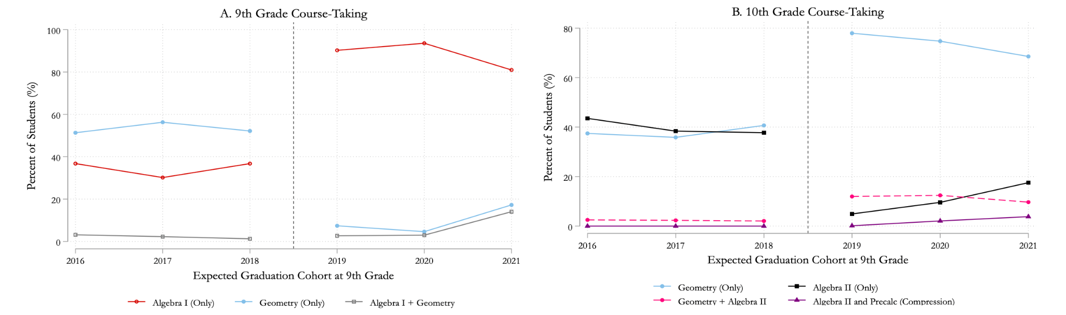
Grade 9: Dramatic shift to Algebra & from Geometry

Slide 10
Grade 10: Dramatic shift to Geometry & from Algebra 2

Slide 11
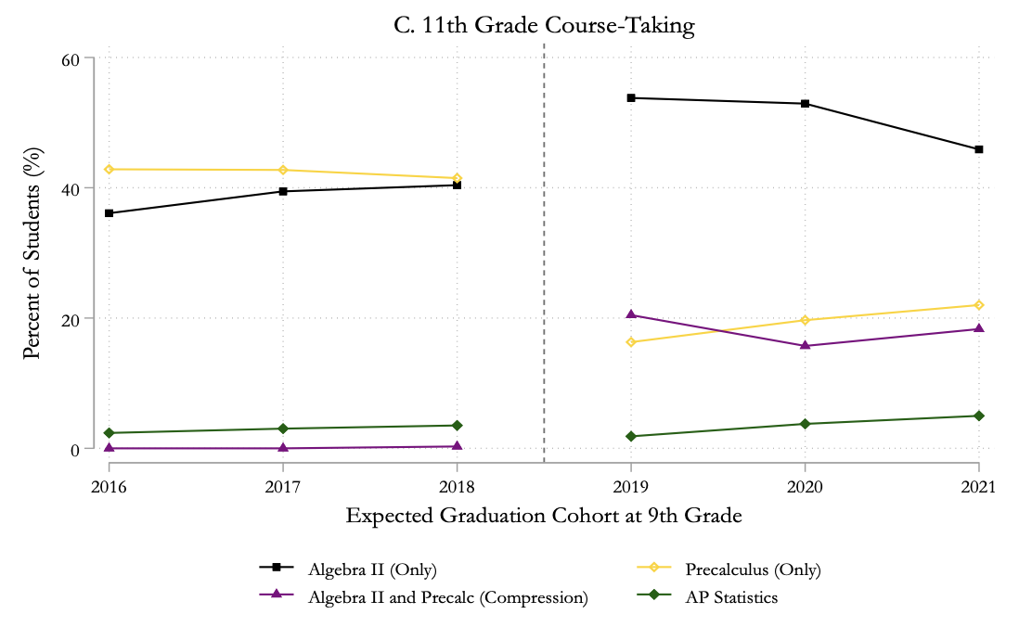
Grade 11: More A2/compression; less full-year Precalculus

Slide 12
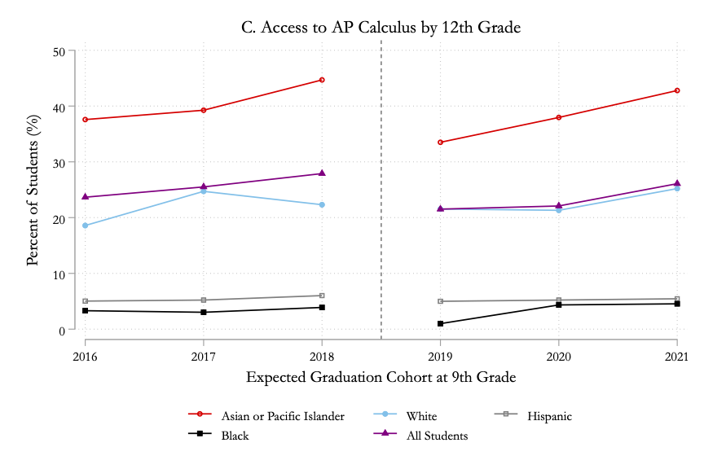
Drop in AP Calc followed by recovery due to acceleration

Slide 13
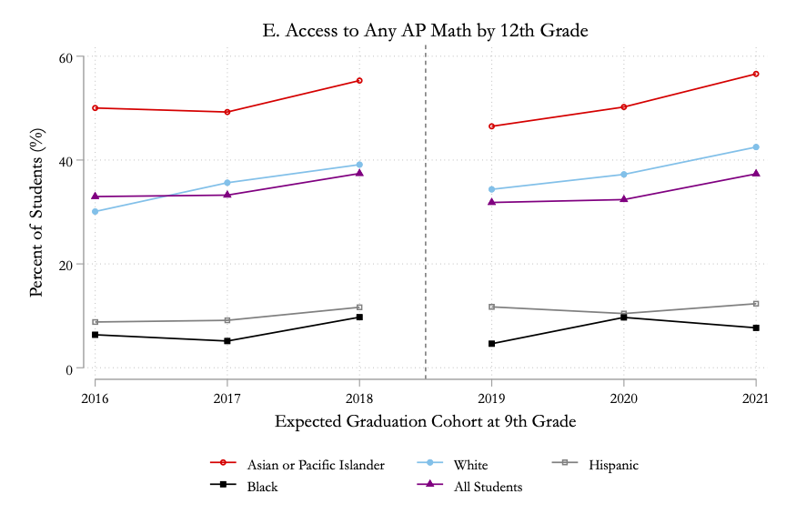
More recovery when focusing on any AP Math course

Slide 14
Conclusions
Participation in Advanced Placement (AP) math initially fell 15% (6 pp.) driven by declines in AP Calculus and among Asian/Pacific-Islander students.
Growing take-up of acceleration options attenuated this initial decline
Sustained drop in AP Calculus (2.4 pp.) balanced by growth in AP Statistics
Ethnoracial gaps in AP math remained largely unchanged

Slide 15
Implications?
Fitting a 5-year course sequence (A1→AP Calc) in 4 years of high school implies confronting tradeoffs
The Alg2/Precalc compression course not recognized as Precalculus by state universities
Acceleration in grades 9 and 10? Is acceleration in grade 8 really so much worse?
Deeper questions about the content knowledge within each course name & what we want students to know (e.g., Calculus vs. Statistics?)
A need for new insights (an “equity audit”?) about the persistent barriers to representation in advanced math
Is it the quality of earlier pedagogy and opportunities, the character of course advising, the availability of advanced courses at all schools, or all of the above?

