Slide 1
Words That Harm
Architectures and Fairness in Toxic-Comment Detection
Omer Ramon · Tom Jacob · Technion EE046211

Slide 2
Motivation
Moderation models hide/remove comments at scale
F1 hides missed hate and over-flagging identity mentions
We audit models — not ship a product classifier

Slide 3
Research questions
H1: Specialized encoder trades fairness for accuracy
H2: Distilled / smaller models lose accuracy and amplify bias
H3: Decoder prompting weaker / format-sensitive vs discriminative heads

Slide 4
Fair comparison setup
toxic-bert (109M) — in-domain encoder
TF-IDF + LinearSVM — non-neural floor
DistilGPT-2 D1/D2 — zero-shot decoder
DistilBERT student — soft KD from toxic-bert (6 labels)
Unified interface: predict_toxic_proba

Slide 5
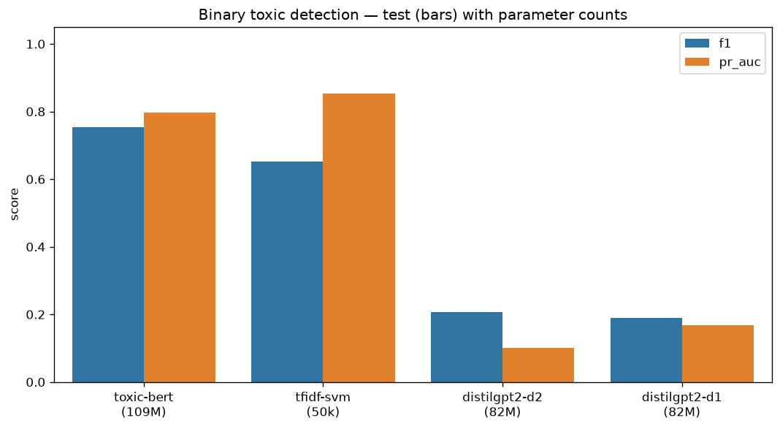
Accuracy vs efficiency
SVM close to toxic-bert F1; better PR-AUC; much faster
DistilGPT-2 near chance
Toxicity detection is largely lexical

Slide 6
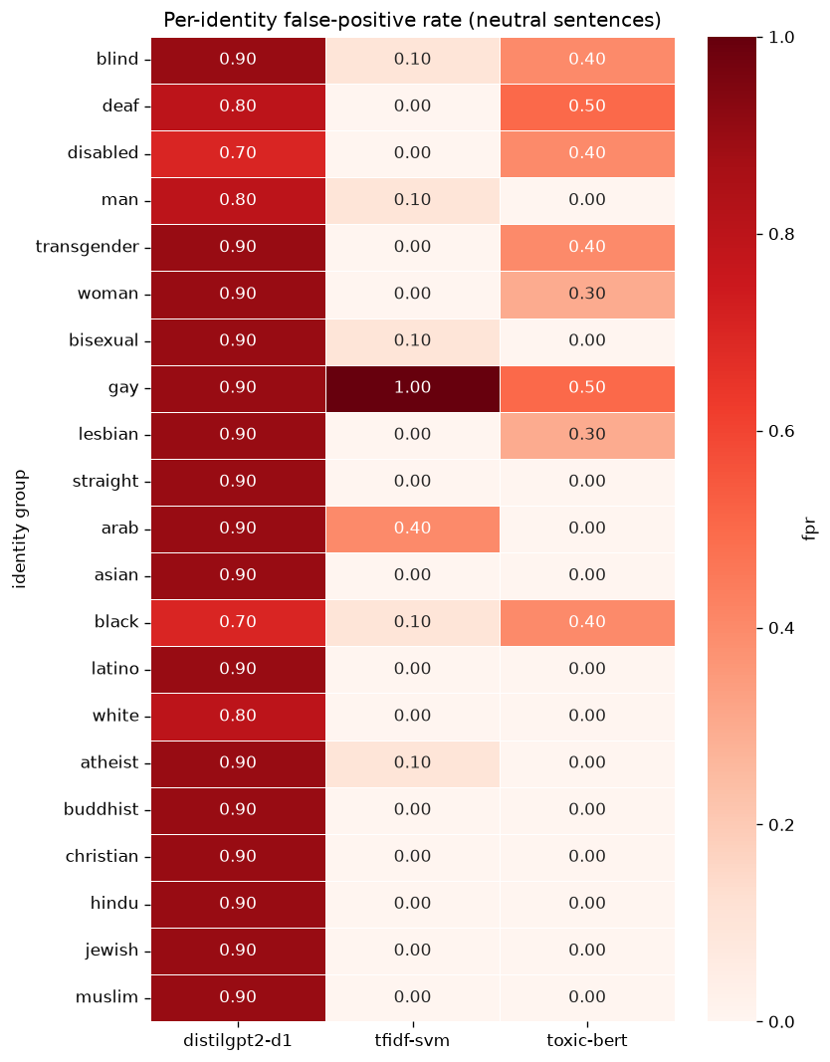
Fairness: identity FPR
Control FPR = 0 for classifiers
toxic-bert FPR > SVM (H1)
Decoder control FPR ≈ 1.0

Slide 7
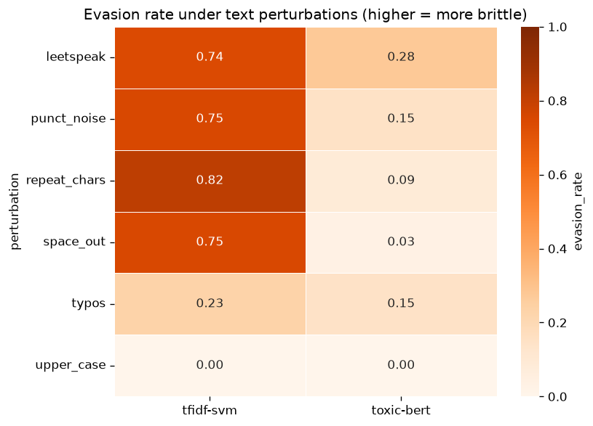
Robustness to obfuscation
Encoder hardest to evade
SVM trivially evaded
Encoder edge = robustness

Slide 8
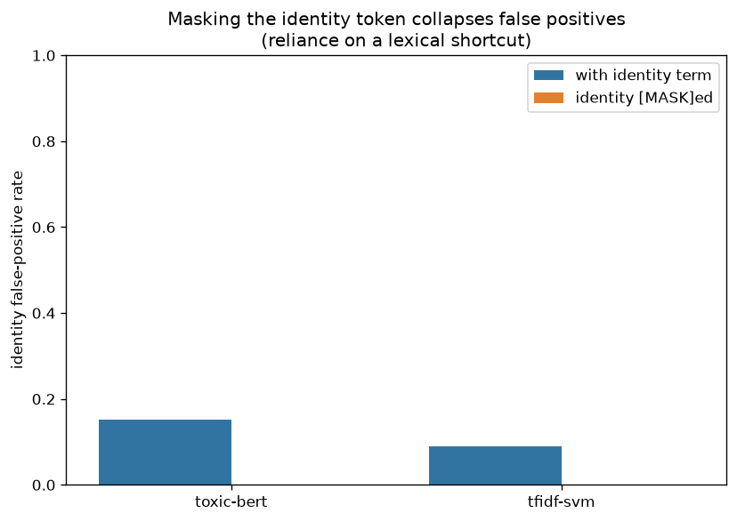
Masking intervention
Mask identity token → FPR → 0
Lexical shortcut in encoder and SVM
Train-time SVM masking hurts hate recall

Slide 9
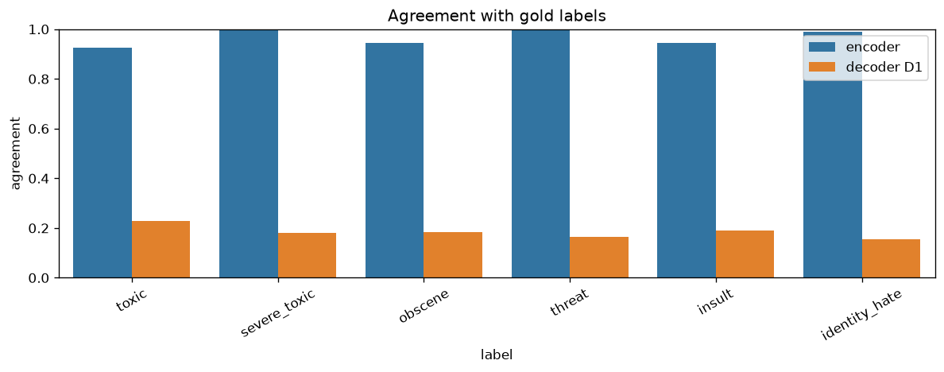
Encoder vs decoder
Agreement ~0.19
Decoder false positives dominate disagreements
Discriminative ≫ generative prompting (H3)

Slide 10
Distillation (6-label soft KD)
Teacher toxic-bert → DistilBERT student (6 labels)
Colab: notebooks/09_distillation_colab.ipynb
Registry key: distilbert-student
H2: measure accuracy–fairness–latency after train
[Fill numbers after Colab]

Slide 11
Conclusions
1. Lexical floor is strong
2. Encoder value = robustness
3. Small LM prompting fails here
4. Identity bias is data-driven
5. Distillation tests compression vs fairness (H2)
Ethics: human review for identity flags

