Slide 1
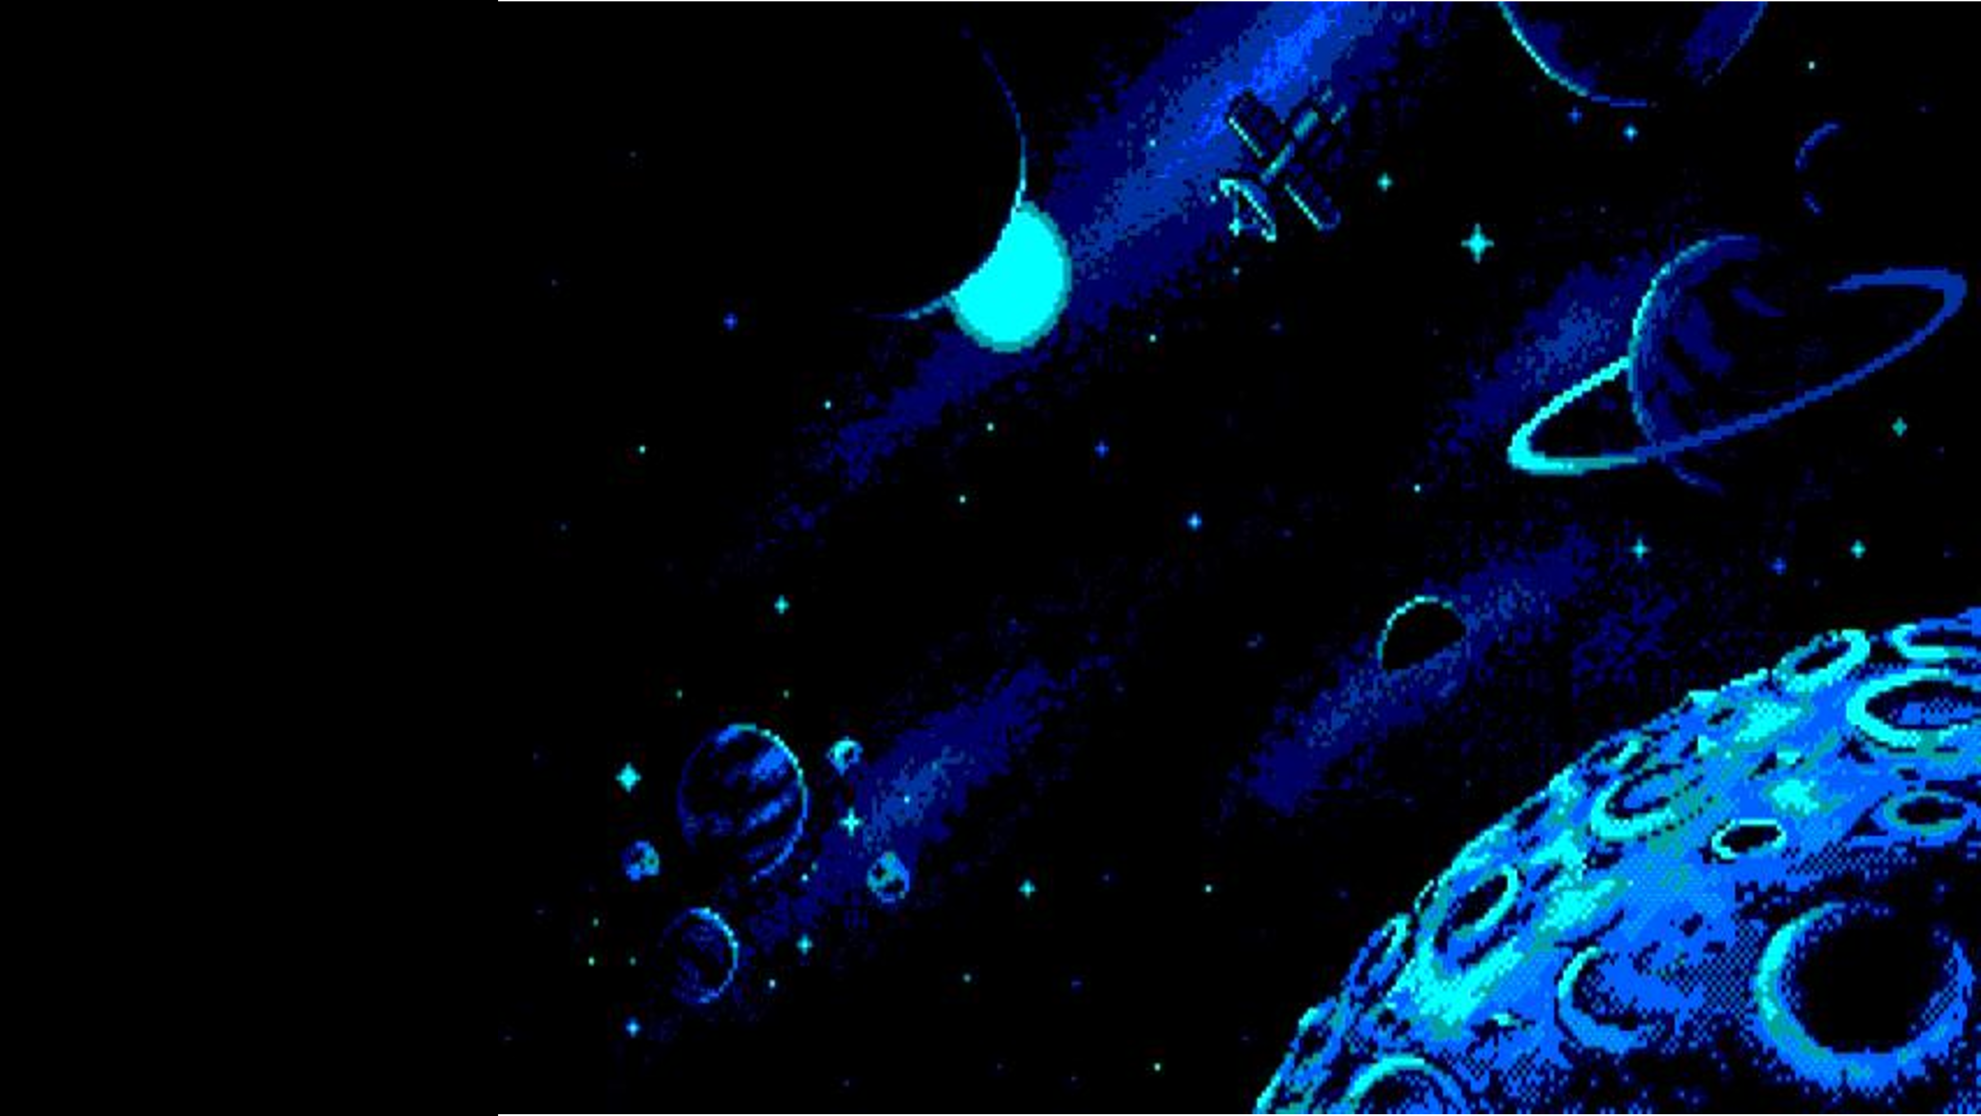
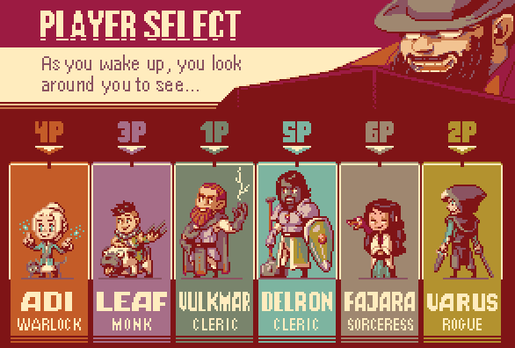



PLAYER SELECT…
Alex Kidd
In space
TOM JACOB
STUDENT
ALMA SALMAN
STUDENT
DAN WARTSKI INSTRUCTOR

Slide 2
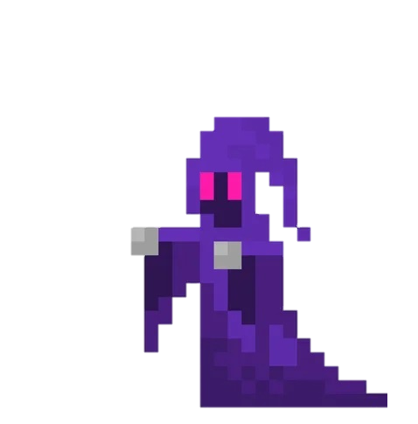

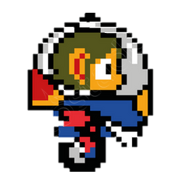

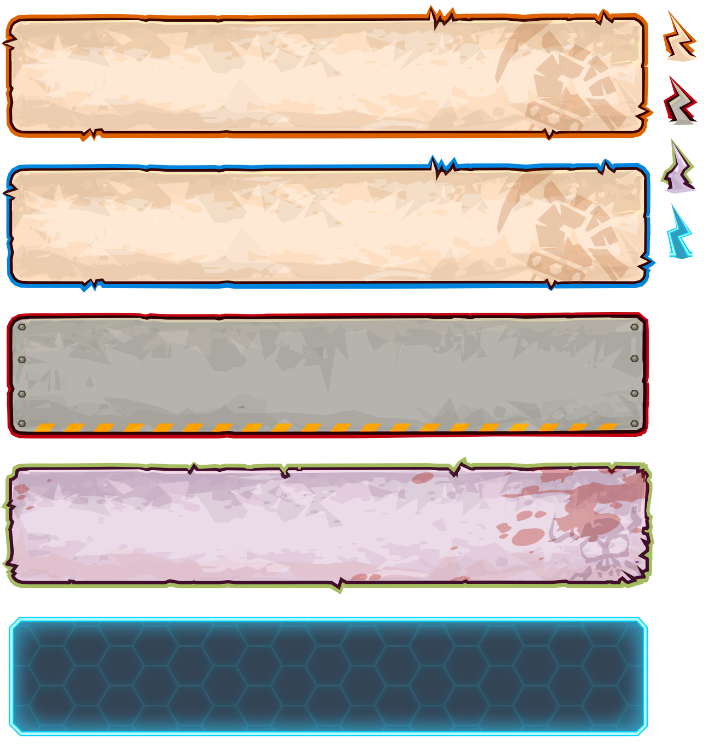
Alex Kidd
In space
STORYBOARD
Alex, burdened by the malevolent sorcerer's curse, was compelled to traverse the vast expanse of the universe in search of celestial bodies. It is only through the accumulation of precisely 300 stars that he will ultimately find solace in returning to his rightful abode.

Slide 3
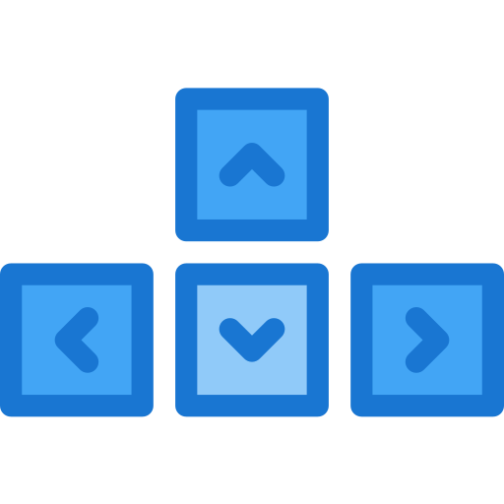
Alex Kidd
In space
How to play...

Slide 4



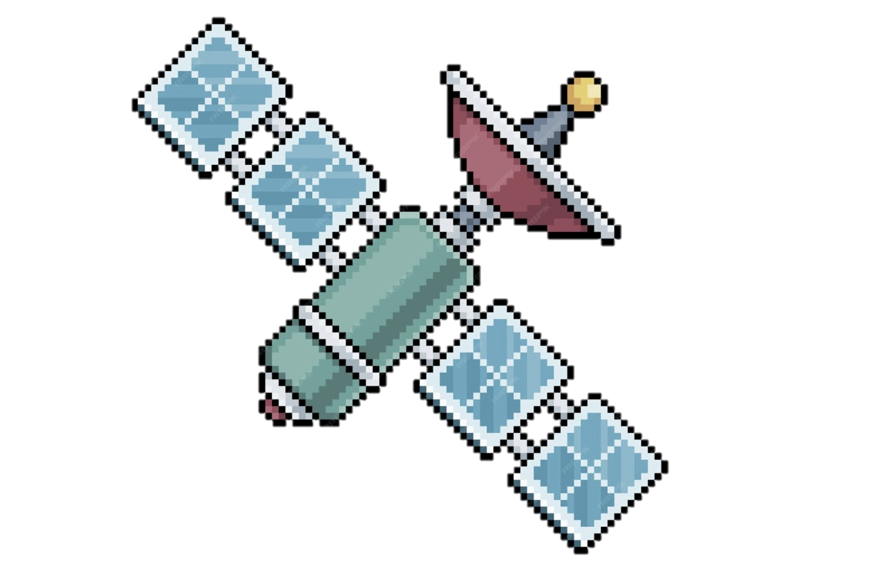


2nd level
LEVELS
HOW TO PLAY…
00
01
1st level
3rd level
You can touch a star to collect
If you collide with a moon, a sound will be heard.
When you collide with a satellite you will lose one heart.

Slide 5

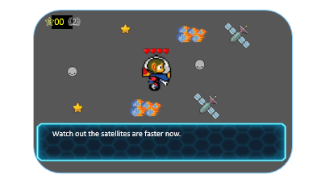
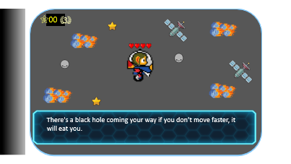
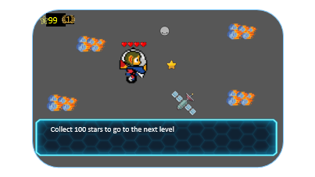
HOW TO PLAY…
LEVELS
2nd level
1st level
3rd level

Slide 6

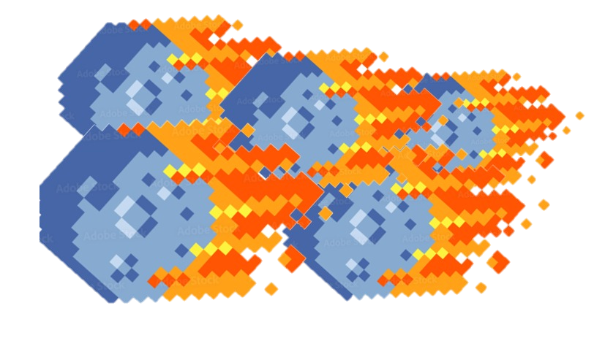
99
1
00
2
Collect 100 stars to go to the next level

Slide 7
00
01
2
Watch out the satellites are faster now.

Slide 8
00
01
3
There's a black hole coming your way if you don’t move faster, it will eat you.

Slide 9

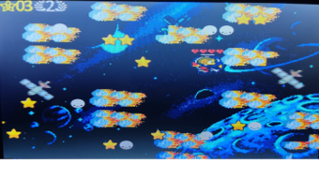
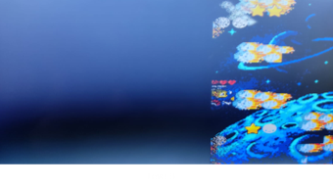
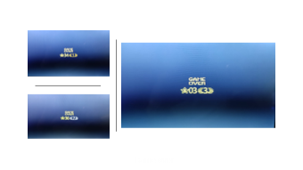
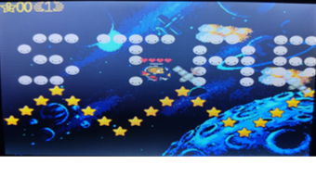
gallery

Slide 10
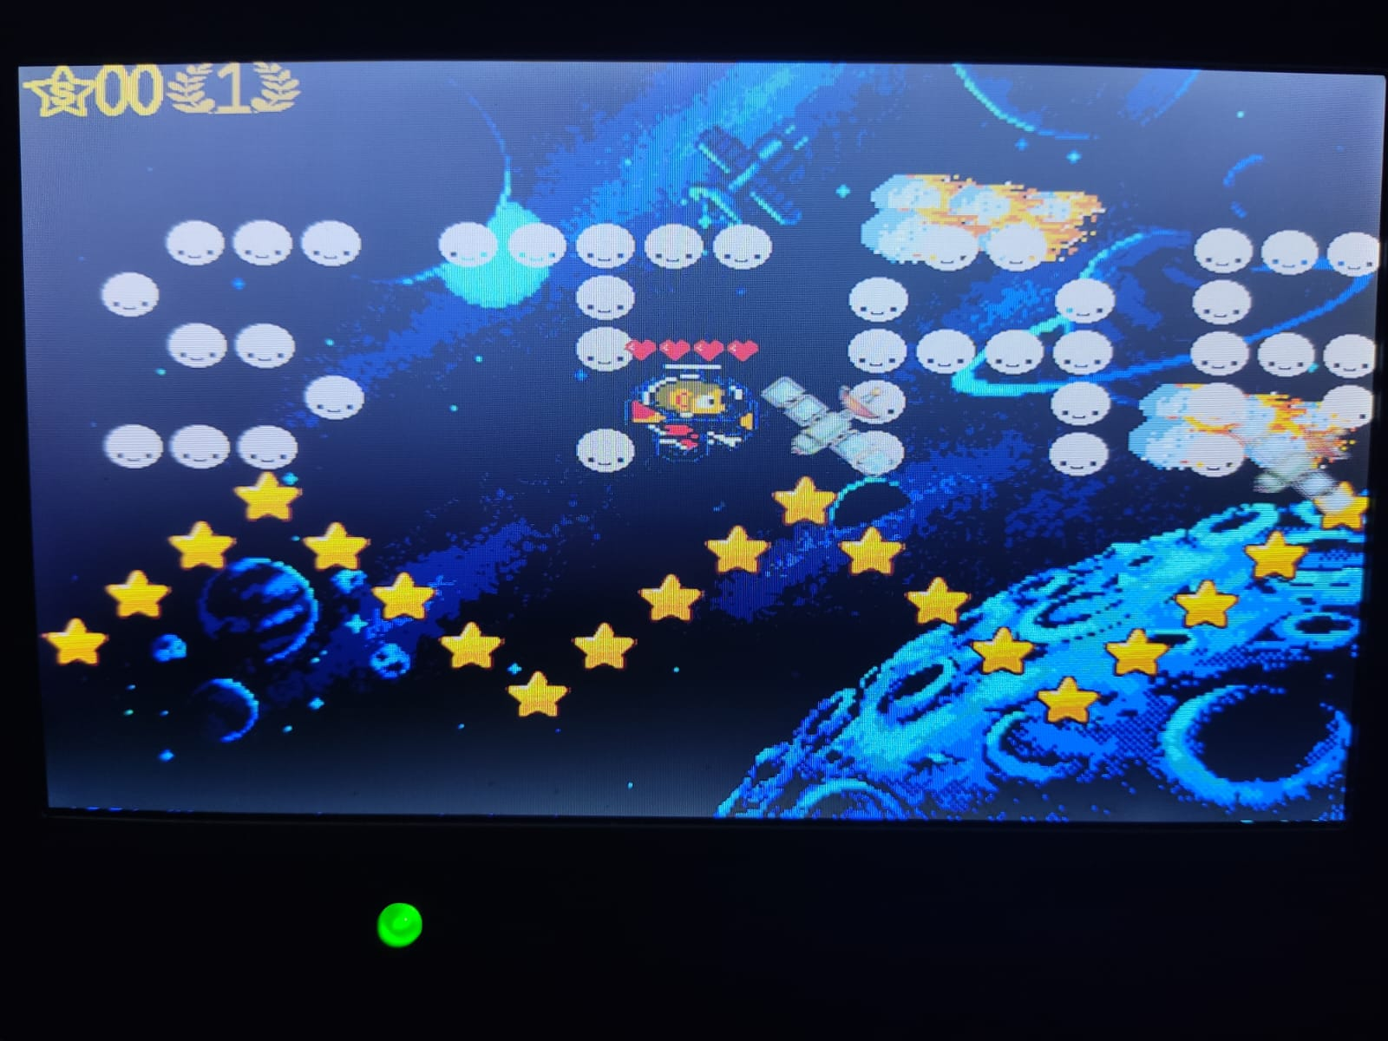
Level 1

Slide 11
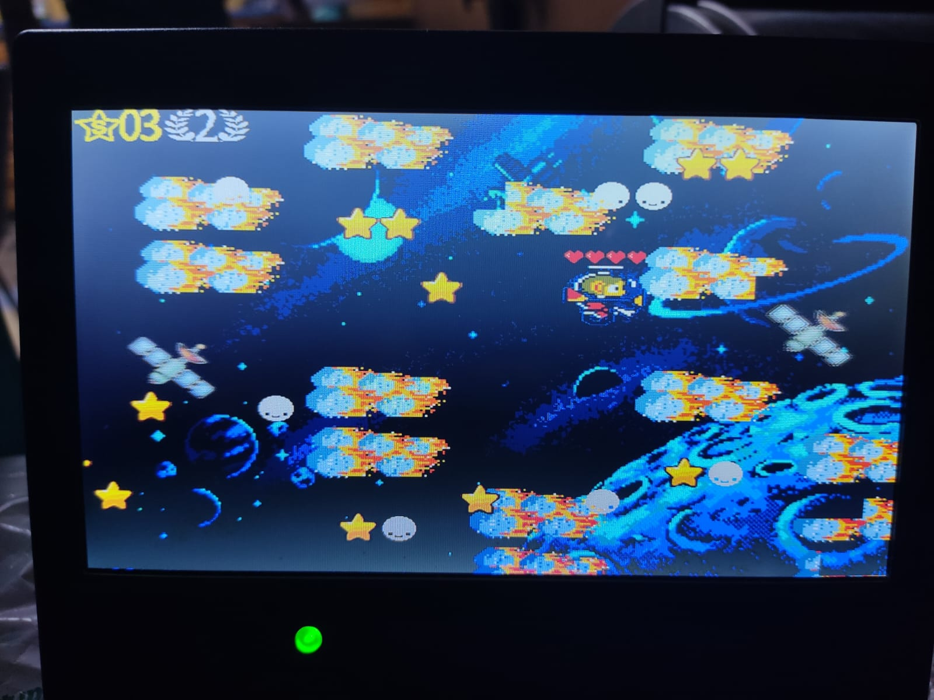
Level 2

Slide 12
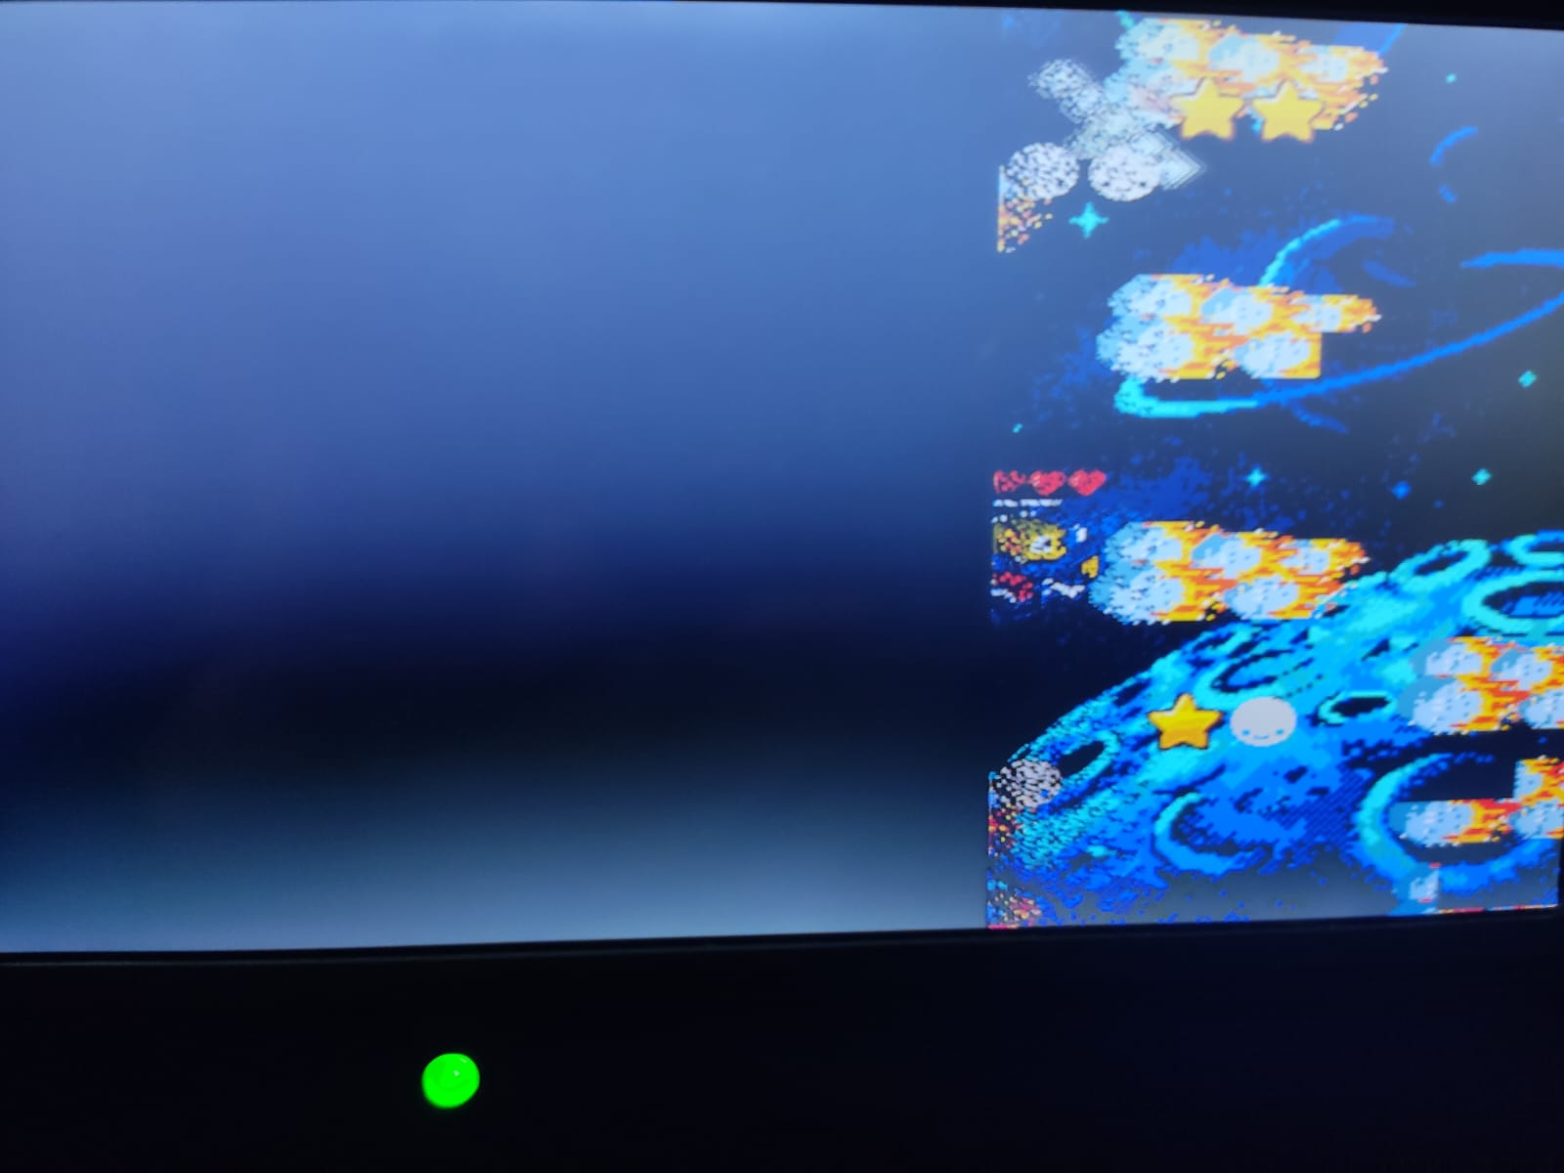
Level 3

Slide 13
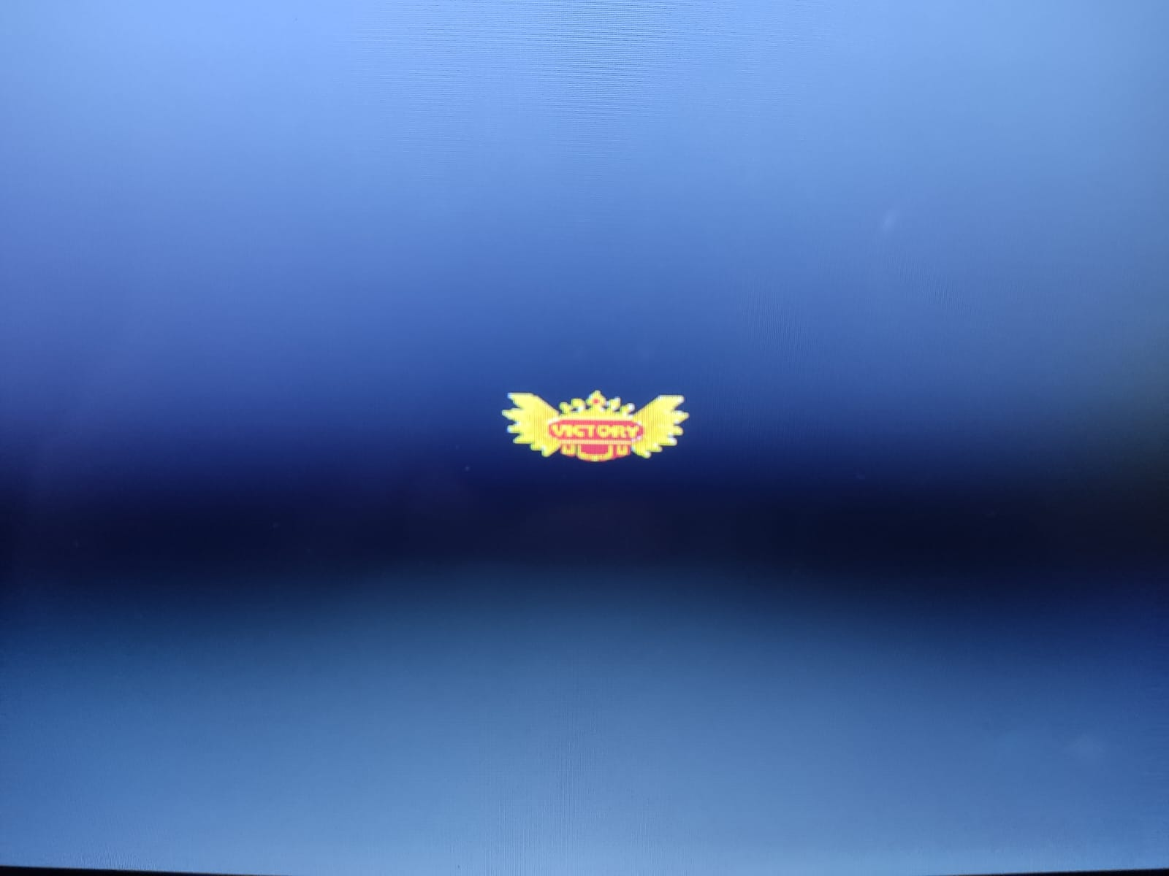
Win

Slide 14
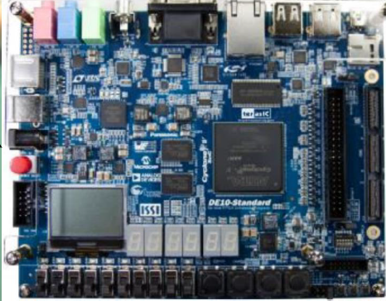

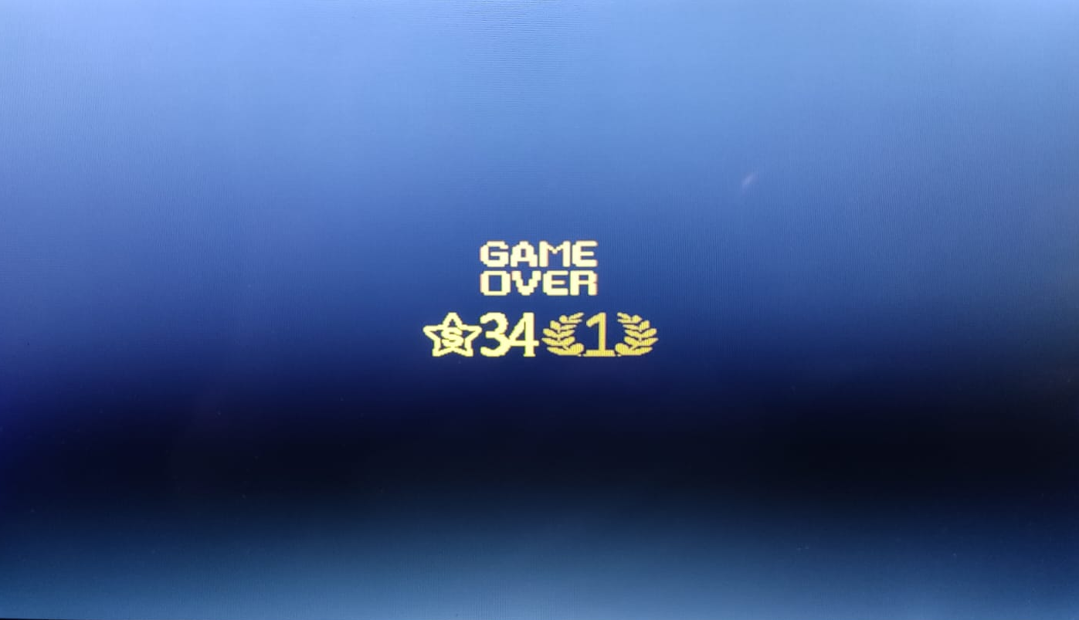
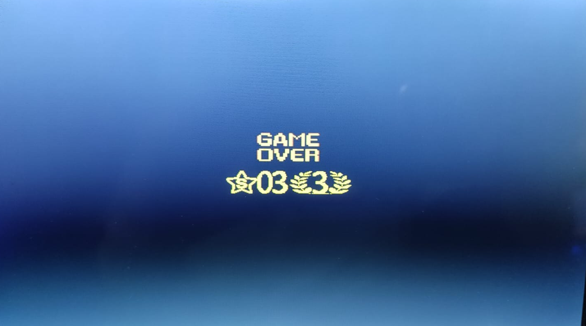

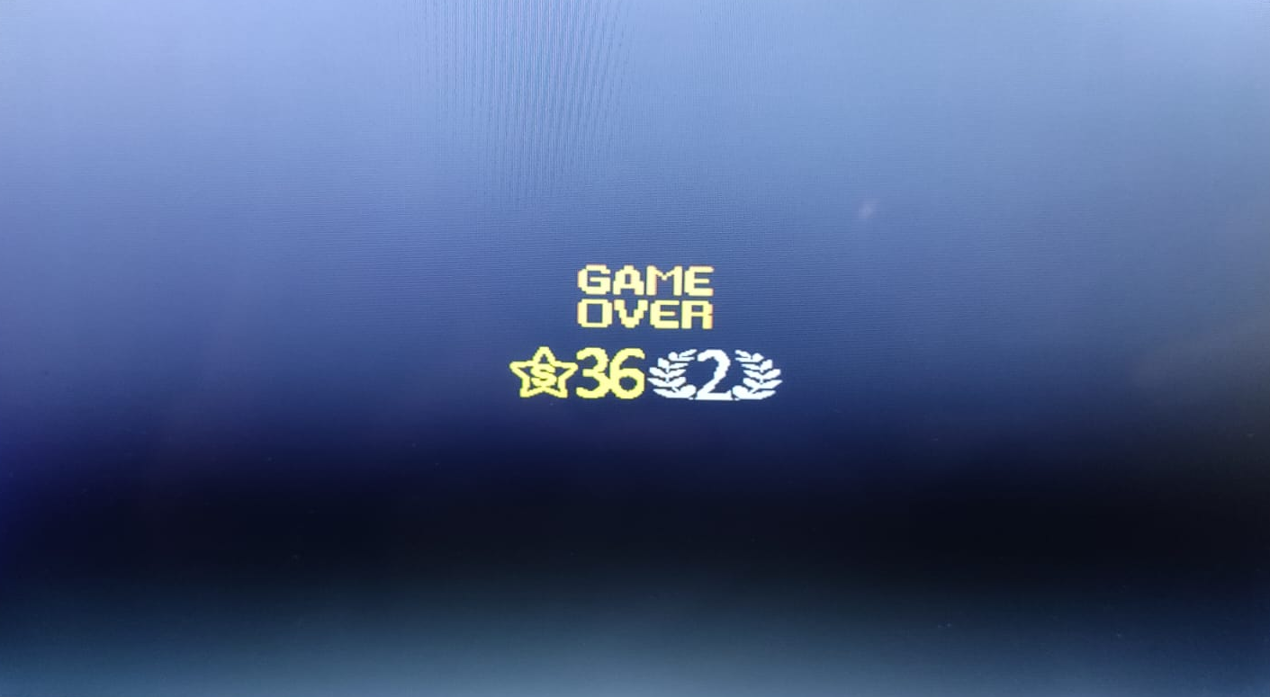

DE_10
Game over

Slide 15
Architecture
DE_10

Slide 16
Blocks Diagram
Blackhole
Object Mux
Levels + score + HP
Game controller
KBD
Alex
VGA
birds
random
Star and moon
Background
Objects drawing request
Hit
audio
Audio
out

Slide 17
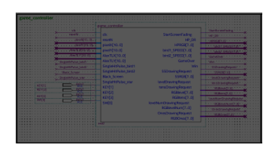
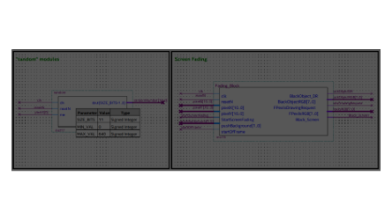
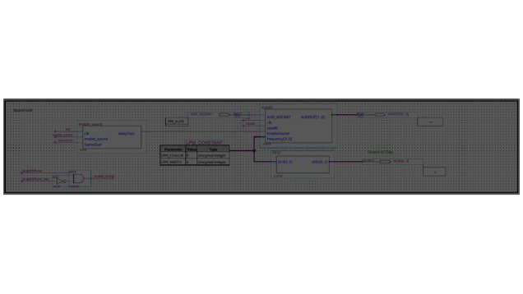
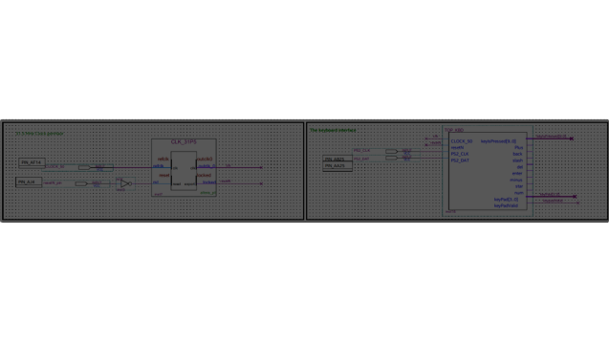
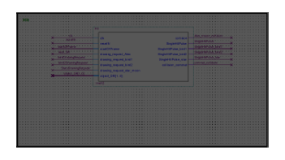
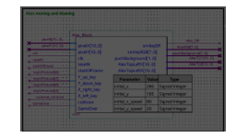
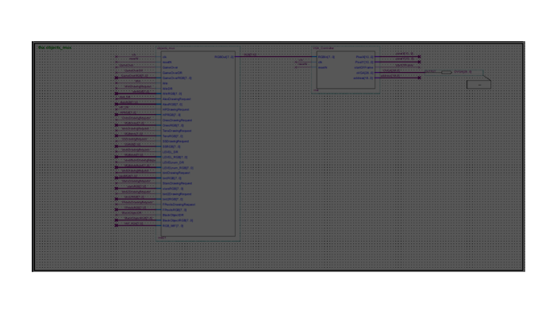
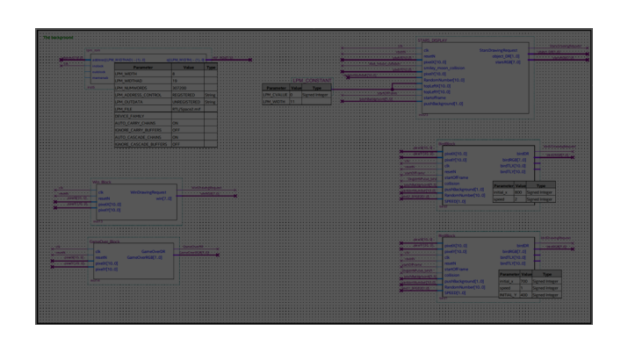
OUR TOP
clock
KBD
Game controller
Hit
Static + dynamic background
Objects mux
random
Black hole (for lvl3)
Alex (player)
audio

Slide 18
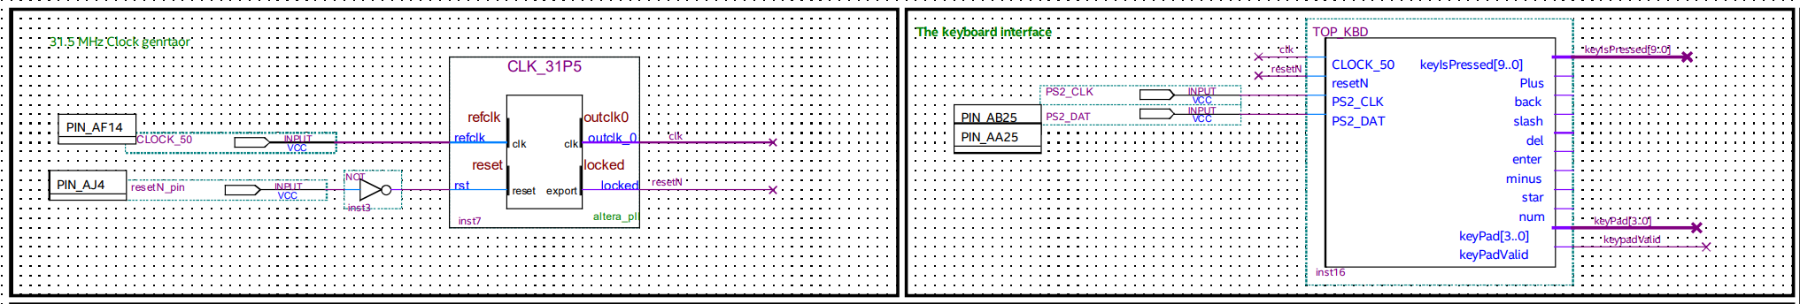

Slide 19
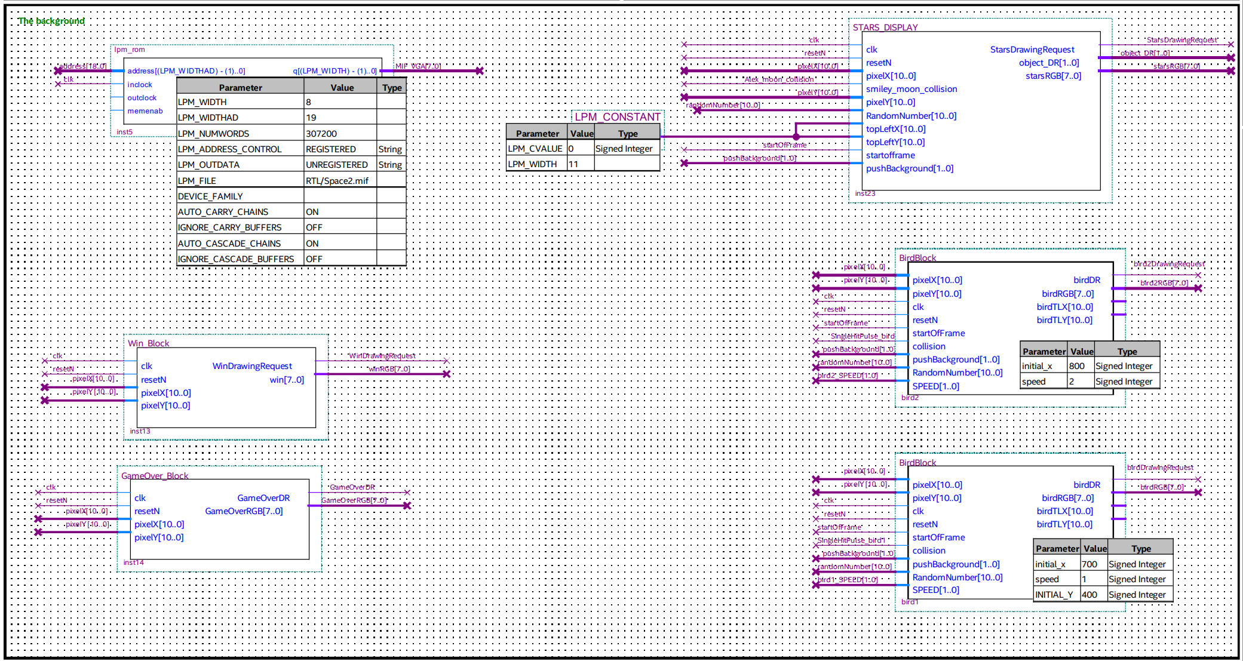

Slide 20
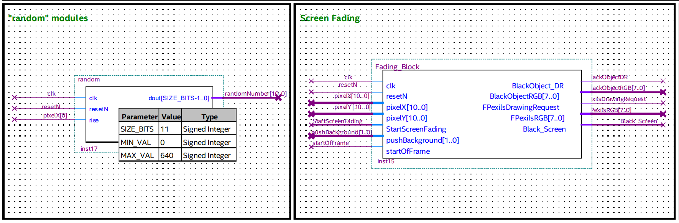

Slide 21
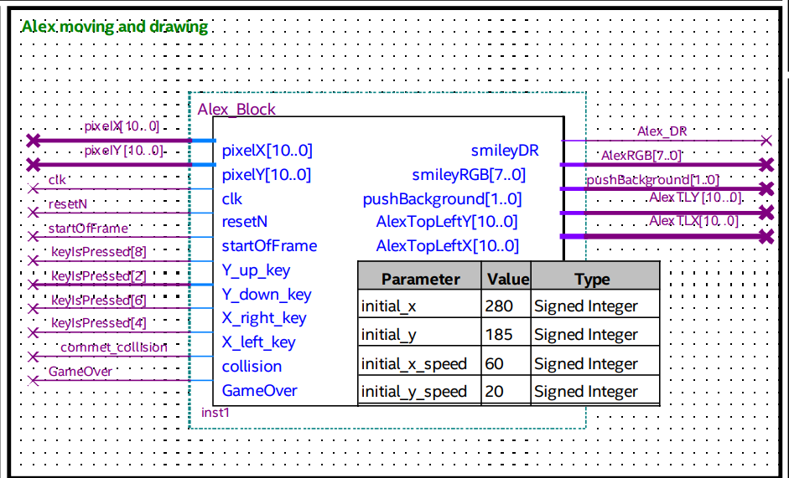

Slide 22
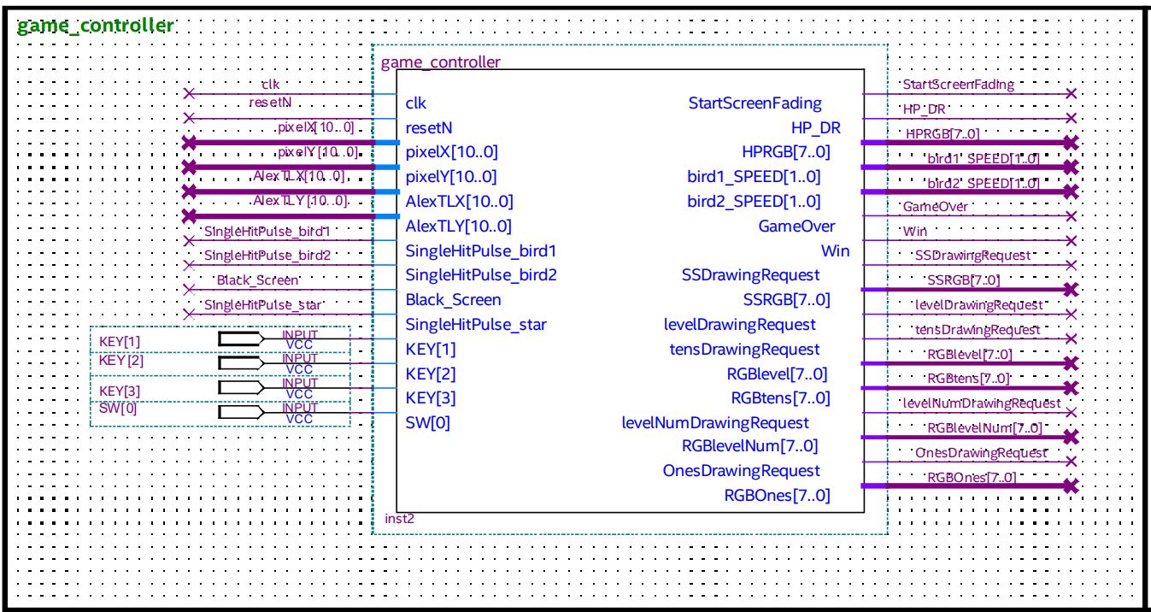

Slide 23
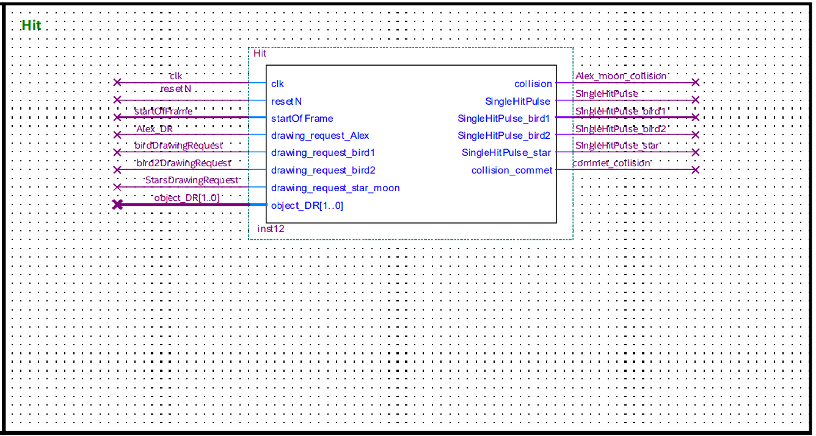

Slide 24
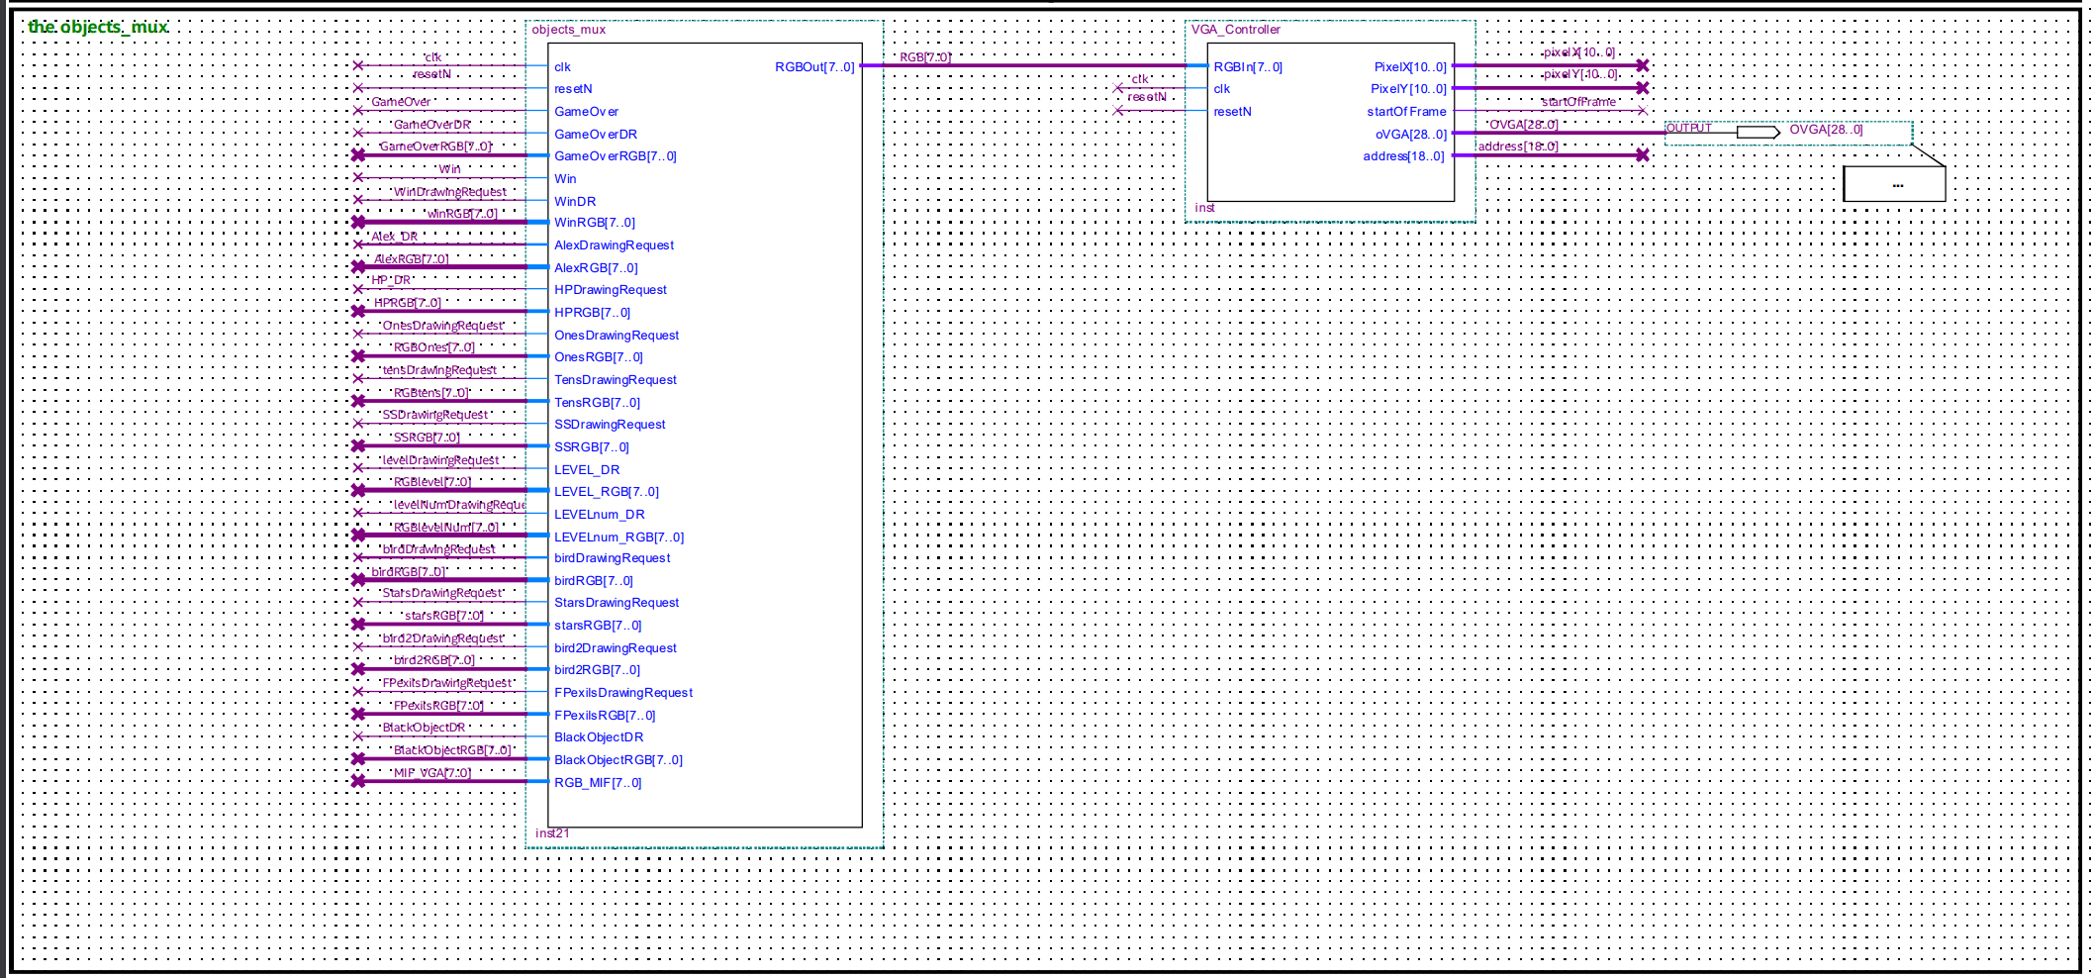

Slide 25
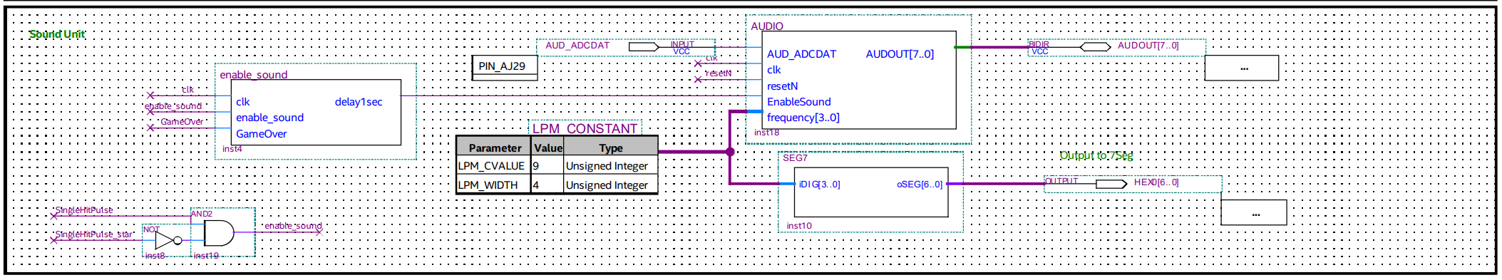

Slide 26
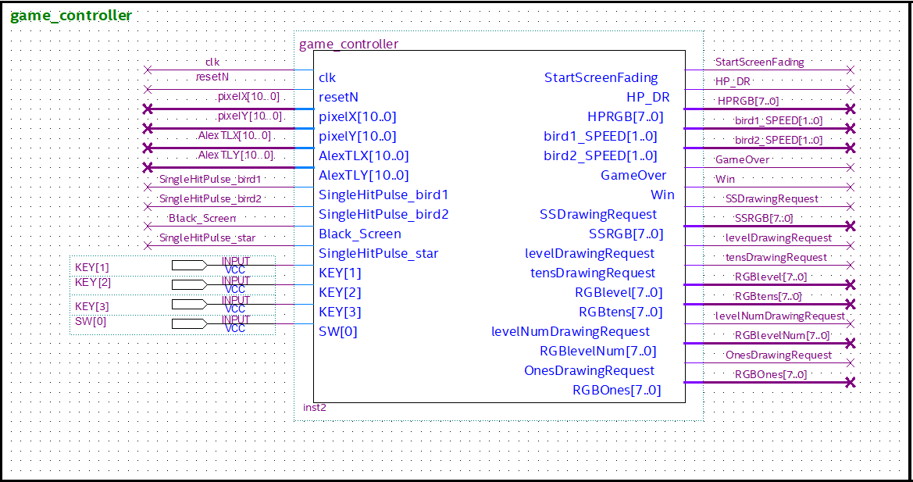
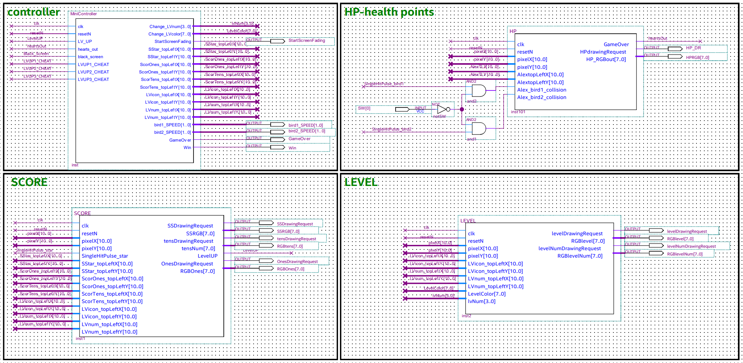
1st module

Slide 27
bubble diagram
win
resetN
LVUP
1st level
LVUP
2nd level
LVUP
3rd level
Hearts out
Hearts out
Game Over
Hearts out OR black screen

Slide 28
bubble diagram _cheats
Key[2]
Key[3]
resetN
1st level
LVUP
|| Key[1]
2nd level
LVUP
|| Key[2]
3rd level
LVUP
|| Key[3]
win
Hearts out
Hearts out
Game Over
Hearts out OR black screen

Slide 29
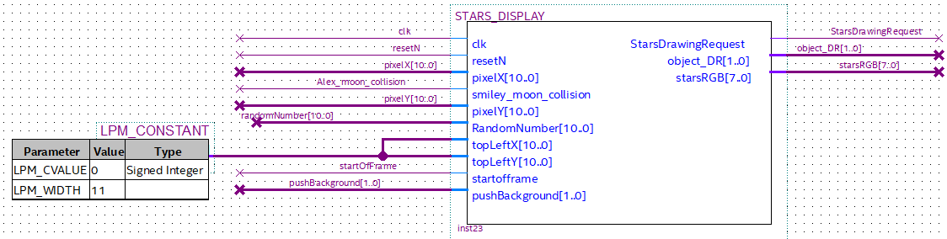
2nd module

Slide 30
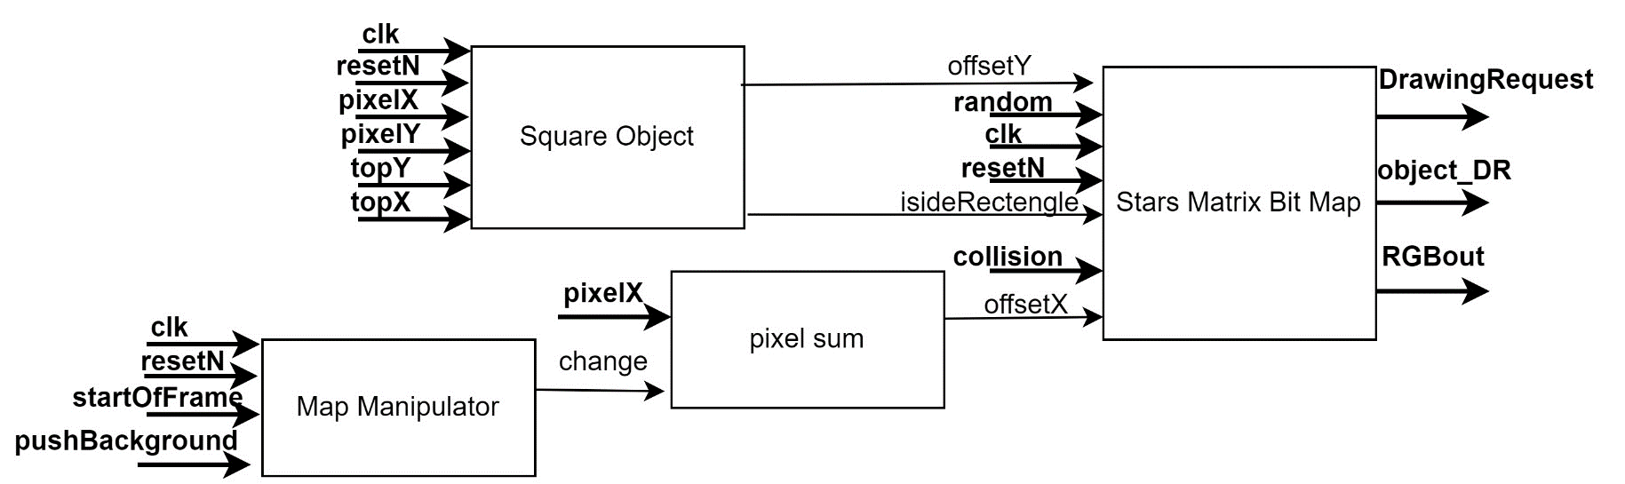
Blocks

Slide 31
Blocks

Slide 32
Blocks

Slide 33
1 | 0 | 2
2

Slide 34
1 | 0 | 2
2

Slide 35
rand

Slide 36
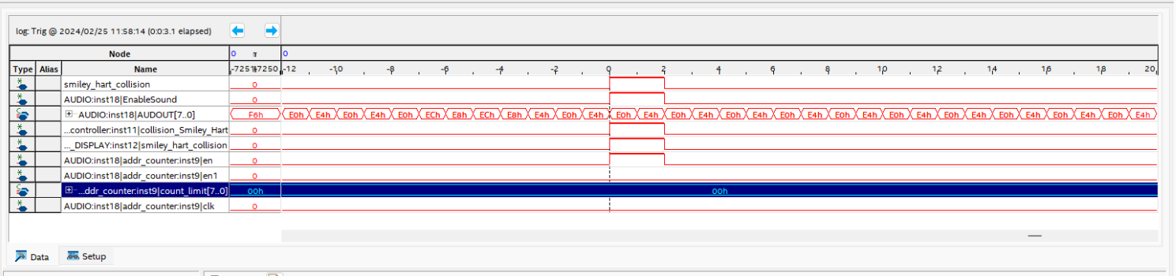
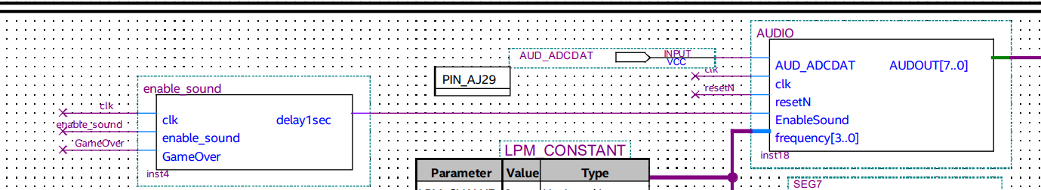
Signal Tap
While trying to add sound upon collision we had a bug.
We eventually found out the sound was , created but it was too short to hear.
smiley_hart_collision

Slide 37
Solution
Adding a counter before enable to extend the signal for half a second.

Slide 38
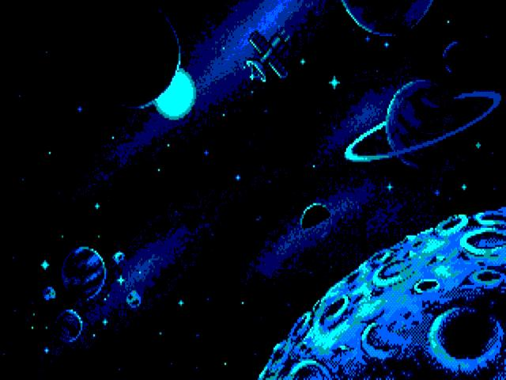
Conclusions
ליישם את כל מה שנלמד במהלך המעבדה
להיות יצרתיים
01
החברים שלנו למעבדה
תכנון פרוייקטים
05
02
עבודה בצוות
ניהול זמנים
04
03
כתיבת תוכנה וכתיבה בשפת חומרה
הסיגנל טאפ

