Slide 1
Bi-Weekly Presentation
Tom-Ole Korbach
Anton Wagner

Slide 2
1
The Approach
2
The Problem
3
The Solution?
4
Timeline

Slide 3
Bachelor Thesis
Automatic Generation of 3D Environment Models from Robot Sensor Data

Slide 4
The Approach
1

Slide 5
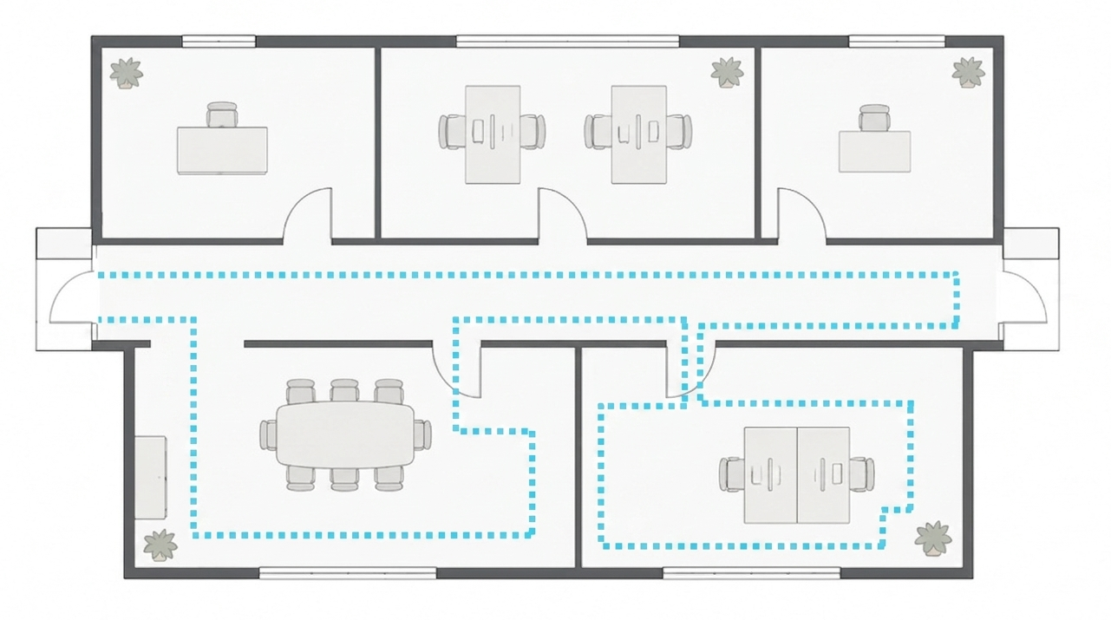
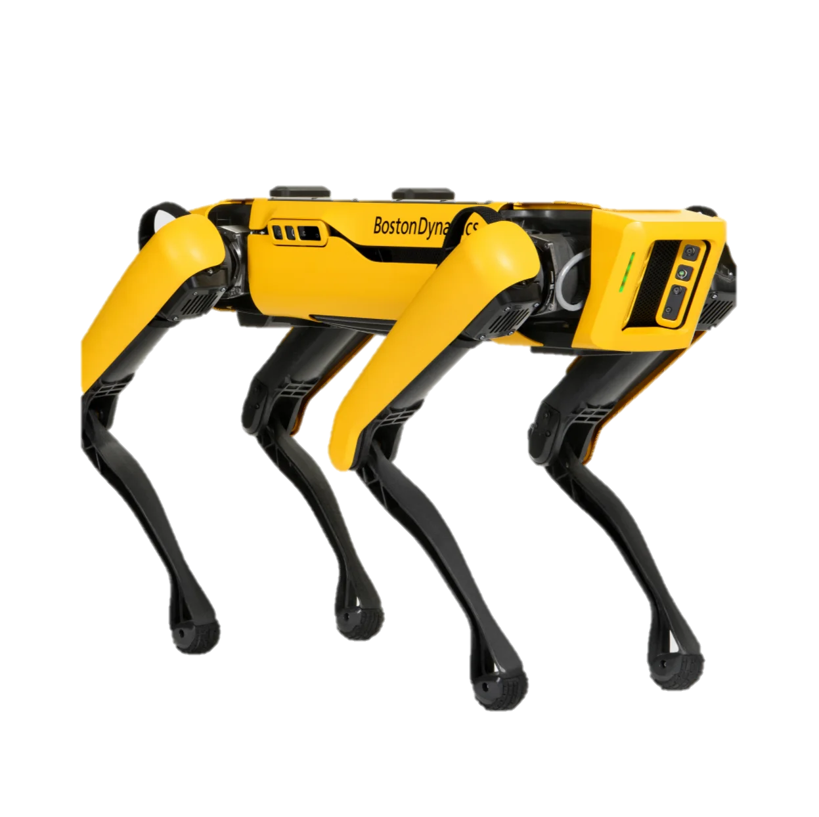
The Approach
Manually walk a path

Slide 6
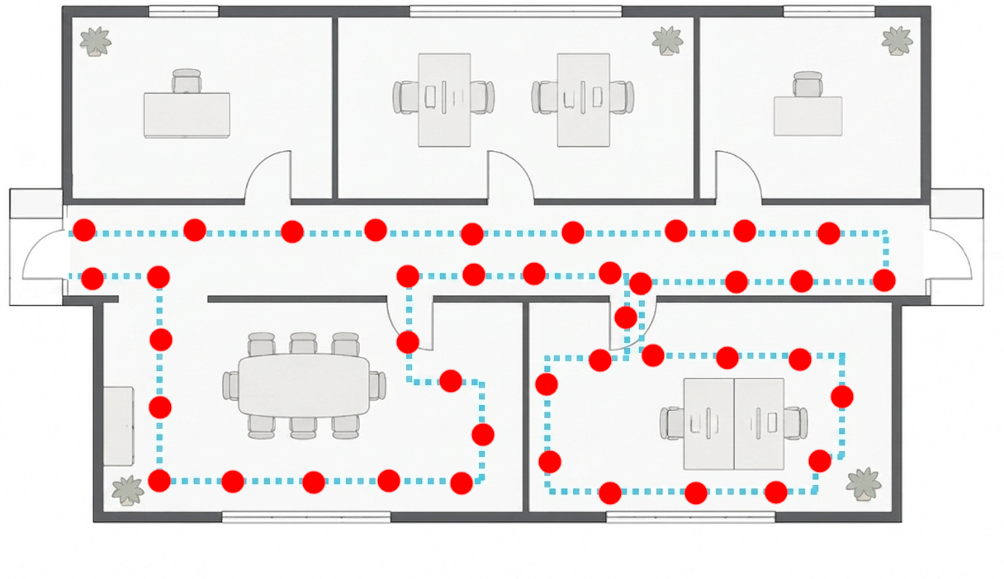
The Approach
Automatically creating waypoint
E.g. every 1m

Slide 7
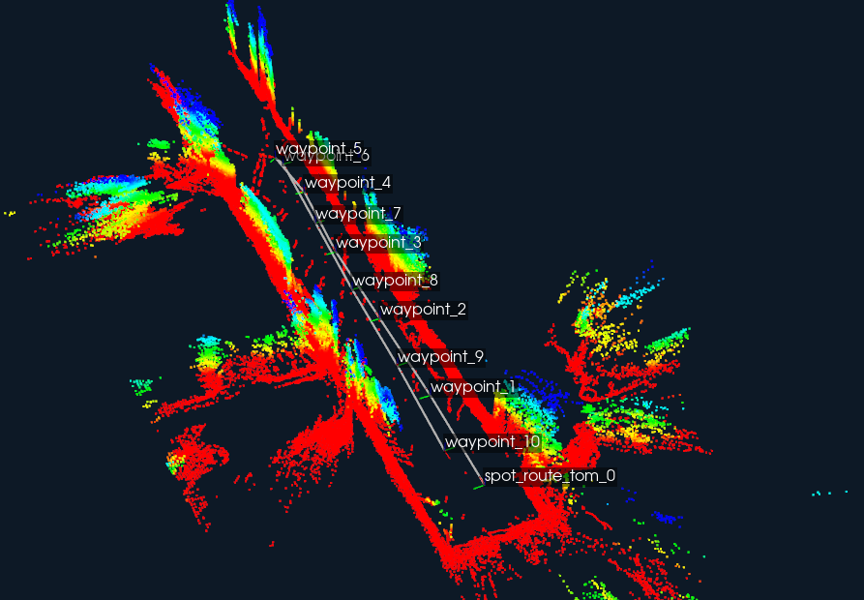
The Approach

Slide 8
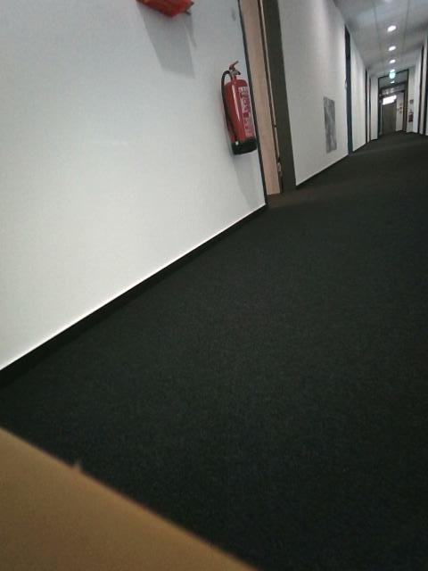

The Approach

Slide 9
The Problem
2

Slide 10
The Problem
Walk the recorded Path

Slide 11

The Problem

Slide 12

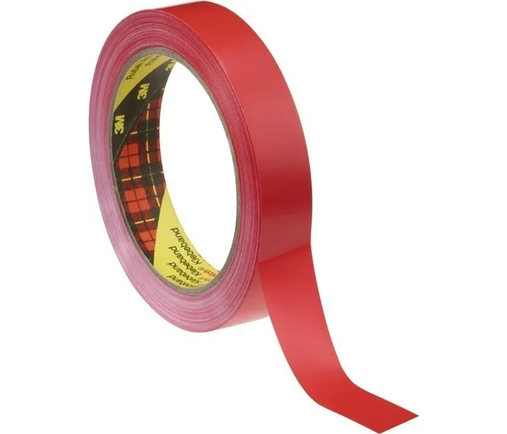
The Problem
April Tags
Visual Markers
Slower Speed

Slide 13
The Solution?
3

Slide 14
The Solution?

Slide 15
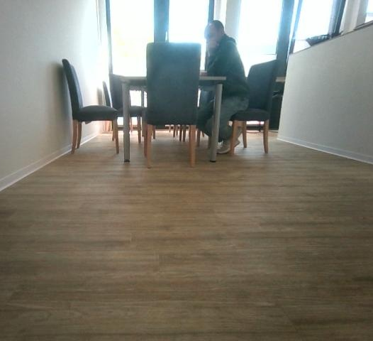
The Solution?
Humans in almost all Points
Stronger Preprocessing
No identical routes

Slide 16
Timeline
4

Slide 17
Timeline

Slide 18
Questions?
5

