Slide 1
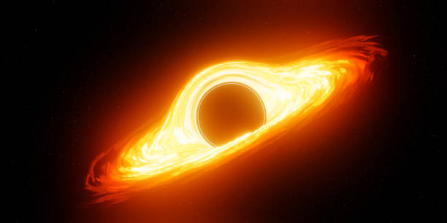
Space: The Penultimate Frontier
Then moving on to time!

