Slide 1
Building a Serverless Customer Service Chatbot

Slide 2
Who am I?
Tommy Englert
twitter @tommyenglert
Senior Data Analyst at ASRC Federal
BS Decision Sciences at ODU
Graduate Candidate (April 2018) MS in Decision Analytics at VCU

Slide 3
Let’s take a brief look at some key data science concepts/tools involved with this project!

Slide 4
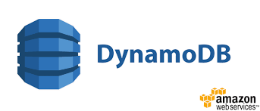
Let’s take a brief look at some key data science concepts/tools
SQL
NoSQL
SELECT * FROM customer_tbl WHERE last_name = ‘Smith’;
GET customer.first_name, customer.last_name, customer.productid. * where last_name = ‘Burbank’
custID | last_name | first_name
101 | Smith | Deb
102 | Smith | Chris
203 | Smith | Steve
204 | Smith | Josiah
Key | Value
7461117 | First_Name: Allen Last_Name: Burbank Productid: 2010:8
1245568 | First_Name: Glenda Last_Name: Burbank Productid: 2917:8 1094: 9
8675309 | First_Name: Jacob Last_Name: Burbank Productid: 2099:8

Slide 5

Let’s take a brief look at some key data science concepts/tools
Elasticsearch is a search engine based on Lucene. It provides a distributed, multitenant-capable full-text search engine with an HTTP web interface and schema-free JSON documents
https://www.elastic.co/products/elasticsearch
Fast, Scalable and Flexible
Client Libraries include: Java, C#, Python, JavaScript, PHP, Perl and Ruby

Slide 6
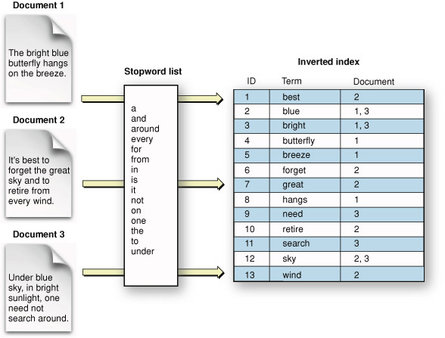
Let’s take a brief look at some key data science concepts/tools
Apache Lucene is a high-performance, full-featured text search engine library written entirely in Java.
Suitable for nearly any application that requires full-text search, especially cross-platform.
https://lucene.apache.org/
Great overview at
http://karthikkumar.me/intro-to-lucene

Slide 7
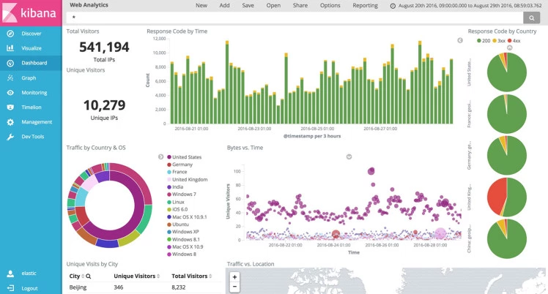

Let’s take a brief look at some key data science concepts/tools
Kibana is an open source analytics and visualization platform designed to work with Elasticsearch
Kibana makes it easy to understand large volumes of data.
Its simple, browser-based interface enables you to quickly create and share dynamic dashboards that display changes to Elasticsearch queries in real time.

Slide 8
Let’s take a brief look at some key data science concepts/tools
NLP
Natural Language Processing, or NLP for short, is broadly defined as the automatic manipulation of natural language, like speech and text, by software.
NLTK
Natural Language Toolkit - NLTK is a leading platform for building Python programs to work with human language data.
It provides easy-to-use interfaces to over 50 corpora and lexical resources such as WordNet, along with a suite of text processing libraries for classification, tokenization, stemming, tagging, parsing, and semantic reasoning, wrappers for industrial-strength NLP libraries

Slide 9
Let’s take a brief look at some key data science concepts/tools
English Snowball Stemmer
Stemming is used as an approximate method for grouping words with a similar basic meaning together.
Fish <- fishing, fished, fisher
Demo can be found here http://snowballstem.org/demo.html

Slide 10
Let’s take a brief look at some key data science concepts/tools
Vader
Included in NLTK
Used to perform Sentiment Analysis (neg, positive, neutral)
Better equipped than other analyzers to handle social media data
This movie was the SHIT!
My burrito was the bomb
WHY AM I SO BAD AT FANTASY FOOTBALL!!!!!
☺ :D

Slide 11
Brief overview of the project

Slide 12


Customers
Customers send our company a message via FB Messenger

Slide 13




Customers
Lambda Function
API GATEWAY
DynamoDB
The Lambda function is notified of an incoming message.
A copy of the message is automatically stored into DynamoDB

Slide 14


Customers
Lambda Function
API GATEWAY
NLP
DynamoDB
ElasticSearch
/knowledgebase
Lambda function strips out stop words, stems words, and checks to see if the message approximately matches any of our previous messages (KnowledgeBase)
If a message receives a high enough match score, a previous response is automatically returned to the customer

Slide 15


Customers
Customer Service Team
Approve/Reject
Lambda Function
API GATEWAY
NLP
DynamoDB
ElasticSearch
Query
/knowledgebase
If a message receives a low match score, best guess is sent to Customer Service team for approval/rejection
If Customer Service approves , the best guess response is sent to the customer
Customer Service can reject and send a different response.

Slide 16
Customers
Customer Service Team
Approve/Reject
Lambda Function
API GATEWAY
Sentiment Analysis
NLP
DynamoDB
ElasticSearch
Query
/messages
/knowledgebase
Sentiment Analysis (with Vader) is performed on the message

Slide 17


Customers
Customer Service Team
Approve/Reject
Lambda Function
API GATEWAY
Sentiment Analysis
NLP
DynamoDB
ElasticSearch
Query
/messages
/knowledgebase
Real-time Sentiment Metrics in Kibana
Management

Slide 18
Time Check!
Let’s ask Chris, Dan, and/or Deb if we have enough time left for a live (albeit quick) demonstration of the project

Slide 19
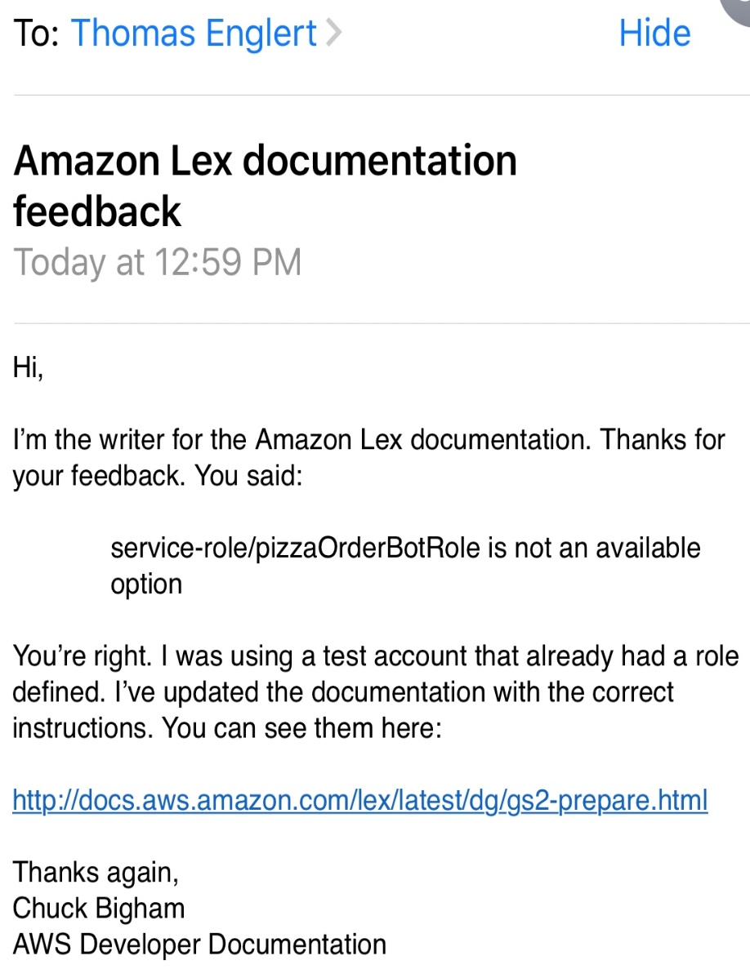
Lessons Learned
Difficult to navigate AWS Documentation for various services they provide
AWS Documentation may be outdated/incorrect

Slide 20
Lessons Learned
Must properly submit messenger application approvals to Facebook
Web Browsers: Chrome vs Firefox vs Edge
Snapshots of ElasticSearch clusters are a good idea
Security in real life
A more structured approach to collecting test data (see next slide for examples)

Slide 21
People are Unpredictable
You are the supreme ruler of the black hole of suckyness that is your Company.
w0w, 1'v3 n3v3r 533n 4ny7h1n6 45 4m4z1n6 45 y0ur pr0duc75. 7h3 1nf3c710n w3n7 4w4y 1mm3d1473ly, wh1ch w45 1mp0r74n7 b3c4u53 1 h4d 4 h07 d473!
I purchased a shrink ray about a month ago and it isn't shrinking my student loans. When I point it at the studentloans.gov website, it just shrinks the computer. Can you please provide assistance?
He's cuuuute!

Slide 22
Next Steps
Visit AWS github page https://github.com/awslabs
Try working your way through their more recent workshop https://github.com/awslabs/aws-serverless-workshops
Looking for something harder??? https://github.com/awslabs/aws-lambda-zombie-workshop
requires you to spend some $$$ for IoT equipment

Slide 23
Thank You!
Any (easy) Questions?
References:
AWSLabs
AWS Documentation and Tutorials
O’Reilly Online Training – Building Lex Bots

