Slide 1



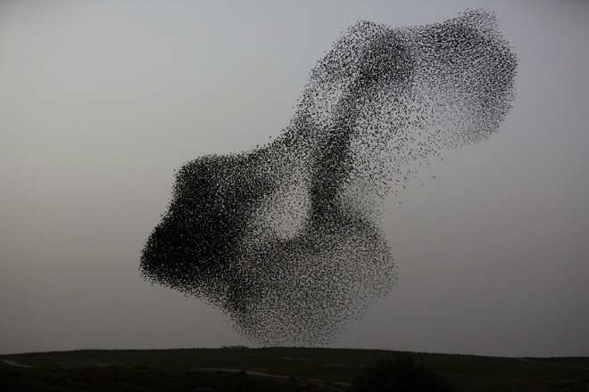
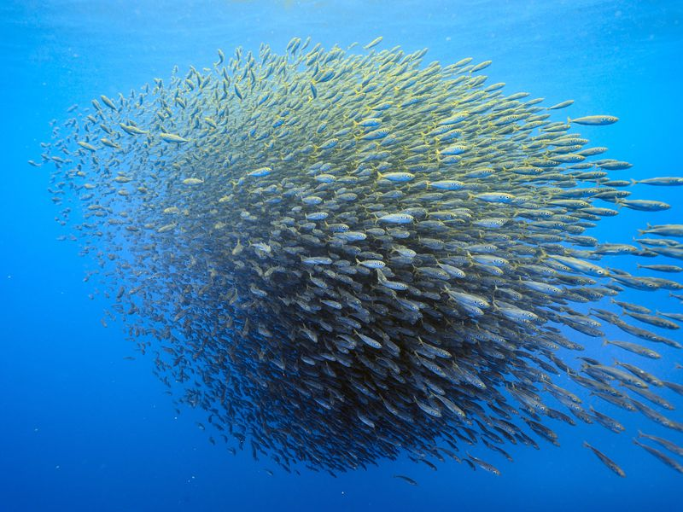
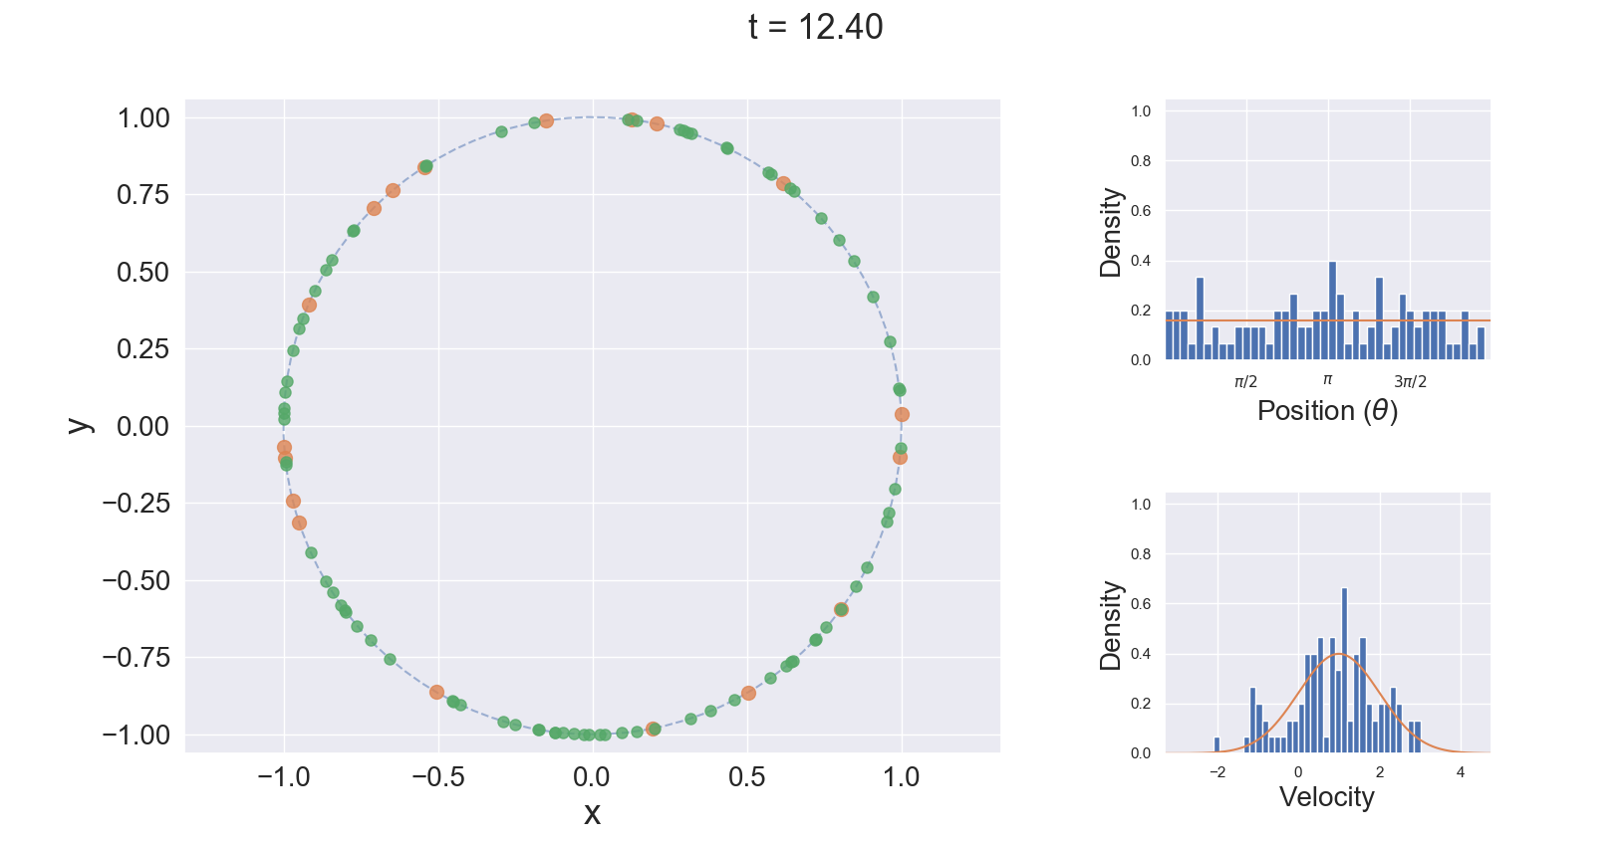
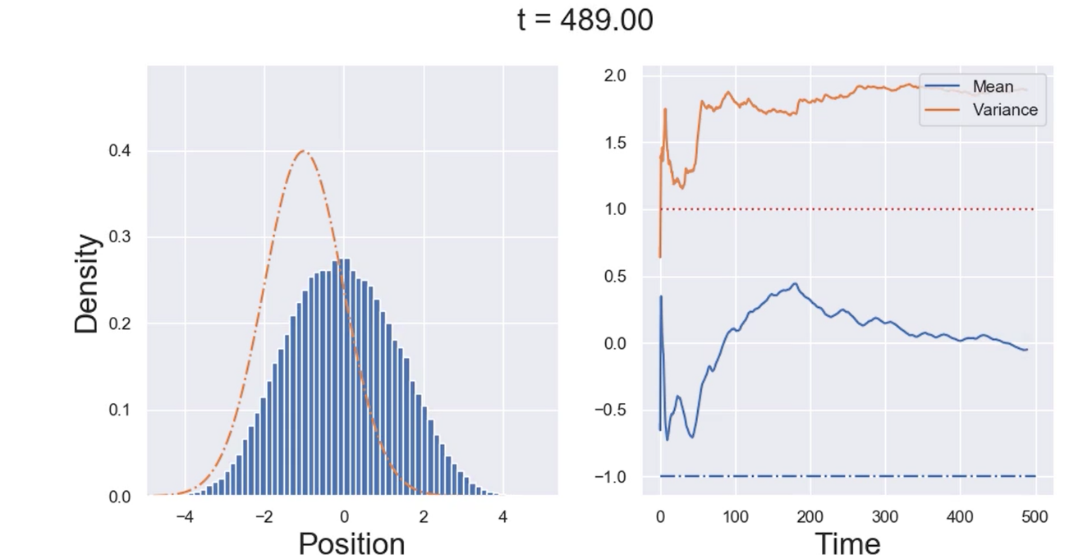
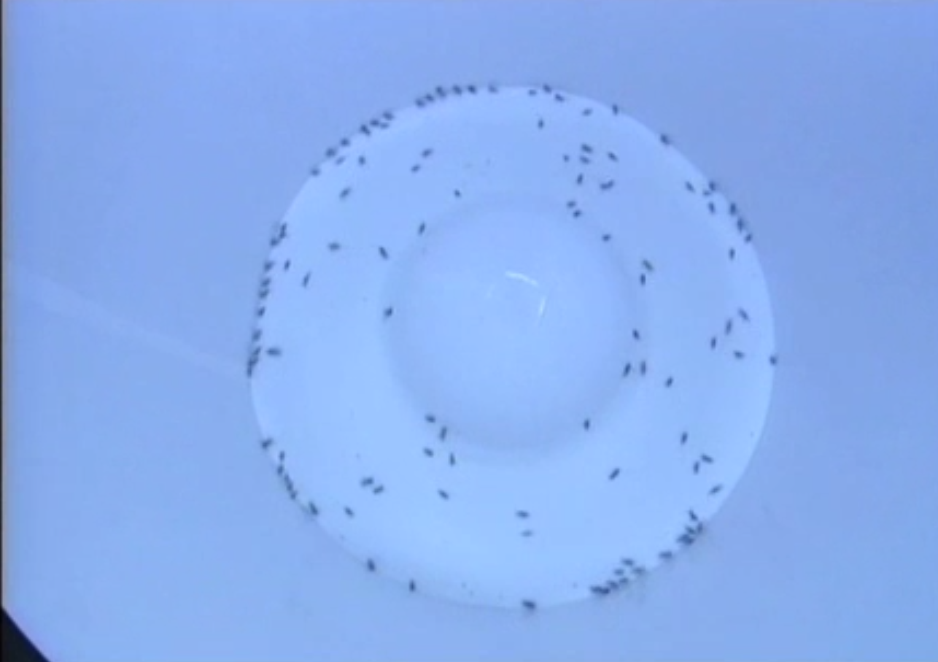
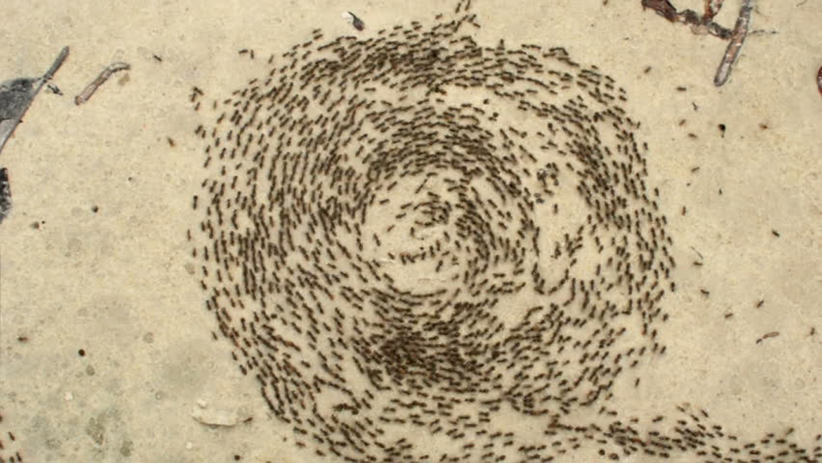
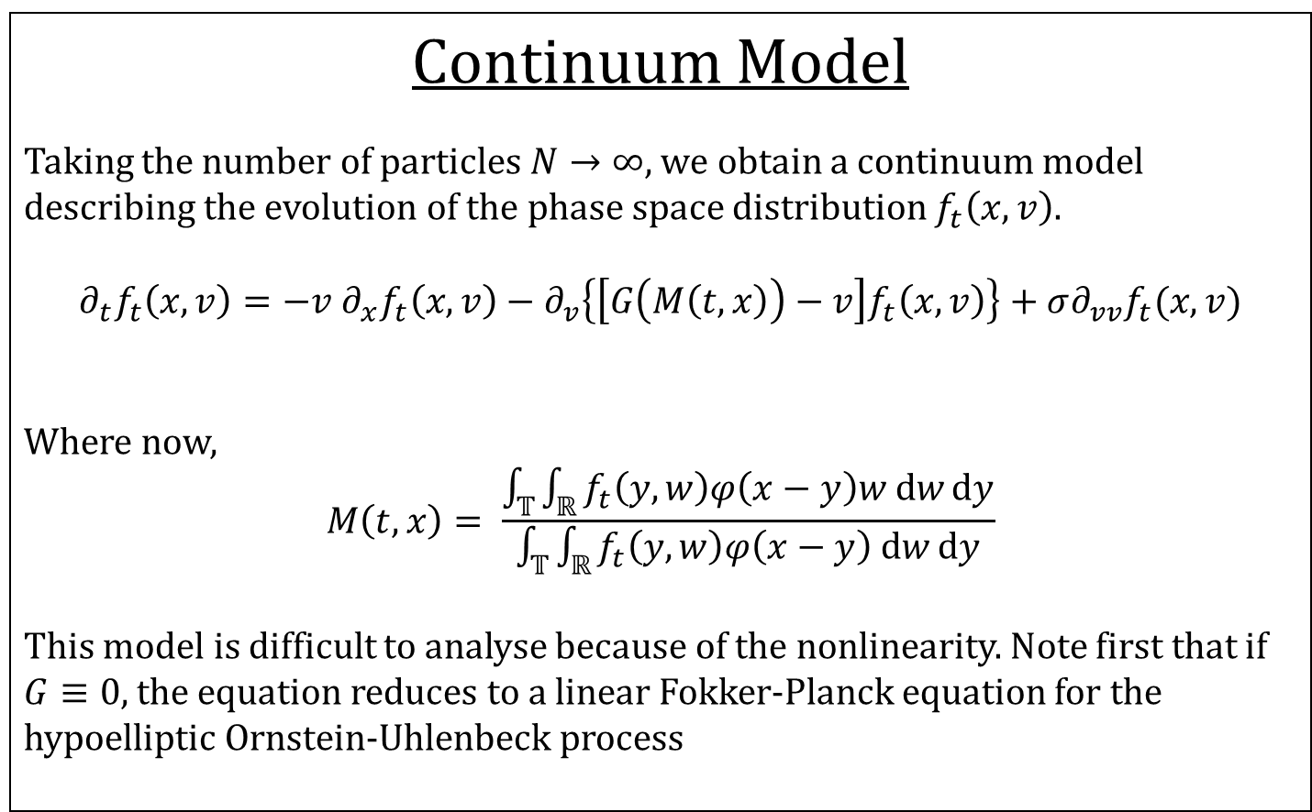

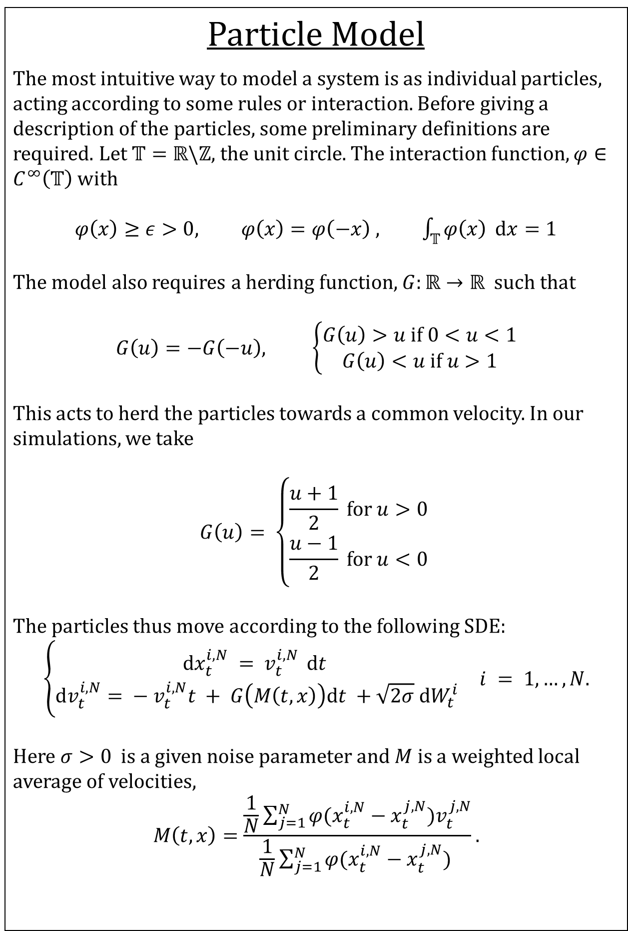
Comparing Continuous and Interacting Particle Models for Swarm Behaviour
Thomas Hodgson
Supervised by Dr Michela Ottobre and Prof. Kevin Painter
Motivation
Swarming behaviour and ordered collective motion are ubiquitous in nature. Most species, when present in large numbers, will interact in some way occasionally producing spectacular patterns. Two classic examples of this are murmurations of starlings and schooling of fish.
These systems are widely represented in two ways: either as an interacting particle system or a continuum model. The aim of our research is to investigate the link between these models for the Vicsek model on the 1-torus \ref++++ .
Continuum Model
Taking the number of particles $N→∞$, we obtain a continuum model describing the evolution of the phase space distribution $f_{t}\left(x,v\right).$
$$∂_{t}f_{t}\left(x,v\right)=−v ∂_{x}f_{t}\left(x,v\right)−∂_{v}\left\{\left[G\left(M\left(t,x\right)\right)−v\right]f_{t}\left(x,v\right)\right\}+σ∂_{vv}f_{t}(x,v)$$
Where now,
$$M\left(t,x\right)= \frac{\int_{𝕋}{\int_{ℝ}{f_{t}\left(y,w\right)φ\left(x−y\right)w \text{d}w}\text{d}y}}{\int_{𝕋}{\int_{ℝ}{f_{t}\left(y,w\right)φ\left(x−y\right) \text{d}w}\text{d}y}}$$
This model is difficult to analyse because of the nonlinearity. Note first that if $G≡0,$the equation reduces to a linear Fokker-Planck equation for the hypoelliptic Ornstein-Uhlenbeck process
Numerical Simulation
PDE simulation? Comparison to particle system. Switch?
Invariant Measures under Space Homogeneity
If we look only for space-homogeneous solutions, we can in fact close equations on the moments of the distribution $f_{t}.$ Doing so leads to the following ODEs for the first three moments:
$${\dot{M}}_{0}=0$$
$${\dot{M}}_{1}=G\left(M_{1}\right)−M_{1}$$
Particle Model
The most intuitive way to model a system is as individual particles, acting according to some rules or interaction. Before giving a description of the particles, some preliminary definitions are required. Let $𝕋=ℝ\backslash ℤ$, the unit circle. The interaction function, $φ∈C^{∞}\left(𝕋\right)$ with
$φ\left(x\right)≥ε>0, φ\left(x\right)=φ\left(−x\right) , \int_{𝕋}{φ\left(x\right) }\text{d}x=1$
The model also requires a herding function, $G:ℝ→ℝ$ such that
$$G\left(u\right)=−G\left(−u\right), \left\{\begin{aligned}G\left(u\right)>u \text{if} 0<u<1 \\ G\left(u\right)<u \text{if} u>1\end{aligned}\right.$$
This acts to herd the particles towards a common velocity. In our simulations, we take
$$G\left(u\right)= \left\{\begin{aligned}\frac{u+1}{2} \text{for} u>0 \\ \frac{u−1}{2} \text{for} u<0\end{aligned}\right.$$
The particles thus move according to the following SDE:
$$\left\{\begin{aligned}\text{d}x_{t}^{i,N} = v_{t}^{i,N } \text{d}t \\ \text{d}v_{t}^{i,N}= −{ v}_{t}^{i,N}t + G\left(M\left(t,x\right)\right)\text{d}t +\sqrt{2σ} \text{d}W_{t}^{i}\end{aligned}\right. i = 1,…,N.$$
Here $σ>0$ is a given noise parameter and $M$is a weighted local average of velocities,
$$M\left(t,x\right)=\frac{\frac{1}{N}\sum_{j=1}^{N}{φ(x_{t}^{i,N}−x_{t}^{j,N})v_{t}^{j,N}}}{\frac{1}{N}\sum_{j=1}^{N}{φ(x_{t}^{i,N}−x_{t}^{j,N}) }}.$$
Next Steps
Now a scheme for the space-homogeneous case has been developed we wish to extend to the full system. The aim is to find an invariant measure of the particle system that is not uniform in space. That is, the diffusion in velocity does not affect the position.
From a biological viewpoint, Couzin et al. have observed ordered motion in locusts when restricted to a circle
References
P. Buttà, F. Flandoli, M. Ottobre, and B. Zegarlinski. A non-linear kinetic model of self-propelled particles with multiple equilibria. Kinetic & Related Models, 12(4):791–827, 2019.
Schooling Fish, Brian J. Skerry/National Geographic Society/Corbis; Murmuration, Menahem Kahana / AFP / Getty

