Slide 1
Logarithmic
&
Exponential
Functions

Slide 2

$$a^{x}$$
X is a positive integer

Slide 3
$$=a∗a∗a…. (x times)$$

Slide 4

$$a^{−x}$$
X is a positive integer

Slide 5

$$\frac{1}{a^{x}}$$

Slide 6
$$a^{x}∗a^{y}$$

Slide 7
$$a^{x+y}$$

Slide 8

$$\frac{a^{x}}{a^{y}}$$

Slide 9
$$a^{x−y}$$

Slide 10
$$({a^{x})}^{y}$$

Slide 11
$$a^{xy}$$

Slide 12
$$a^{0}$$

Slide 13
$$1$$

Slide 14
$$a^{x/y}$$

Slide 15
X is the power, y is the root

Slide 16

Radical form for…
$$a^{m/n}$$

Slide 17

$\sqrt[n]{a^{m}}$ or ${(\sqrt[n]{a})}^{m}$

Slide 18

${\sqrt[n]{x}}^{n}$ , where n is even

Slide 19
$$\left|x\right|$$

Slide 20
e =
(2 diff expressions)

Slide 21

${\left(1+\frac{1}{x}\right)}^{x}$as $x→∞$
or
${\left(1+x\right)}^{1/x}$ as $x→0$

Slide 22
e is approximately…

Slide 23
2.718…

Slide 24
$$f\left(x\right)=b^{x}, b>1$$

Slide 25
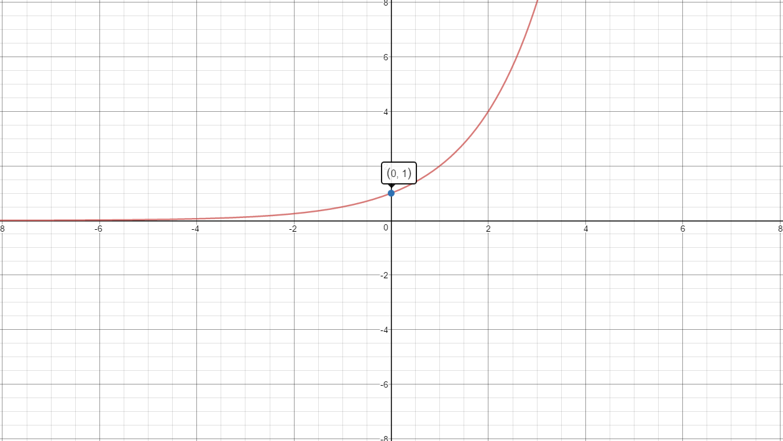

Slide 26
$$f\left(x\right)=b^{x}, 0<b<1$$

Slide 27
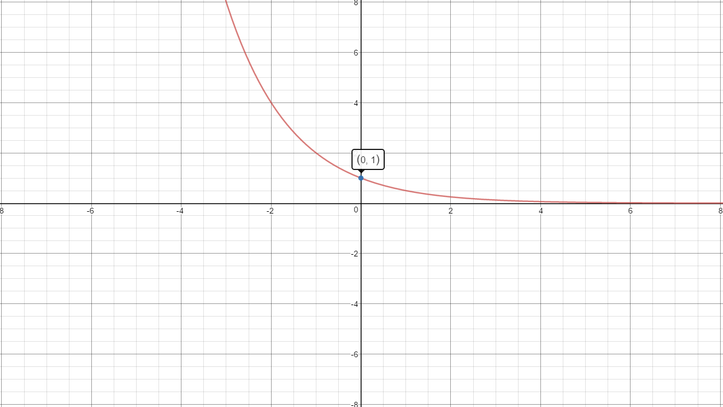

Slide 28
$$f\left(x\right)=e^{x}$$

Slide 30
$$\log_{a}(xy)$$

Slide 31
$$\log_{a}\left(x\right)+\log_{a}(y)$$

Slide 32

$$\log_{a}\left(\frac{x}{y}\right)$$

Slide 33
$$\log_{a}\left(x\right)−\log_{a}(y)$$

Slide 34
$$\log_{a}\left(x^{y}\right)$$

Slide 35
$$y∗\log_{a}\left(x\right)$$

Slide 36
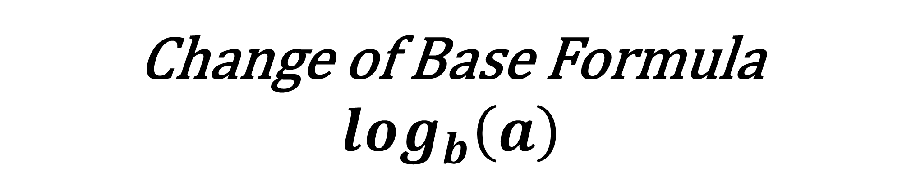
Change of Base Formula
$$\log_{b}\left(a\right)$$

Slide 37

$$\frac{log a}{log b}=\frac{ln a}{ln b}$$

Slide 38
$$ln(1)$$

Slide 39
$$0$$

Slide 40
$$ln(e)$$

Slide 41
$$1$$

Slide 42
$$f\left(x\right)=\log_{b}(x), b>1$$

Slide 43
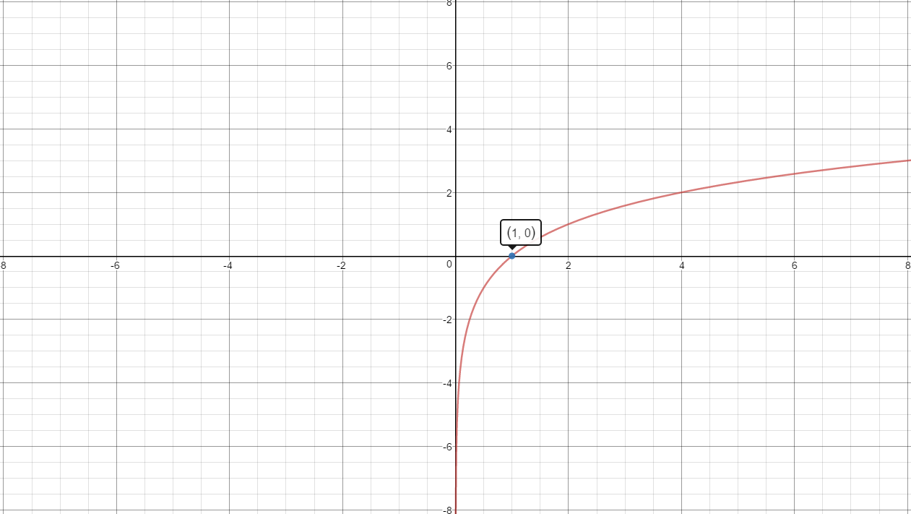

Slide 44
$$f\left(x\right)=\log_{b}\left(x\right), 0<b<1$$

Slide 45
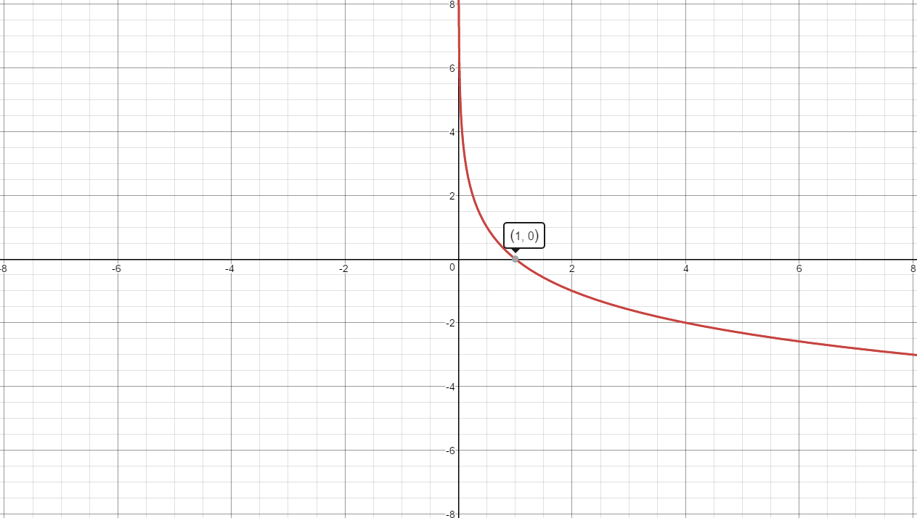

Slide 46
$$f\left(x\right)=ln x$$

Slide 48

$$Investment equation$$
Simple interest
A=

Slide 49

$$A=P\left(1+rt\right)$$
P=principle
r = interest rate (decimal)
t = # of years

Slide 50

$$Investment equation$$
Compound interest
A=

Slide 51

$$A=P{\left(1+\frac{r}{n}\right)}^{nt}$$
P=principle
r = interest rate (decimal)
t = # of years

Slide 52

$$Investment equation$$
Continuous interest
A=

Slide 53

$$A=P{\left(e\right)}^{rt}$$
P=principle
r = interest rate (decimal)
t = # of years

Slide 54

$$Population Growth$$
y =

Slide 55

$$y=B{\left(e\right)}^{kt}, k>0$$

Slide 56

$$Radioactive Decay$$
y =

Slide 57

$$y=B{\left(e\right)}^{kt}, k<0$$

Slide 58

$$Population Growth$$
Model

Slide 59
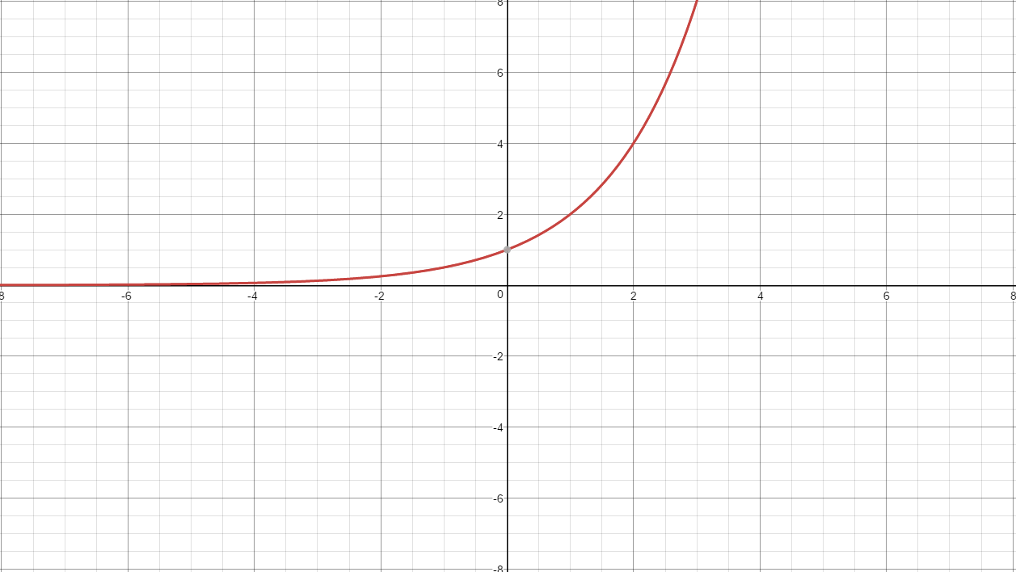

Slide 60

$$Radioactive Decay$$
Model

Slide 61
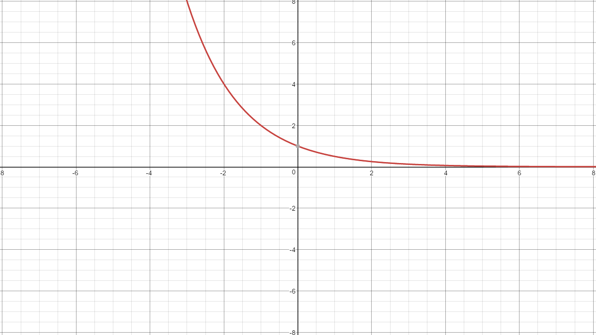

Slide 62

$$Bounded Growth$$
y =

Slide 63

$$y=A−B{\left(e\right)}^{−kt}, t≥0$$

Slide 64

$$Logistic Growth$$
y =

Slide 65

$$y=\frac{A}{1+Be^{−Akt}} t≥0$$

Slide 66

$$Bounded Growth$$
Graph

Slide 67
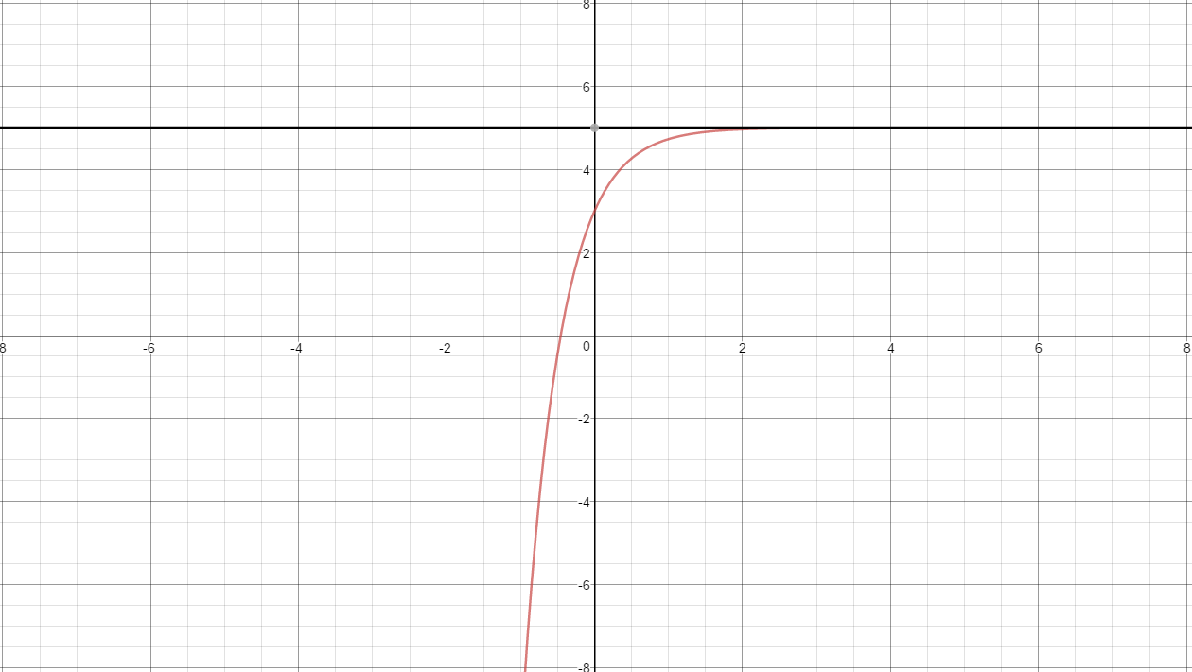
A
A-B

Slide 68

$$Logistic Growth$$
Graph

Slide 69
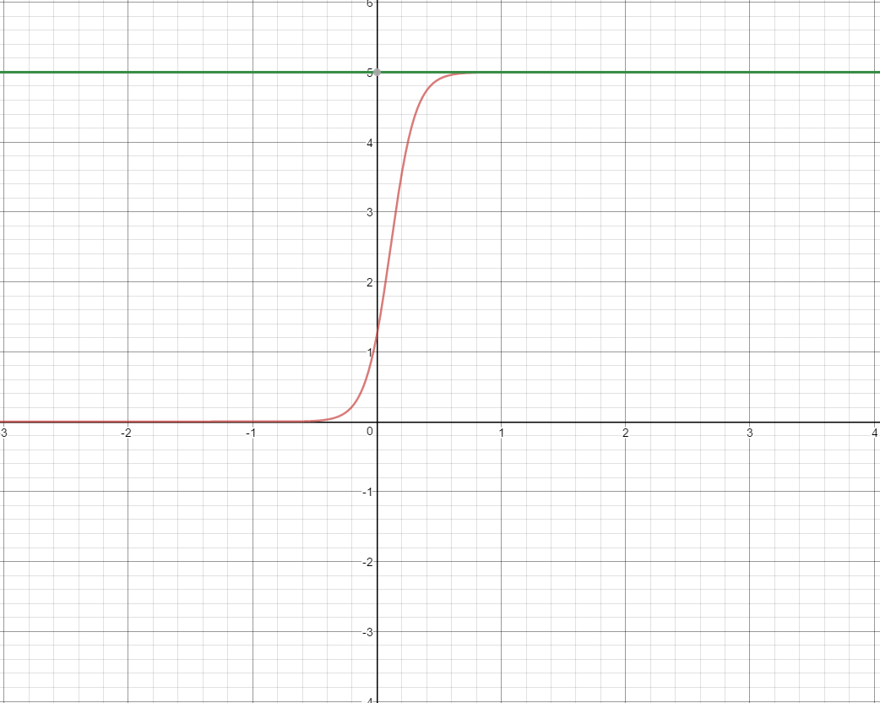
A
A/(1+B)

