Slide 1
Build and tune your own sequence aligner
Turning global and local alignment into a tool, then using it to ask which alignment is actually right.
A
C
G
T
A
C
G
T
A
-
G
C
A
T
G
A
A
C
G
-
A
G
G
T
A
C
G
C
A
T
G
A
Thomas | CMU Pre-College Computational Biology | Module 2
Notes:
One line opener: the algorithm is only half the story. The scoring you choose decides the answer, and this project is about how to tell a good answer from a bad one.

Slide 2
THE PROBLEM
Change the scoring, change the alignment
The same two sequences can line up sensibly or turn into nonsense, depending only on three numbers you pick:
The three knobs
Match reward
points for two letters that agree
So which alignment is right, and how would you know?
Mismatch penalty
points lost when two letters differ
Gap penalty
points lost for every dash inserted
Notes:
Set up the whole talk: there is no single correct alignment, only the best one for the scoring you chose.

Slide 3
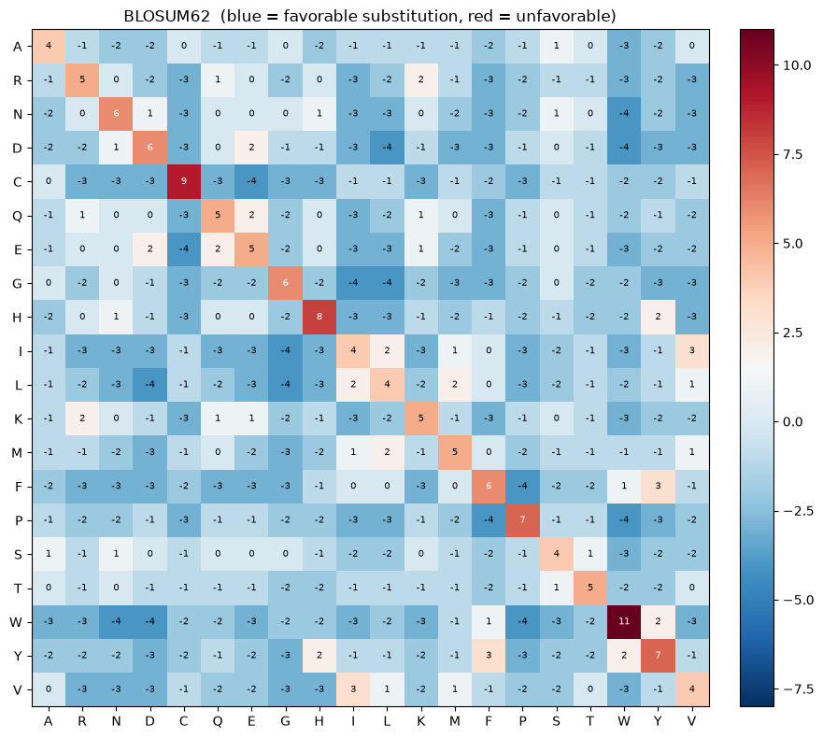
WHAT I BUILT
A tunable aligner that runs my own code
Sliders for match, mismatch, and gap
Switch between global and local alignment
Works on DNA and on protein
Protein scoring matrices: BLOSUM62 and PAM250
Reads out the alignment, score, percent identity, and gaps
Redraws live as you move the sliders
BLOSUM62, the protein scoring matrix the app uses
Notes:
Demo moment. Show the sliders moving and the alignment recoloring. Mention it runs the global and local code I wrote, generalized to proteins.

Slide 4
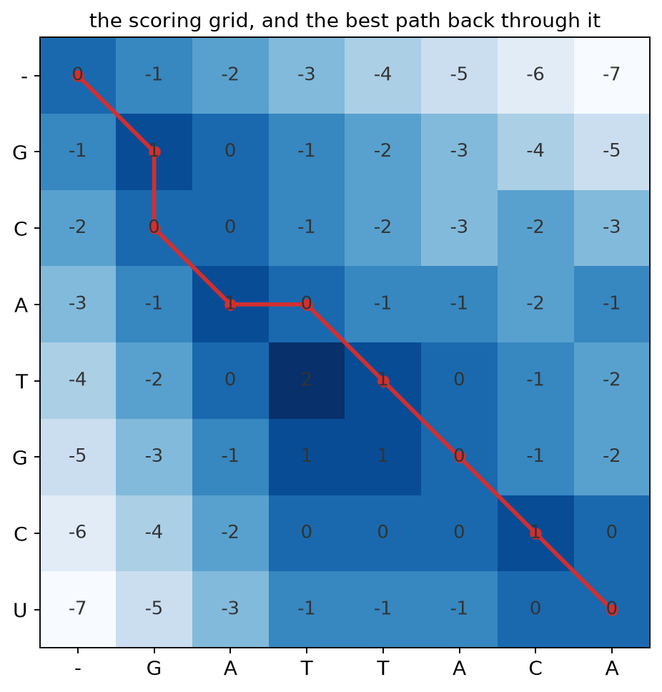
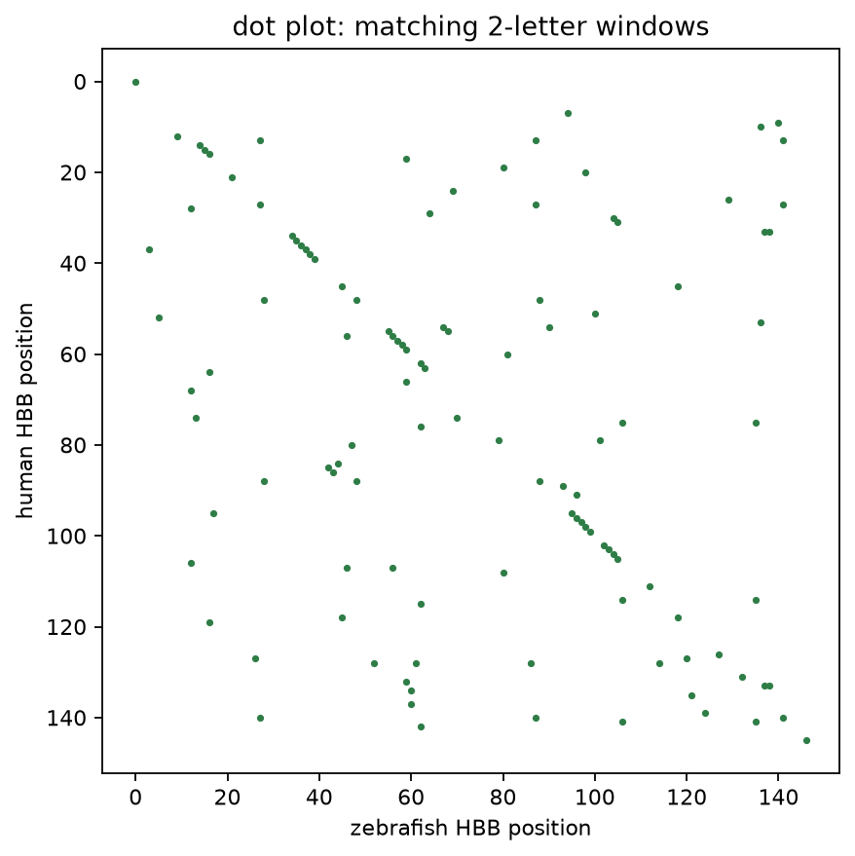
HOW IT WORKS
The aligner fills a grid, then walks back
Left: the scoring grid. Each box holds the best score for lining up everything up to that point. The red path back through it is the alignment.
Right: a dot plot. A dot marks every spot where the two sequences share a short piece. Related sequences make a diagonal line, and breaks in it are insertions or deletions.
Notes:
Two charts: how the grid is filled and walked back, and how a dot plot shows shared regions at a glance.

Slide 5
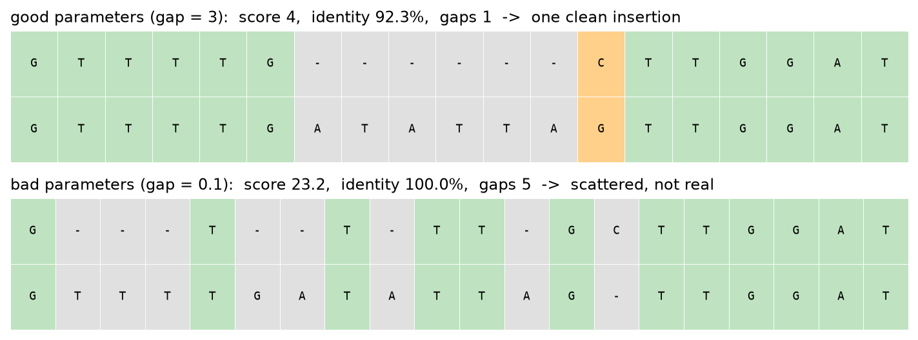
GOOD VS BAD PARAMETERS
A toy example makes it obvious
The bad settings score almost 6 times higher and reach 100 percent identity, but they are wrong. Only biology tells them apart: one clean insertion is believable, five scattered gaps are not.
Notes:
This is the core good-versus-bad story. Point at the scattered gaps in the bad panel.

Slide 6
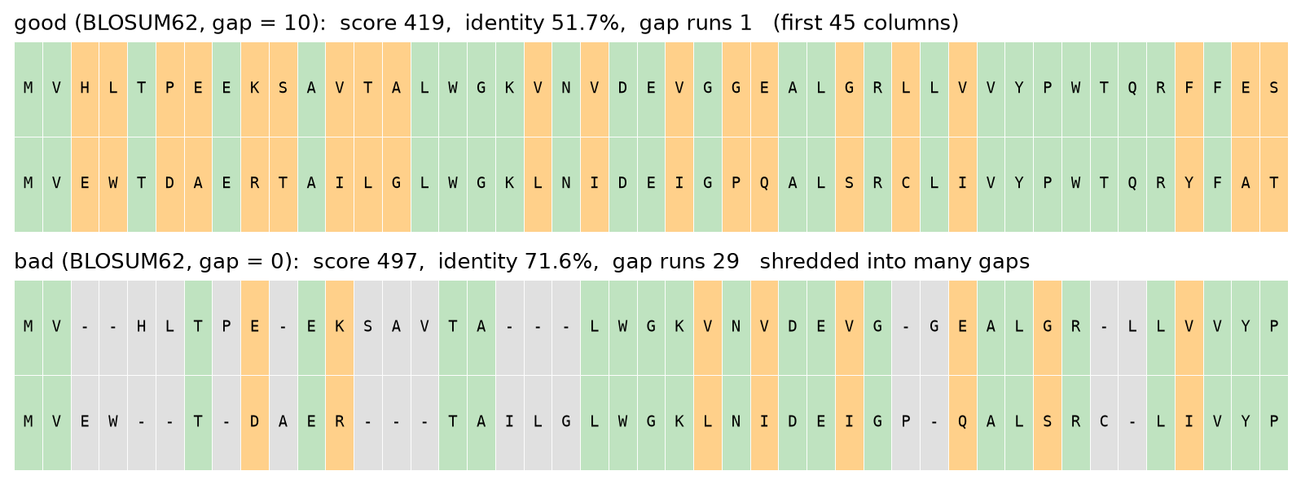
GOOD VS BAD PARAMETERS
The same trap on a real gene (hemoglobin beta)
Here both the score and the identity go up for the bad settings. The giveaway is the gap structure. 29 separate insert or delete events in one small protein is not believable.
raw score
separate gap runs
419 → 497
1 → 29
Notes:
Stronger than the toy: even identity favors the wrong answer here. Gap structure is what exposes it.

Slide 7
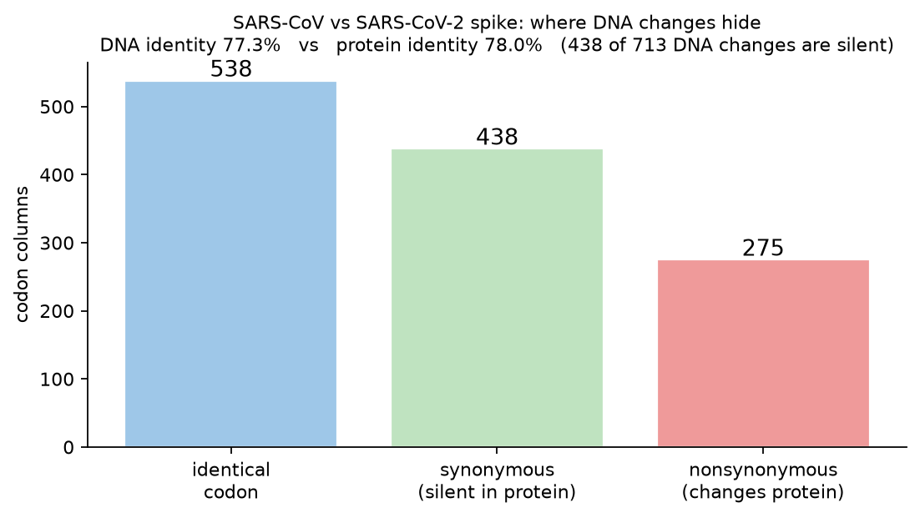
DNA VS PROTEIN
Why some mutations hide
SARS-CoV vs SARS-CoV-2 spike
I aligned the spike gene as DNA, then as the protein it codes for.
438 of the 713 DNA changes are synonymous. They change the DNA but not the protein.
The mutations that matter are the 275 that change the amino acid.
Notes:
The centerpiece. Synonymous changes show up in DNA and vanish in protein because the genetic code is redundant.

Slide 8
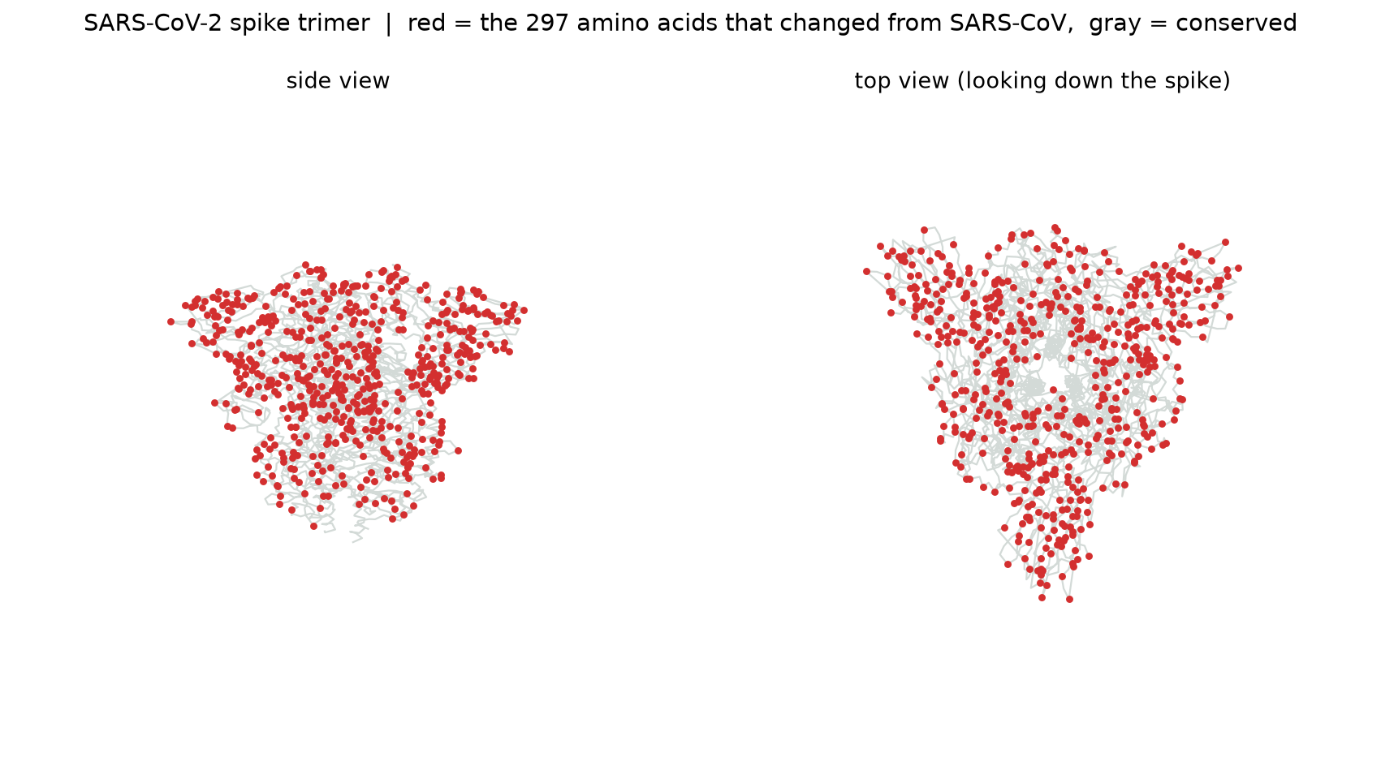
STRETCH: SEEING IT IN 3D
Where the changes land on the real spike
The same 297 changed amino acids (red) drawn on the real spike structure. Most of it is gray and conserved. The red clusters at the head, the part that grabs human cells and that antibodies target. The notebook has this as a picture and as a viewer you can rotate.
Notes:
Switch to the notebook here and rotate the interactive 3D structure. Red is changed, gray is conserved.

Slide 9
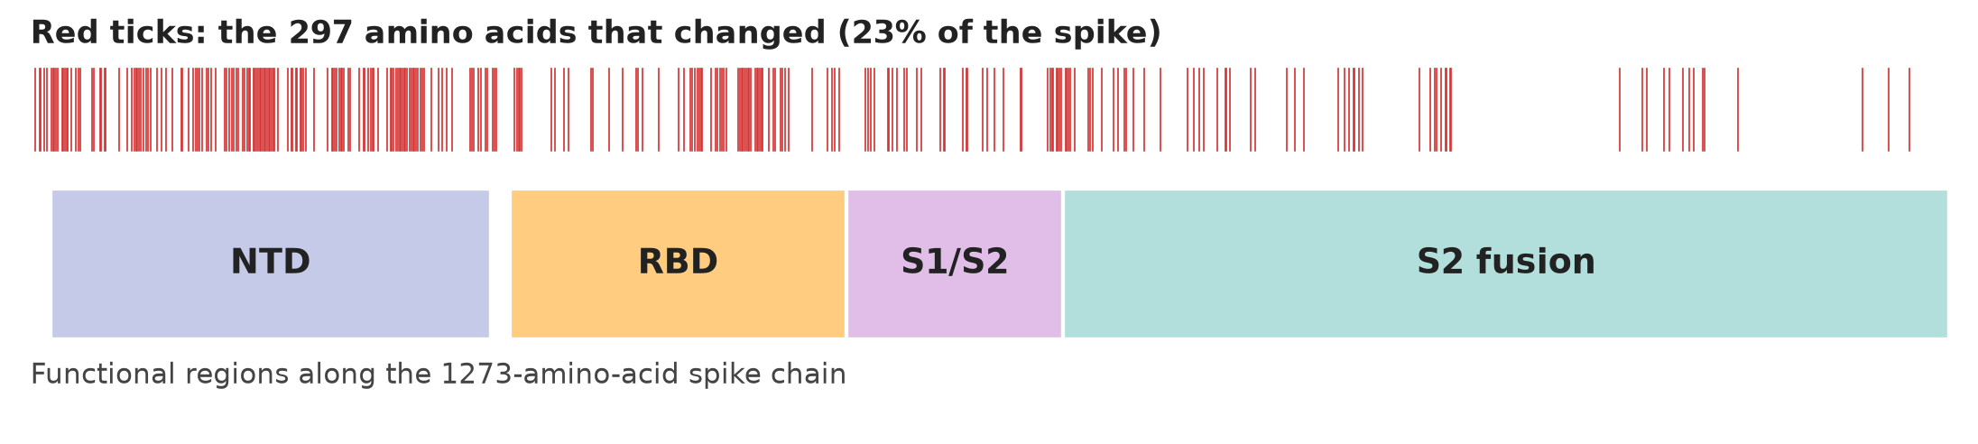
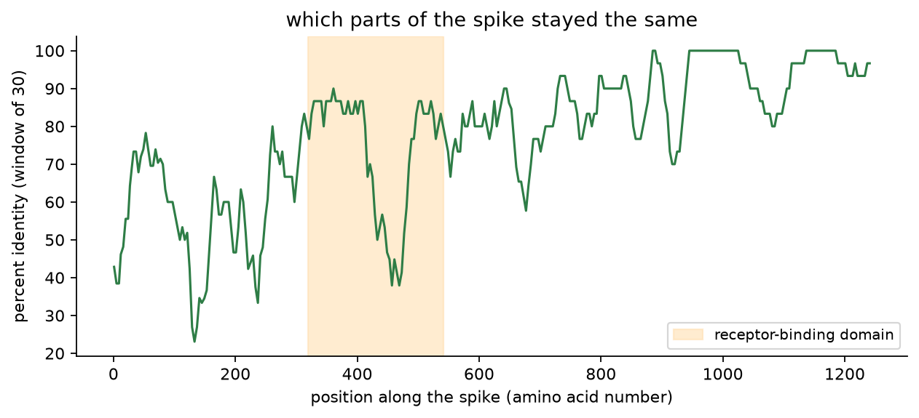
THE SARS CHANGES
Two more views along the sequence
Top: the 297 changed amino acids as red ticks along the 1273-amino-acid chain, with the functional regions marked.
Bottom: percent identity in a sliding window. The S2 fusion stalk stays high, while the host-facing NTD and receptor-binding domain dip the most.
Notes:
Two linear views that complement the 3D: where along the chain the changes fall, and the sliding-window identity.

Slide 10
THE CENTRAL QUESTION
How do you judge a good alignment?
The score cannot be the judge. It is defined by the knobs you picked, so raising the match reward makes any alignment score higher without making it more correct.
Percent identity. does not depend on your settings
Gap structure. a few long gaps beat many scattered ones
1
2
Conserved regions. do the known important parts line up
Better than chance. is the score real or just luck
3
4
Independent evidence. does a pro tool or the 3D structure agree
Believable history. are the implied mutations plausible
5
6
Notes:
This is the graded core. End on the bottom line: a good alignment is one whose story is biologically believable and holds up across reasonable settings, not the one with the biggest number.

Slide 11
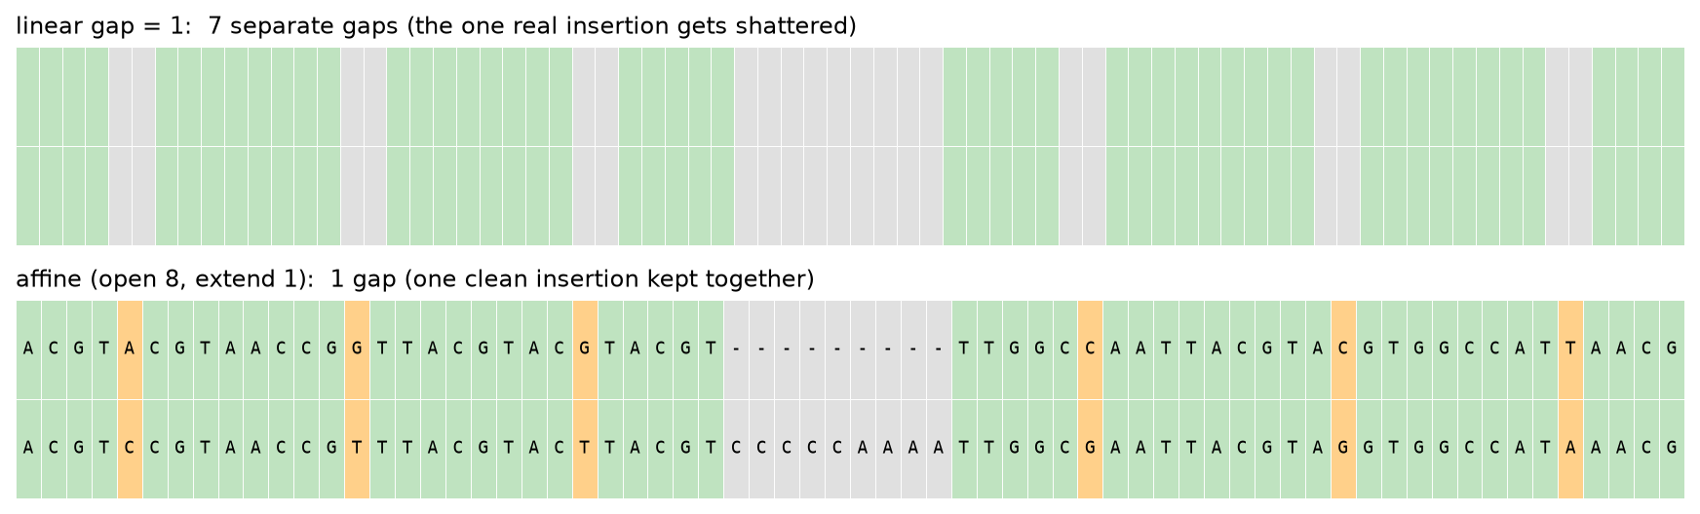
STRETCH: THE GAP PROBLEM
One gap penalty cannot do the job
With a flat penalty, a length-9 gap costs exactly the same as nine length-1 gaps, so no single value can both allow a real insertion and block scattered gaps. Affine gaps fix it: opening a gap is expensive, extending one is cheap.
Notes:
Explain that a real insertion is one event, so extending it should be cheap. Affine scoring matches the biology.

Slide 12
STRETCH: SANITY CHECK
Does my aligner agree with the pros?
777.0 optimal score
99.32% percent identity
My engine and Biopython (a tool professionals use) gave the exact same optimal score and identity on the same sequences with the same settings. Same optimum means the engine is correct. When there is a tie, two tools can show different-looking alignments that still score the same.
Notes:
Independent confirmation the engine is right, not just plausible.

Slide 13
The score rewards what you tell it to.
Biology decides what is true.
A tunable aligner, a good-versus-bad story, the DNA-versus-protein comparison, and a 3D view of the mutations that matter. Everything runs on my own alignment code.
Thank you. Questions welcome.
Notes:
Close on the one-liner, then invite the pointed questions.

