Slide 1
Analysis of 311 calls by zip-code
Bopanna Malachira
Purpose: I wanted to focus on the number of 311 complaints per zip-code & see how it relates to its population, income & crime rate.
Procedure: I extracted complaints per zip-code from our main 311 data-set. I then analyzed & extracted zip-code related data from other publicly available data-sets (population, median household income, crime-rate & renter percentage) using pandas. I then used matplotlib to depict the relationship.

Slide 2
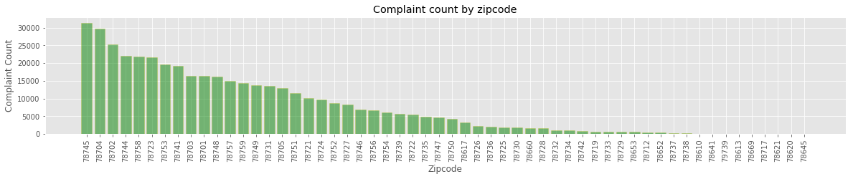
Complaint count by zip-code
Notes:
Complaint count by zip-code information extracted from Austin-311 call data(our primary data source)
The top-3 zipcodes based on complaint counts are
78745 (Sunset Valley)
2. 78704 (Zilker/Barton hills)
3. 78702 (Central-East Austin)

Slide 3
Complaint count by zip-code
Notes:
Complaint count by zip-code information extracted from Austin-311 call data(our primary data source)
The top-3 zipcodes based on complaint counts are
78745 (Sunset Valley)
2. 78704 (Zilker/Barton hills)
3. 78702 (Central-East Austin)

Slide 4
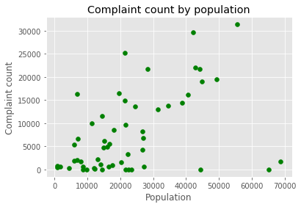
Relationship between complaint count & population
Notes:
From the scatter-plot, there appears to be a low positive correlation between complaint count & population of a zip-code
(Population per zip-code data is from 2010)

Slide 5
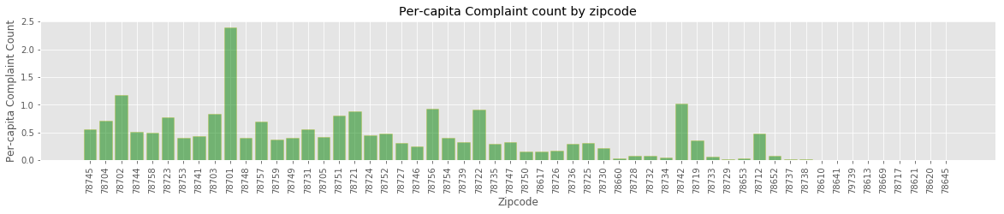
Per-capita complaints by zip-code
Notes:
In order to remove the effect of population on complaint count, it is useful to calculate & plot per-capita complaints by zipcode
Now, The top-3 zip-codes based on per-capita complaint counts are
78701 (Downtown)
78702 (Central-East Austin)
78742

Slide 6
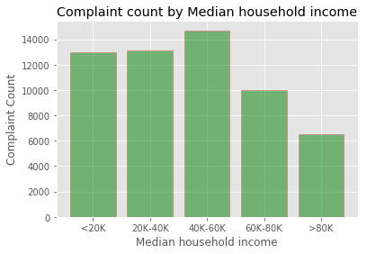
Relationship between complaint count & median household income
Notes:
In order to analyze complaint counts by income, zip-codes were categorized into 5 income groups . Zip-codes with median household income greater than 80K had the least complaints. They were either happy with their surroundings or they have found a better way of fixing their problems!!
(Median household income by zip-code was extracted from a 2014 Housing market analysis data-set)

Slide 7
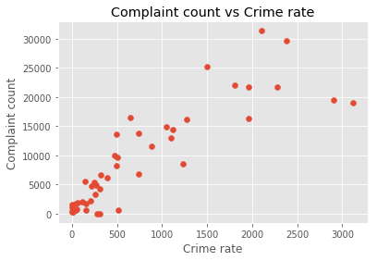
Relationship between complaint count & crime-rate
Notes:
This analysis is based on a 2016 Annual Crime report data. There were zipcode mentioned for each reported crime. I grouped the crime reports by zip-code to get total crime reports per zip-code.
I then used this data to see if neighborhoods that are pro-active in reporting problems have lower crime rates

Slide 8
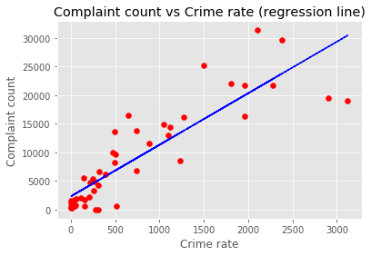
Relationship between complaint count & crime-rate
Notes:
It looks like being involved & vocal about their surroundings isn't helping. I did a linear regression analysis & the best fit line shows a positive correlation between crime rate & complaint count.

Slide 9
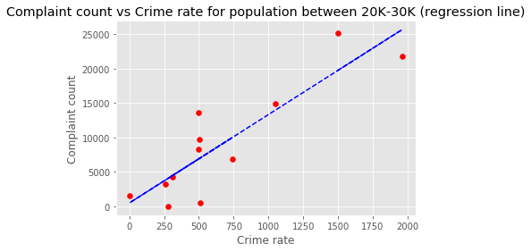
Relationship between complaint count & crime-rate
Notes:
In order to discount the effect of population, I looked at only zip-codes with population between 20-30K. The linear relationship still holds good

Slide 10
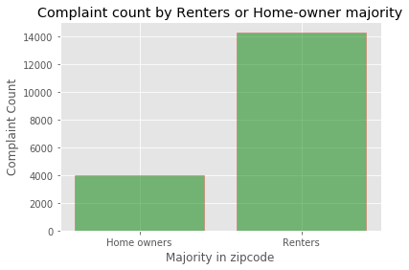
Home-owner or Renter majority zip-codes
Notes:
I wanted to see if home-owners call 311 more frequently since they have a long-term stake in their neighborhood. City-data.com gives you percentage of renters in a particular zip-code. I used this to classify each zip-code into either renter majority zip-code or a homeowner majority zip-code.
As the bar-chart shows, the opposite is true. Renter majority zip-codes have higher complaint count.
This may be because most densely populated areas like downtown have more rentals. Homeowners are for the most part in suburbs. Also, as Donna’s analysis shows, majority of the complaints are pet-related & not infrastructure related.

