Slide 1
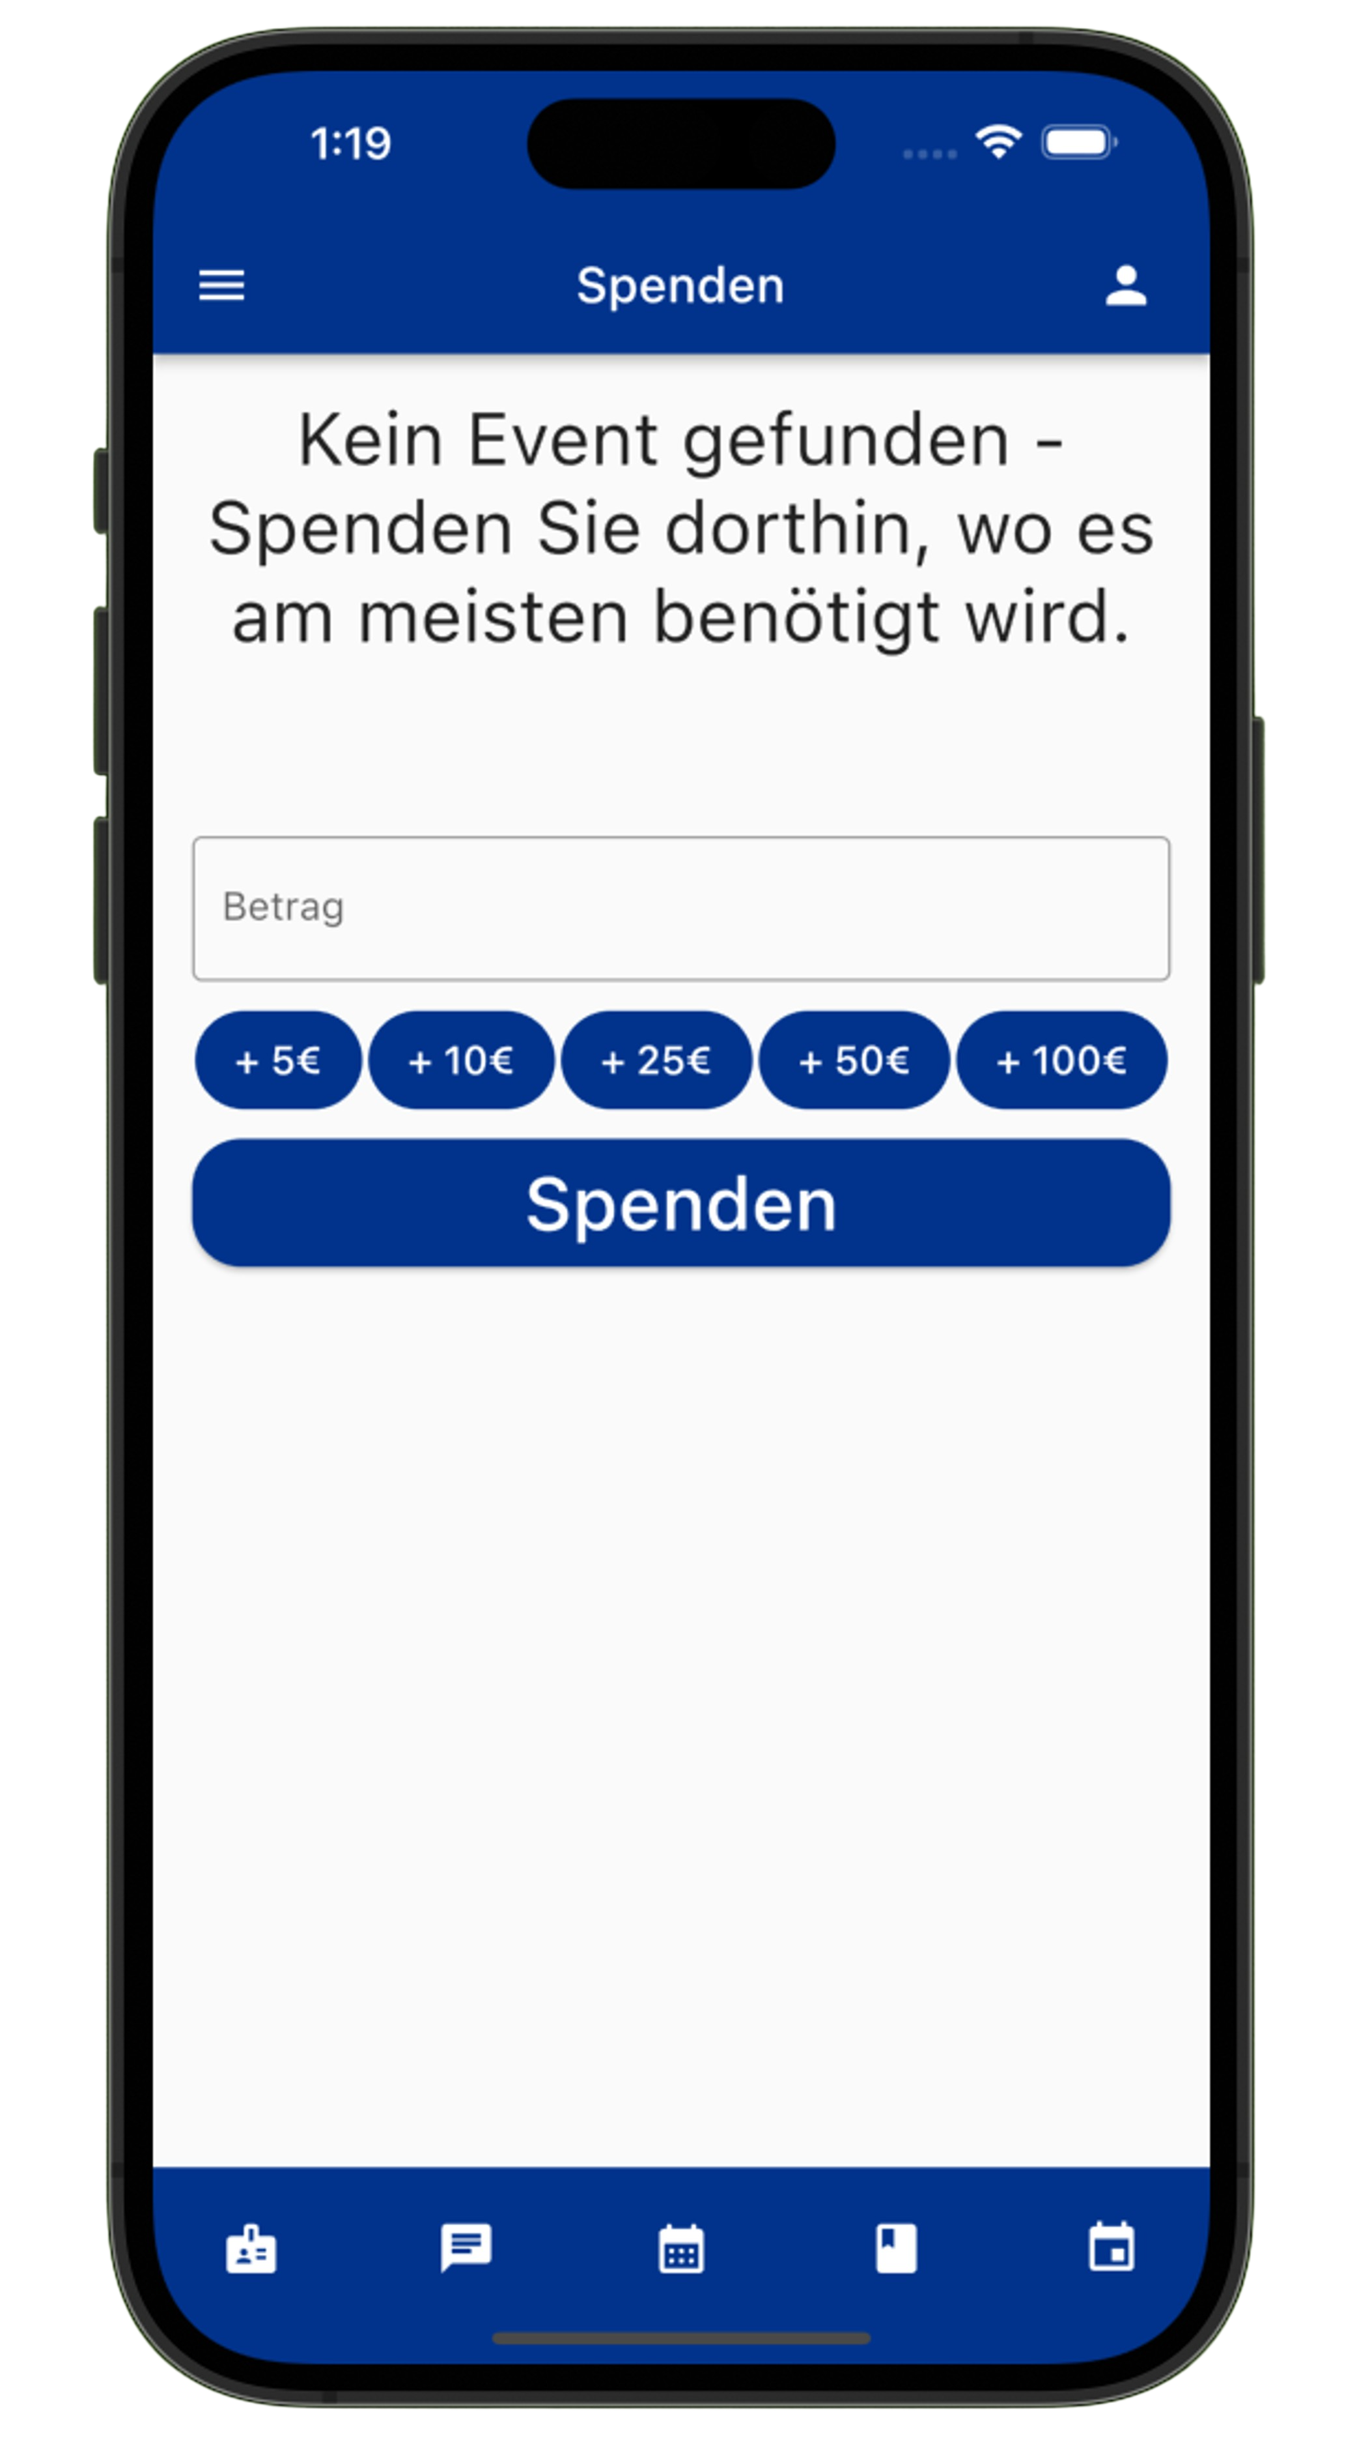
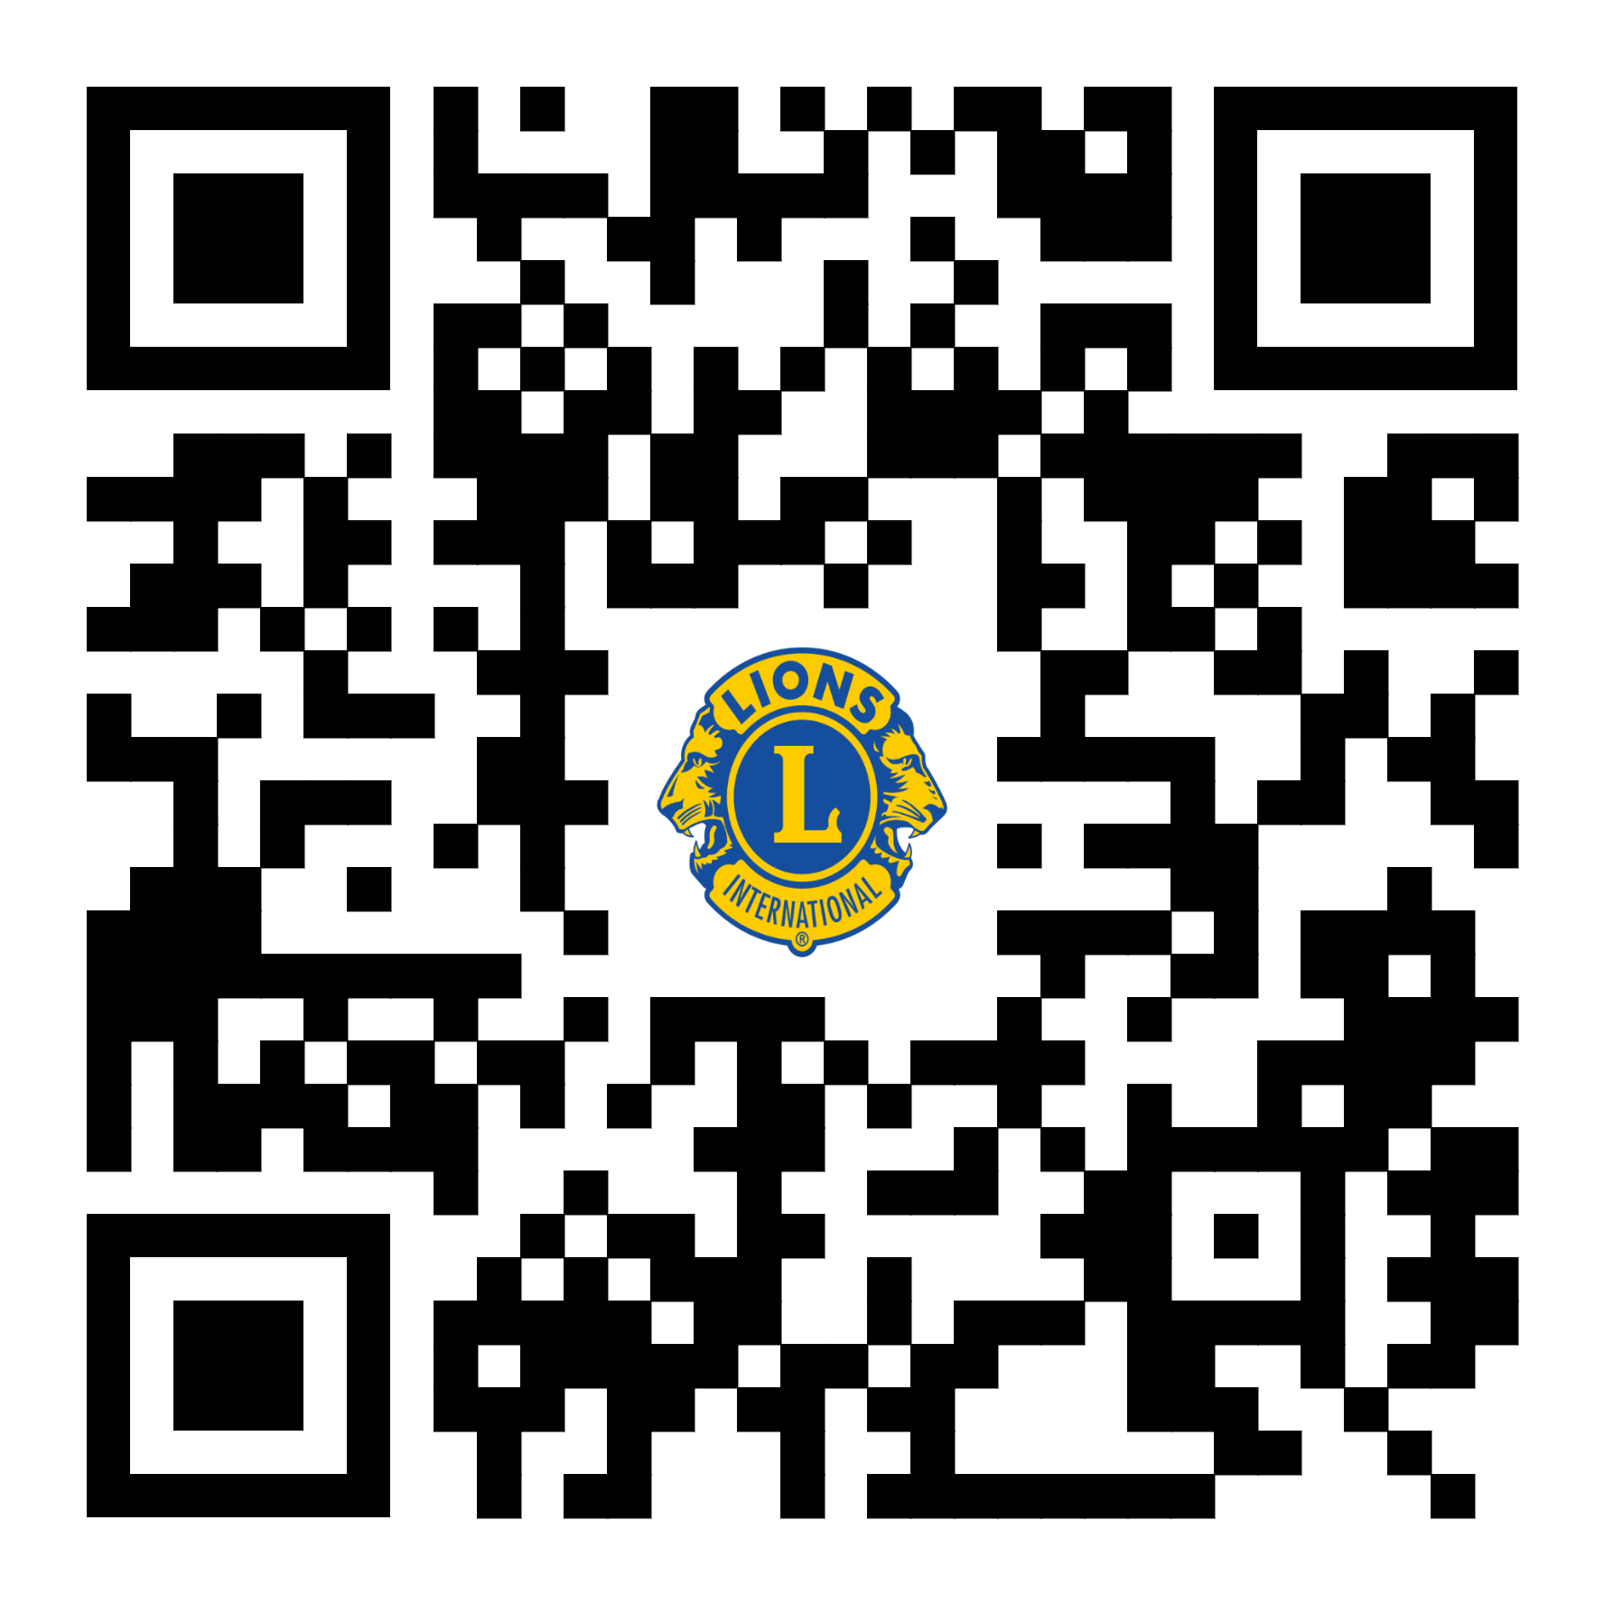

Lions4Charity
Donations Simplified
Einfacher Spenden
Spenden abonnieren
Eventverwaltung
Kalender
Kontaktform
User Authentifizierung
Team Lions:
Tom Brauns (Product Owner)
Ayoub El-Mrabet (Scrum Master)
Nico Hofmann
Philipp Muders
Mikulas Willaschek
Omer Guimdo-Achoungo
Kristiyan Ivanov
Marc Wieland
Saadet Ibrahimova

Slide 2
