Slide 1


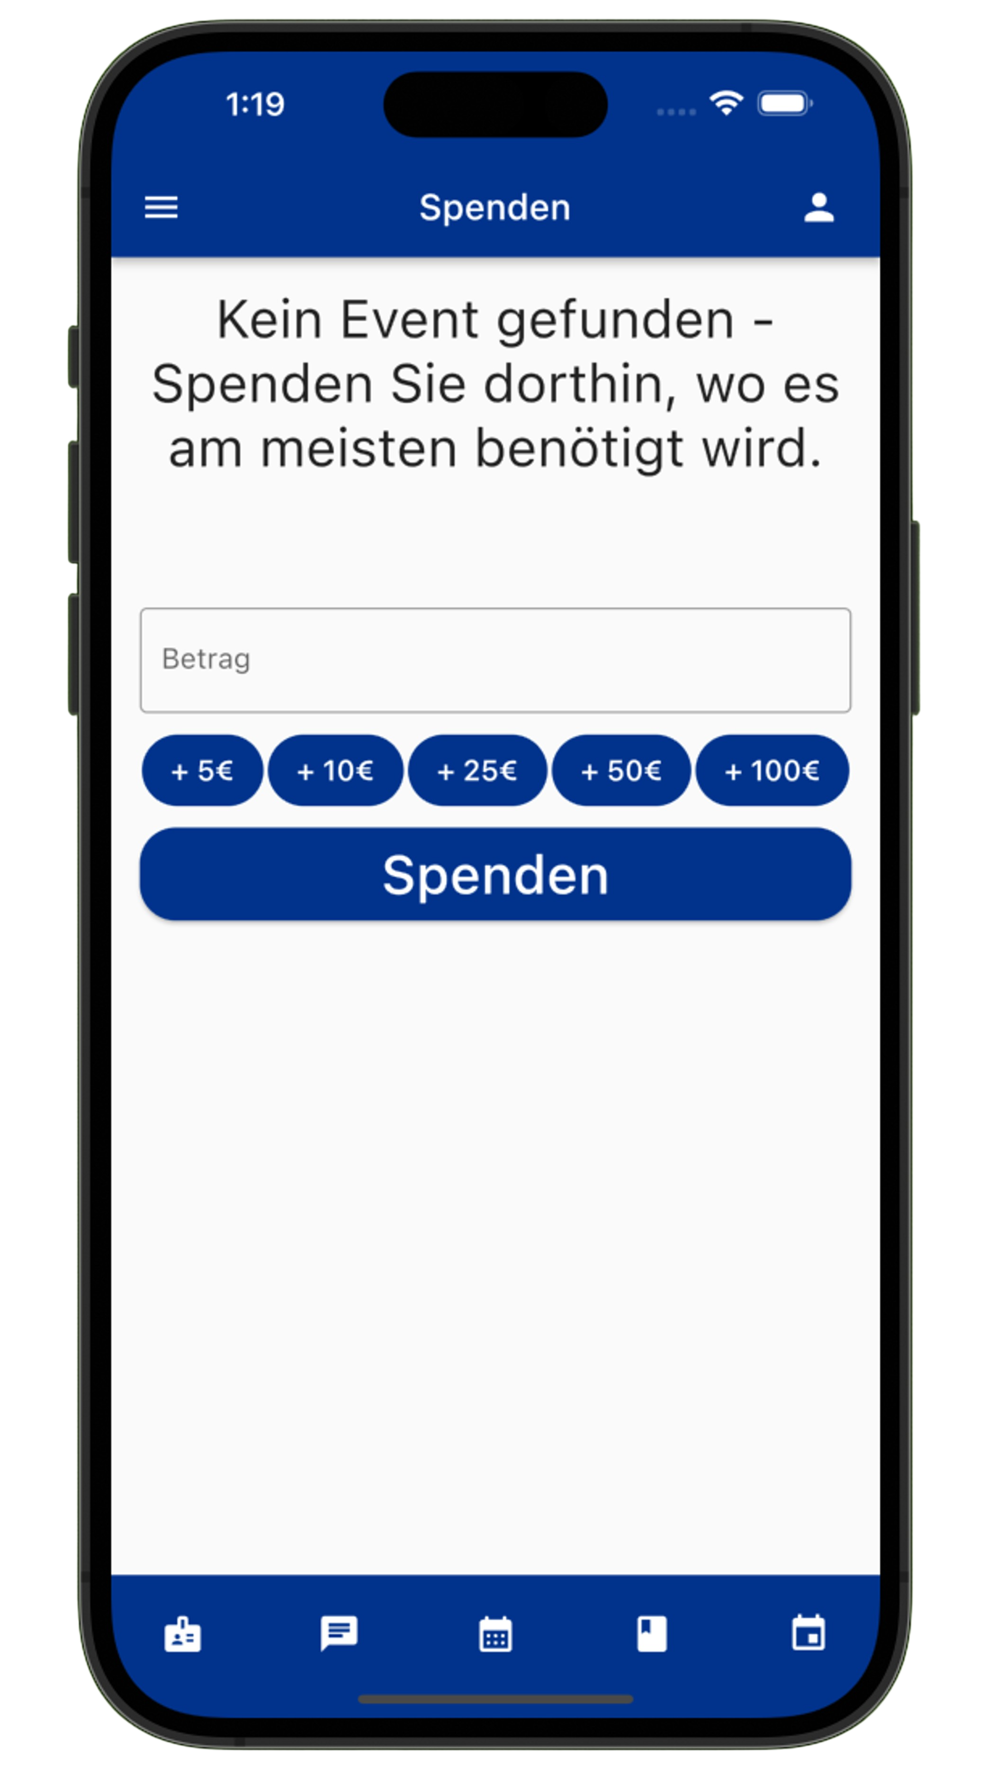
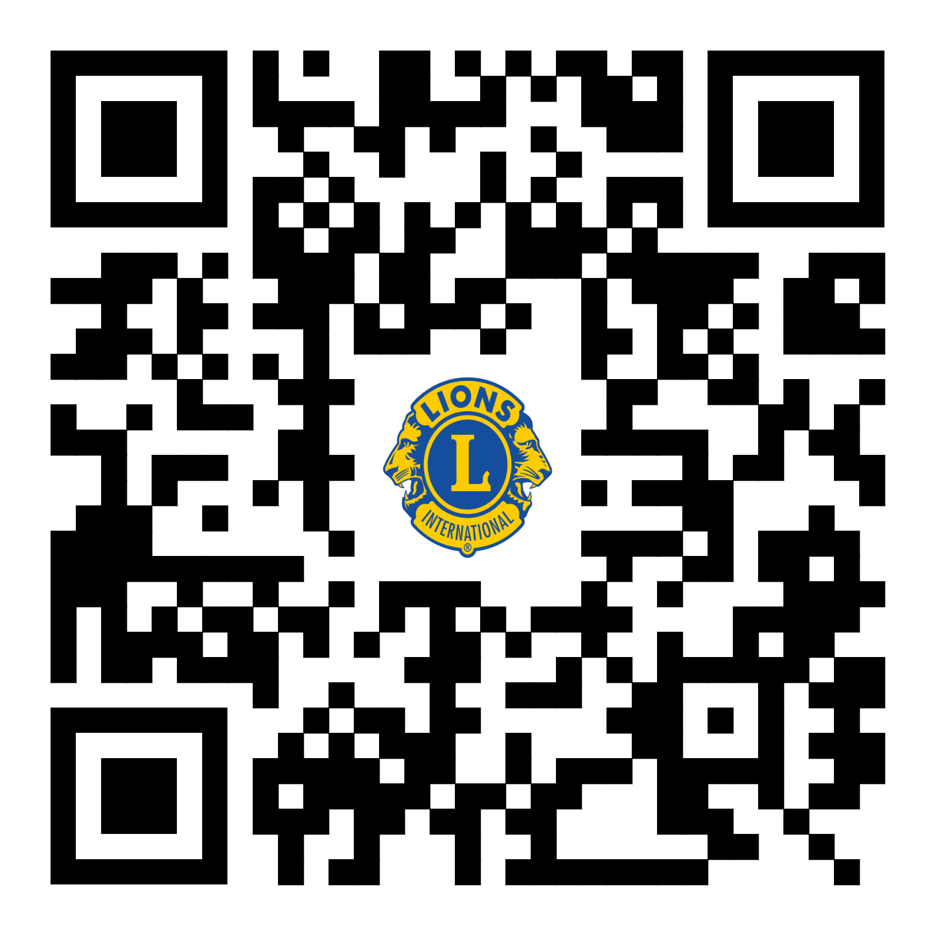
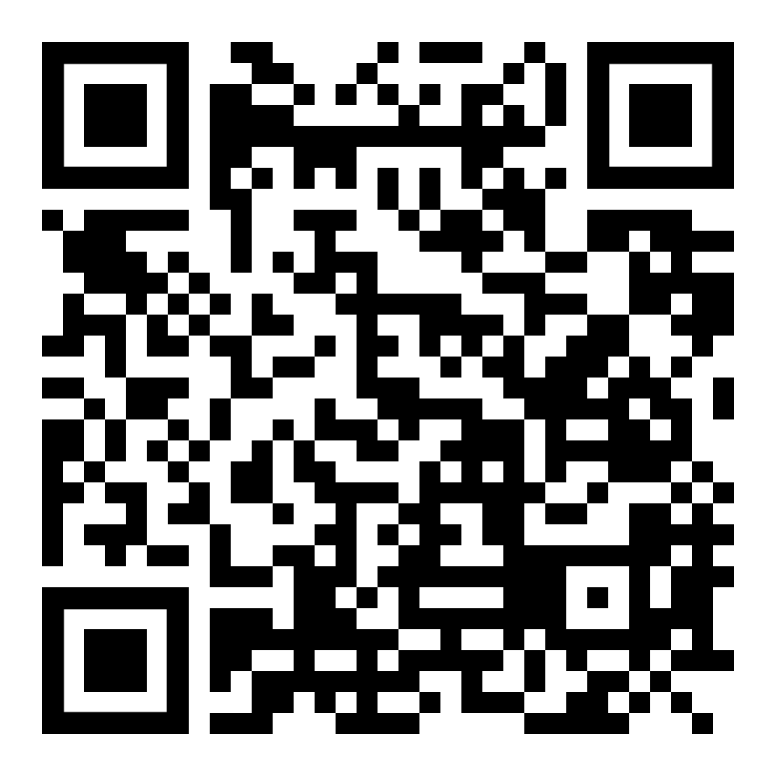
Team Lions
Donations Simplyfied
Einfacher Spenden
Spenden an Hochschule Worms.
Spenden
abonnieren
Kalender
Web & App
Chat
Event-verwaltung
Tom Brauns (Product Owner)
Ayoub El-Mrabet (Scrum Master)
Omer Guimdo-Achoungo
Philipp Muders
Marc Wieland
Kristiyan Ivanov
Mikulas Willaschek
Nico Hofmann
Saadet Ibrahimova

Slide 2
