Slide 1
Gravitational Wave Detection
CMPE 257 Project
September 9, 2021
Tom Casaletto
Anthony Fisher
Phil Shirts
Joel Wiser

Slide 2
Outline
Problem Statement
CWT/CNN Approach
CQT/CNN Approach
Transfer Learning
Next Steps
Additional Material

Slide 3
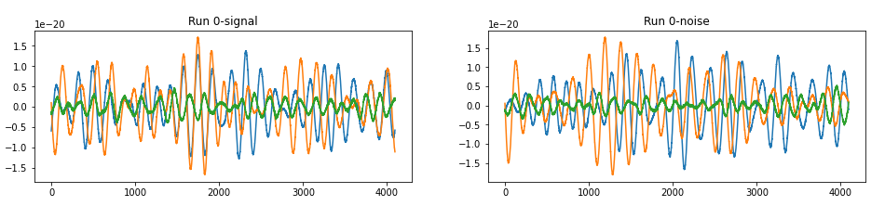
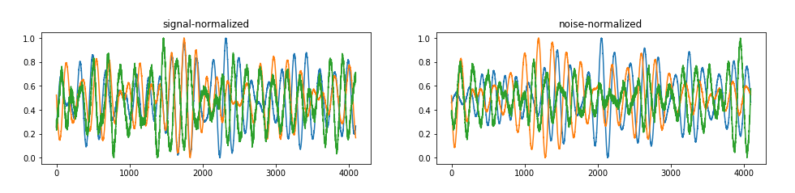
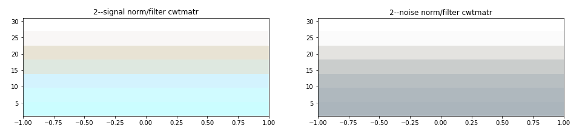
Continuous Wavelet Transform
Transform detector time series into spectrograms (images)
Train CNN with spectrogram training examples
Normalize signals
Perform CWT transform
Apply bandpass filter

Slide 4
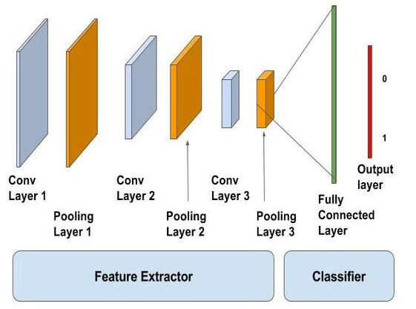
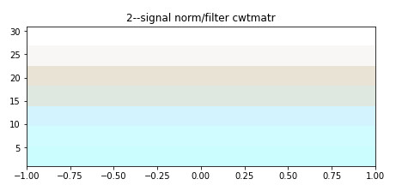
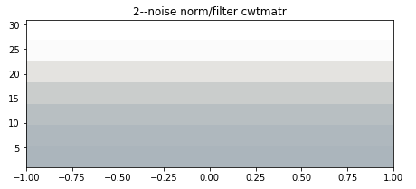
Convolutional Neural Net
Labeled
Spectrograms
Labeled
Spectrograms
model=Sequential()
model.add(Conv2D(32,(3,3),activation='relu',input_shape=(21,4,1)))
model.add(MaxPool2D(2,2))
model.add(Flatten())
model.add(Dense(100,activation='relu'))
model.add(Dense(2,activation='softmax'))
model.compile(loss='sparse_categorical_crossentropy',optimizer='adam',metrics=['accuracy'])
https://www.analyticsvidhya.com/blog/2021/08/beginners-guide-to-convolutional-neural-network-with-implementation-in-python/s

Slide 5
CWT/CNN Results
Model: "sequential"
_________________________________________________________________
Layer (type) Output Shape Param #
=================================================================
conv2d (Conv2D) (None, 19, 2, 32) 320
_________________________________________________________________
max_pooling2d (MaxPooling2D) (None, 9, 1, 32) 0
_________________________________________________________________
flatten (Flatten) (None, 288) 0
_________________________________________________________________
dense (Dense) (None, 100) 28900
_________________________________________________________________
dense_1 (Dense) (None, 2) 202
=================================================================
Total params: 29,422
Trainable params: 29,422
Non-trainable params: 0
_________________________________________________________________
Epoch 1/10
250/250 [==============================] - 2s 3ms/step - loss: 0.6943 - accuracy: 0.5056
Epoch 2/10
250/250 [==============================] - 1s 3ms/step - loss: 0.6937 - accuracy: 0.5006
Epoch 3/10
250/250 [==============================] - 1s 3ms/step - loss: 0.6933 - accuracy: 0.5046
Epoch 4/10
250/250 [==============================] - 1s 3ms/step - loss: 0.6933 - accuracy: 0.5048
Epoch 5/10
250/250 [==============================] - 1s 3ms/step - loss: 0.6931 - accuracy: 0.5001
Epoch 6/10
250/250 [==============================] - 1s 3ms/step - loss: 0.6931 - accuracy: 0.4969
Epoch 7/10
250/250 [==============================] - 1s 3ms/step - loss: 0.6931 - accuracy: 0.4969
Epoch 8/10
250/250 [==============================] - 1s 3ms/step - loss: 0.6932 - accuracy: 0.5027
Epoch 9/10
250/250 [==============================] - 1s 3ms/step - loss: 0.6929 - accuracy: 0.4967
Epoch 10/10
250/250 [==============================] - 1s 3ms/step - loss: 0.6929 - accuracy: 0.5041

Slide 6
Backup

Slide 7
Creating Spectrogram

